Slide 2
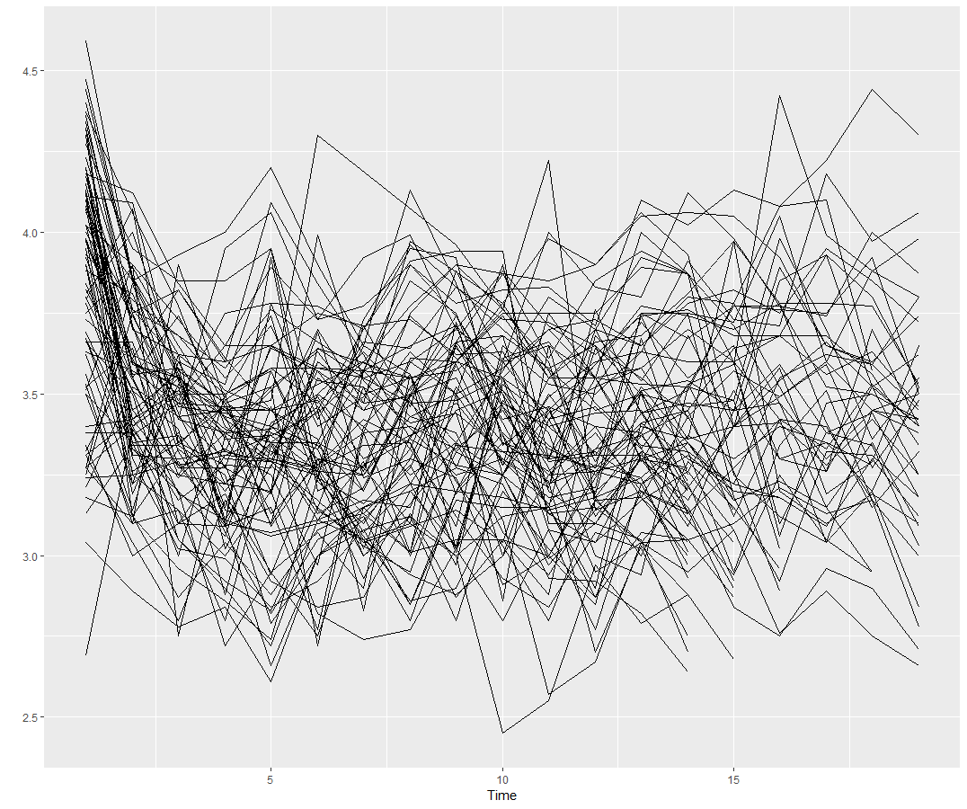
reference set
training set
input - features
(M1, M3)
observed sample
population
sample
fit models
train a classification algorithm
test set
identify “best” model
simulated time series
random forest classifier
new time series
training set
feature calculation
(M4)
forecasting method

Slide 3
reference set
training set
input - features
(M1, M3)
observed sample
population
sample
fit models
train a classification algorithm
test set
identify “best” model
simulated time series
random forest classifier
new time series
training set
feature calculation
(M4)

Slide 4
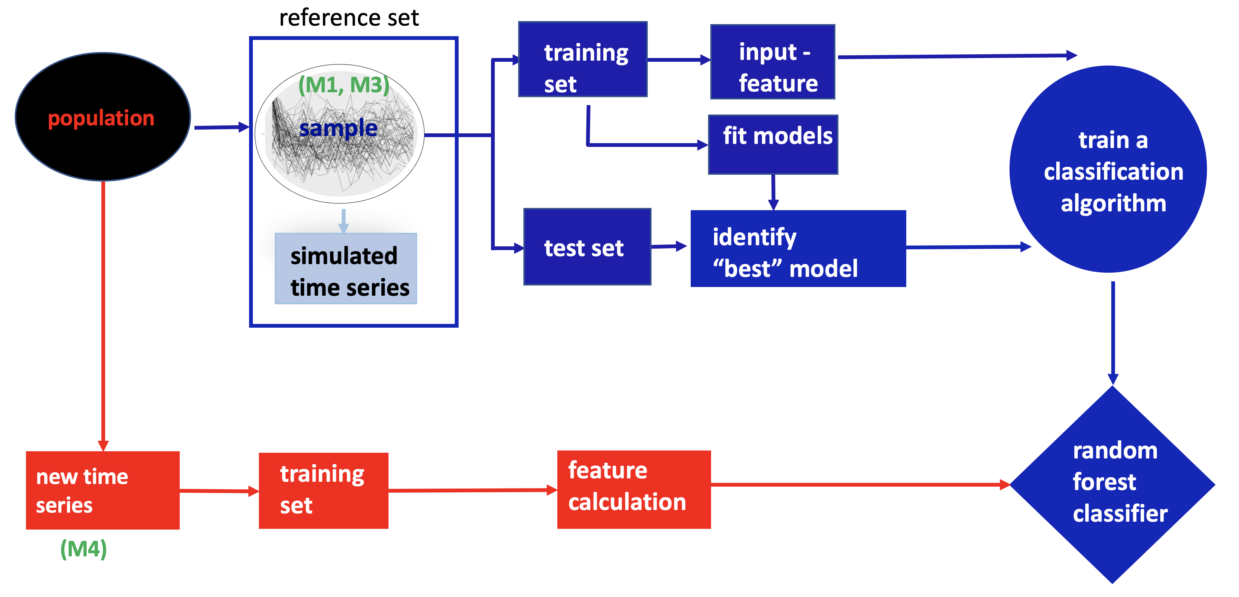
Visualisation of vote matrix [(4)]
Composition of clusters by true class labels [(2) and (3)]
Cluster-wise feature distribution [(1) and (3)]
Visualisation of instance space [(1) and (3)]
(1)
fit models
Vote matrix from the random forest classifier
Best forecast model predicted by the random forest
training set
Cluster rows - M4 series
new time series
rw | rwd | … | nn
(M4)
test set
identify “best” model – true class label
Cluster columns - forecast-models
(4)
(2)
(3)
ground truth – to evaluate model understanding

