Slide 1
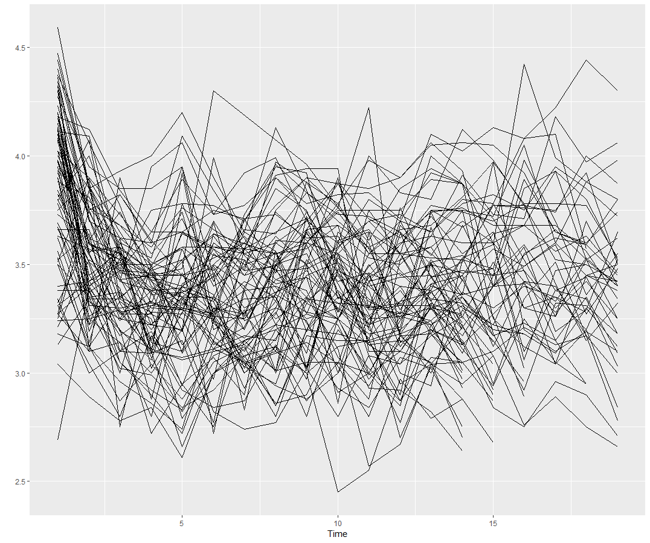
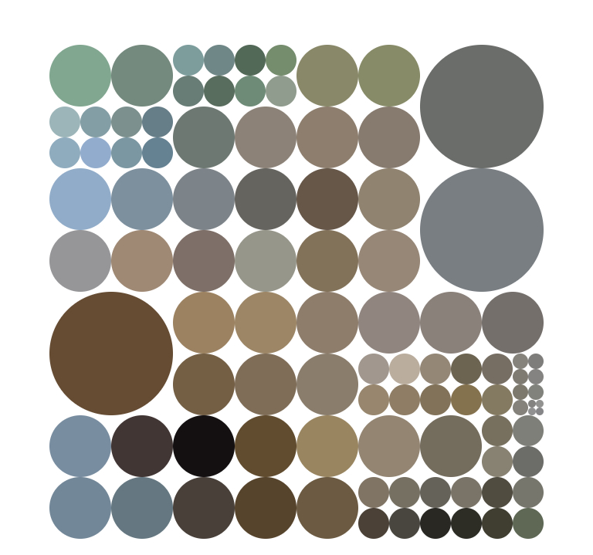
reference set
training set
input - features
observed sample
population
sample
fit models
train a classification algorithm
test set
identify “best” model
simulated time series
random forest classifier
new time seres
feature calculation
forecast-model

Slide 2
reference set
training set
input - features
observed sample
population
sample
fit models
train a classification algorithm
test set
identify “best” model
simulated time series
random forest classifier
new time sers
feature calculation
forecast-model

Slide 3
reference set
training set
input - features
observed sample
population
sample
fit models
train a classification algorithm
test set
identify “best” model
simulated time series
random forest classifier
feature calculation
forecast-model

Slide 4
reference set
training set
input - features
observed sample
population
sample
fit models
train a classification algorithm
test set
identify “best” model
simulated time series
random forest classifier
feature calculation
forecast-model

Slide 5
reference set
training set
input - features
observed sample
population
sample
fit models
train a classification algorithm
test set
identify “best” model
simulated time series
random forest classifier
feature calculation
forecast-model

Slide 6
reference set
training set
input - features
observed sample
population
sample
fit models
train a classification algorithm
simulated time series
test set
id | arima | ets | nn | …
1 | 1.23 | 1.01 | 2.51
2 | 0.06 | 3.51 | 4.51
3 | 0.80 | 0.14 | 0.50
… | …. | …. | … | …
random forest classifier
feature calculation
forecast-model

Slide 7
reference set
training set
input - features
observed sample
population
sample
fit models
train a classification algorithm
simulated time series
test set
random forest classifier
feature calculation
forecast-model

Slide 8
reference set
training set
input - features
observed sample
population
sample
train a classification algorithm
simulated time series
test set
random forest classifier
feature calculation
forecast-model

Slide 9
reference set
training set
observed sample
population
sample
train a classification algorithm
simulated time series
test set
random forest classifier
feature calculation
forecast-model

Slide 10
reference set
training set
observed sample
population
sample
train a classification algorithm
simulated time series
test set
random forest classifier
feature calculation
forecast-model

Slide 11
training set
observed sample
population
sample
train a classification algorithm
simulated time series
test set
random forest classifier
feature calculation
forecast-model

Slide 12
training set
observed sample
population
sample
train a classification algorithm
test set
random forest classifier
feature calculation
forecast-model

Slide 13
training set
observed sample
population
train a classification algorithm
test set
random forest classifier
feature calculation
forecast-model

