Slide 2
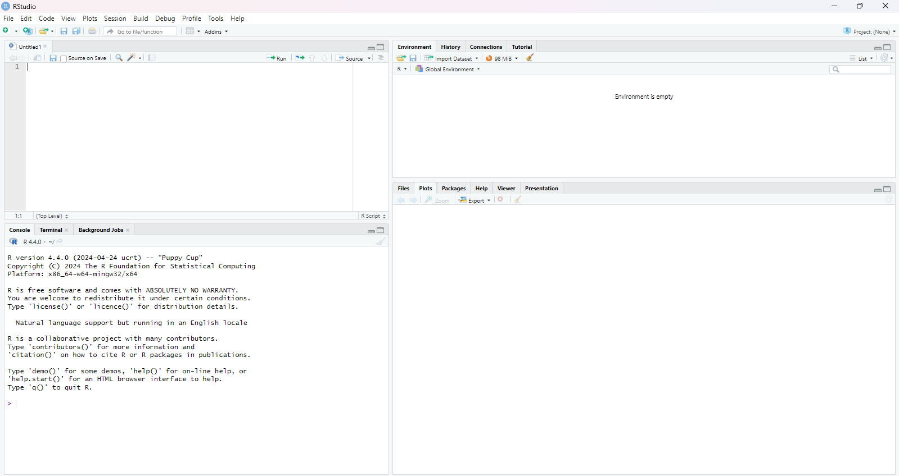
Source/ Script Editor
Environment, History, Connections, Tutorial
File, Plots, Packages, Help, Viewer, Presentation
Console
Command prompt

