Slide 2
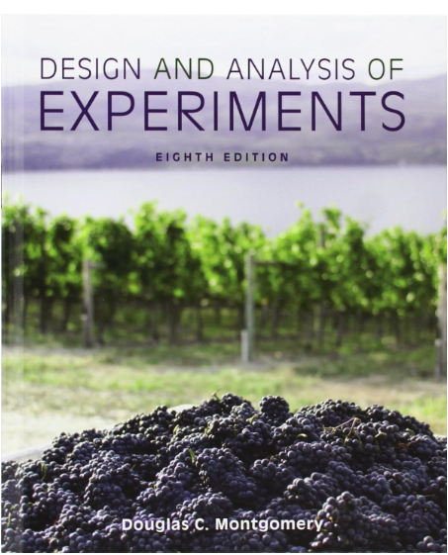
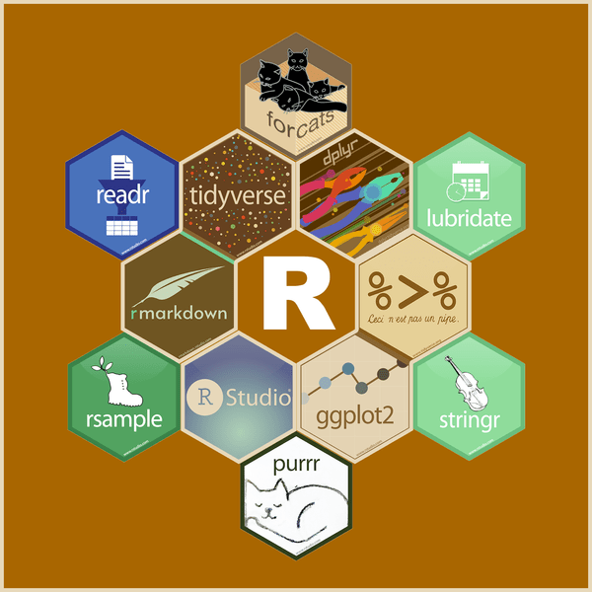
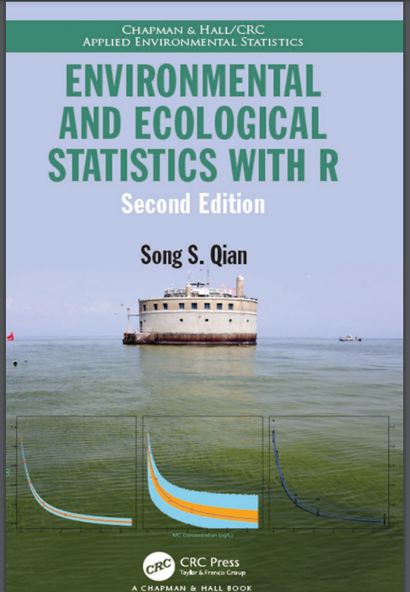




Statistics Starter Pack for Energy and Environmental Researchers
AI Assistants
gstat package
edibble package

