Slide 1




AirInk
A Python finger-tracking whiteboard
Thiyatira Reni N | RA2511003010637
SRM Institute of Science and Technology, Kattankulathur
Notes:
AirInk turns the index fingertip into a pen using a normal webcam. The interface is small and the application code is in one file. Presentation artwork adapted from the supplied Whiteboard Marketing Slides template by Slidesgo.

Slide 2
What is AirInk?
A webcam becomes a pen.
Raise your index finger to write.
Raise two fingers to move.
Notes:
The camera observes the hand. MediaPipe finds the hand landmarks, and OpenCV joins the fingertip positions. The result appears on a camera view or a clean whiteboard.

Slide 3
Existing approach & AirInk
Mouse / touch drawing
Pointer controls the pen.
Precise, familiar input.
AirInk
Finger pose controls the pen.
Touch-free camera input.
Notes:
Conventional drawing applications use a mouse, touch screen, or stylus. AirInk explores another input method: camera-based hand gestures. It is designed for a small classroom demonstration, with a mouse fallback.

Slide 4
A few useful controls
Ink tools
Brush size
Pen, eraser and six colours
Thin notes or bold strokes
Two views
Save & reopen
Zoom, opacity or whiteboard
Keep and continue drawings
Notes:
There are six colours, brush-size, camera-zoom and camera-opacity sliders, pen and eraser tools, two viewing modes, and save and clear buttons. Zoom crops only the display, from 1× to 2.5× (default 1.5×). Tracking uses the full camera frame; the fingertip is mapped into the crop and pauses outside it. The camera fades toward white while the ink remains solid. Save creates a new timestamped PNG in the local AirInk drawings folder. On Mac this is ~/Library/Application Support/AirInk/drawings; on Windows it is %LOCALAPPDATA%\AirInk\drawings. Open starts in that folder and restores the image as editable ink. White pixels become empty canvas. Previous saves remain unchanged.

Slide 5
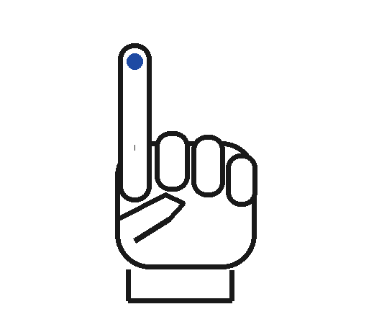
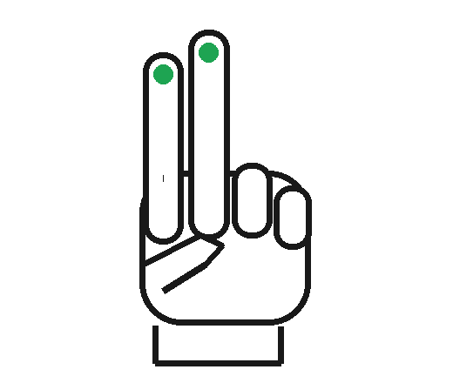
One finger writes. More fingers pause.
DRAW / ERASE
MOVE / PAUSE
Only index raised
Two or more raised
Notes:
Keep the palm facing the camera and the fingers pointing upward. Only the index finger should be raised for writing; the thumb and other fingers must be folded. Two or more raised fingers, a fist, any other pose, or a lost hand pauses the stroke. The pose must remain valid for three frames.

Slide 6
How it works
1
3
Camera
2
Pose
4
Hand
Draw
Track the full
camera frame
Check which
fingers are up
Find 21
landmarks
Join fingertip
positions
Notes:
The repeated loop has four stages: capture a mirrored frame, locate the hand, check the pose, and join the fingertip positions. Tkinter calls this loop again with after(). This keeps the controls responsive between frames.

Slide 7
Main functions
writing_pose()
tick()
draw()
Check five fingers
Track and refresh
Connect two points
Notes:
writing_pose compares each fingertip with a finger joint. tick reads the camera, runs the tracker, and updates the image. draw stores a stroke on the ink layer. build_ui, compose, save, open_drawing, and close handle the interface, display, local storage, reopening, and cleanup. The separate run.py installs dependencies into .venv and launches the app; the README has one-command GitHub setup for Mac and Windows.

Slide 8
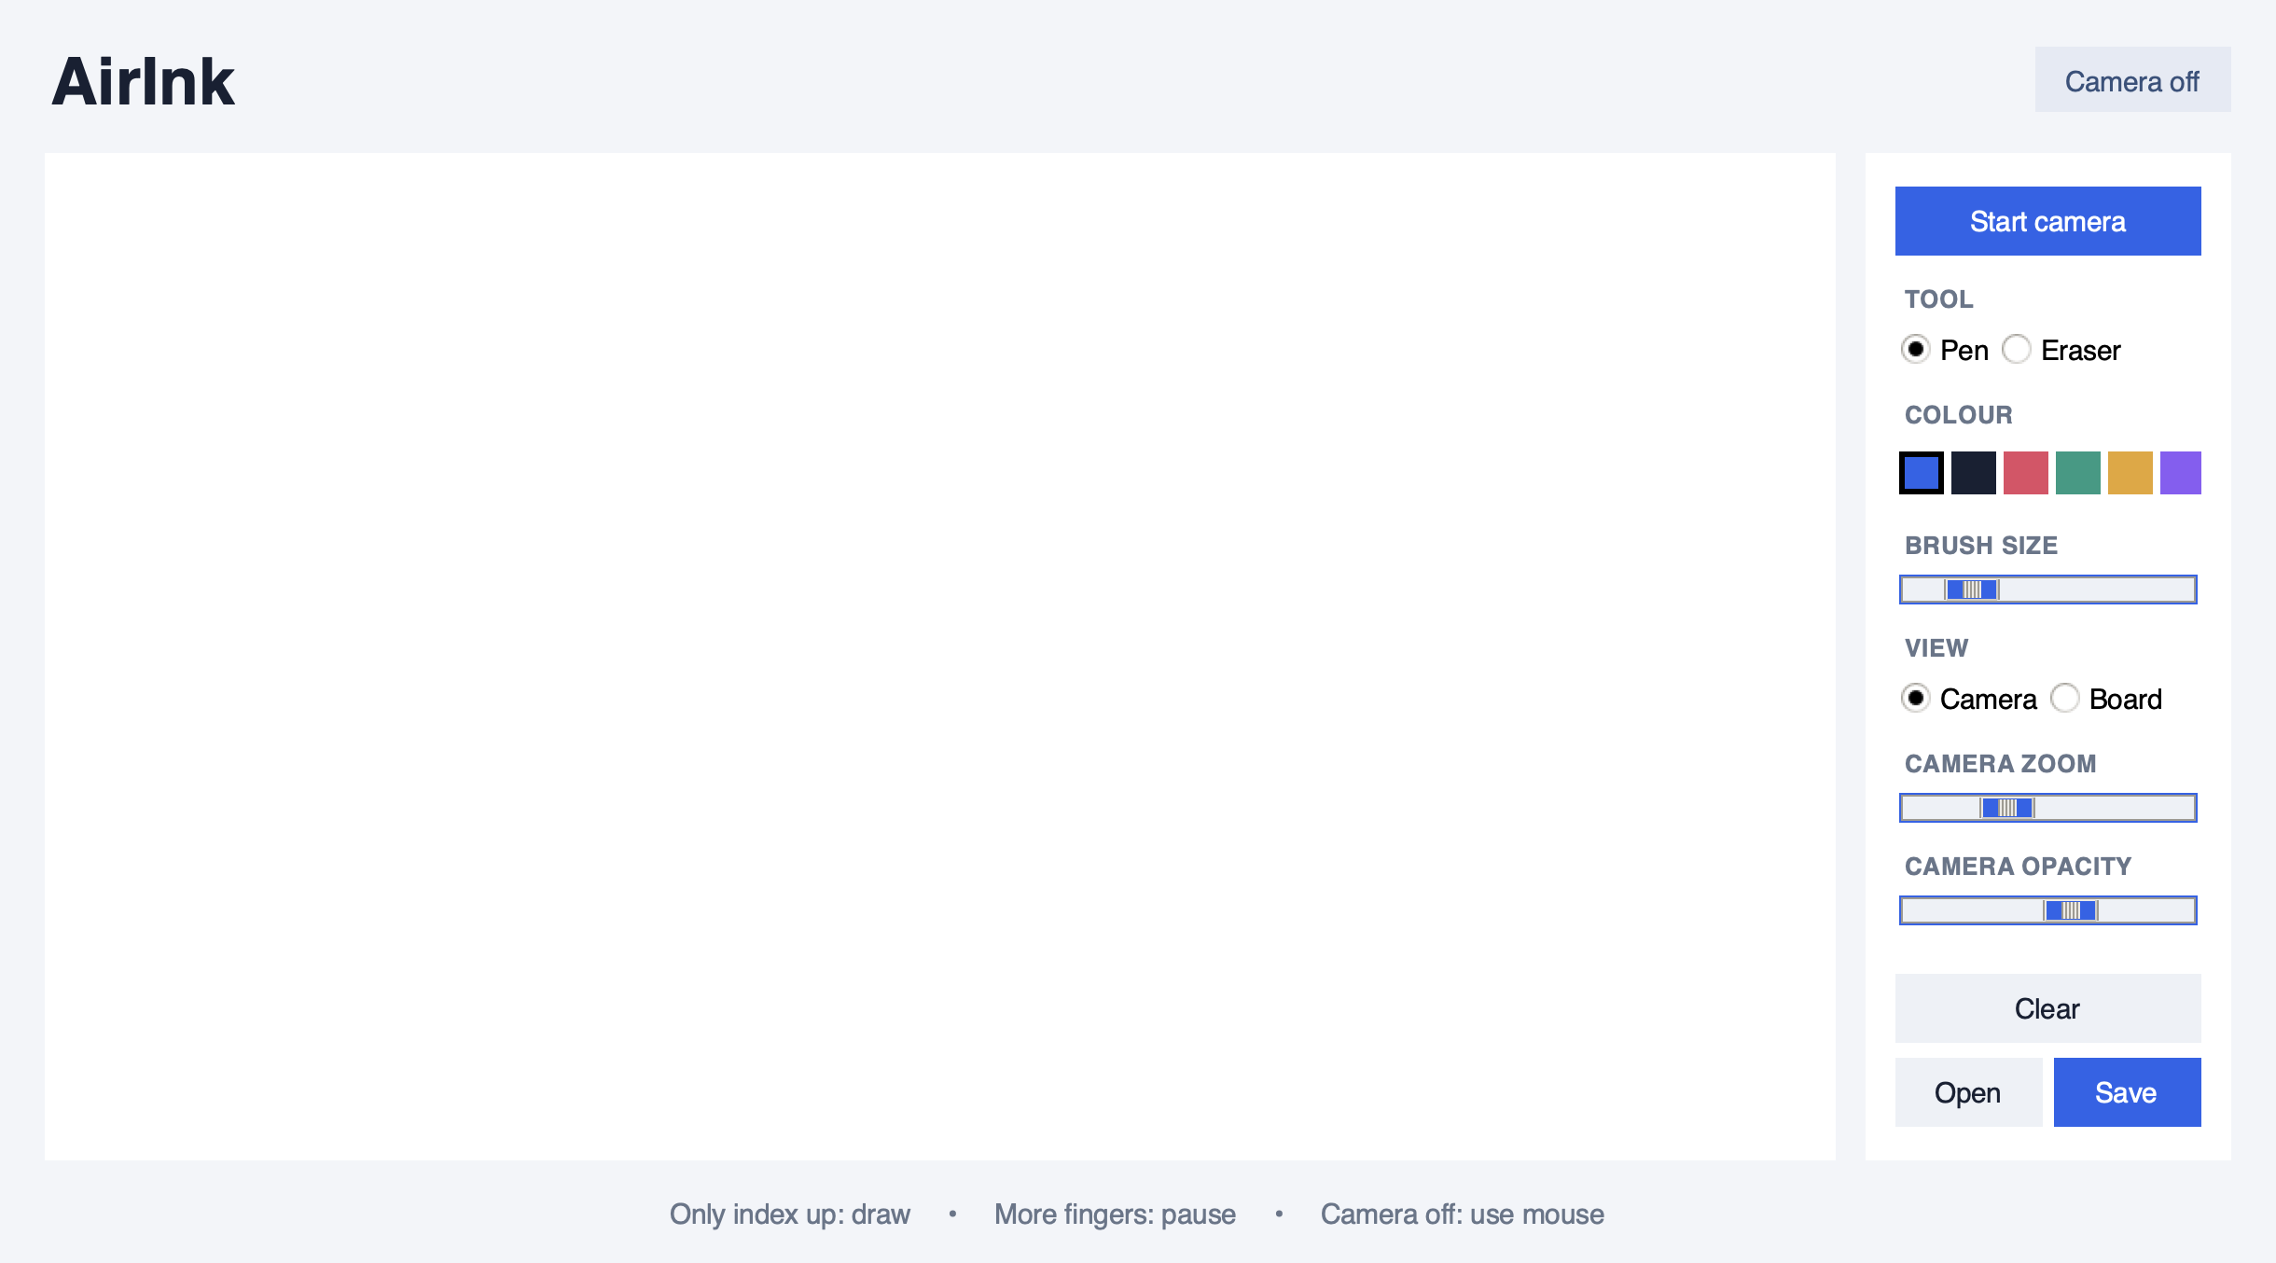

The application
Notes:
This is an actual capture of the Tkinter application. Start camera enables finger input. When the camera is off, the mouse can be used to practise and test the drawing controls.

Slide 9
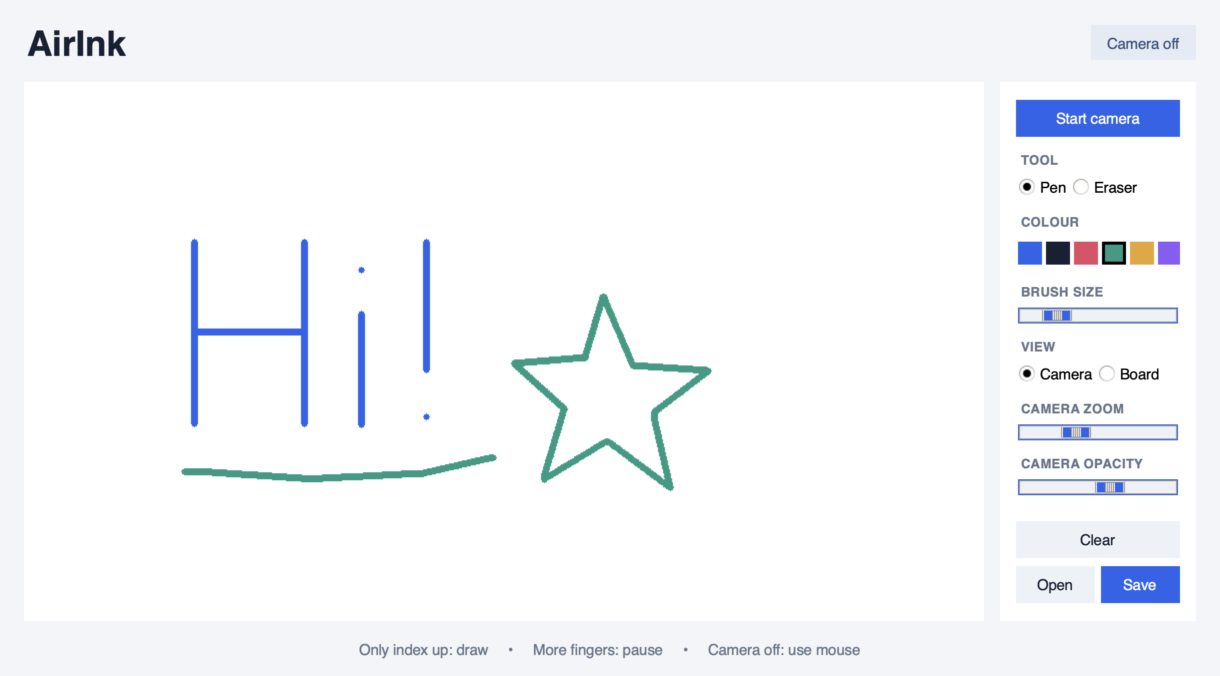
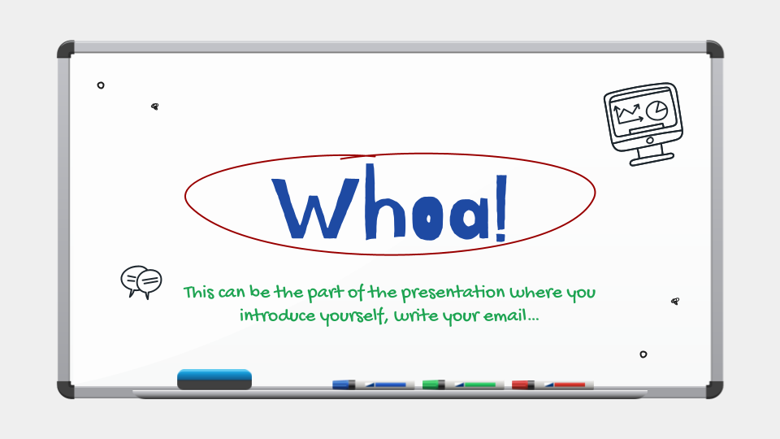
Sample drawing
Camera off • scripted strokes
Notes:
The sample strokes were fed through the application's draw function with the camera off. This image demonstrates the canvas and colour controls; it is not evidence of live webcam tracking. The PNG export keeps only the drawing.

Slide 10
Testing & next steps
38 tests passed
Model checked
✓
21
Pose, ink, PNG and error handling
21 landmarks on a sample hand
Live checks
Improve later
Check light, camera and finger pose
!
+
Undo and rotation-tolerant gestures
Notes:
Thirty-eight automated tests passed. These cover all thirty-two finger combinations, both thumb directions, camera zoom and opacity, drawing and erasing, saving and reopening, platform storage paths, setup failures, and simulated camera failures. Windows paths and setup are simulated; native Windows execution still needs checking. The real model detected twenty-one landmarks on an official sample hand image. Live camera performance and lighting still need checking on the presentation computer.

