Slide 1
SRM StudyHub
Team Blaze · Beyond Hack 2.0 · Campus Innovation & Student Life

Slide 2
The problem
Scattered
Unreadable
Guesswork
Past papers live in WhatsApp groups, drives and blurry photos.
Math and code get lost in scans; nothing is searchable.
No view of which units repeat, so revision isn't prioritised.

Slide 3
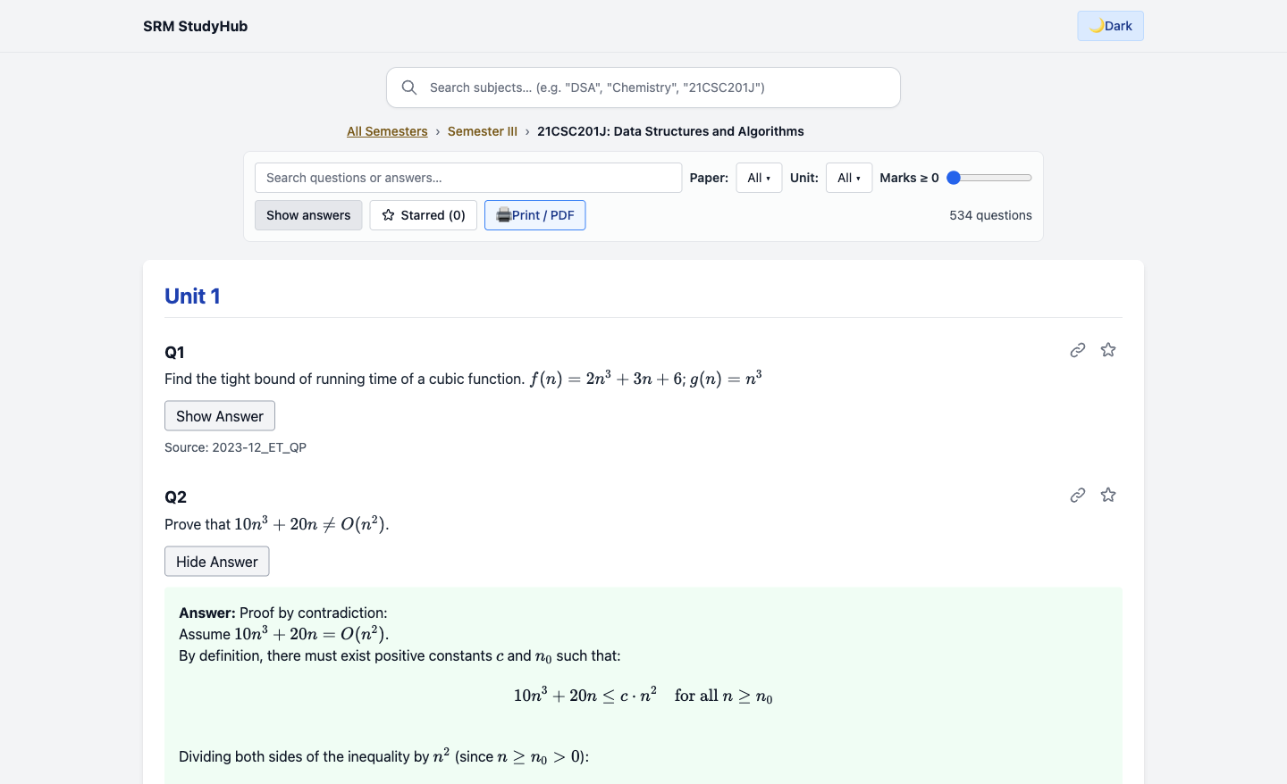
SRM StudyHub
One searchable home for every SRM previous year paper: by course code, unit and marks, with math and code rendered properly.

Slide 4
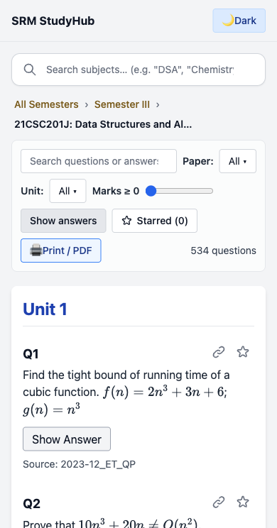
Built for the phone
Mobile-first, dark mode, bookmarks and shareable question links. No login, no tracking.

Slide 5
Key features
Smart search
Rich rendering
Filters
Find any subject by code, name or acronym.
KaTeX math and highlighted code.
Paper, unit, marks and keyword.
Practice mode
AI explainer
Topic heatmap
Timed mock tests from real papers.
Step-by-step answers citing the source paper.
See which units repeat every year.

Slide 6
System architecture
Next.js client
API layer
Data + AI
Search, filters, practice; reads the question bank directly.
Express: retrieval + grounded prompt, rate limited.
JSON bank per course code, embeddings, LLM API.

Slide 7
Tech stack
Frontend
Rendering
Next.js 15, React 19, TypeScript, Tailwind
KaTeX, PrismJS
Backend
AI + Deploy
Node.js, Express
Claude API with retrieval; Vercel

Slide 8
Implementation plan
9–11 | 11–13 | 13–15 | 15–16 | 16–17
Setup + question bank | Search, filters, rendering | Practice mode + AI layer | Polish + security | Deploy + demo
 | Core demo ready |  | Feature freeze

Slide 9
Expected impact
01
02
03
Revision in minutes, not hours of scrolling chats
Juniors get the same prep seniors pass around
Ports to any university by course code

Slide 10
Thanks!
Team Blaze
SRM StudyHub · Beyond Hack 2.0
Please keep this slide for attribution

