Slide 1
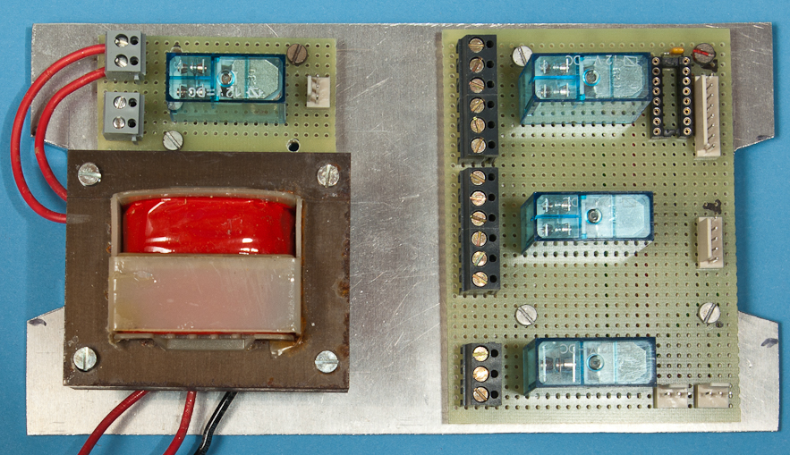
Relay boards: naming scheme
P1
P1
S1
S1
Relay K1
O1
P2
P2
S2
S2
O2
P1
S1
O1
Relay K2
P2
S2
O2
O1
Relay K3
S1
P1

Slide 2
Relay boards: cabling scheme
P1
P1
S1
S1
Relay K1
O1
P2
P2
S2
S2
O2
P1
S1
O1
Relay K2
P2
S2
O2
O1
Relay K3
S1
P1

