Slide 1
⚓ AIS Ship Tracker
Real-time ship tracking
Kafka · PostgreSQL · Python
Docker · GitHub Actions · AWS EC2 · AWS CloudWatch
Flask · Streamlit
Capstone Project · Data Engineering Bootcamp · Thomas Junge · 2026

Slide 2
Project Overview
▸ Subscribe to 35 000+ live ship positions via the aisstream.io WebSocket API
▸ Consume all AIS message types through Apache Kafka
▸ Clean & transform data, persist live positions and static ship data in PostgreSQL
▸ Persist position history for individual ships (by configuration table) in PostgreSQL
▸ Flask webapp to show ships/routes on map, Streamlit analytics dashboard for some statistics
▸ Fully containerised with Docker Compose · deployed to AWS EC2 · logging in AWS CloudWatch
▸ Automated CI/CD pipeline via GitHub Actions

Slide 3
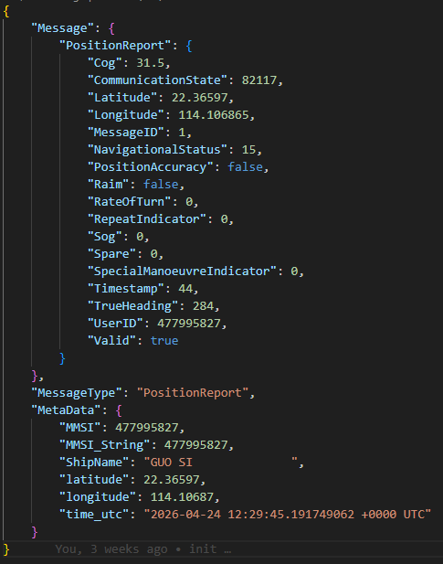
Data Source – AIS Protocol
What is AIS?
Automatic Identification System, mandated on all large vessels globally
How it works
Ships broadcast VHF radio signals captured by satellites and shore stations
27 message types
PositionReport · ShipStaticData · SafetyMessage · StandardClassBPosReport …
Our source
aisstream.io – WebSocket API delivering a real-time global AIS feed (provides shore stations only)
Volume observed
~240–260 msg/s, >3 Gbs of data per day

Slide 4
System Architecture
ships_live_data_processor
Streamlit Dash
python
ships_live_data_consumer
PostgreSQL
Apache Kafka
python
ais_producer
position_history_consumer
python
python
ships_static_data_consumer
python
Flask Webapp
ships_static_data_processor
tracking_sync
python
python
ingestion
processing
persisting layer
serving
GitHub Actions
CI/CD auto-deploy
AWS CloudWatch
Docker logs from EC2
AWS EC2
Docker Compose stack
(all services)
Infrastructure layer

Slide 5
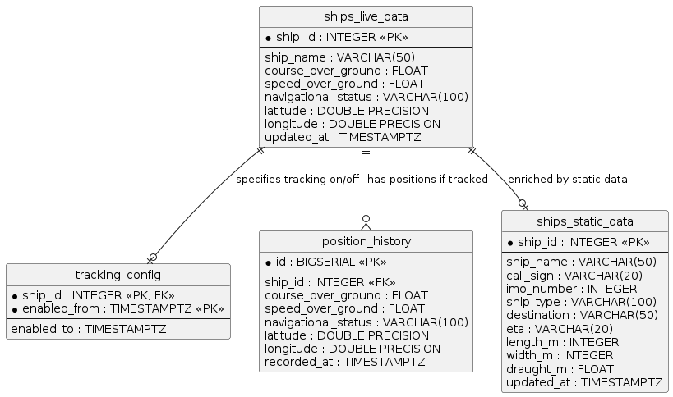
Database model · PostgreSQL

Slide 6
Kafka Message Pipeline
ais_producer
▸ Subscribes to aisstream.io WebSocket · routes each message by MessageType to its own Kafka topic
ships_live_data_processor
▸ Validates PositionReport · normalises MMSI, lat/lon, speed · publishes to ships_live_data topic
ships_live_data_consumer
▸ Reads ships_live_data topic · upserts latest position into PostgreSQL ships_live_data table
position_history_consumer
▸ Reads ships_live_data topic · appends rows for actively-tracked ships · respects tracking_config
ships_static_data_processor
▸ Parses ShipStaticData · extracts name, type, dimensions · publishes to ships_static_data topic
ships_static_data_consumer
▸ Reads ships_static_data topic · upserts ship metadata into ships_static_data table
tracking_sync
▸ Syncs tracked ship IDs from config JSON to PostgreSQL tracking_config on manual trigger

Slide 7
Infrastructure & Deployment
Docker Compose
AWS EC2
- Single compose file:
- ZooKeeper · Kafka · Kafka-UI · PostgreSQL
- 7 Python apps · Flask webapp · Streamlit dashboard
- Container tracking_sync:
- Does NOT start with `docker compose up`
- `option profiles: - tools`
- All other containers: `restart: unless-stopped`
- Ubuntu instance
- t3.large
- region: eu-central-1
- CloudWatch
- awslogs driver on every container
- log group ais-ship-tracker
- Security group:
- SSH inbound
- 5000 inbound for flask webapp
- 8501 inbound for streamlit dashboard
GitHub Actions
Secrets & Security
- provision-ec2.yml
- manual
→ one-time EC2 setup
- deploy.yml
- push to main
→ SSH → git pull → docker compose up
- tracking-sync.yml
- commit to main in path config
→ SSH → git pull → run tracking_sync.py
Github secrets:
- provision
- AWS credentials for AWS CLI
- KeyPair name
- SSH deploy key to access GitHub repo from EC2 instance
- deploy/tracking
- EC2 instance access (user, host)
- KeyPair key
- ENV_FILE secret keeps .env out of git
- SSH deploy key to access GitHub repo from EC2 instance

Slide 8
Tech Stack & Key Learnings
Streaming
Backend
Frontend
Data
DevOps
Apache Kafka 7.5
Python 3.11
Streamlit
PostgreSQL 16
Docker Compose
Confluent ZooKeeper
Flask
MapLibre GL JS
GeoJSON
AWS EC2
kafka-python
psycopg2
Plotly Express
AIS Protocol
GitHub Actions
websockets
asyncio
Pandas
aisstream.io
CloudWatch
Key Learnings
▸ End-to-end streaming: live WebSocket → Kafka → PostgreSQL → interactive dashboards
▸ Multi-consumer architecture enables independent scaling and independent schema evolution
▸ Docker Compose gives full local dev / production parity with a single file
▸ GitHub Actions CI/CD with SSH deploy removes every manual deployment step

Slide 9
⚓ Thank You
AIS Ship Tracker · github.com/thjunge11/aisstream-ship-tracker

