Slide 1
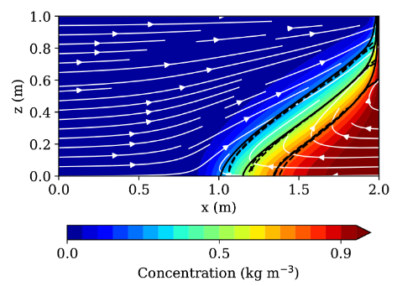
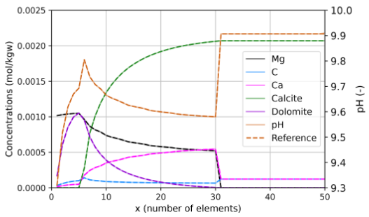
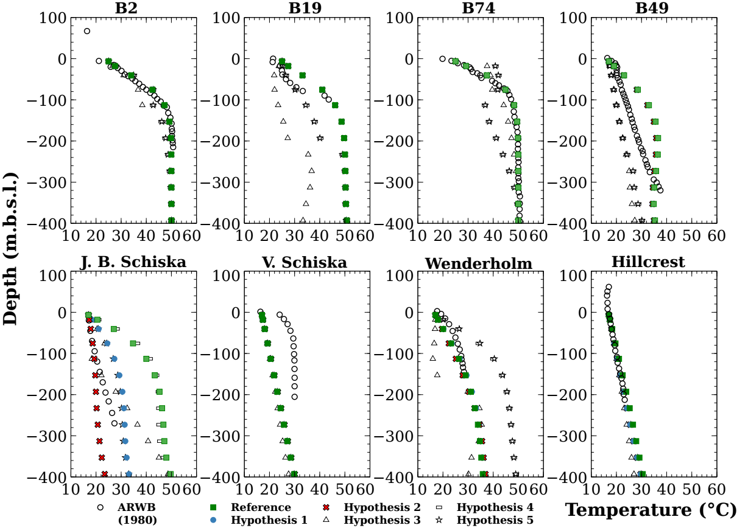
TRANSPORT Simulation Environment
Course simulations
Thomas Kempka
GFZ German Research Centre for Geosciences
University of Potsdam
29/03/2023 - Potsdam
Notes:
<Foliennummer>

Slide 2
Course schedule focusses on simulations with increasing complexity and process integration
Groundwater flow
Groundwater flow with advective, conductive and dispersive transport of heat
Groundwater flow with advective, conductive and dispersive transport of heat as well as advective, diffusive and dispersive
transport of a passive tracer
Density-driven groundwater flow based on chemical species concentrations and transport of heat using fluid equations of state
Groundwater flow with transport of heat and chemical species considering chemical reactions by a coupling to a surrogate model
Groundwater flow with transport of heat and chemical species considering chemical reactions by a coupling to PHREEQC

Slide 3
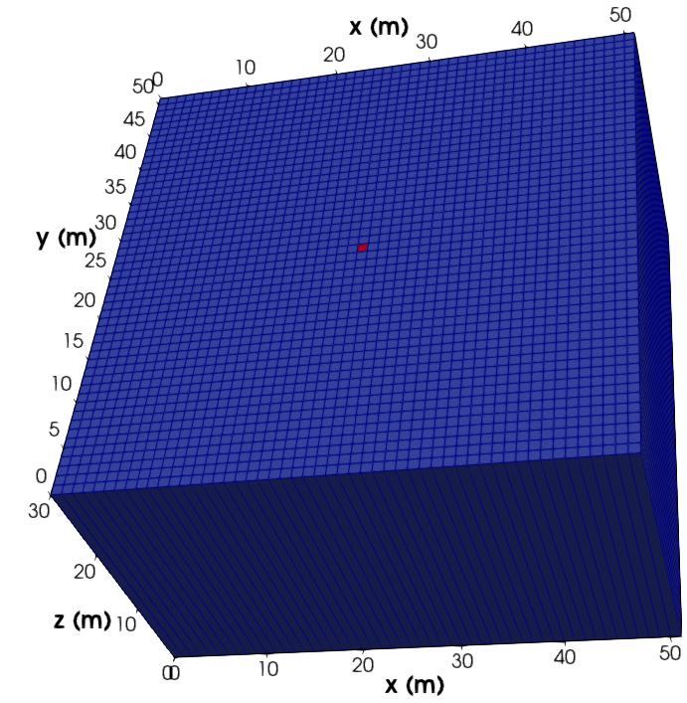
2D geothermal reservoir model used as base case
Model extent 51 m x 51 m x 30 m with
1 m x 1 m x 30 m grid discretisation
Initial reservoir pressure is 15 MPa
Injection well located at model centre with 50 m³ h⁻¹ source term
Lateral model boundaries are open (Dirichlet-type conditions)
Top and bottom boundaries are closed (Neumann 'no-flow' type)
Refer to specific config.py for parametrisation of each example
Fluid EOS and chemical equlibria
(later examples) derived from PHREEQC
Kühn, M. and Schneider, W. (2003) in Clauser, C. (ed.)
Numerical Simulation of Reactive Flow in Hot Aquifers. pp 253-262

