Slide 1

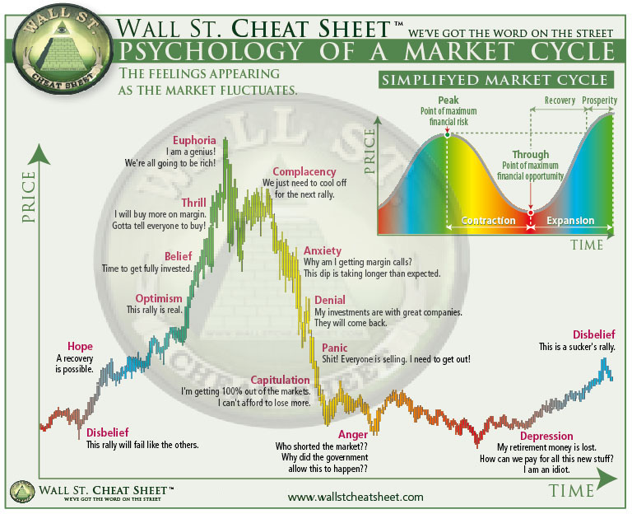
Sentiment analysis team
Taehoon Kim
Joe Gorfinkle
Wenjie Gao
Bharathan Mayavaram Sridharan

Slide 2
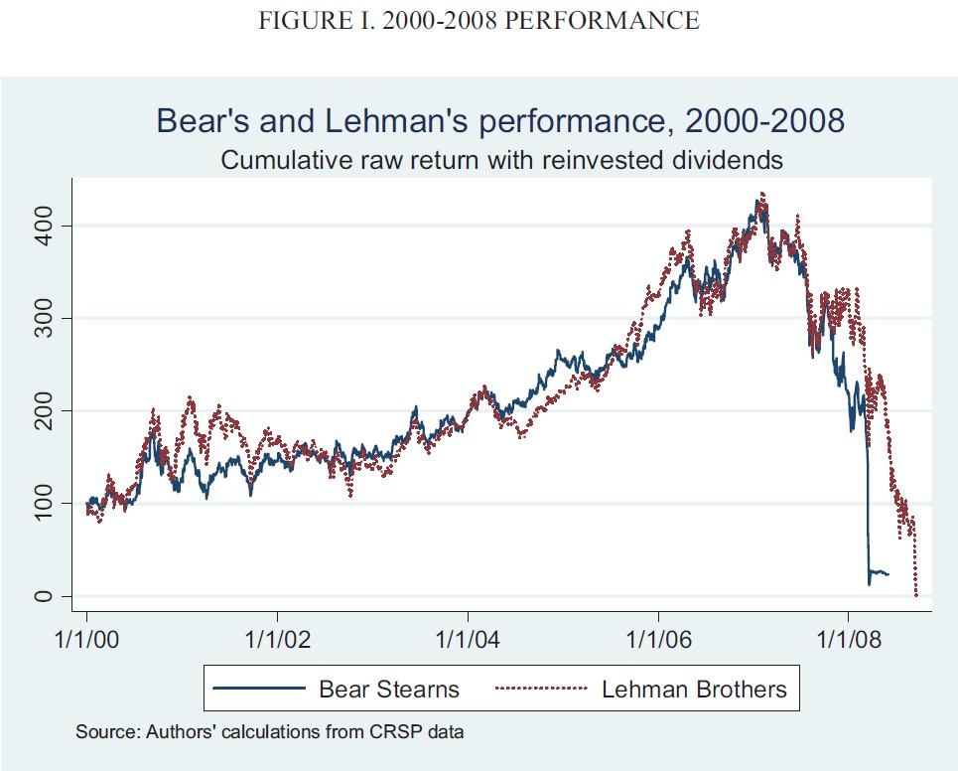
GLOBAL FINANCIAL CRISIS

Slide 3

Stock market – the ultimate illusion ?

Slide 4



SENTIMENT Definition - Wikipedia
We should have played the video…
The use of natural language processing and text analysis
to systematically identify, extract, quantify, and study
affective states and subjective information.
0
1
1
www.seekingalpha.com

Slide 5

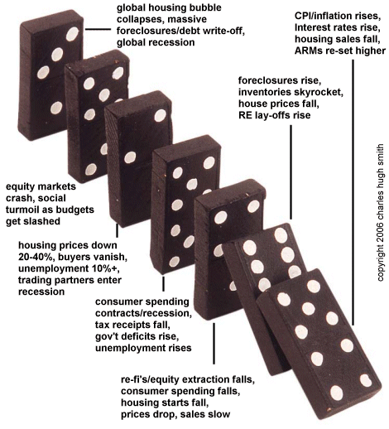
GLOBAL FINANCIAL CRISIS
Who pushed the 1st Domino ?
Who does the market listen to ?

Slide 6





What does a stock price reflect ?
∑ All Market Sentiments:
Macroeconomic outlook
Industry / Sector outlook
Fundamental Analysis
Technical Analysis
Analyst Reports

Slide 7
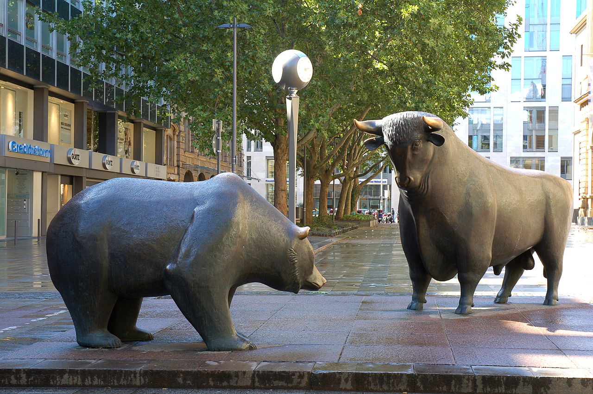
Our approach
bears
bulls
BB
GE
DISH
AMD
FB
AMZN
NVIDIA
GOOG
150 SENTIMENT SCORES
SA EARNINGS CALL TRANSCRIPTS
2013-18 W/HISTORICAL PRICES
STATISTICAL CORRELATIONS

Slide 8
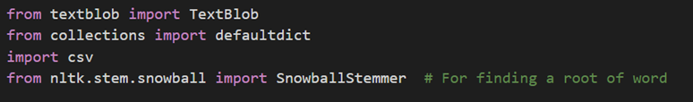
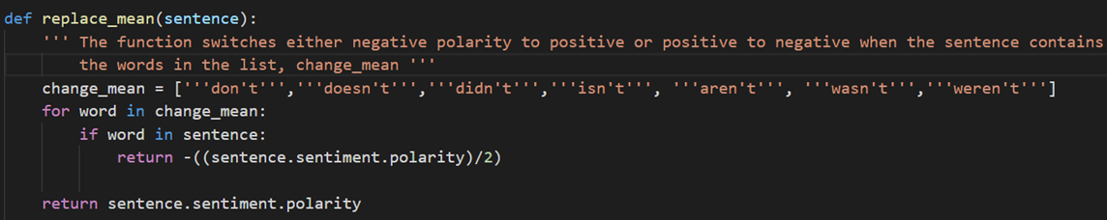
THE CODE
Library
The Fucntion, Replace_mean
Notes:
In order to do the sentiment analysis, we used a library called textblob.
However, since the library was not made for analyzing the financial text, there were some errors for getting the accurate polarities. Therefore, we first focused on making TextBlob as a better version of sentiment analysis tool for finance texts. There are two main functions we created: Function of ‘replace_mean’ and ‘replace_word’.
We have tried textblob on a lot of sentences and figured out that it does not correctly react to ‘verb + not’ when the word is simplified to such as “isn’t” or “don’t”. Therefore, I created the function called ‘replace_mean’ that covers those simplified words; it returns the opposite of half amount of the polarity.

Slide 9


Example of function, Replace_mean
Notes:
For example, when we analyze for the sentence “I love you” with textblob, it returns 0.5.
Also, when we analyze the opposite sentence “I do no love you”, it returns -0.25 this time.
It seems to be reasonable because now we have negative meaning sentence.
However, how about the sentence “I don’t love you”. It should give -0.25, but it returns 0.5 again.
Therefore, we made a function replace_mean and enable to have a correct polarity, -0.25.

Slide 10
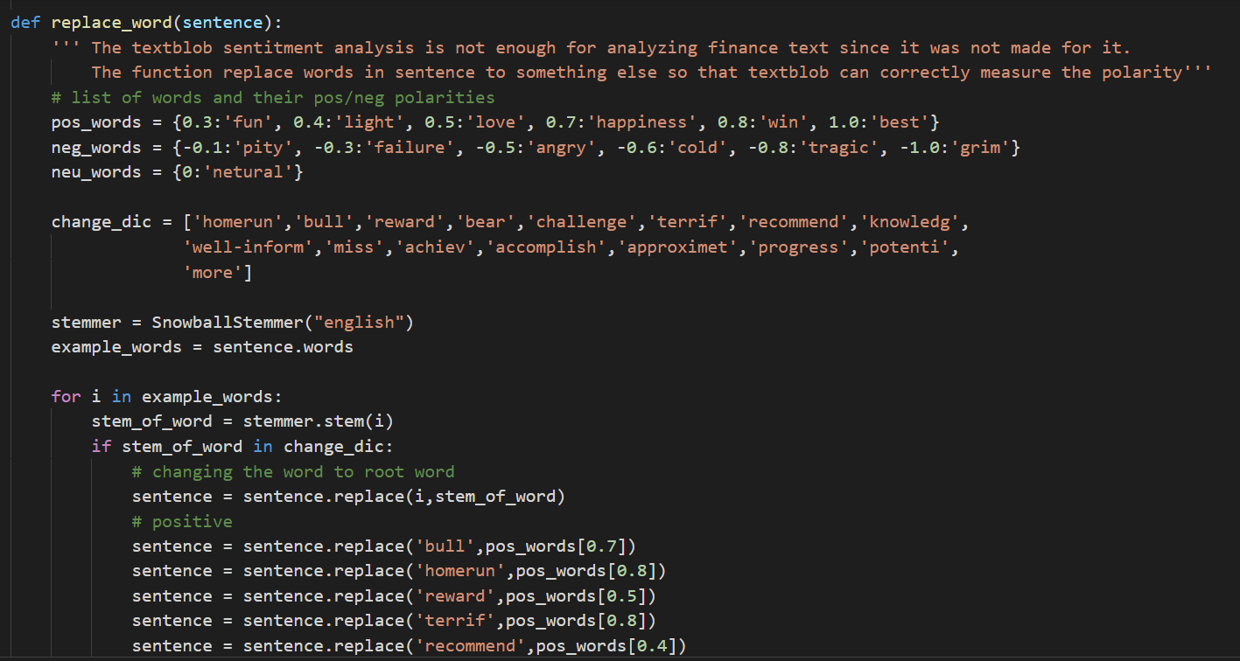
The Function, Replace_word
Notes:
Furthermore, in the financial transcripts, there are many words that are used differently from a real word. Also, some of words are recognized as neutral in the textblob library when they are leaned on one side. Therefore, we made a function called ‘replace_word’. It replaces the word to one that has right amount of polarity in our perspective.

Slide 11

Example of function, Replace_word
Notes:
For instance, when we analyze the sentence, it returns 0.0 although we want the positive polarity.
We think that the word ‘recommend’ has about 0.4 polarity, so we replace word ‘recommend’ to the word that has 0.4 polarity.
We found that when textblob does the sentiment analysis, it basically separates all the words and find polarity of each words. Then it excludes the neutral words and returns the average of the polarities of the rest of the words. Therefore, we have no problem replacing words without concerning parts of speech such as noun, verb, or adjective.

Slide 12
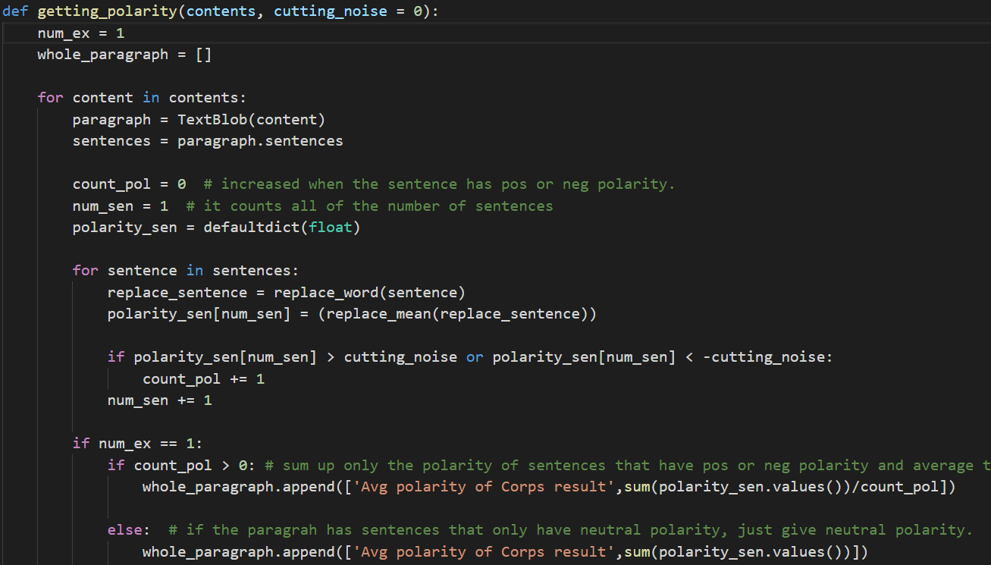
The Function, getting_polarity
Notes:
After we make the textblob sentiment analysis more accurate with those functions, we analyze the actual texts with the function, ‘getting_polarity’. We put two arguments in the function: a text and how much we would like to see as noise value. For example, if we write 0.05 for the amount, the function excludes sentences in the text that have polarity between -0.05 and 0.05 when it calculates the polarity of the whole text. Using those three functions, we import the text, analyze it and save the result into the csv file.

Slide 13
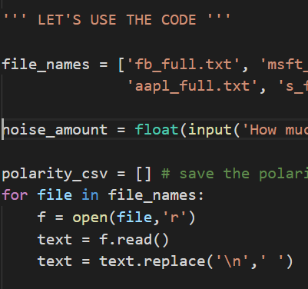
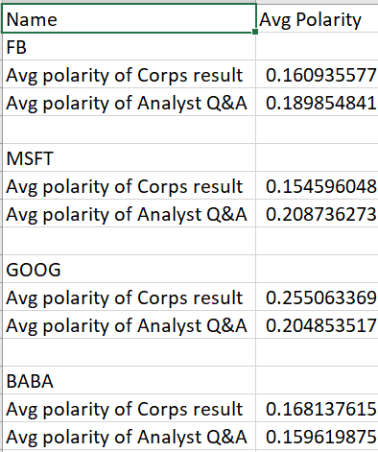

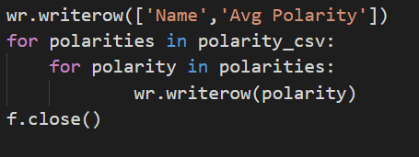
Result of the Code
Notes:
Here is the outcome of the code when it is executed.

Slide 14
results - AMZN

Slide 15
Insights – PROJECT
ETL – Huge Pain point w/o API’s
Lack of Data to discern anything useful (our Project limitation)
Finance data becoming premium products…
I have respect for PM now, basically how to you scale this !!!
SA Model / Segment Interesting Idea (Google)
Weighting Subjectiveness, ART or SCIENCE, Can ML Help?
QUESTIONS ?

Slide 16

Insights – transcripts
WE NEVER FOUND NEGATIVE SENTIMENT (EVEN IN 2008)
AMZN VERY NEUTRAL WITH NARROW RANGE
ANALYSTS MORE OPTIMISTIC THAN CORPORATE (DISH exception)
COMMENTS FROM LISTENERS HAVE STRONG SENTIMENT…
THE SEARCH CONTINUES FOR THE DOMINO PUSHERS…
Michael J. Burry was one of the first
investors to recognize and profit from the impending subprime mortgage crisis.

Slide 17
results - AMZN

Slide 18
results - GE

Slide 19
results - DISH

Slide 20
results - goog

Slide 21
results – LEHMAN BROTHERS

