Slide 1



R Workshop
Wrigley Marine Science Institute
T. Hamdi Kitapci

Slide 2
Outline
What is R?
How to prepare your input data for R
Basic data plotting in R
Test for normality of data
Statistical testing
Statistical significance (p-value) vs Effect size vs biological significance
Linear regression
PCA

Slide 3
Installing R
https://www.r-project.org/
Open source, free statistical analysis software
Many third party add-on packages available
https://www.rstudio.com/ IDE (Integrated development environment) for R

Slide 4
Input for R
Input file should such that every row contains a different data entry and columns should be seperated a a delimiter
Example CSV format
S.Length,S.Width,P.Length,P.Width,Species
5.1,3.5,1.4,0.2,"setosa"
4.9,3,1.4,0.2,"setosa"
4.7,3.2,1.3,0.2,"setosa"
First line is called the “header” line which describes each column
Each following line in the file is a separate data entry
Input file should be generated in the same OS as the R's running platform

Slide 5
Scatter plot, histogram, boxplot
plot(), hist(), boxplot()
How to get help for R functions
  Prepend “?” to the function name
  ex: ?plot(),?hist(),?boxplot()
  google!
  use forums such as stackoverflow

Slide 6
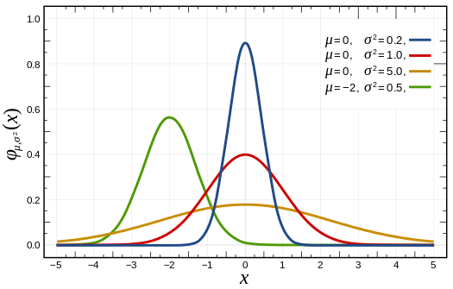
Test data for Normality
Normal distribution

Slide 7
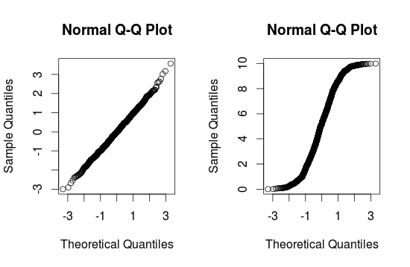
Test for Normality
CLT (Central limit theorem)
QQ-plot
quantile: In statistics and the theory of probability, quantiles are cutpoints dividing the range of a probability distribution into contiguous intervals with equal probabilities, or dividing the observations in a sample in the same way.

Slide 8
Statistical hypothesis testing
A statistical hypothesis is an assumption about a population parameter. This assumption may or may not be true. Hypothesis testing refers to the formal procedures used by statisticians to accept or reject statistical hypotheses.
Statistical significance
  p-value: The probability, under the null hypothesis, of sampling a test statistic at least as extreme as that which was observed.
Parametric tests
  t-test
Non-parametric tests
  wilcoxon test

Slide 9
Let do an experiment by simulating some data
rnorm() , hist(), t-test()

Slide 10
Linear Regression
In statistics, linear regression is an approach for modeling the relationship between a scalar dependent variable y and one or more explanatory variables (or independent variables) denoted X.
R function for linear regression
  lm()

Slide 11
PCA
Principal component analysis
  Principal component analysis (PCA) is a statistical procedure that uses an orthogonal transformation to convert a set of observations of possibly correlated variables into a set of values of linearly uncorrelated variables called principal components.

