Slide 1
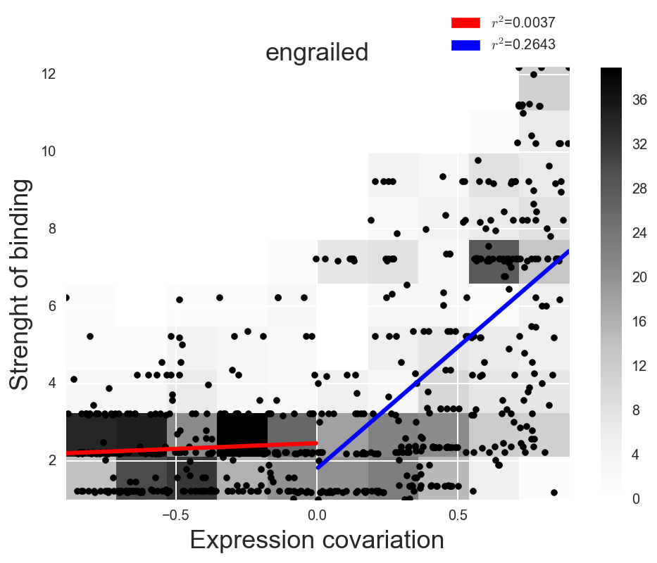
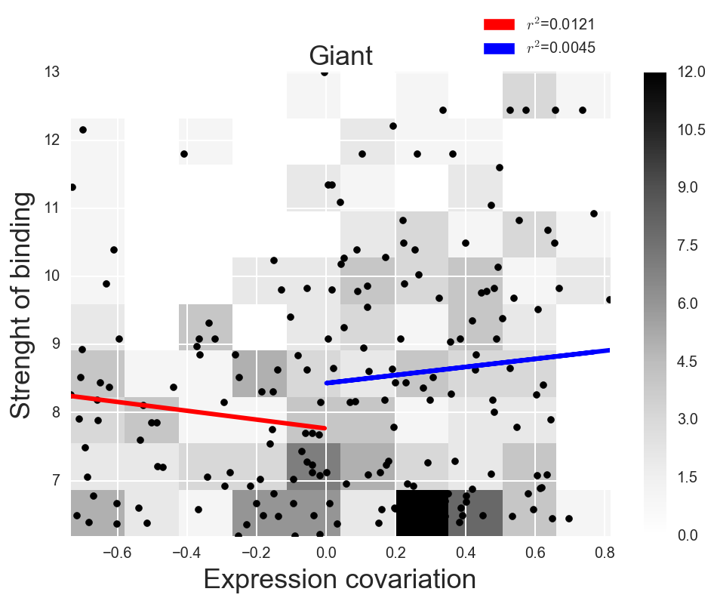
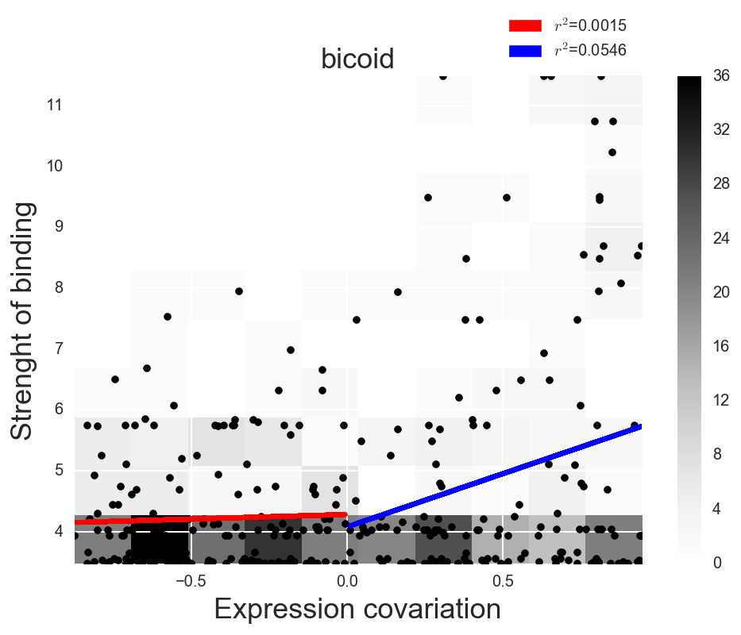
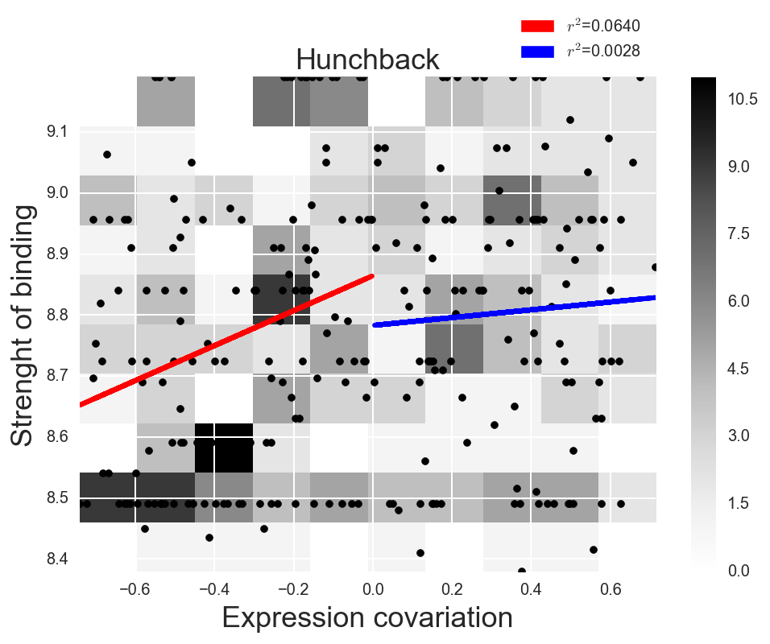
a
c
a
Engrailed
Giant
Average strength of TF binding sites
Average strength of TF binding sites
b
d
Bicoid
Hunchback
Average strength of TF binding sites
Average strength of TF binding sites

