Slide 1
HadoopDB
Miguel Angel Pastor Olivar
miguelinlas3 at gmail dot com
http://miguelinlas3.blogspot.com
http://twitter.com/miguelinlas3

Slide 2
Contenidos
Introduction,objetives and background
HadoopDB Architecture
Results
Conclusions

Slide 3
Introduction

Slide 4
General
Analytics are important today
Data amount is exploding
Previous problem → Shared nothing architectures
Approachs:
  Parallel databases
  Map/Reduce systems

Slide 5
Desired properties
Performance
  Cheaper upgrades
  Pricing mode (cloud)
Fault tolerance
  Transactional workloads: recover
  Analytics environments: not restart querys
  Problem at scaling

Slide 6
Desired properties
Heterogeneus environments
  Increasing number of nodes
  Difficult homogeneous
Flexible query interface
  BI usually JDBC or ODBC
  UDF mechanism
  Desirable SQL and no SQL interfaces

Slide 7
Background: parallel databases
Standard relational tables and SQL
  Indexing, compression,caching, I/O sharing
Tables partitioned over nodes
  Transparent to the user
  Optimizer tailored
Meet performance
  Needed highly skilled DBA

Slide 8
Background: parallel databases
Flexible query interfaces
  UDFs varies acroos implementations
Fault tolerance
  Not score so well
  Assumption: failures are rare
  Assumption: dozens of nodes in clusters
  Engineering decisions

Slide 9
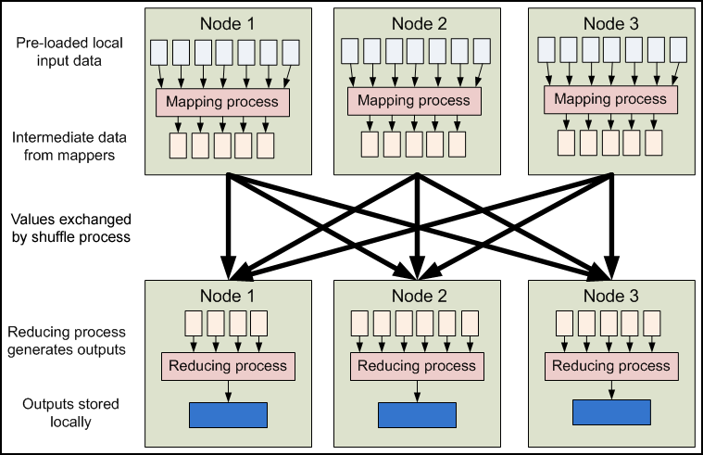
Background: Map/Reduce

Slide 10
Background: Map/Reduce
Satisfies fault tolerance
Works on heterogeneus environment
Drawback: performance
  Not previous modeling
  No enhacing performance techniques
Interfaces
  Write M/R jobs in multiple languages
  SQL not supported directly (Hive)

Slide 11
HadoopDB

Slide 12
Ideas
Main goal: achieve the properties described before
Connect multiple single-datanode systems
  Hadoop reponsible for task coordination and network layer
  Queries parallelized along de nodes
Fault tolerant and work in heterogeneus nodes
Parallel databases performance
  Query processing in database engine

Slide 13
Architecture background
Hadoop distributed file system (HDFS)
  Block structured file system managed by central node
  Files broken in blocks and ditributed
Processing layer (Map/Reduce framework)
  Master/slave architecture
  Job and Task trackers

Slide 14
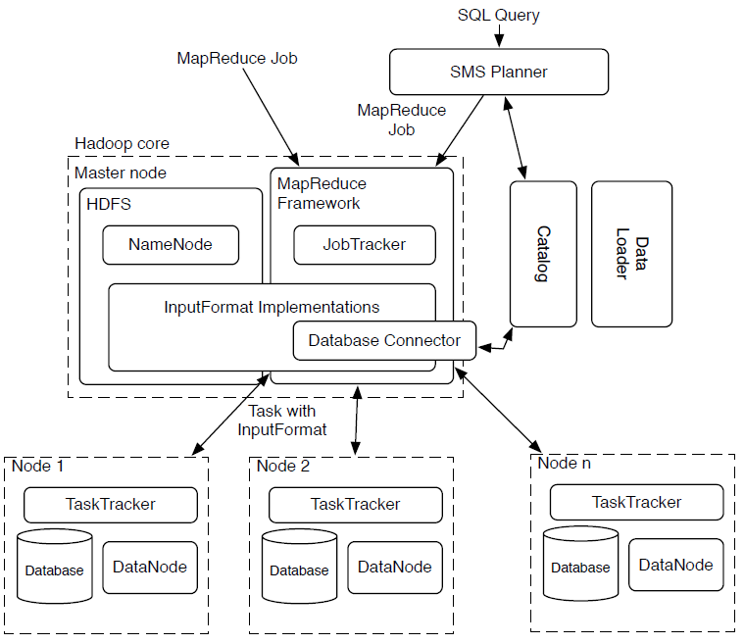
Architecture

Slide 15
Database connector module
Interface between database and task tracker
Responsabilities
  Connect to the database
  Execute the SQL query
  Return the results as key-value pairs
Achieved goal
  Datasources are similar to datablocks in HDFS

Slide 16
Catalog module
Metadata about databases
  Database location, driver class, credentials
  Datasets in cluster, replica or partitioning
Catalog stored as xml file in HDFS
Plan to deploy as separated service

Slide 17
Data loader module
Responsabilities:
  Globally repartitioning data
  Breaking single data node in ckunks
  Bulk-load data in single data node chunks
Two main components:
  Global hasher
    Map/Reduce job read from HDS and repartition
  Local Hasher
    Copies from HDFS to local file system

Slide 18
SMS Planner module
SQL interface to analyst based on Hive
Steps
  AST building
  Semantic analyzer connects to catalog
  DAG of relational operators
  Optimizer reestructuration
  Convert plan to M/R jobs
  DAG in M/R serialized in xml plan

Slide 19
SMS Planner extensions
Update metastore with table references
Two phases before execution
  Retrieve data fields to determine partitioning keys
  Traverse DAG (bottom up). Rule based SQL generator

Slide 20
Benckmarking

Slide 21
Environment
Amazon EC2 “large” instances
Each instance
  7,5 GB memory
  2 virtual cores
  850 GB storage
  64 bits Linux Fedora 8

Slide 22
Benchmarked systems
Hadoop
  256MB data blocks
  1024 MB heap size
  200Mb sort buffer
HadoopDB
  Similar to Hadoop conf,
  PostgreSQL 8.2.5
  No compress data

Slide 23
Benchmarked systems
Vertica
  New parallel database (column store),
  Used a cloud edition
  All data is compressed
DBMS-X
  Comercial parallel row
  Run on EC2 (not cloud edition available)

Slide 24
Used data
Http log files, html pages, ranking
Sizes (per node):
  155 millions user visits (~ 20Gigabytes)
  18 millions ranking (~1Gigabyte)
  Stored as plain text in HDFS

Slide 25
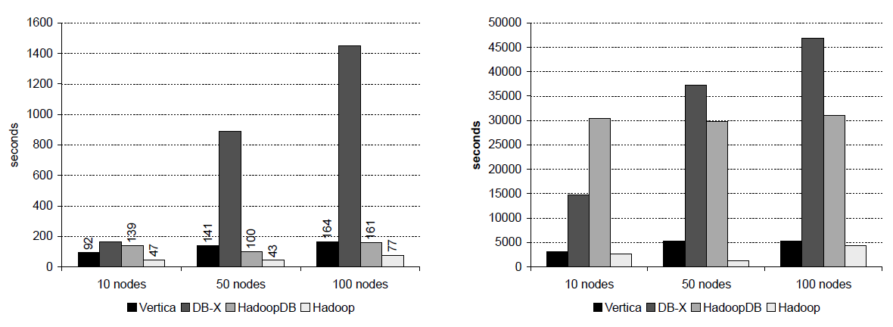
Loading data

Slide 26
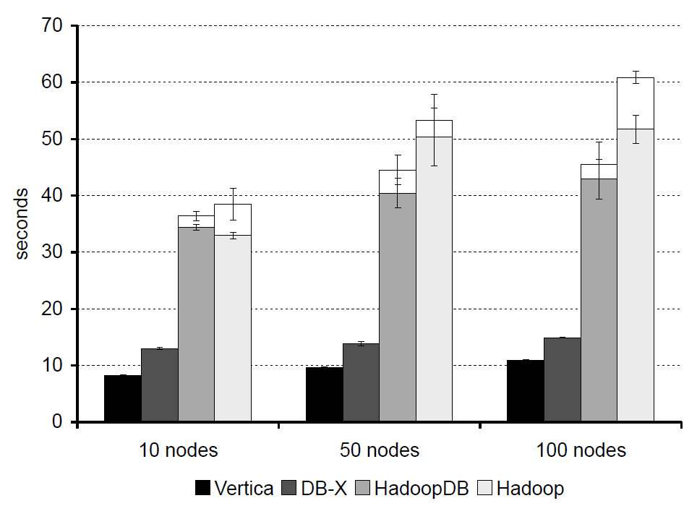
Grep Task

Slide 27
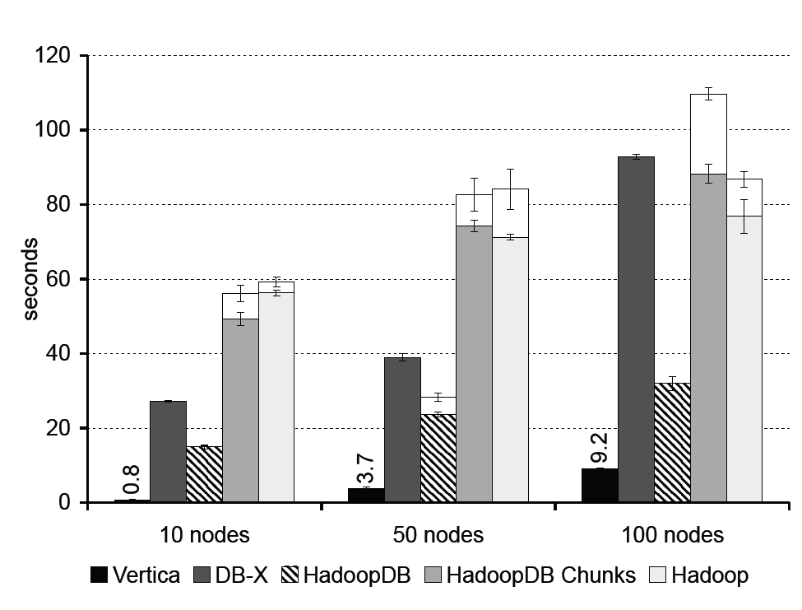
Selection Task
Consulta ejecutada
  Select pageUrl, pageRank from Rankings where pageRank > 10

Slide 28
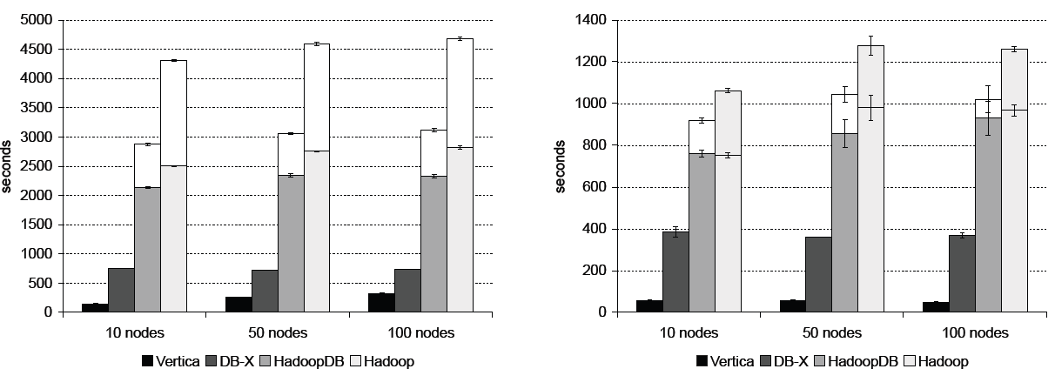
Aggregation Task
Smaller query
SELECT SUBSTR(sourceIP, 1, 7), SUM(adRevenue)
FROM UserVisits
GROUP BY SUBSTR(sourceIP, 1, 7);
Larger query
SELECT sourceIP, SUM(adRevenue)
FROM UserVisits
GROUP BY sourceIP

Slide 29
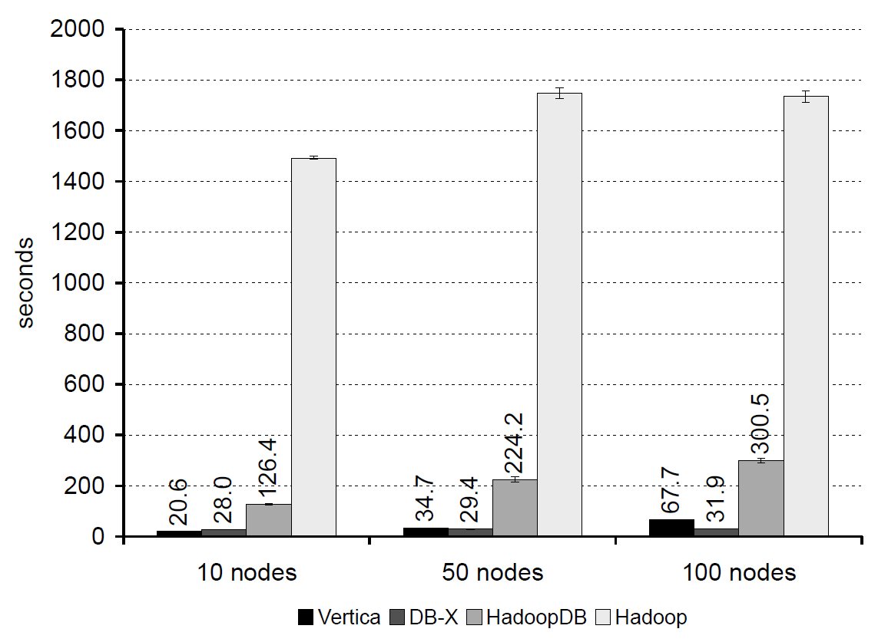
Join Task
Query
SELECT sourceIP, COUNT(pageRank), SUM(pageRank),SUM(adRevenue)
FROM Rankings AS R, UserVisits AS UV
WHERE R.pageURL = UV.destURL AND
UV.visitDate BETWEEN ‘2000-01-15’ AND ‘2000-01-22’
GROUP BY UV.sourceIP;
Not same query

Slide 30
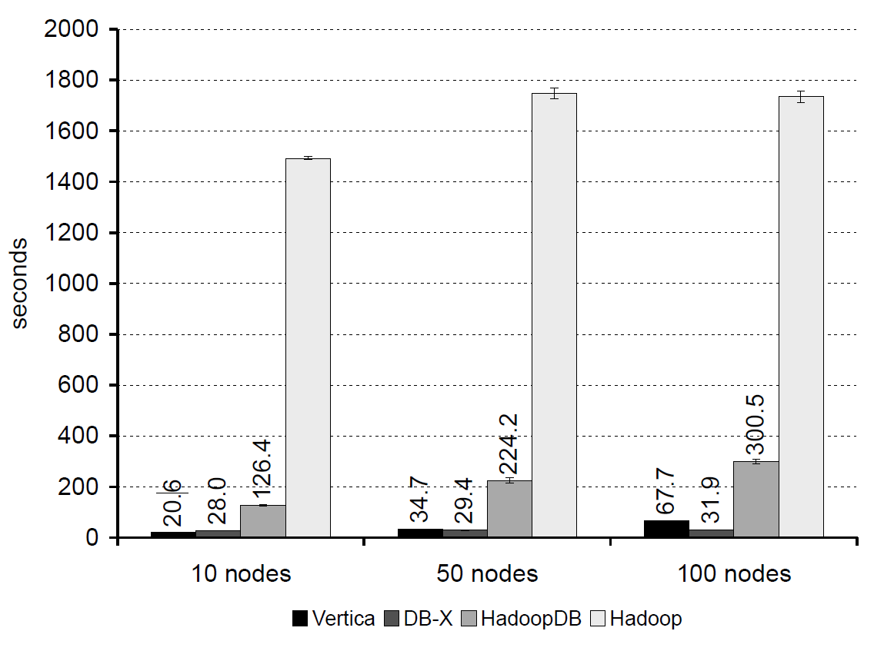
UDF Aggregation Task

Slide 31
Summary
HaddopDB approach parallel databases in absence of failures
  PostgreSLQ not column store
  DBMS-X 15% overly optimistic
  No compression un PosgreSQL data
Outperforms Hadoop

Slide 32
Fault tolerance and heterogeneus environments

Slide 33
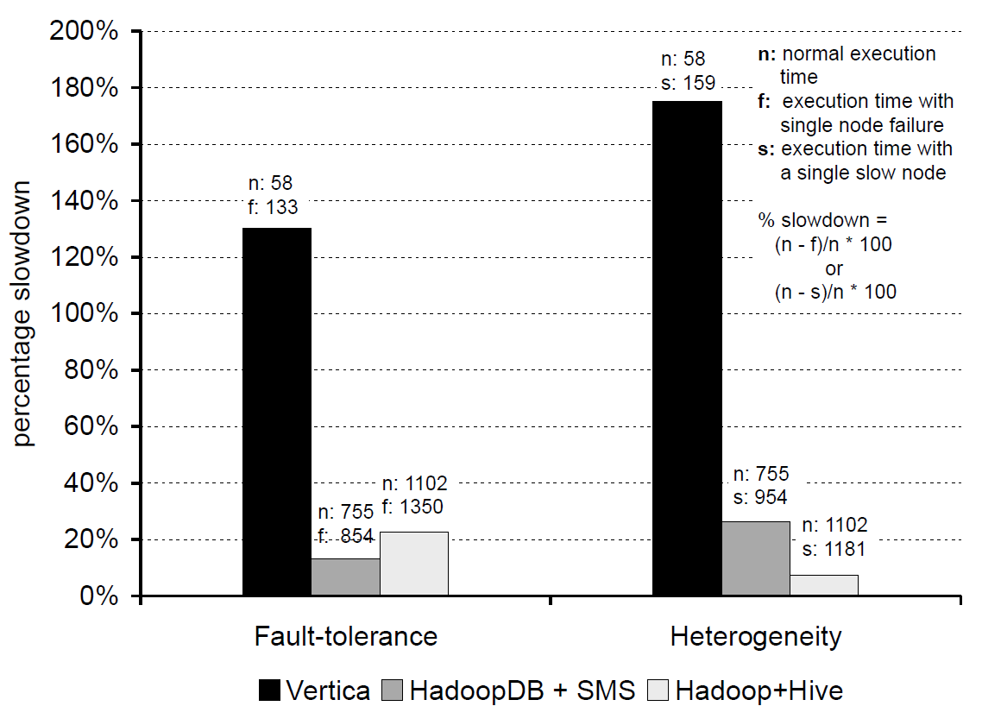
Benchmarks

Slide 34
Discussion
Vertica is faster
Reduce the number of nodes to achieve the same order of magnitude
Fault tolerance is important

Slide 35
Conclusions

Slide 36
Conclusion
Approach parallel databases and fault tolerance
PostgreSQL is not a column store
Hadoop and hive relatively new open source projects
HadoopDB is flexible and extensible

Slide 37
References

Slide 38
References
Hadoop web page
HadoopDB article
HadoopDB project
Vertica
Apache Hive

Slide 39
That´s all!

