Slide 1
Unit Testing w/JUnit
CSC 142 Fall 2019

Slide 2
Unit Testing
Test every single entity, all classes, methods, fields, accessors, etc.
Process to deliver quality products
Unit test characterized by known input and expected output. The input should test a pre-condition and the output should test a post-condition.

Slide 3
JUnit
Java framework for writing and running tests
Concurrent coding and testing
Annotations to identify test methods
Assertions for testing expected results

Slide 4
Junit - Annotations
@Test – test method
@ParameterizedTest
@RepeatedTest
@Before – run methods before @Test methods
@After – run methods after @@Test methods
…

Slide 5
Junit - Assertions
Compare pre and post conditions of objects. Only failed assertions are recorded
assertEquals – checks whether two objects are equal
assertNotEquals – checks whether objects are not equal
assertTrue – checks whether conditions is true
assertFalse – checks whether conditions false

Slide 6
BlueJ
BlueJ makes creating a test class and recording assertions straightforward, the user interacts with the interface and the code is automatically generated

Slide 7
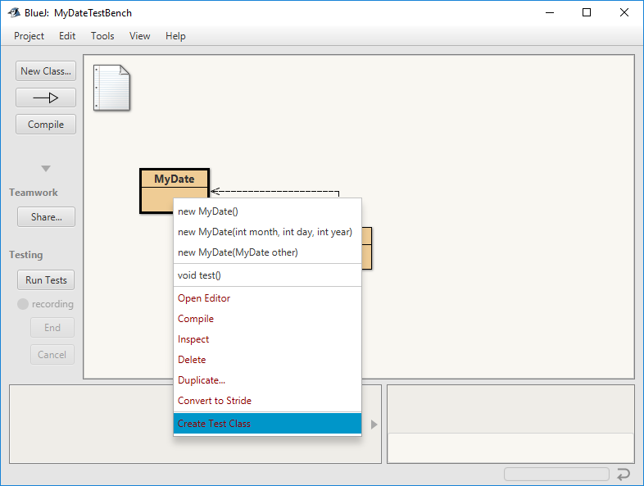
Create Test Class
Right-click on a class and select Create Test Class
In BlueJ the new Test Class will appear stacked behind the original class

Slide 8
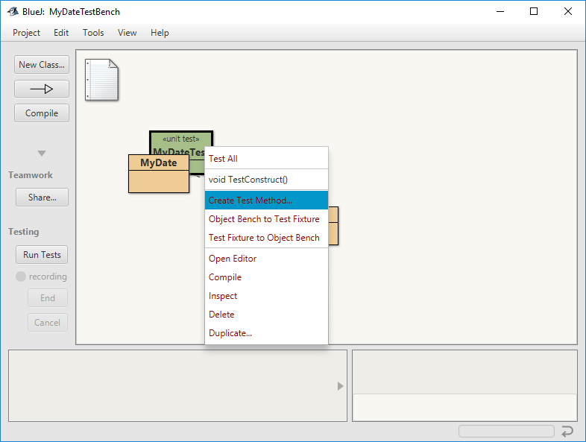
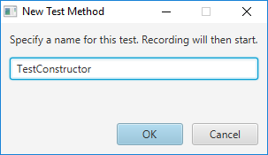
Create Test Method(s)
Right-click on test classes to create Test Methods
Enter name relevant to the test being performed

Slide 9
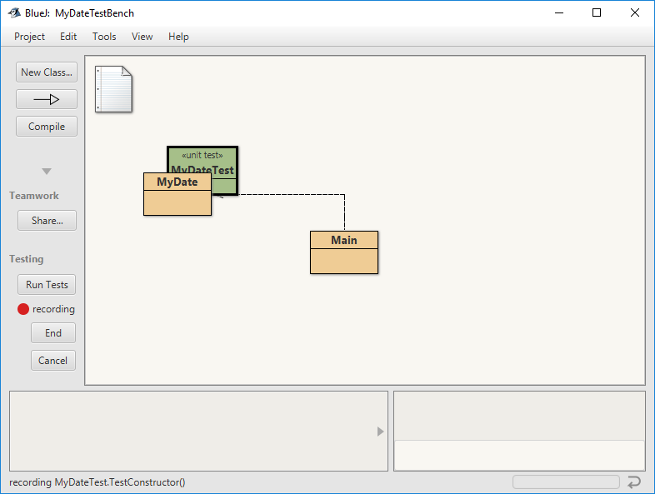
BlueJ Begins Recording User Actions
Recording status indicated by red circle and text “recording”
When a method test is complete, click End to complete recording the test

Slide 10
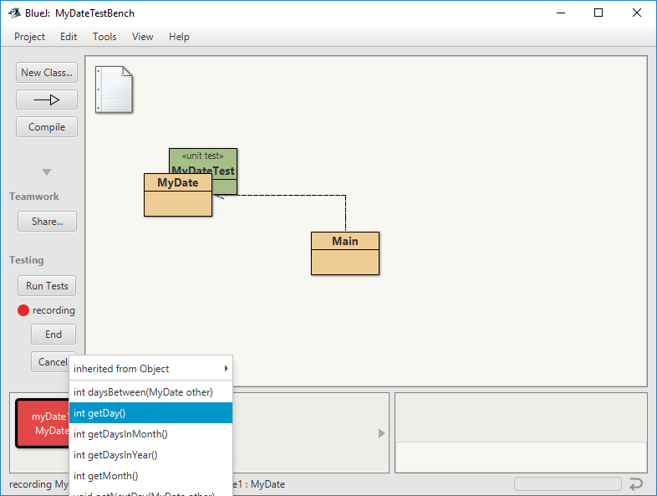
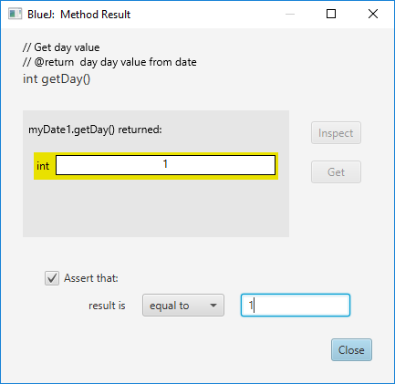
Write Unit Tests
Select methods to test, this example uses the getDay() method
Set assertion condition
BlueJ shows result of method on object, can be helpful in identifying issues before test
Step 2
Step 1

Slide 11
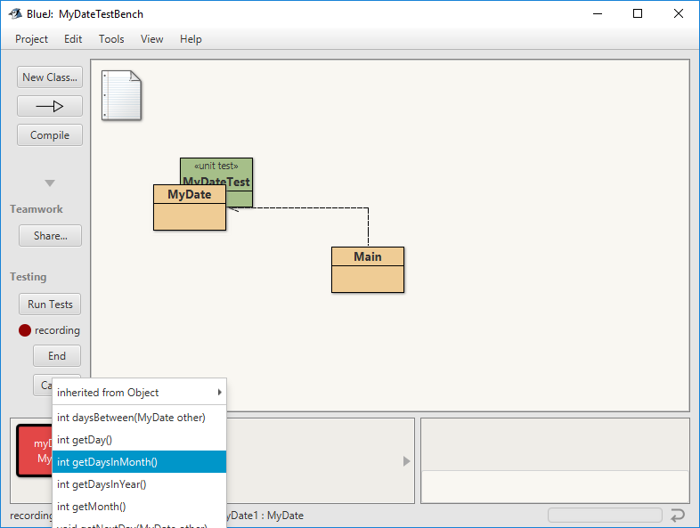
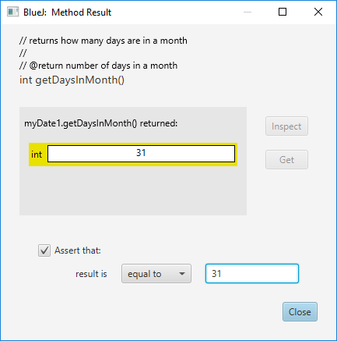
Keeping adding test cases
Keeping adding test cases to a test method
Similar to scope of methods, it’s best practice to constrain number of tests per method

Slide 12
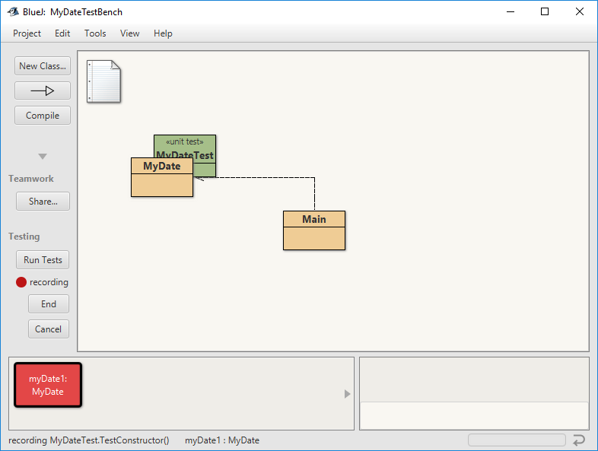
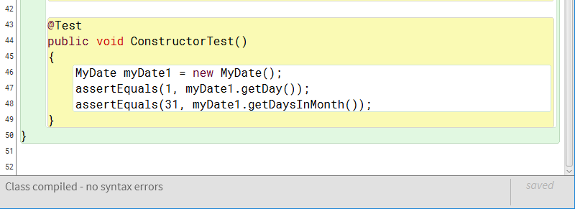
End Recording
When complete, end the recording
Code is generated in the Class test file

Slide 13
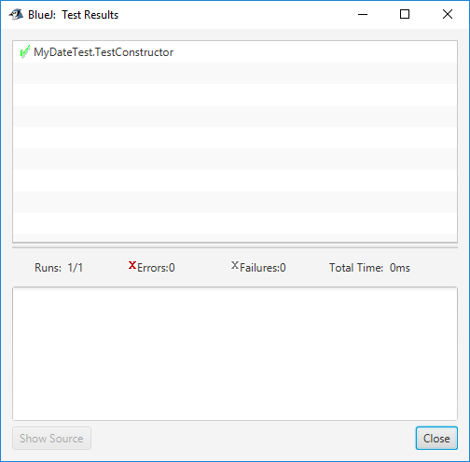
Run Tests

Slide 14
Junit – Example Pseudocode Student Example
import junit libraries
Declare test class{
@Test // test annotation
test method(){
assertions for test
}
}

Slide 15
Junit – Example Java Student Class
import static org.junit.Assert.*;
import org.junit.After;
import org.junit.Before;
import org.junit.Test;
public class StudentTest{
@Test
//test simplified student constructor
public void testStudent(){
Student s1 = new Student(“Jane”,”Austen”,”121775”);
assertEquals(s1.getFirstName(),”Jane”); //validate constructor input
assertNotEquals(s1.getFirstName(),””); //validate not blank
}

Slide 16
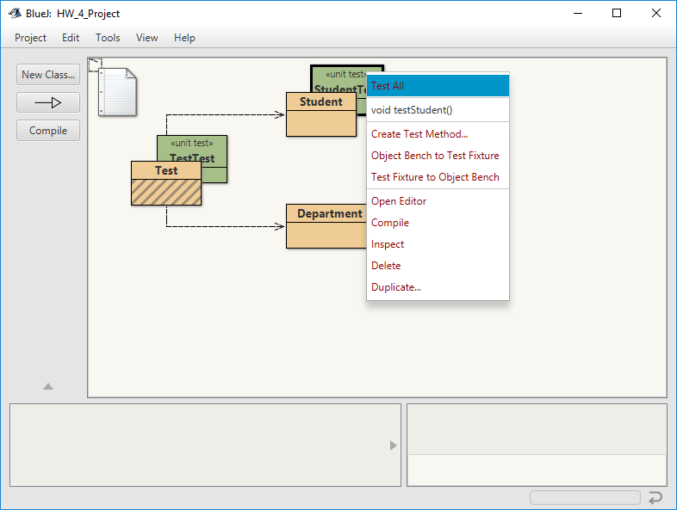
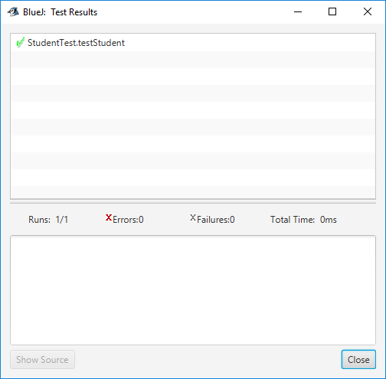
Junit – Example BlueJ (passing)

Slide 17
Junit – Example Java
import static org.junit.Assert.*;
import org.junit.After;
import org.junit.Before;
import org.junit.Test;
public class StudentTest{
@Test
//test simplified student constructor
public void testStudent(){
Student s1 = new Student(“Jane”,”Austen”,”121775”);
assertEquals(s1.getFirstName(),”Jake”); //create failed test
assertNotEquals(s1.getFirstName(),””); //validate not blank
}

Slide 18
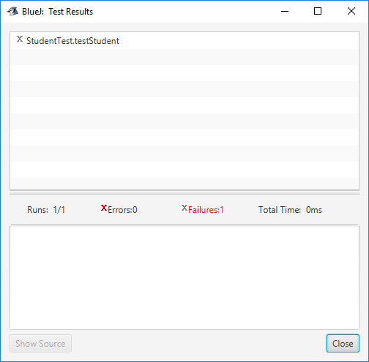
Junit – Example BlueJ (failure)

