Slide 1

Golden Boy Chatbot

Slide 2
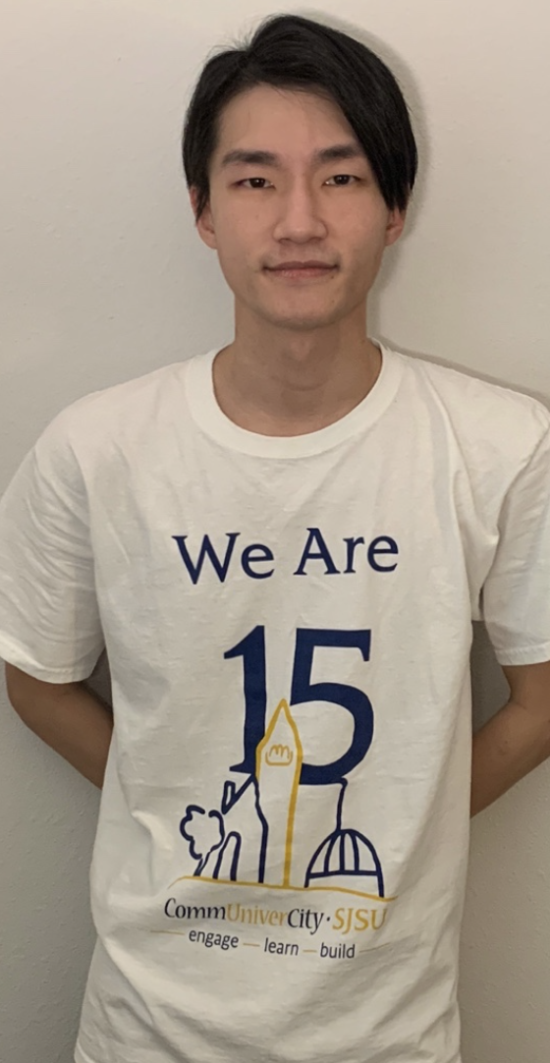
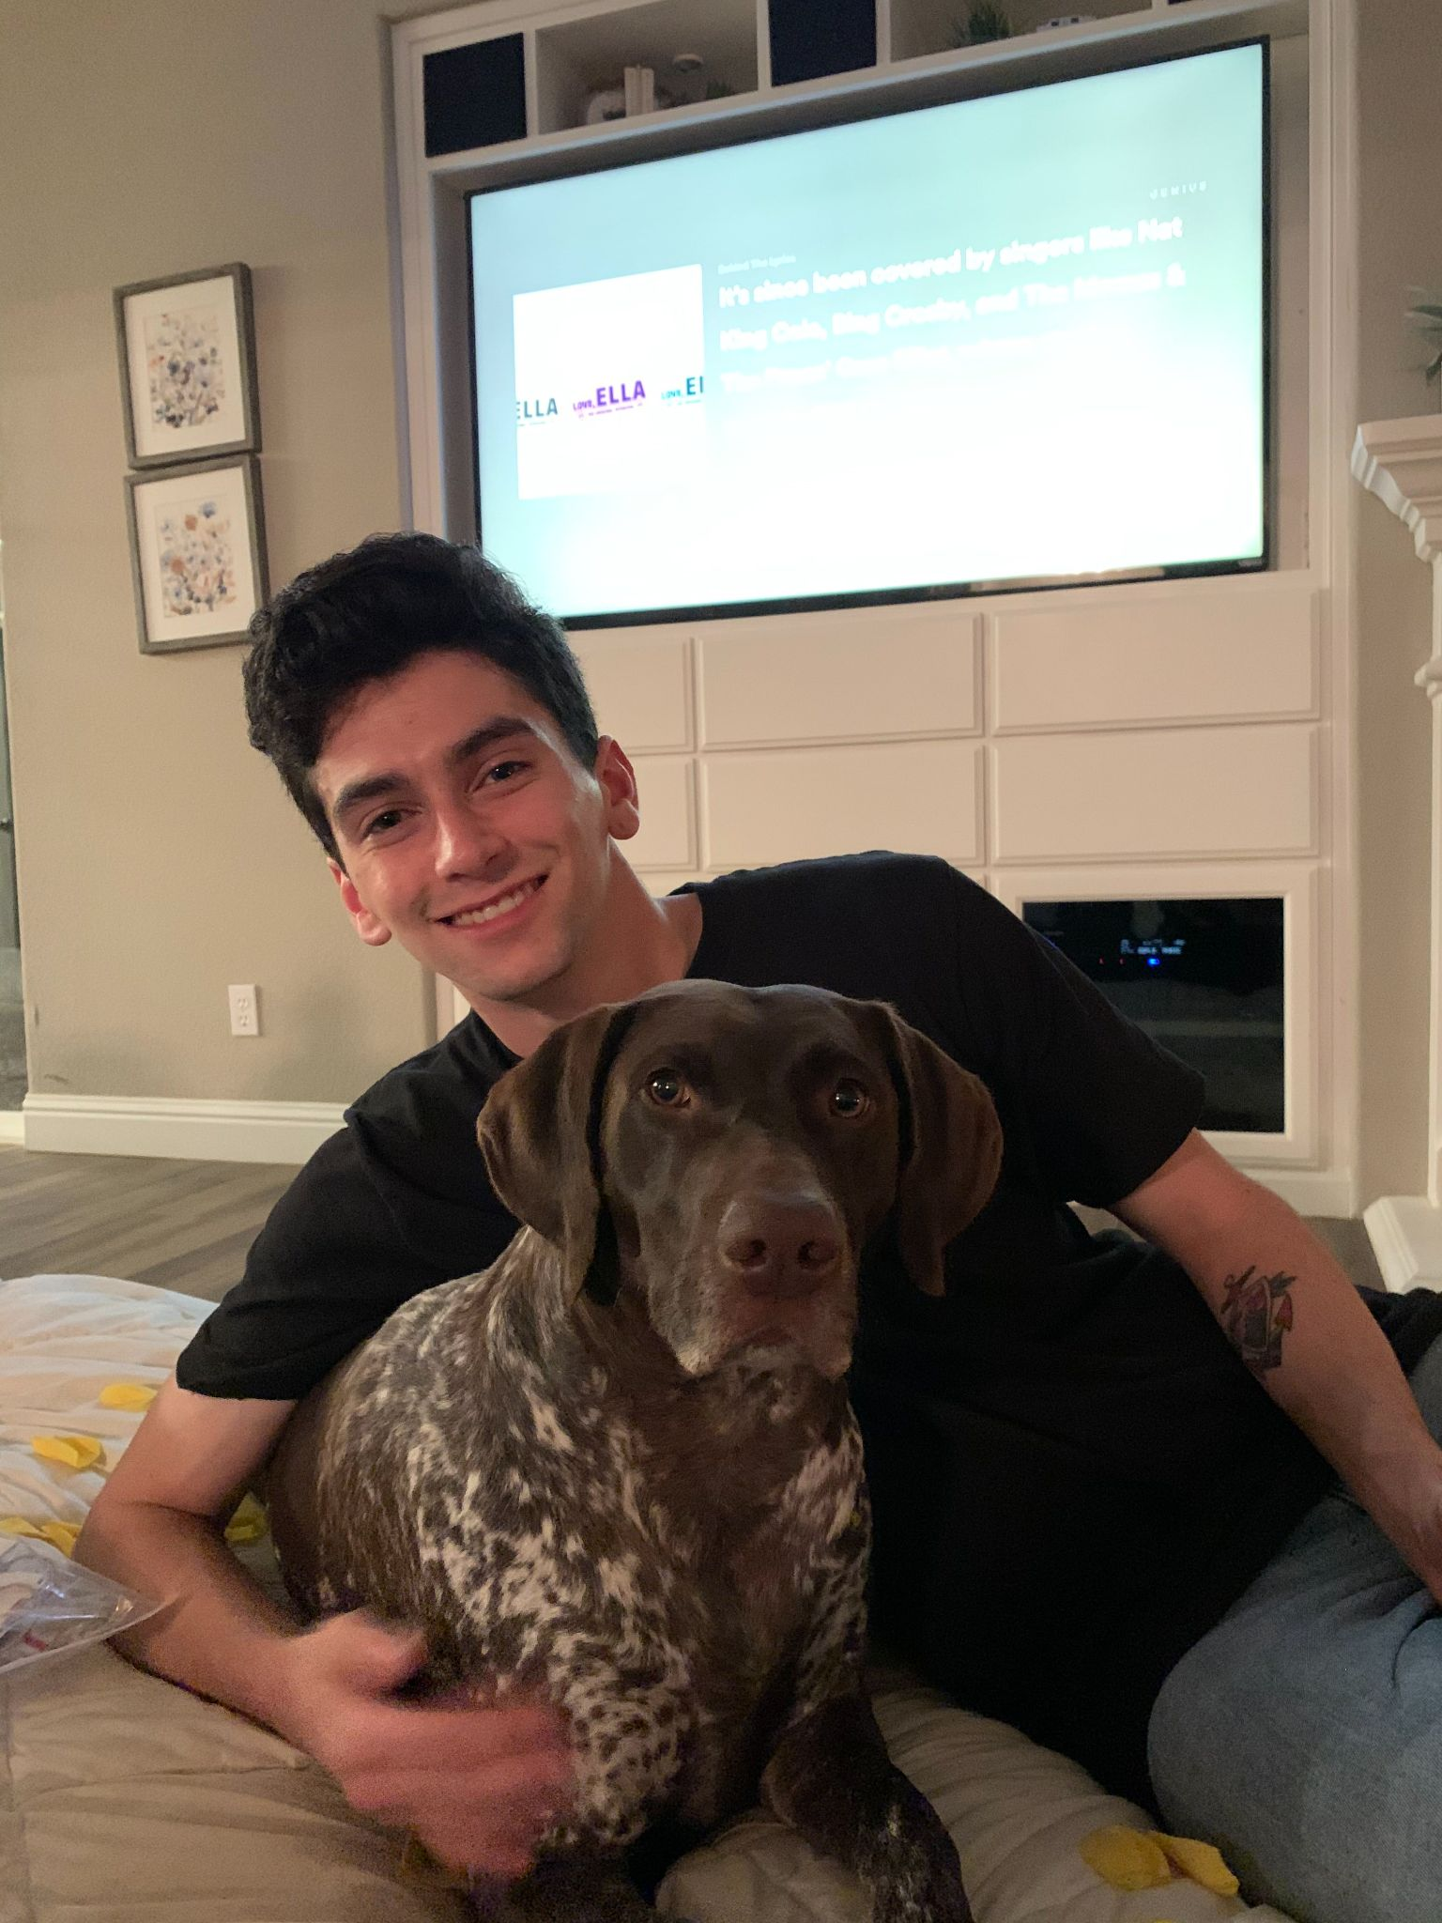
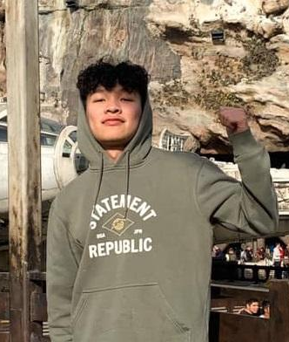


About us
Chang Kook Lee
Ernesto Martinez
Devid Chou
Rohan Nalawadi
Thanh Luu
In 2021, Golden Team was established to develop a chatbot that is powered by IBM Watson to inform and mitigate bias that appears within the development of facial recognition and artificial intelligence.
Notes:
Introduce our selves Team names , members’ names

Slide 3
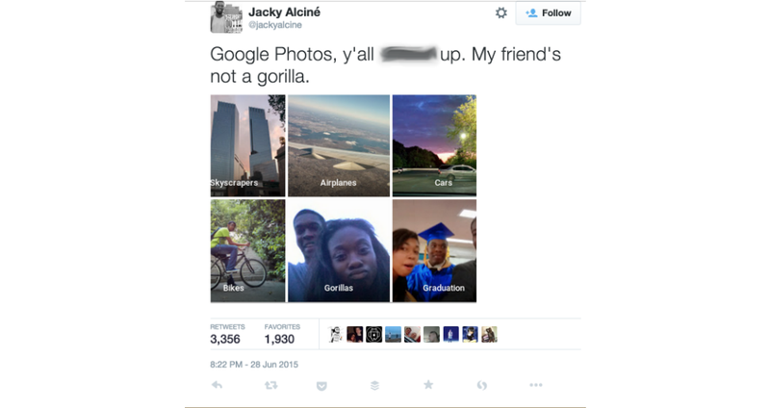
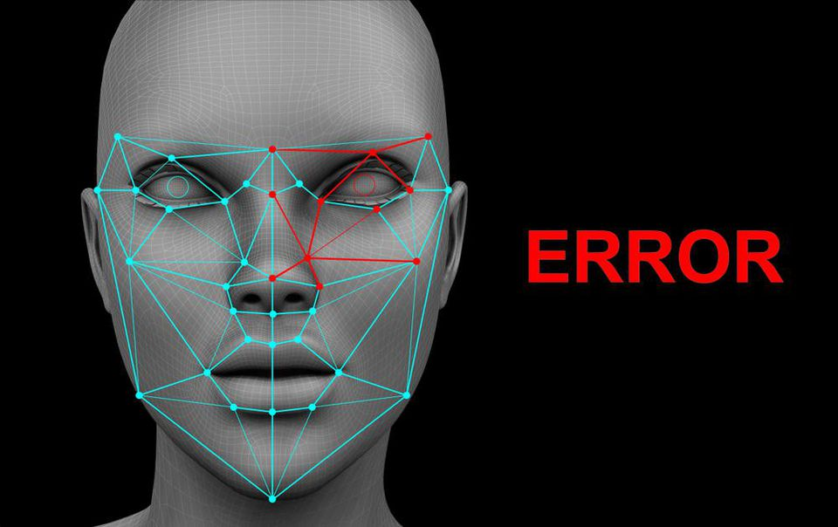
What, Why, and Target Market
Facial recognition is already highly adopted in various fields, especially law enforcement.
FBI Image database already holds an estimated 300 million photos of citizens in the U.S.
- Data set was estimated to be 80% white
- 35% of facial recognition errors happen when identifying dark-skinned women, compared to 1% for white males
Notes:
Most coded algorithm in facial recognition technology today hadn't been taught well enough to identify a broad range of skin tones and facial structures
This is because most facial recognition applications’ data set was estimated to be 80% white - and 35% of facial recognition errors happen when identifying dark-skinned women, compared to 1% for white males
This has been criticized and seen as a form of discrimination and racism

Slide 4


Slide 5

Effectiveness & Improvements
Most of the user liked the Golden Boy because;
Straight forward
Informative
Easy implementation
Improvements;
More visual aids (images & videos)
Minor fixes and removed unnecessary menus
More advanced recognition of keywords/phrases

Slide 6
Q & A
THANK YOU!

