Slide 1



Stochastic Learning Rate with Memory:
Optimization in the Stochastic Approximation and Online Learning Settings
Theodoros Mamalis
Electrical and Computer Engineering
University of Illinois at Urbana Champaign
CDC 2022

Slide 2
Large scale optimization
Astronomical data: massive data, can contain billions of objects
Medical and genetics: solve molecular cluster problems; solve protein folding problems
Industry: a) create, test and use various enterprise models; solve problems related to the company’s supply chain by accounting all the process and business units comprising the company; b) solve heat exchanger network problems; c) solve airline crew scheduling problems; d) inventory/supplies optimization
Urban planning: a) determine the best zones for integrating an energy distribution network b) solve stochastic wind generation problems c) design CO2 pipeline networks
Machine learning: computer vision; natural language processing

Slide 3
Gradient optimization-algorithms
First-order gradient algorithms:
Advantages: simple, easy to implement both in software and in hardware, low-cost iterations
Disadvantages: Slow in directions of low curvature, bouncy in directions of high curvature
Second-order gradient algorithms:
Advantages: significantly better convergence properties
Example, Newton methods: scale invariance means poorly scaled parameters are easier to optimize; avoids problems with high- and low- curvature directions
Disadvantages: runtime and memory costs
Example, Newton method: computation of second order gradient demands
memory storage and computing effort for the Hessian inverse
Notes:
James Martens, Deep Learning via Hessian-free optimization

Slide 4
Empirical Risk Minimization
Find model parameters that
best fit the data. Optimization problem
is large-scale if dimension d large.
: loss function (e.g. squared loss, cross-entropy loss)
: data
: input (examples)
: true output (labels)
: model parameters (e.g. neural network weights)
: model (e.g. neural network)
: model output for input given ,
sometimes denoted as

Slide 5
Stochastic learning rate SGD
1)
Stochastic Gradient Descent (SGD)
: deterministic stepsize (e.g. )
: parameter to be estimated
: gradient of the ERM function
w.r.t.
2)
Multiplicative Stochastic
Learning Rate SGD (MSLR SGD)
: stochasticity factor
3)
MSLR SGD w/ memory

Slide 6
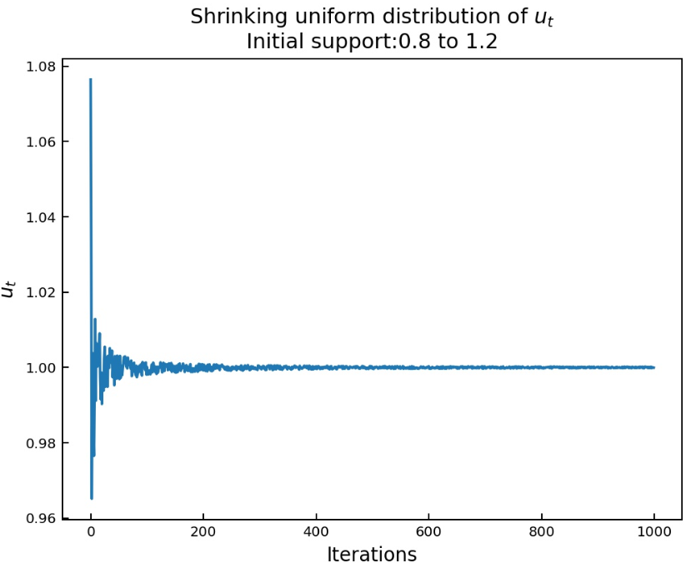
Stochasticity factor (MSLR)

Slide 7
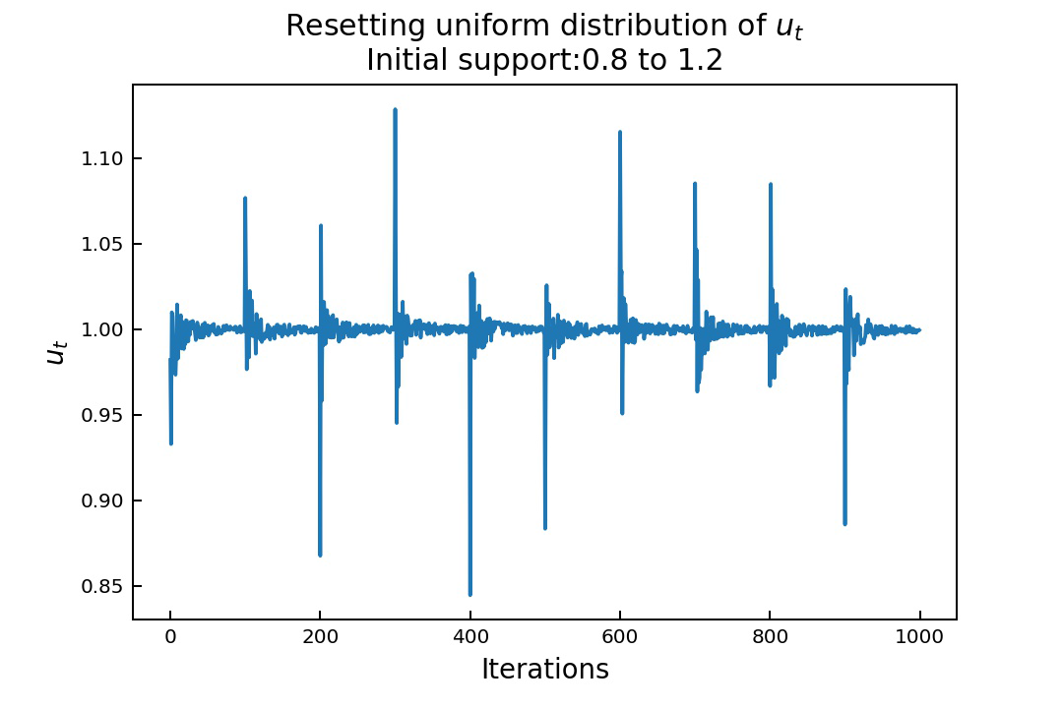
Resetting stochasticity factor (RMSLR)
v_{t}
v_{t}

Slide 8
Stochastic learning rate SGD
1)
Stochastic Gradient Descent (SGD)
: deterministic stepsize (e.g. )
: parameter to be estimated
: gradient of the ERM function
w.r.t.
2)
Multiplicative Stochastic
Learning Rate SGD (MSLR SGD)
: stochasticity factor
3)
MSLR SGD w/ memory

Slide 9
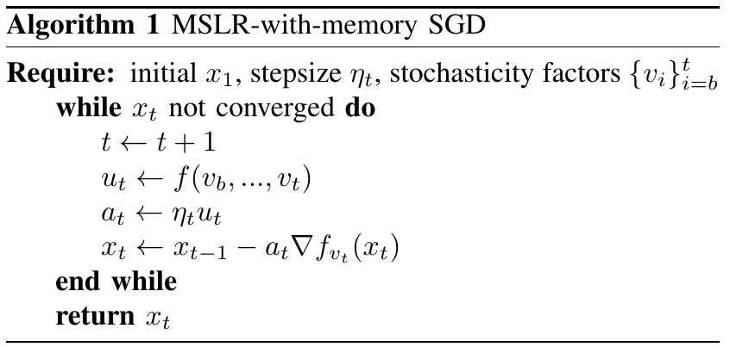
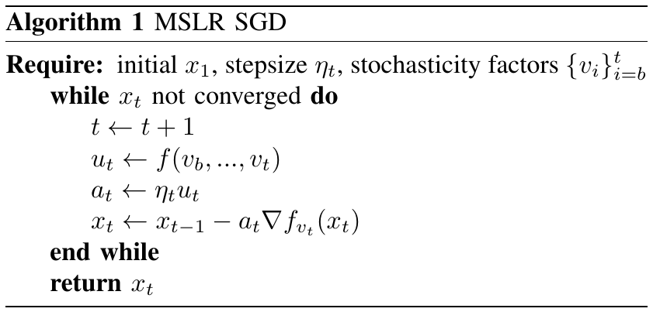
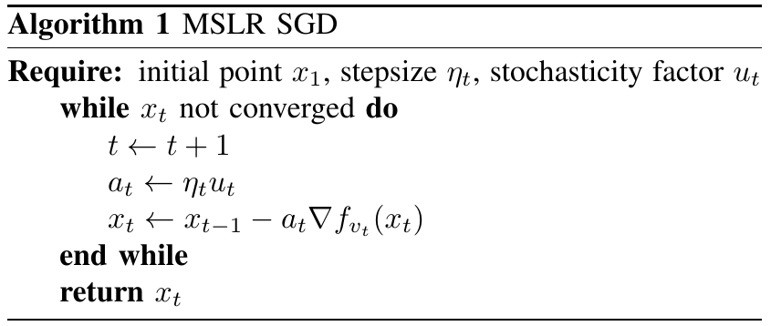
MSLR w/ memory:
Random variables:
,
3

Slide 10
Prior literature
Byproducts of few works (e.g [1]) resulted in sampling-distribution learning rates:
Depend exclusively on the sampling distribution
Often tailored to, and a byproduct of, solving a specific optimization problem
Learning rate distribution not able to take any form
Special case of the general framework presented in this work
Significantly reduced expressive power compared to a stochastic learning rate
[1] N. Loizou et al. Stochastic Polyak Step-size for SGD: An Adaptive Learning Rate for Fast Convergence

Slide 11
Stochastic learning rate SGD
1)
Stochastic Gradient Descent (SGD)
: deterministic stepsize (e.g. )
: parameter to be estimated
: gradient of the ERM function
w.r.t.
2)
Multiplicative Stochastic
Learning Rate SGD (MSLR SGD)
: stochasticity factor
3)
MSLR SGD w/ memory

Slide 12
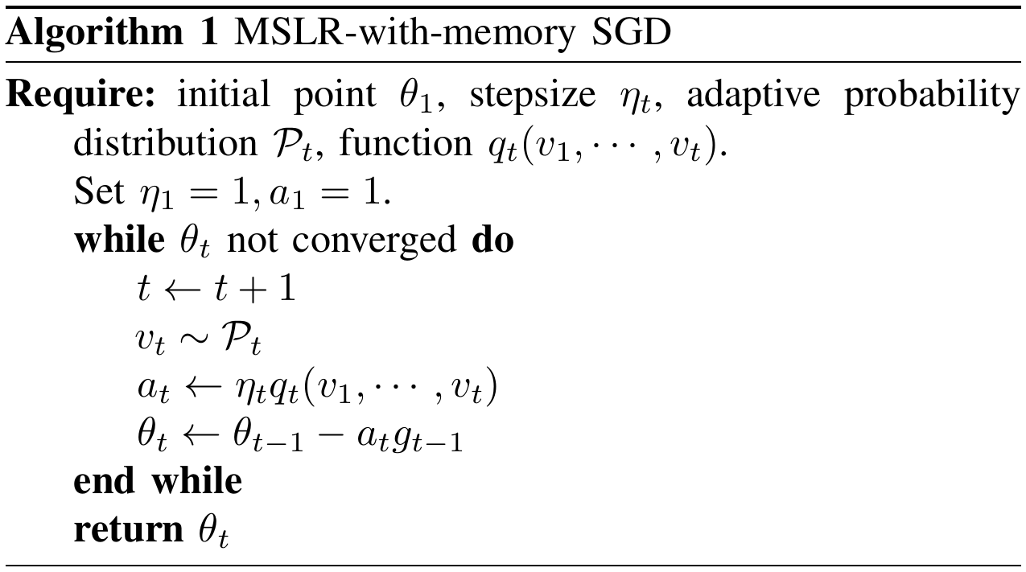

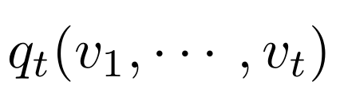
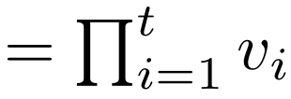
The algorithm MSLR-with-memory SGD:
This paper:
Case when

Slide 13
The algorithm MSLR-with-memory SGD:
This paper:
Case when
For the no-memory case, see [2] T. Mamalis et al. Stochastic Learning Rate Optimization in the Stochastic Approximation and Online Learning Settings

Slide 14
The algorithm MSLR-with-memory SGD:
For the no-memory case, see [2] T. Mamalis et al. Stochastic Learning Rate Optimization in the Stochastic Approximation and Online Learning Settings

Slide 15
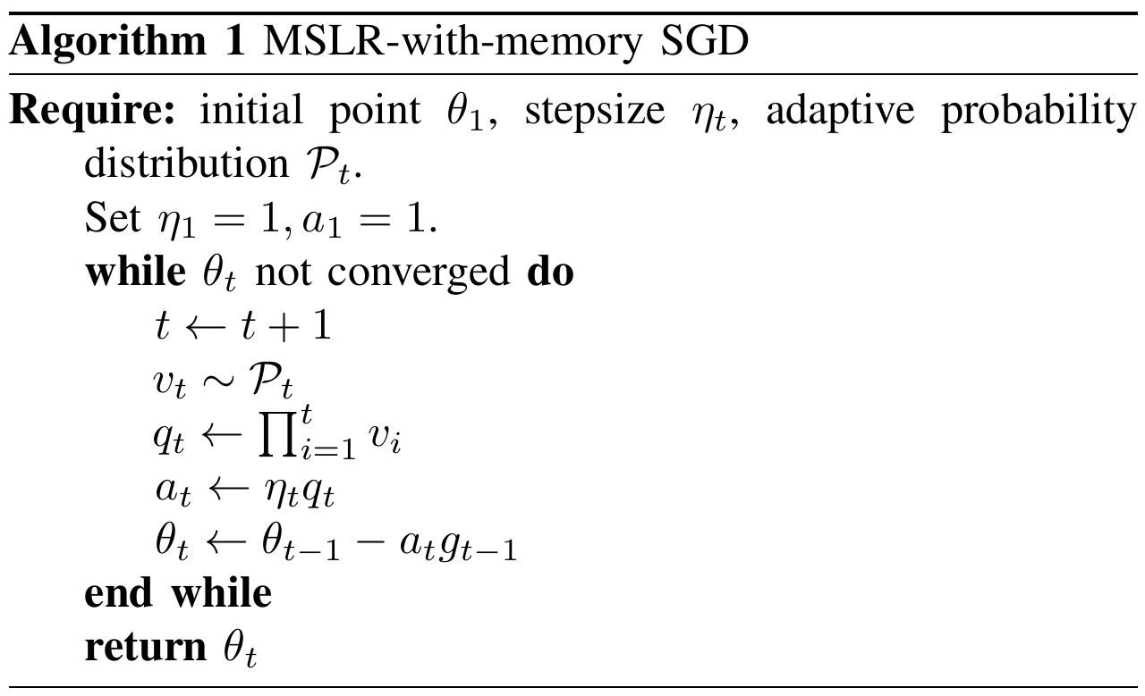
The algorithm MSLR-with-memory SGD:
For the no-memory case, see [2] T. Mamalis et al. Stochastic Learning Rate Optimization in the Stochastic Approximation and Online Learning Settings

Slide 16
The algorithm MSLR-with-memory SGD:
For a resetting stochasticity factor, the algorithm is called
Resetting-MSLR-with-memory SGD (RMSLR SGD /w memory)

Slide 17
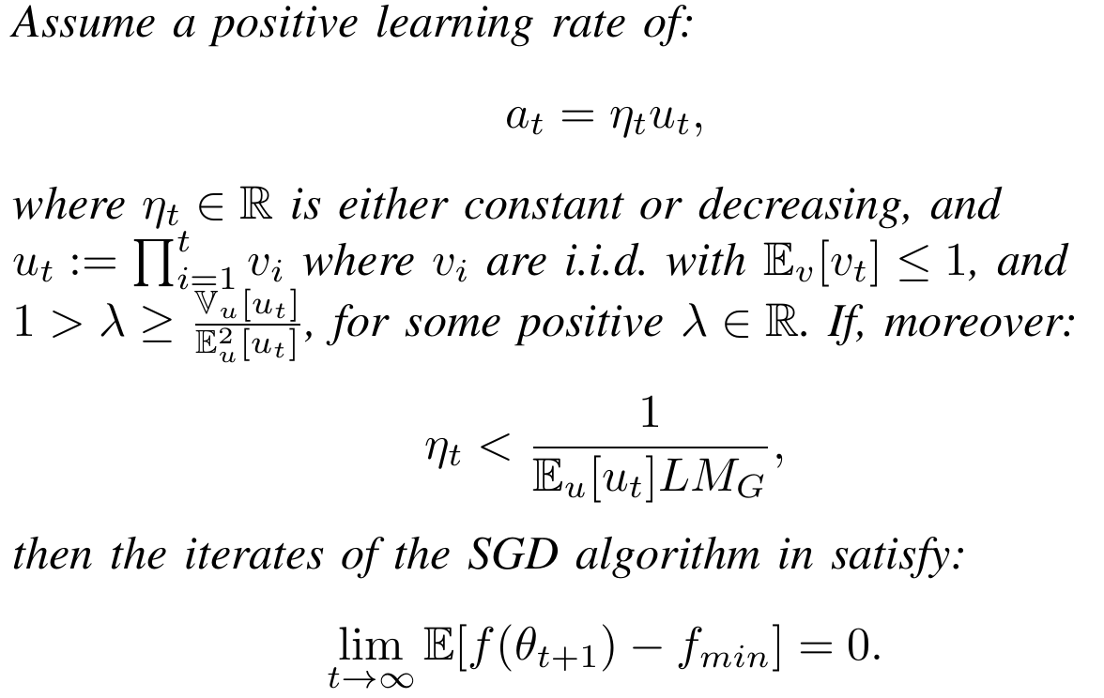
Convergence of MSLR-with-memory SGD
Smoothness constant:
Convexity constant:
Bounded gradients constants:
Theorem 1: Convergence of MSLR-w/-memory SGD

Slide 18
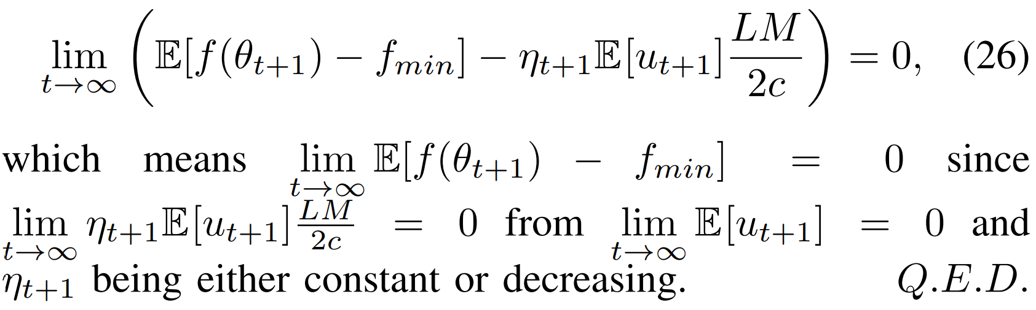
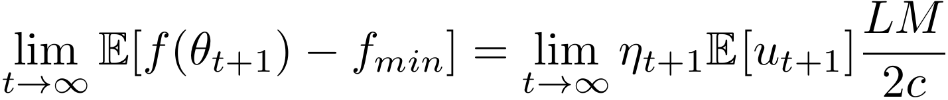
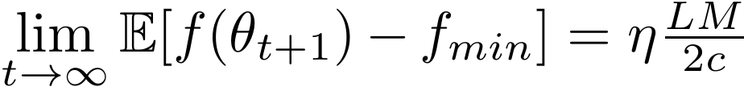
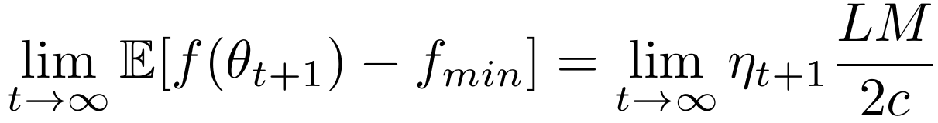

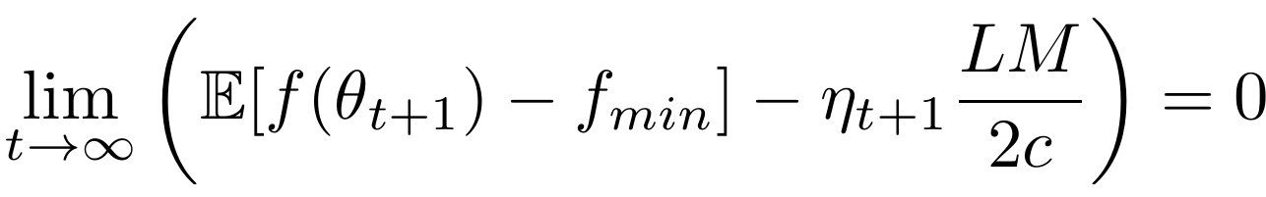
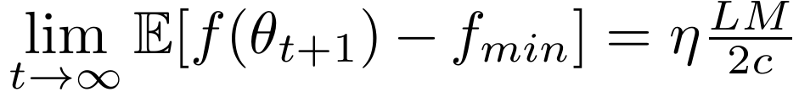
Convergence of MSLR-with-memory SGD

Slide 19
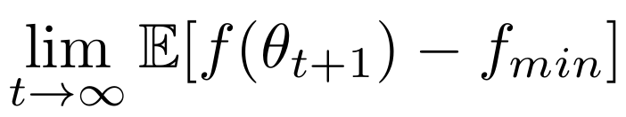
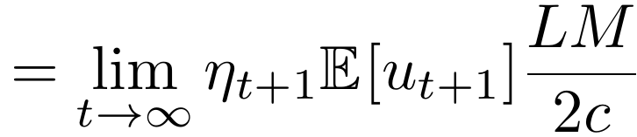
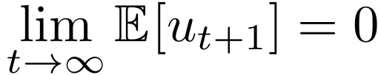
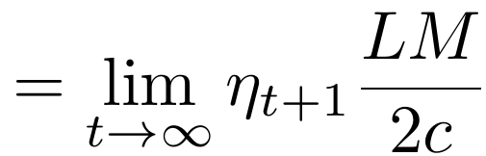
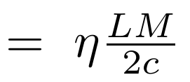
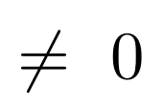
Convergence of MSLR-with-memory SGD
With a stochastic learning rate optimality gap = 0
With a deterministic learning rate optimality gap ≠ 0

Slide 20


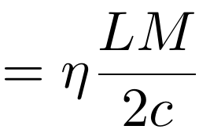
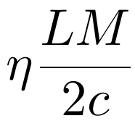
Convergence of MSLR-with-memory SGD:
For a decreasing stepsize , both stochastic and deterministic rates
yield
For a constant stepsize the deterministic learning rate yields optimality gap ≠ 0:
A stochastic learning rate yields optimality gap = 0, however!
The presence of noise "M" is canceled without using a decreasing stepsize! The stochasticity induced by the learning rate nullifies it!
The use of a constant stepsize allows for faster optimization
The actual learning rate of the algorithm remains nondecreasing
Showcases why being able to freely choose the stochasticity matters.

Slide 21
Convergence of MSLR-with-memory SGD:
For a decreasing stepsize , both learning rates yield optimality gap = 0
For a constant stepsize the deterministic learning rate yields optimality gap ≠ 0:
A stochastic learning rate yields optimality gap = 0, however!
The presence of noise "M" is canceled without using a decreasing stepsize! The stochasticity induced by the learning rate nullifies it!
The use of a constant stepsize allows for faster optimization
The actual learning rate of the algorithm remains nondecreasing
Showcases why being able to freely choose the stochasticity matters.

Slide 22
Convergence of MSLR-with-memory SGD
For a decreasing stepsize , both stochastic and deterministc rates
yield a zero optimality gap.
For a constant stepsize :
Deterministic
learning rate
The presence of noise "M" is canceled without using a decreasing stepsize! The stochasticity induced by the learning rate nullifies it.
The use of a constant stepsize allows for faster optimization.
The actual learning rate of the algorithm remains nondecreasing.
Showcases why being able to freely choose the stochasticity matters.

Slide 23
Convergence of MSLR-with-memory SGD
For a decreasing stepsize , both stochastic and deterministc rates
yield a zero optimality gap.
For a constant stepsize , the deterministic learning rate yields a nonzero optimality gap:
However, a stochastic learning rate yields a zero optimality gap!
The presence of noise "M" is canceled without using a decreasing stepsize! The stochasticity induced by the learning rate nullifies it.
The use of a constant stepsize allows for faster optimization.
The actual learning rate of the algorithm remains nondecreasing.
Showcases why being able to freely choose the stochasticity matters.

Slide 24
Stochastic Learning Rate Advantage
1) For a decreasing stepsize , both learning rates yield optimality gap=0.
2a) For constant stepsizes , deterministic learning rates yield optimality gap ≠0:
2b) However, a stochastic learning rate yields a zero optimality gap!
The presence of noise "M" is canceled without using a decreasing stepsize! The stochasticity induced by the learning rate nullifies it!
The use of a constant stepsize allows for faster optimization. The actual learning rate of the algorithm remains nondecreasing.
Showcases why being able to freely choose the stochasticity matters.

Slide 25
Convergence of MSLR-with-memory SGD
The optimality gap is zero for the former case regardless of whether a fixed or a decreasing stepsize is used, and nonzero for the latter. This improvement is due to the memoryful property of MSLR-with-memory, since for a memoryless MSLR (including RMSLR), the optimality gap for fixed stepsizes would remain nonzero [13].
The reason is that, in the latter case, the presence of noise (M ̸= 0) causes the optimality gap to be nonzero, since the expected objective values do not converge to the minimizer but to a noise-dependent neighborhood of it. However, a stochastic learning rate injects its SF to the optimality-gap expression and directly controls the gap. Therefore, if appropriately chosen, the SF is able to cancel the effects of the noise and guide the iterates through this neighborhood towards the minimizer. Mathematically, this is observed in equation (26) where the SF expectation causes the optimality-gap to convergence to zero. For a deterministic learning rate, this added degree of freedom of controlling the limiting value of the optimality gap through the SF is absent. This shows the importance of being able to freely choose the properties of the learning-rate randomness, similarly to the stochastic-learning rate schemes introduced in this work.

Slide 26
Online learning
Regret up to timestep T:
Define the online algorithm:
Where is the projection of on .

Slide 27
Convergence of online MSLR SGD
Bounded gradient norm constant:
Bounded diameter constant:
Theorem 3: Decreasing stepsize online MSLR SGD
Decreasing stepsize:
Bounded stochasticity factor:
Learning rate:
with
Then:
This means:

Slide 28
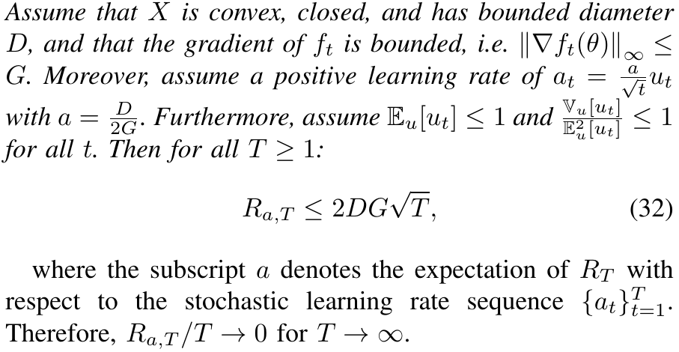

Convergence of online MSLR-w/-memory SGD
Theorem 2: Convergence of Online MSLR-w/-memory SGD​
Stochastic learning rate preserves the expected regret rate of the regret
bounds: , as in the deterministic case.

Slide 29
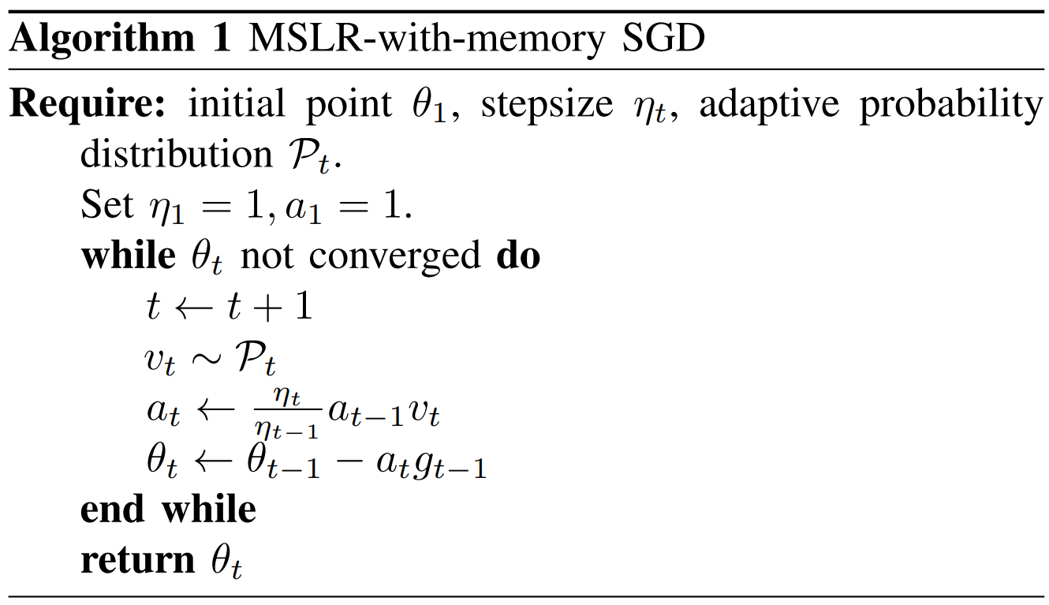


Experiments
β-Resetting-Uniform-Multiplicative-SLR-w/-memory:​

Slide 30
Experiments

Slide 31
The algorithm MSLR-with-memory SGD:
Not practical since q_{t} needs to store an ever-increasing number of variables – leads to memory issues

Slide 32
In Practice:
Minimal added cost by the MSLR-w/-memory scheme

Slide 33
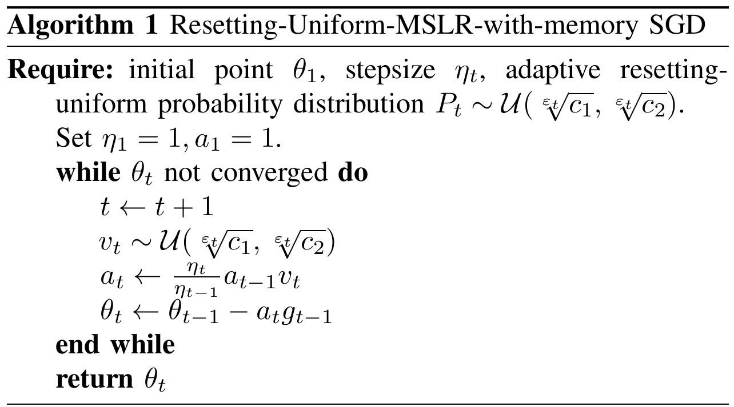
The algorithm RUMSLR-w/-memory SGD:
In this paper, the distribution resets according to :

Slide 34
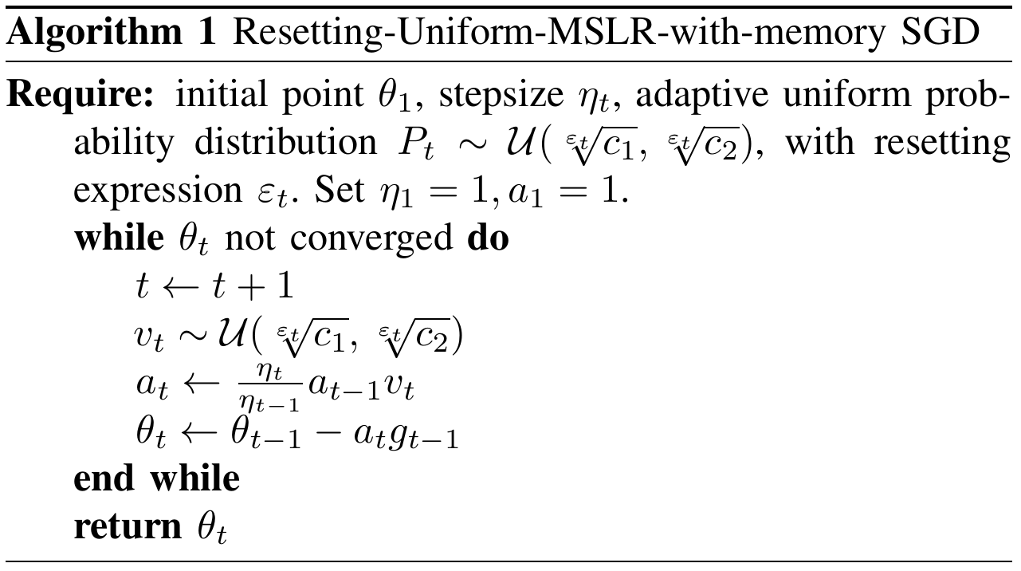
The algorithm RUMSLR-w/-memory SGD:
This paper:
Case when
and

Slide 35
Example of a Resetting-Uniform Stochasticity Factor: c₁=0.8, c₂=1.2, β=100.
Then
(Recall)

Slide 36
The algorithm RUMSLR-w/-memory SGD:

Slide 37


Experiments
Minimize training cross-entropy loss of neural networks for MNIST, CIFAR-10 and CIFAR-100.
Compare optimization performance between deterministic- and stochastic-learning-rate schemes.
Optimizers: SGD, and two momentum versions. ADAM and derivatives (AMSGRAD ADAMW).
Hyperparameters such as stepsizes, momentums are chosen via grid search for each algorithm.
All plots concern the average performance over 20 runs with different random seeds so that any observed optimization gains will not be due to an advantageous initial point of a single run, but because of the specific learning rate.
Other experimental details:
Stochastic learning rate for experiments: β-RUMLSR-w/-memory.
Hyperparameters: resetting parameter β = 100, c1, c2 = 0.7 and 1.3 for MNIST; 0.8 and 1.2 for CIFAR-10; 0.9 and 1.1 for CIFAR100 (AMSGRAD uses 0.85, 1.15), batch size = 128.
MNIST: logistic regression and diminishing stepsize . CIFAR-10 and CIFAR-100: Pytorch's ResNet18 and fixed stepsize .
Fixed Stepsizes: SGD: 0.1, both SGD-with-momentum: 0.01, all ADAM-related algorithms: 0.001.

Slide 38
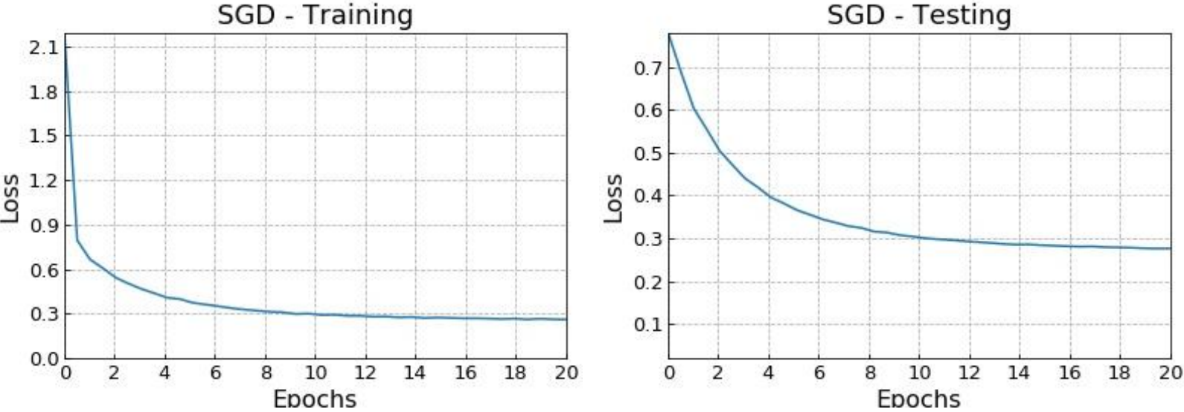

Results - MNIST
Plots verify convergence of the SGD algorithm using a stochastic learning rate, in specific β−RUMSLR-with-memory, in a convex setting by using logistic regression.

Slide 39
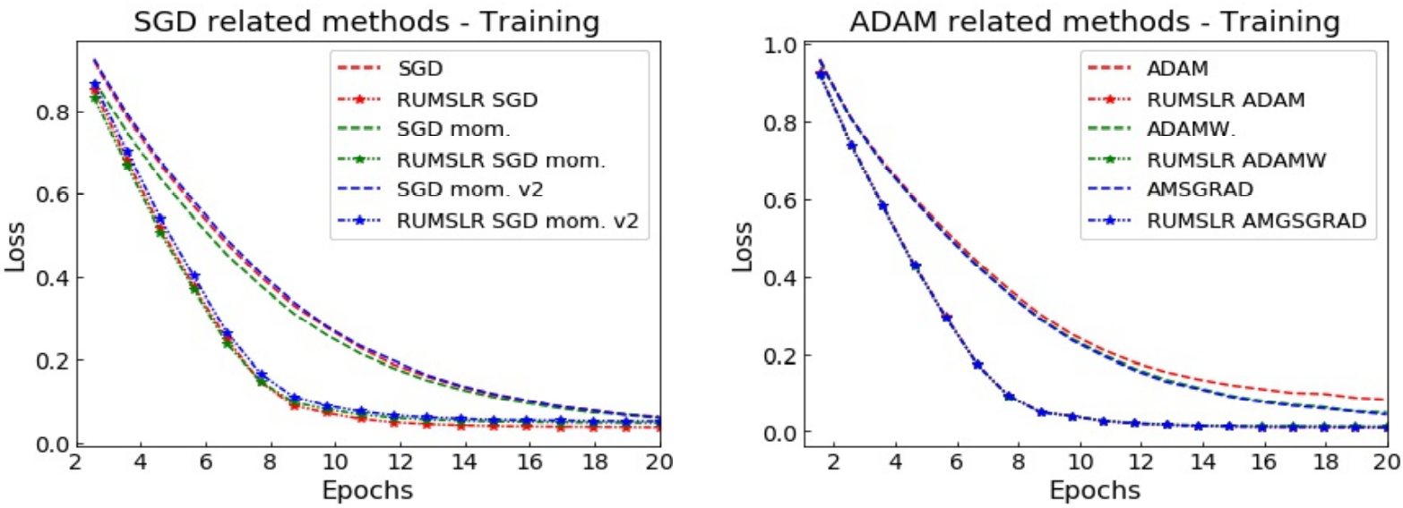
Results – CIFAR-10
Plots illustrating β-RUMSLR-with-memory (* starred) and deterministic learning rate (- - dashed) for CIFAR-10.
The stochastic learning rate demonstrates significantly faster convergence compared to a deterministic learning rate. The minimization performance for CIFAR-10 is greatly enhanced by employing β-RUMSLR.

Slide 40
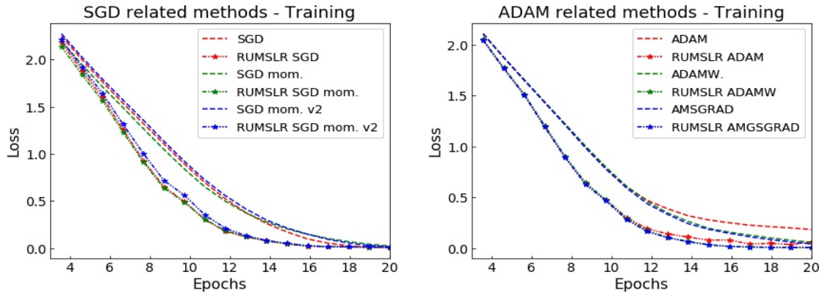
Results – CIFAR-100
Plots illustrating β-RUMSLR-with-memory (* starred) and deterministic learning rate (- - dashed) for CIFAR-100.
The minimization performance for CIFAR-100 is greatly enhanced by employing a stochastic learning rate compared to a deterministic learning rate.

Slide 41
Results – CIFAR-100
Plots illustrating β-RUMSLR-with-memory (* starred) and deterministic learning rate (- - dashed) for CIFAR-100.
The minimization-performance for CIFAR-100 is greatly enhanced by employing a stochastic learning rate compared to a deterministic learning rate.

Slide 42
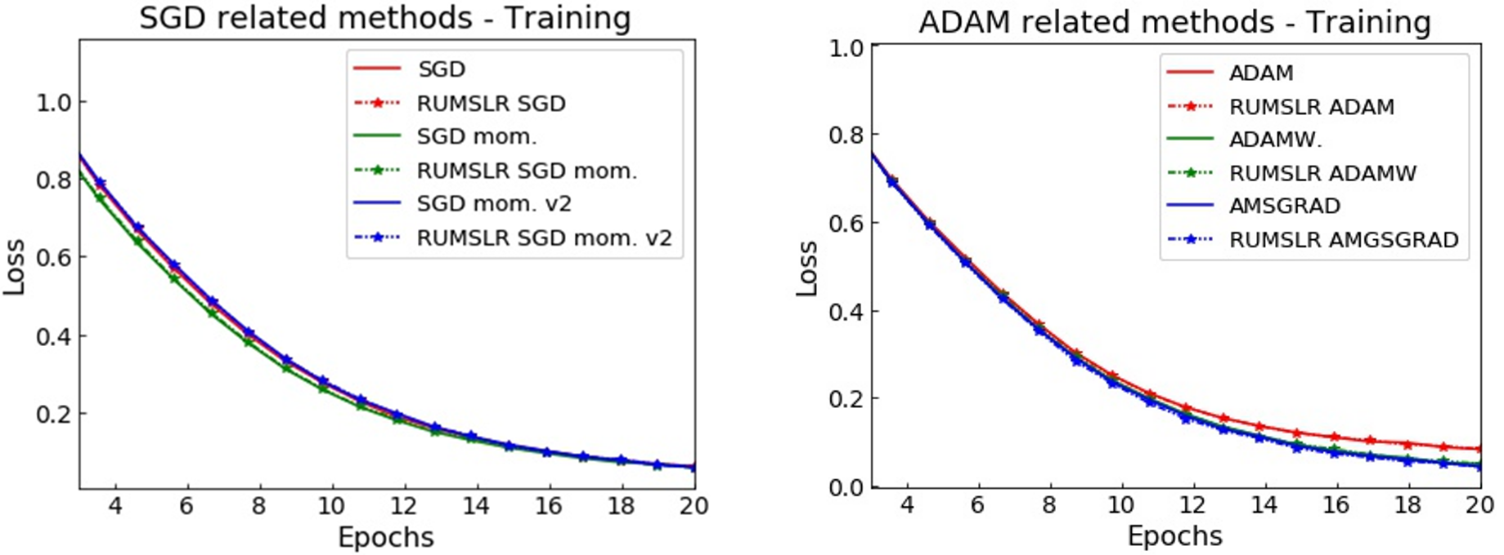
Extra – CIFAR-10
Q: How do we know that the observed performance increase is due to the Memory component of the stochastic learning rate, and not just due to its Resetting nature?
A: The Resetting-Multiplicative-Stochastic-Learning rate without Memory fails to produce noticeable gains!
Unifrom-SLR: Memory + Resetting > Memory + NonResetting > NoMemory + Resetting

Slide 43
Extra – CIFAR-10
Q: How do we know that the observed performance increase is due to the Memory component of the stochastic learning rate, and not just due to its Resetting nature?
A: The Resetting-Multiplicative-Stochastic-Learning rate without Memory fails to produce noticeable gains!
(No memory: q_{t} = v_{t} )

Slide 44
Extra 2 – CIFAR-10
Q: How do we know that the observed performance increase is due to the Memory component of the stochastic learning rate, and not just due to its Resetting nature?
A: The Resetting-Multiplicative-Stochastic-Learning rate without Memory fails to produce noticeable gains!

Slide 45
Conclusions
This work introduced learning-rate schemes that make the learning rate stochastic by multiplicatively equipping it with a function of random variables, which are coined stochastic factors.
Convergence of the SGD algorithm employing stochastic learning rate schemes with memory of past stochastic factors was theoretically analyzed and compared with known results for the algorithm’s deterministic-learning-rate version.
Empirical results on popular algorithms demonstrated noticeable increase in optimization performance, presenting stochastic-learning-rate schemes as a viable option for enhancing performance.

Slide 46
Directions for future work
In-depth empirical testing performance studies.
Convergence analysis of algorithms except SGD.
Investigation of the effect of various stochastic factor distributions and hyperparameters on algorithm performance.
Almost-surely convergence rate analysis.

