Slide 1




Task 3: Predictive Models
Machine Learning Techniques
Pablo Alcázar Morales
Diego Pedregal Hidalgo
Alberto Velasco Mata

Slide 2

First Iteration
Feature Selection
No clue on how physical sensors are affected on attacks
Initially, all “meaningful” features selected
UserID
UUID
Version
TimeStemp
Gyroscope (X mean, Z mean, z-x cov, z-y cov)
Magnetic Field (X mean, Z mean, z-x cov, z-y cov)
Pressure (mean)
Linear Acceleration (X mean, Z mean, z-x cov, z-y cov)
attack
ATTACK
80%
Train: 30 simples
Test: 8 samples
20%
80%
NO-ATTACK
Train: 19584 simples
Test: 4896 samples
20%
Machine Learning Techniques

Slide 3
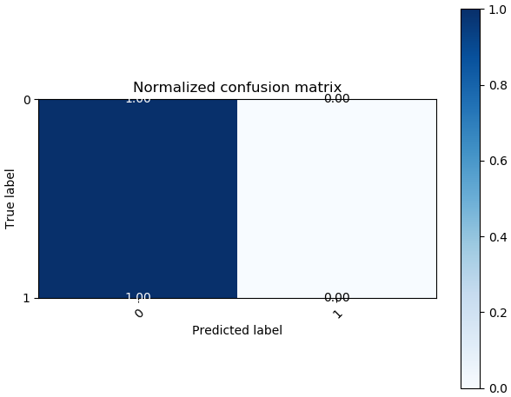

First Iteration
Naïve Bayes
Tried different classifier models
All give really bad results due to unbalanced data
All are black :D
Accuracy: 99.84%
Machine Learning Techniques

Slide 4
First Iteration
Decision Trees
Unbalanced data leads to practically the same result
No attack
No attack
No attack
No attack
Accuracy: 99.84%
Machine Learning Techniques

Slide 5
First Iteration
Random Forests
Once again…
It’s time to
BALANCE
Accuracy: 99.84%
Machine Learning Techniques

Slide 6
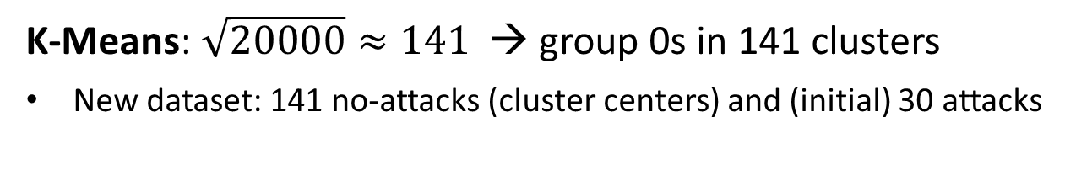
Second Iteration
Improvement
Balance Dataset
Clustering 0s
K-Means: $\sqrt{20000}≈141$ → group 0s in 141 clusters
New dataset: 141 no-attacks (cluster centers) and (initial) 30 attacks
Better results with this one
Random selection of 0s
Downsample no-attacks by randomly selecting samples
New dataset: ~200 no-attacks and 30 attacks
Machine Learning Techniques

Slide 7
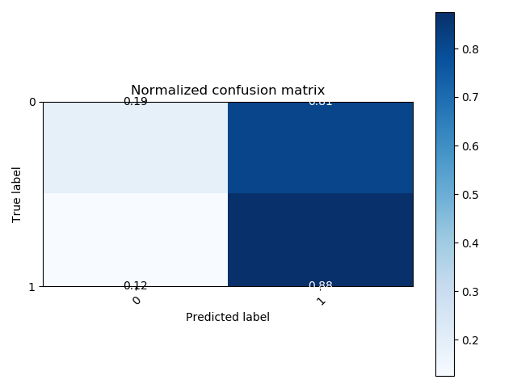
Second Iteration
Naïve Bayes
Tends to predict attacks
However, it seems like balancing the data did its job
Hm…
Accuracy: 18.8%
Machine Learning Techniques

Slide 8
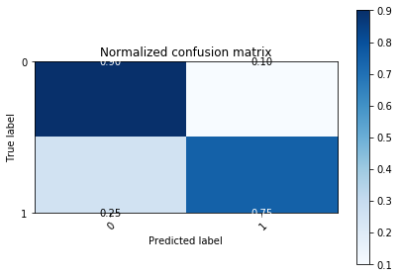
Second Iteration
Decision Trees
75% of attacks in test are detected
In this cases it might be better to have false positives rather than false negatives
Maybe Random Forests can do better (as they usually do…)
Accuracy: 90.07%
Machine Learning Techniques

Slide 9
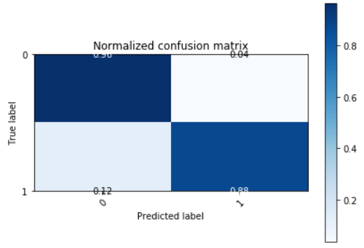
Second Iteration
Random Forests
They do!
 |  | Predicted
 |  | 0 | 1
Actual | 0 | 4716 | 180
 | 1 | 1 | 7
Accuracy: 96.0%
Machine Learning Techniques

Slide 10
Observations
Balancing the dataset was the key
Random Forest gives the best results
However, it might be interesting to obtain more false positives if that leads to detect all attacks
To do so, we could try to select those features RF gives more relevance (third iteration focusing on feature selection)
Machine Learning Techniques

