Slide 1




Task 3: Predictive Models
Machine Learning Techniques
Pablo Alcázar Morales
Diego Pedregal Hidalgo
Alberto Velasco Mata

Slide 2

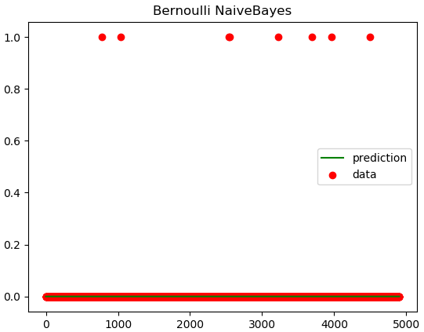
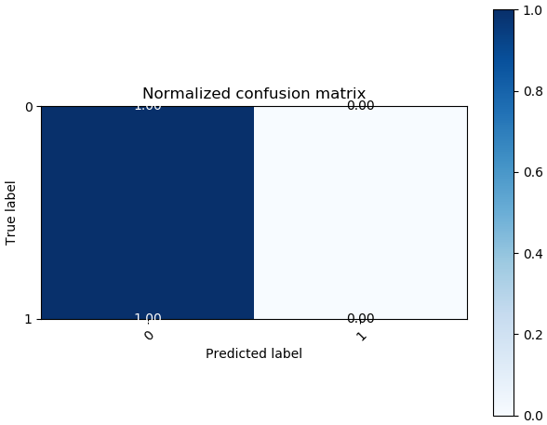
First Iteration
Naive Bayes
Accuracy: 0.99836867862969
Machine Learning Techniques

Slide 3
First Iteration
Decision Tree
Machine Learning Techniques

Slide 4
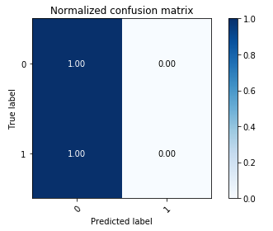
First Iteration
Ensembles
Random Forest
 |  | Predicted
 |  | 0 | 1
Actual | 0 | 4896 | 0
 | 1 | 8 | 0
Accuracy: 0.99836867862969
Machine Learning Techniques

Slide 5
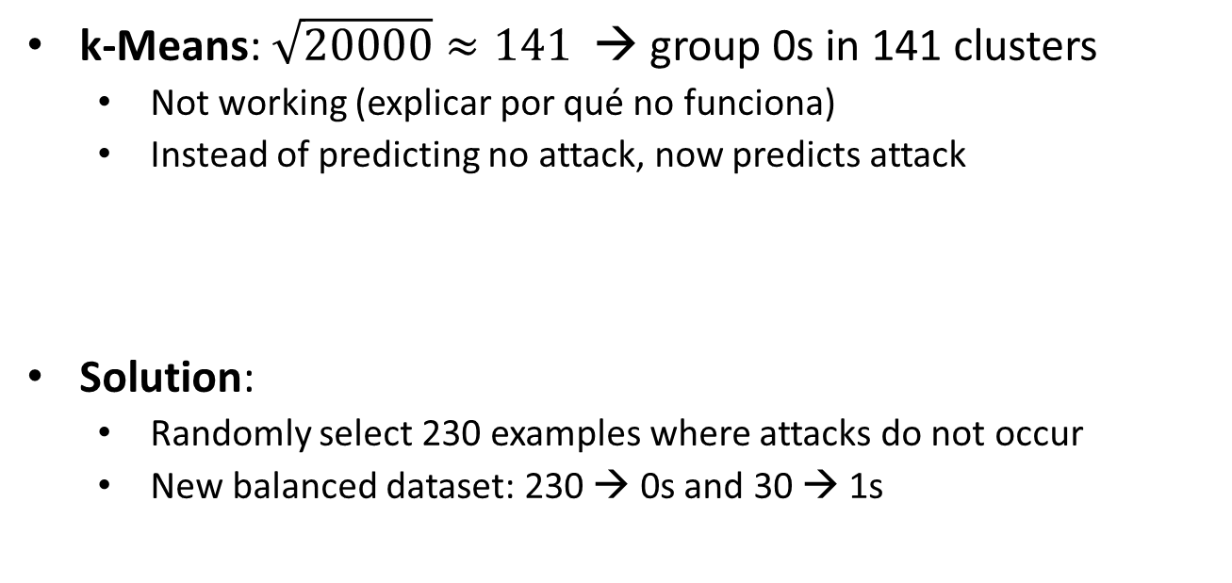
Improving
Balancing dataset
k-Means: $\sqrt{20000}≈141$ → group 0s in 141 clusters
Not working (explicar por qué no funciona)
Instead of predicting no attack, now predicts attack
Solution:
Randomly select 230 examples where attacks do not occur
New balanced dataset: 230 → 0s and 30 → 1s
Machine Learning Techniques

Slide 6
Second Iteration
Naive Bayes
No sé qué poner aquí porque el plot del naïve bayes balanceado sale con todas las rayas y queda feísimo
Accuracy: 0.99836867862969
Machine Learning Techniques

Slide 7
Second Iteration
Decision Tree
Poner plot del decision tree (matriz confusion)
Machine Learning Techniques

Slide 8
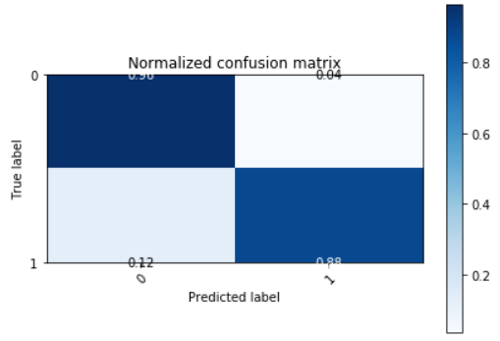
Second Iteration
Ensembles
Random Forest
 |  | Predicted
 |  | 0 | 1
Actual | 0 | 4713 | 183
 | 1 | 1 | 7
Accuracy: 0.96
Machine Learning Techniques

Slide 9
Observations
Balanced model much better
Predicts almost all the attacks
It is much better to obtain false positives rather tan not detecting any of the attack situations
Machine Learning Techniques

