Slide 1
More VITEK Analysis

Slide 2
Goals
Run some tests to increase knowledge of VITEK-2
  Sources of variation
  Non-biological effects on VITEK readings
  Predictive power of white cards tests

Slide 3
Sources of Variation
What are the sources of variation in card reads?
Cards were run with a few different conditions to investigate what physically introduces error
  White test cards (no tape, no media)
  Engineering cards (tape but no media)
  Unfilled production cards
  Filled production cards
  Filled production cards with cut straws (no vacuum seal)
  Filled production cards, Sealed, but with the heater turned of
  Normal production conditions (filled, sealed, heated)
Each condition run for multiple runs and 7 reads each

Slide 4
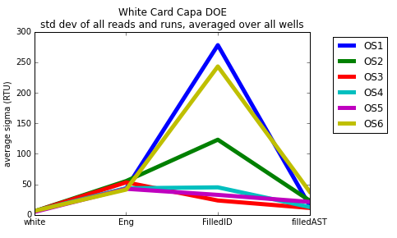
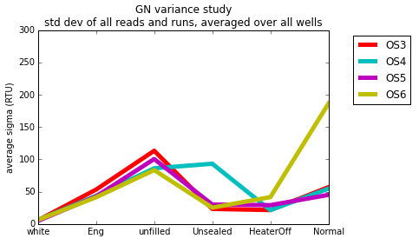
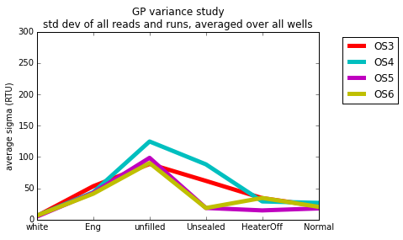
variance between card runs
600nm, GN, average std dev

Slide 5
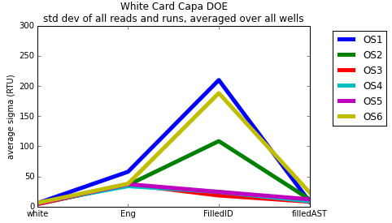
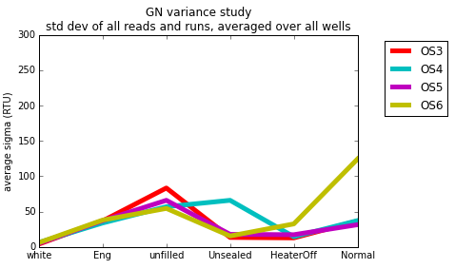
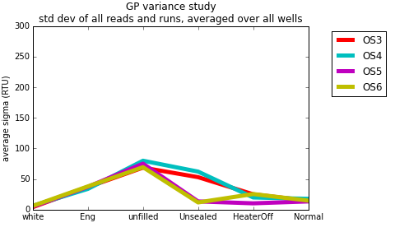
variance between card runs
560nm, GN, average std dev

Slide 6
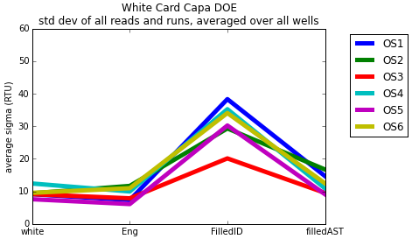
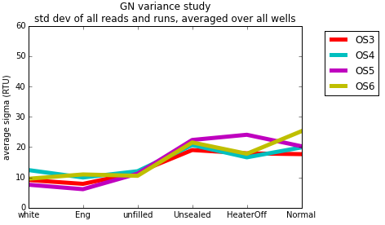
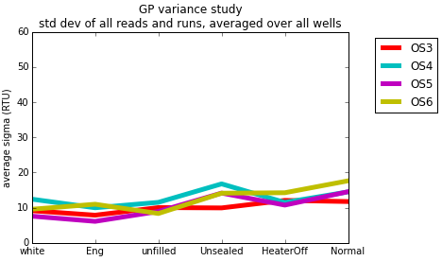
variance between card reads
600nm

Slide 7
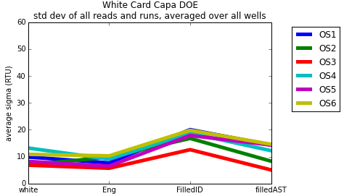
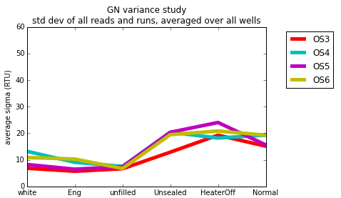
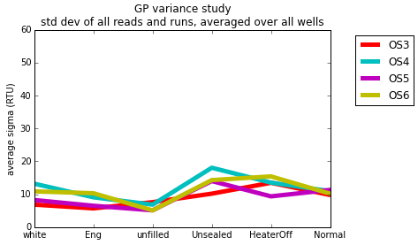
variance between card reads
560nm

Slide 8
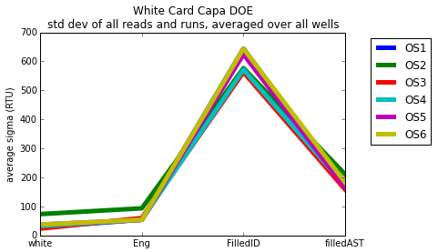
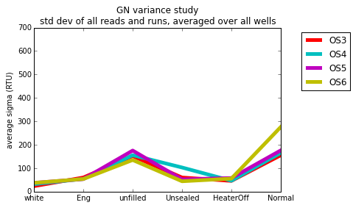
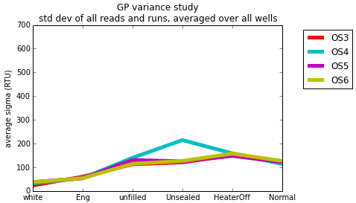
Total variance
600nm

Slide 9
Total Variance
560nm

Slide 10
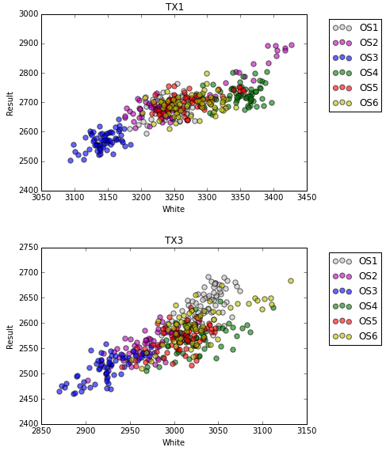
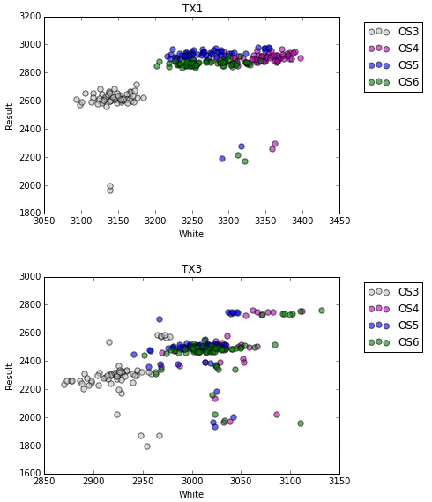
White Card predictive power first look ID
Eng Cards
GP-AST

Slide 11
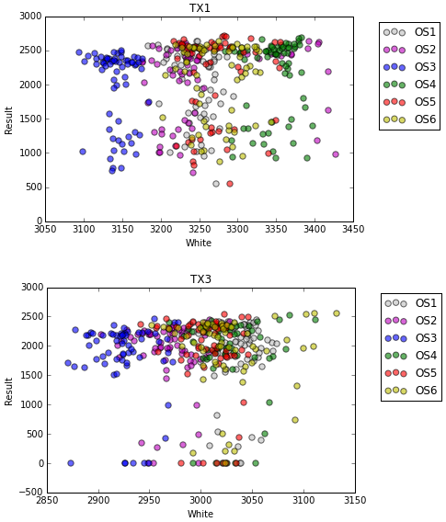
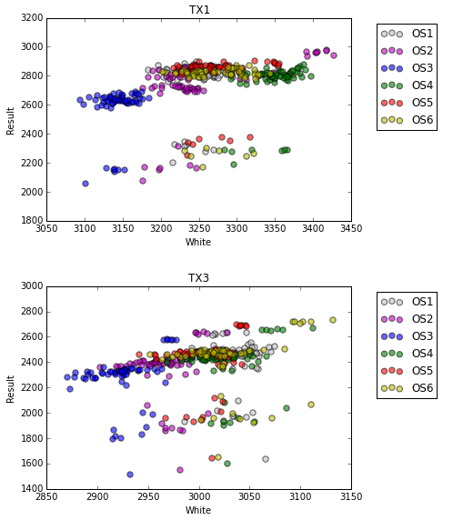
White Card predictive power first look ID
ID AST-GN
AST -GN

Slide 12
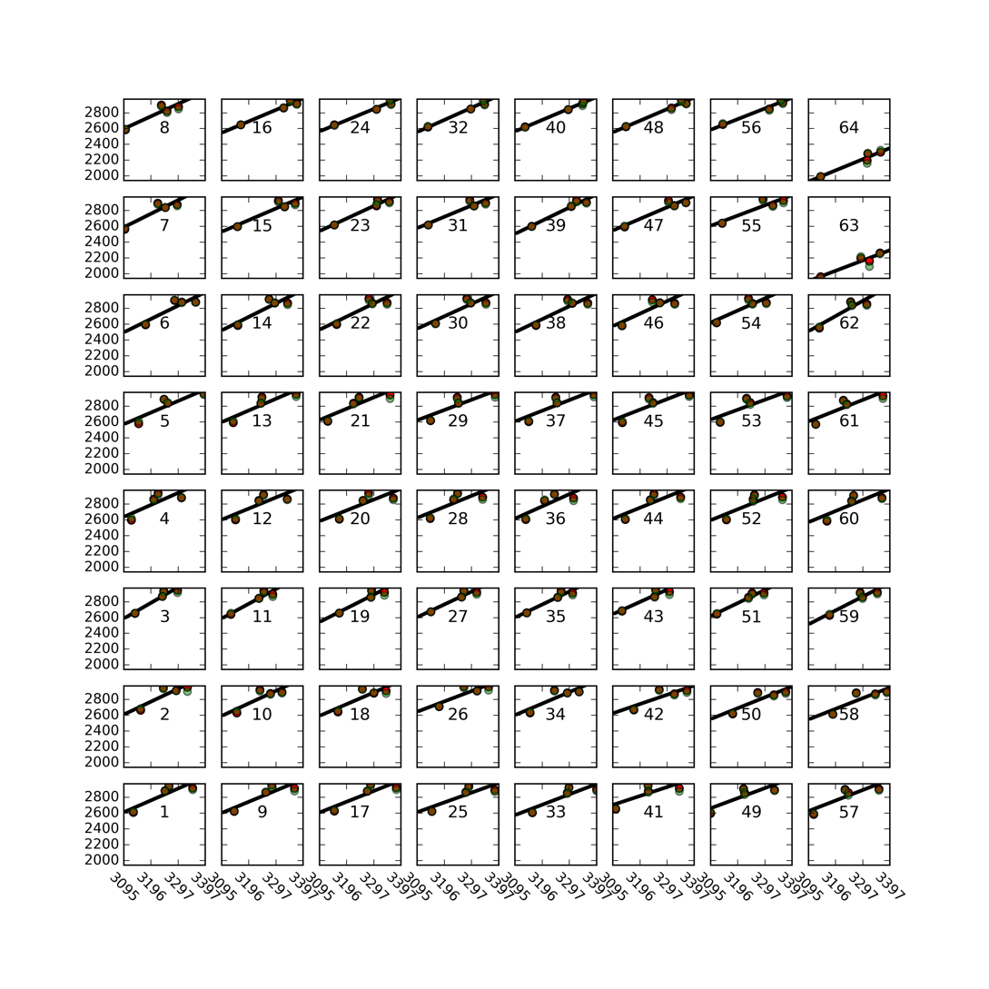
By wellAST GP, training and test set TX1

Slide 13
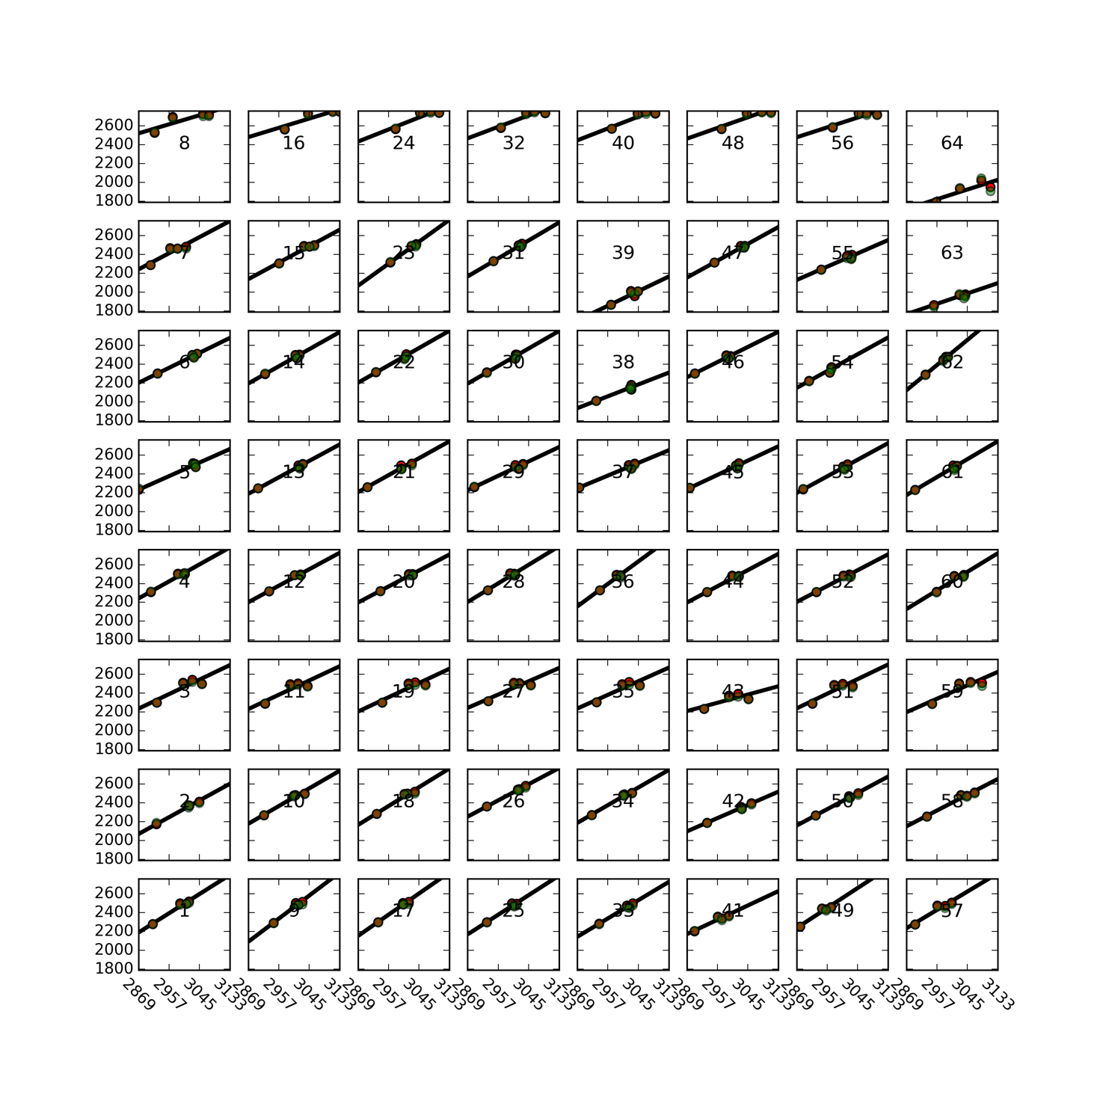
By wellAST GP, training and test set TX3

Slide 14
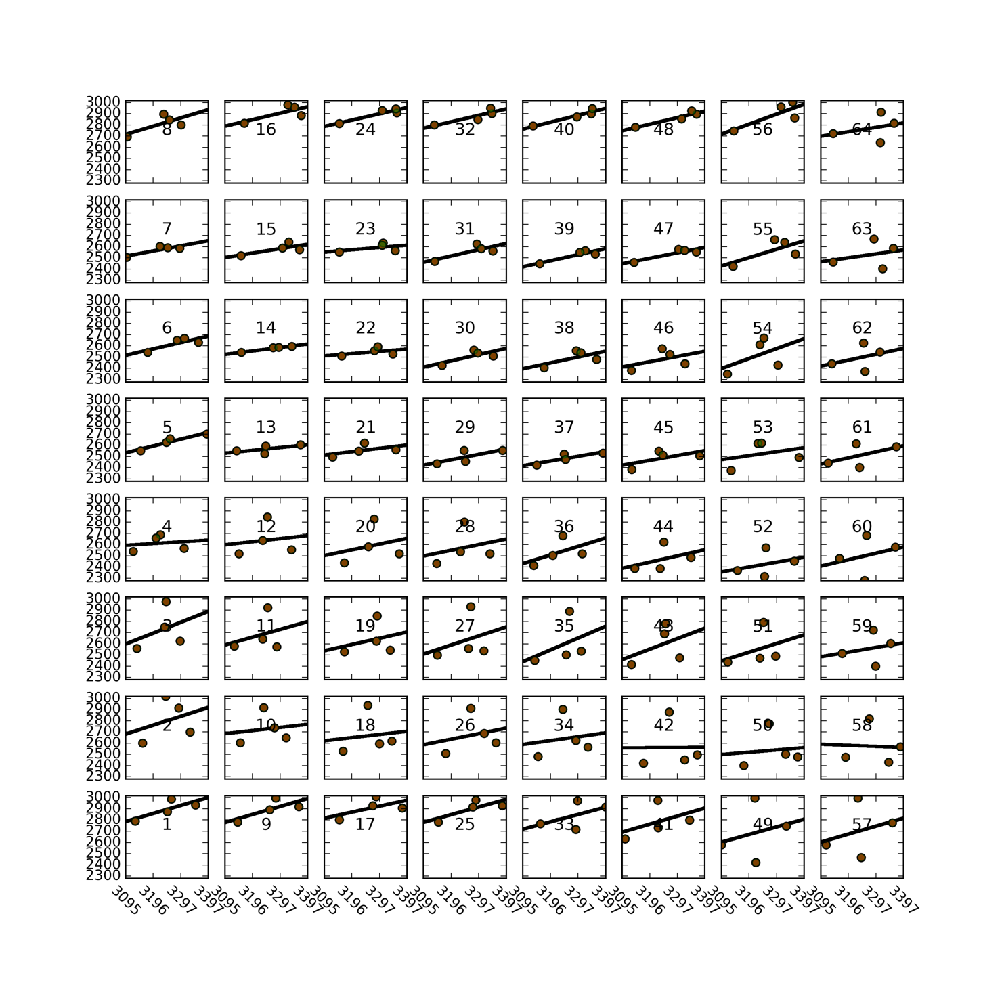
By well AST-GN, training and test set TX1

Slide 15
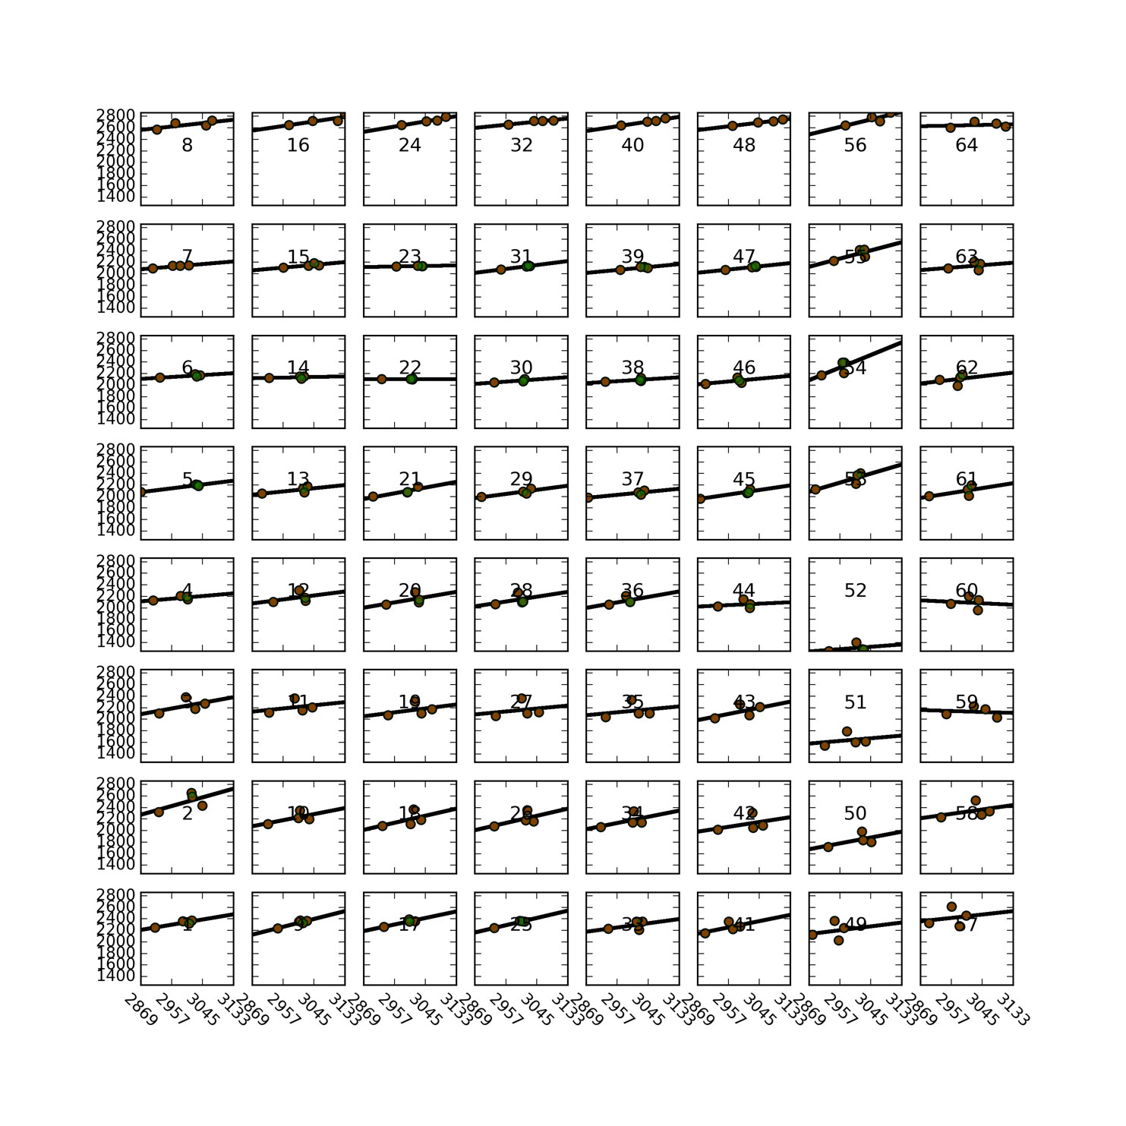
By well AST-GN, training and test set TX3

Slide 16

Non-biological dynamics

Slide 17
GP

