Slide 1
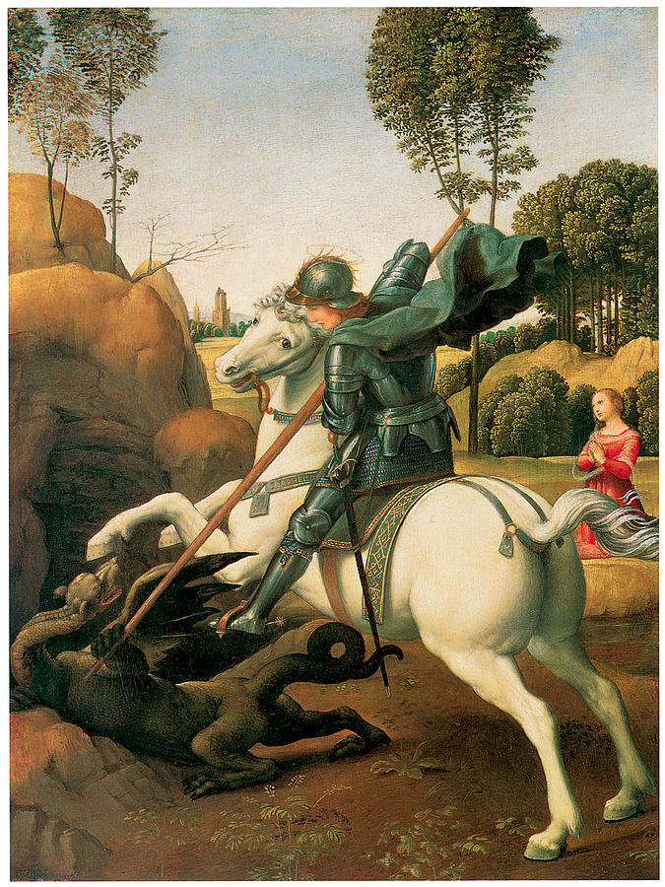
Applied Informatica in Python
How to apply Python for data processing and analysis

Slide 2
Previous experience
What have you programmed?
In what environment?
What do you want to achieve?

Slide 3
How did I learn?
Natural language vs. Computer language
  Fluency, struggles and immersion
Documentation and … BOOKS
Applying knowledge
Repeat

Slide 4
What is Python?
90’s lang by Guido van Rossem
  Centrum van Wiskunde en Informatica (Amsterdam)
  https://nl.wikipedia.org/wiki/Python_(programmeertaal)
High-level language
Interpreted (vs. compiled languages like C/C++, Rust, Go)
Dynamically typed ( … vs. C/C++, Rust, Go)
Garbage collection ( … vs … whatever you get the point)

Slide 5
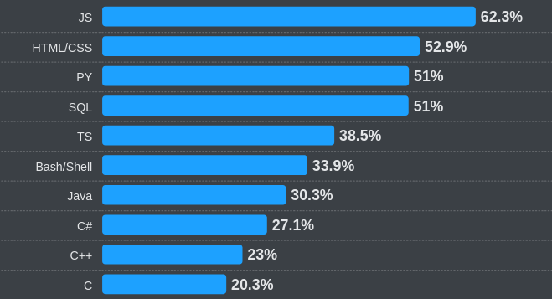

Why use Python?
Most used language, behind javascript
Ease of use
Plethora of packages through pip
  Numpy, Pandas, Matplotlib, Jupyter
Who cares about performance?

Slide 6
WTF is an interpreter??
Direct translation of characters into machine code
Line by line execution
Variables in runtime
Interactive mode

Slide 7
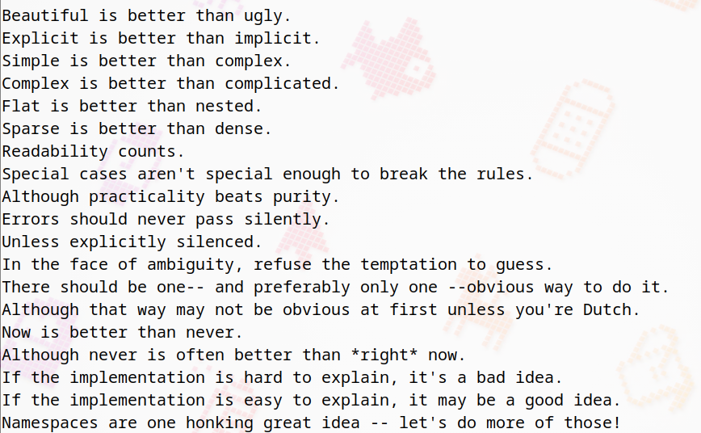
How to use Python?
Loops
  Zero indexed ...
Functions
Variables
Operators

Slide 8
Notebook examples
Printing
Control flow
Functions
Expressions vs statements
Set, list, tuple
Arithmetic

Slide 9
Installing the goods
Install python3
Install needed packages in a venv
  Numpy, matplotlib, jupyter, pandas
Install Visual Studio Code
  Including Python and Jupyter extensions (in the sidebar of VSC)
Read the official python tutorial introduction (§3.1-3.2)
  https://docs.python.org/3/tutorial/introduction.html
Take a look at W3Schools
  https://www.w3schools.com/python/python_intro.asp

Slide 10
How to make a .venv
“$” indicates that this is from the commandline
$ python -m venv .venv
$ source .venv/bin/activate
$ pip install numpy pandas matplotlib jupyter
$ deactivate
This will make all your packages be installed in a directory, instead of system wide (sys wide is HEAVILY discouraged)

Slide 11
Further reading
Easy to understand, yet comprehensive python for beginners:
  https://python.swaroopch.com/
  Could-be-useful chapters: basics, operators and expressions, control flow, and functions
The official python documentation:
  https://docs.python.org/3/tutorial/index.html
  Very well rounded, 2.1 and chapter 3 are a good start
Link to notebook:

Slide 12
Further notes
Literature:
  https://wesmckinney.com/book/preliminaries
  Read §1.1-1.2 for an intro if you feel like it
Use LLM for exploration of concepts
  “What are the differences in ordering between set list and tuple. also give some coding examples”
  Don’t use for code completion
W3Schools for quick glancing
Codewars ...

