Slide 1
Predicting Tumor Mutational Burden from microRNA Expression Levels
Thomas Murray
Advisor: Owen Anderson

Slide 2
Introduction
Tumor Mutational Burden (TMB): total number of somatic mutations in a tumor per megabase (MB)
Suggested that TMB has potential to be used as a predictor for effectiveness of treatment with immune checkpoint inhibitors (ICI) in certain cancers
High TMB correlates to more effective treatment
Threshold of TMB >= 10 has been shown to be clinically significant in classifying tumors as high/low TMB
Current methods of calculating TMB rely on whole exome sequencing (very inefficient) or targeted sequencing panels (more efficient), but targeted sequencing panels struggle due to the limited amount of tumor DNA that is obtainable via biopsy
microRNAs (miRNAs) have been shown to be promising new methods of diagnosis and treatment in cancers
If accurate enough for clinical use, a TMB classifier (high/low) using miRNA expression data could allow more widespread use of TMB in deciding treatment options for patients, specifically ICI
This has been previously investigated by Lv et al. with promising results regarding non-small cell lung cancer
Our goal: attempt to reproduce Lv et al.’s findings and further investigate which miRNAs show significance in the classification of TMB
Notes:
Check point 4

Slide 3
Data
Data obtained from TCGA-LUAD
Only subjects with both mutation and miRNA expression data
Mutation annotation files (maf) used for calculating TMB
TCGAbiolinks package in R to determine total number of somatic mutations
Estimated 38MB per exome (same as referenced paper and others)
University of California – Santa Cruz XENA database used for miRNA expression values
2288 total miRNAs measured for each subject
1399 miRNAs with > 0.1 prominence within entire dataset
441 total subjects
Test/train split 286:155 (65:35)
Notes:
Log2 reads per million for miRNA units
Potential error w different test/train than paper

Slide 4
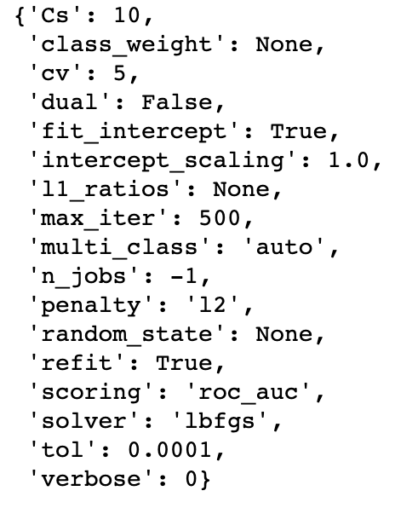
Methods
Two thresholds for TMB:
High TMB >= 10 (based on clinical relevance)
High TMB >= 4.3 (50:50 split within train dataset)
Two methods for miRNAs
Include all miRNA expression values as independent variables
Only include miRNAs which are not 0 at least 10% of the time (prevalence >= 0.1)
SKLearn LogisticRegressionCV
# of folds used in cross validation – 5
L2 penalty
Scoring – area under the curve (AUC)
Determine all miRNA with coefficient values >= 0.01 in each model
Notes:
L2: equal to the square of the magnitude of coefficients (removes a small percentage of weights at each iteration)

Slide 5
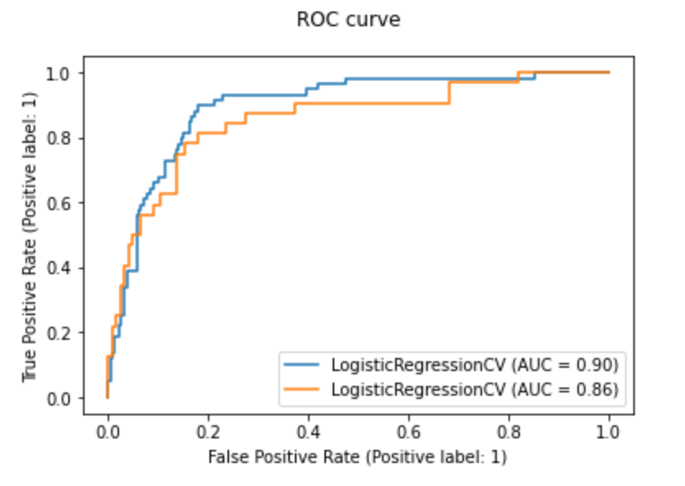
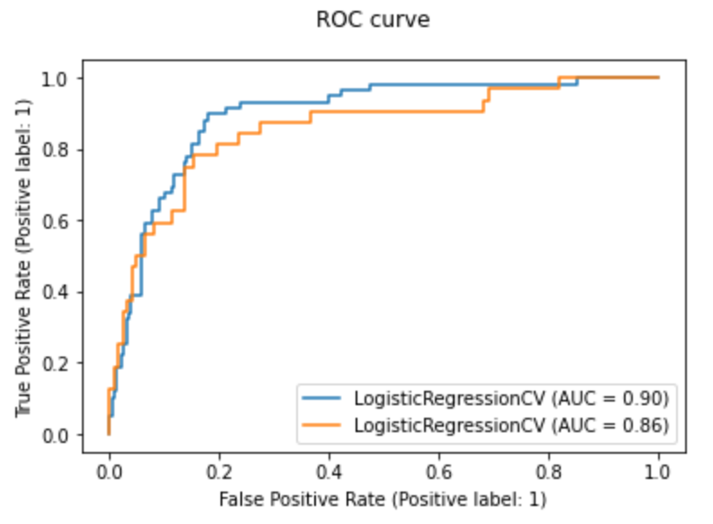
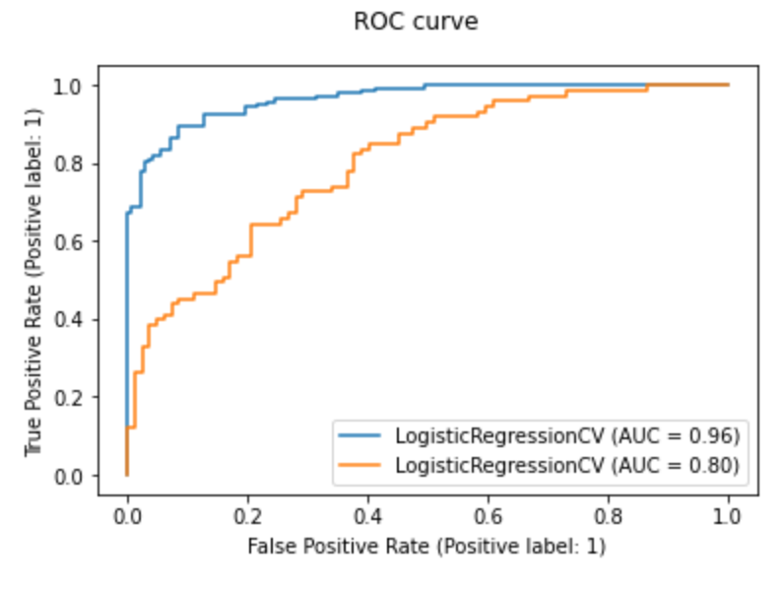
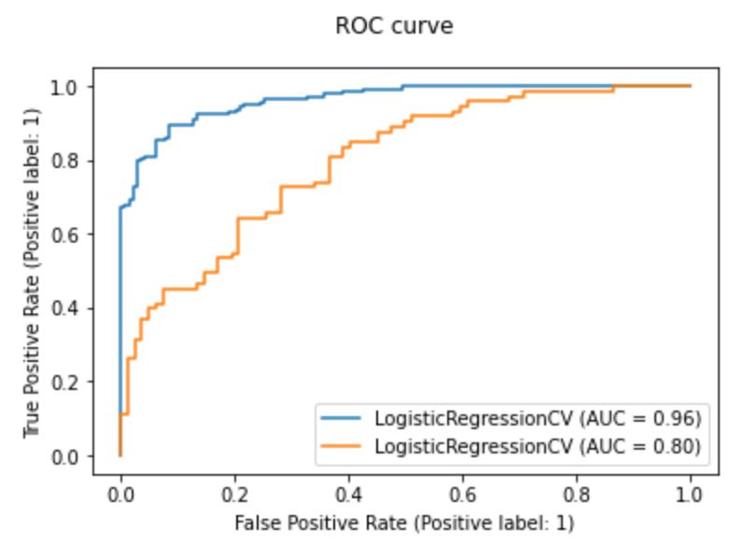
Results
Model 1: all miRNA values, high TMB >= 10
Model 2: miRNA values prev >= 0.1, high TMB >= 10
Model 3: all miRNA values, high TMB >= 4.3
Model 4: miRNA values prev >= 0.1, high TMB >= 4.3
Notes:
Paper referenced AUC: Train – 0.90, Test – 0.83

Slide 6
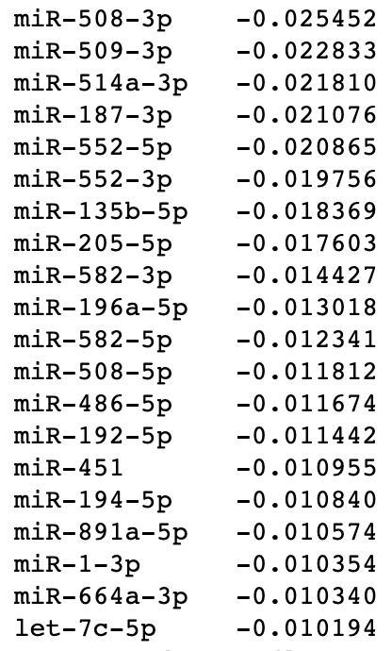
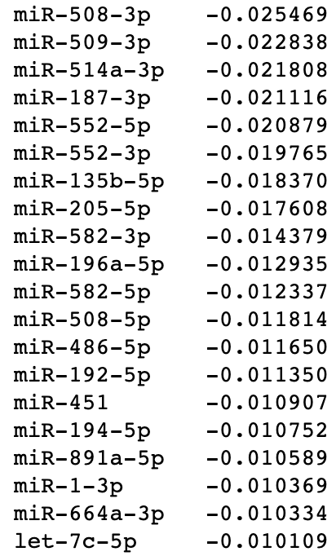
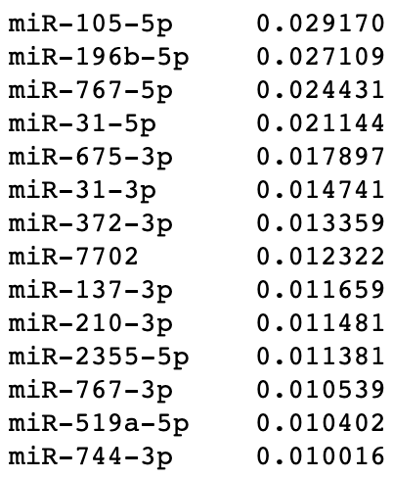
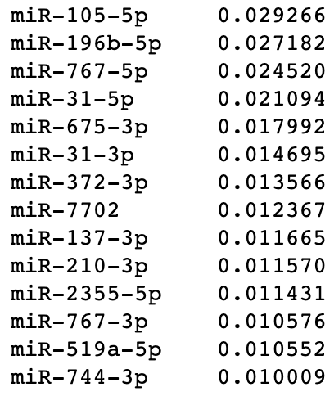
High significance miRNAs
Model 1
Model 2
Positive coefficients
Negative coefficients
Positive coefficients
Negative coefficients
Notes:
MLSeq

Slide 7
Next steps
Determine what, if any, clinical research there is regarding the high significance miRNAs determined in the models
Try random forest model to see if AUC or clinical usability can be improved
Use calibration curve to determine statistically optimally high/low threshold for classifier

