Slide 1
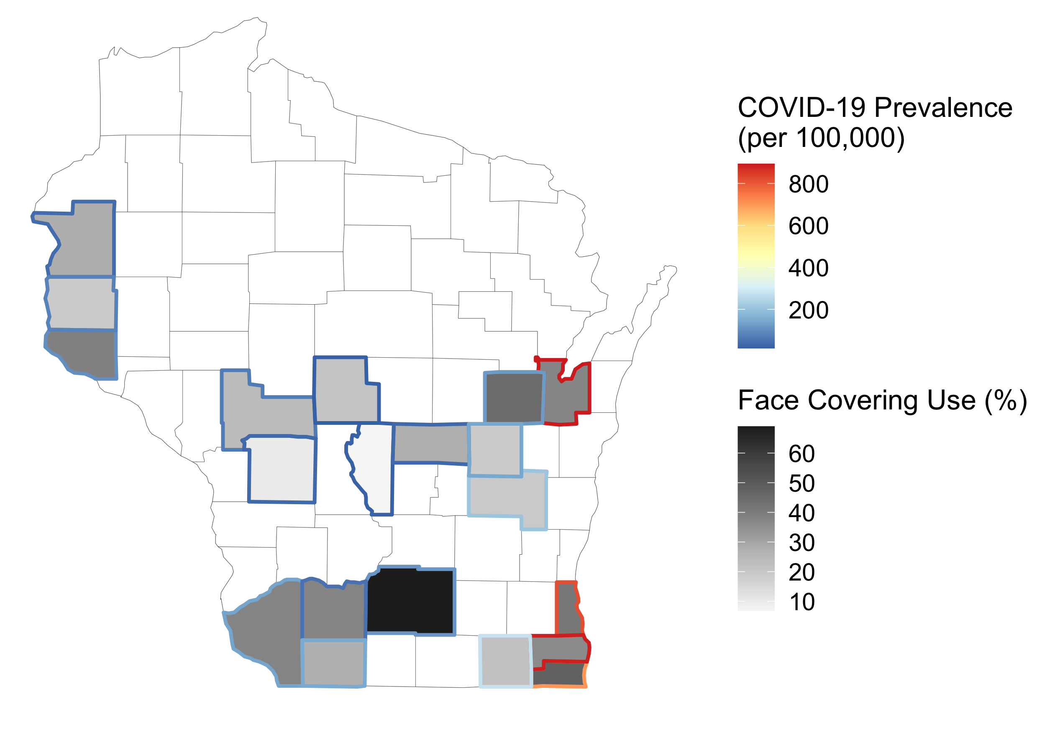
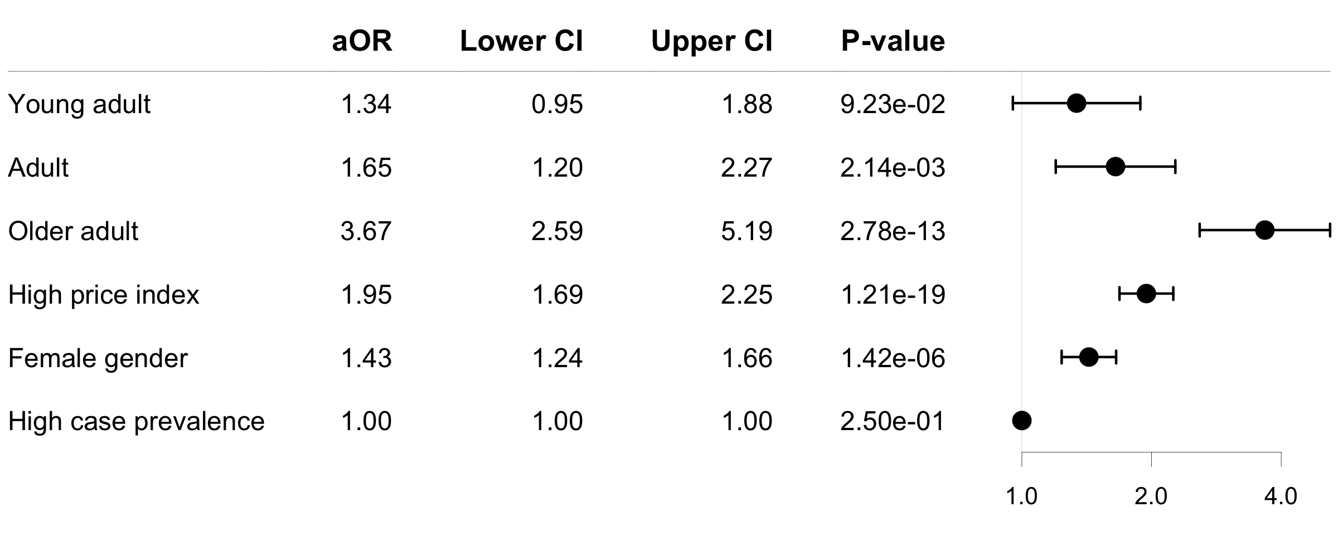
A
Outline
13
14
12
WI County
6
18
11
2
1. Adams
2. Brown
3. Dane
4. Grant
5. Iowa
6. Jackson
7. Kenosha
8. Lafayette
9. Milwaukee
10. Monroe
11. Outagamie
12. Pierce
13. Polk
14. Saint Croix
15. Racine
16. Waushara
17. Walworth
18. Wood
19. Winnebago
20. Fond du Lac
16
19
Fill
10
1
20
4
5
3
9
8
17
15
7
B
Favors Face Covering →
aOR (95% CI)

