Slide 1
TEAM DYNAMITE : FOOD ORDERING SYSTEM
Chloe Ho
Fernando Mendoza

Slide 2
Introduction
People have no time to go out and eat their favorite food at restaurant in these busy lives.
So many people prefer to order food online at their home or office
What we do
- Provides the menu online and customers can easily place the order by just click the mouse or by touching a button on their smartphones.
- Allows the user to select the desired food items from a list of available menu items provided by the restaurant.

Slide 3
Technology used:
Language: HTML, PHP, CSS, JavaScript
XAMPP
phpMyAdmin 4.8.5 – administrative tool for MySQL
PHPmailer – a library to send (transport) emails safely and easily via PHP
Notes:
We have used XAMPP which is a free and open source cross-platform web server solution stack. It comes with apache web server, mysql database, and php

Slide 4
Components
Multiple databases
User
Orders
Login page
Enter user ”EMAIL” && ”PASSWORD”
Registration page
Enter user data
Name
Email
location
Address
Phone number
Password
Confirmation
Verify account
Email verification after registration completed
Ordering page
Displays images of foods
Modify number of items to order
About page
Get into contact with us

Slide 5
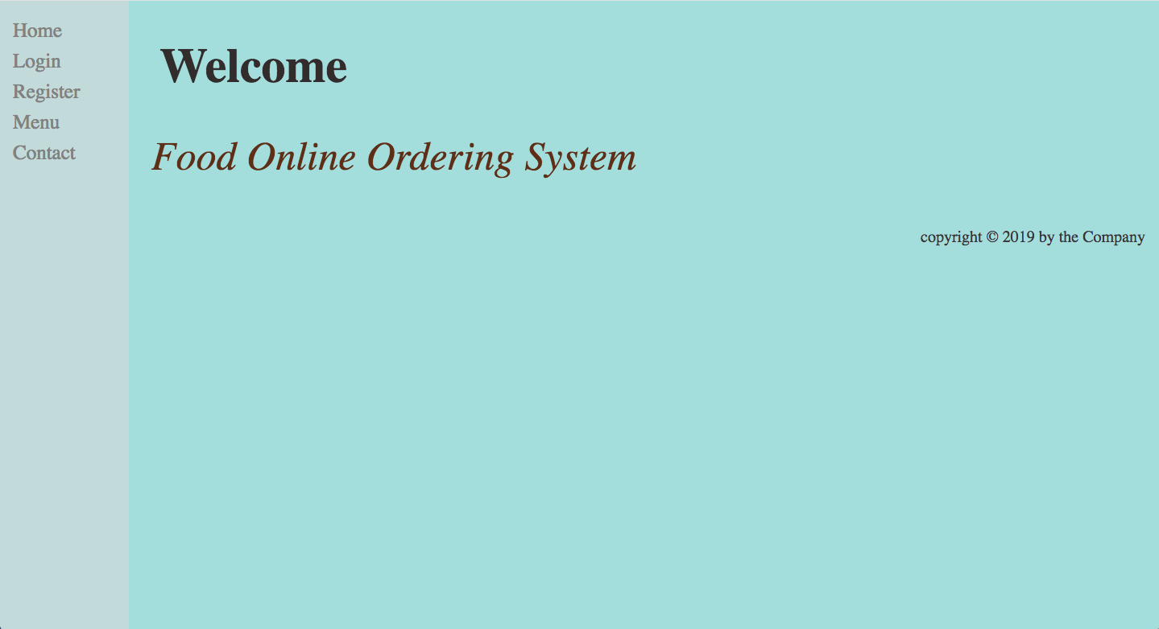

Slide 6
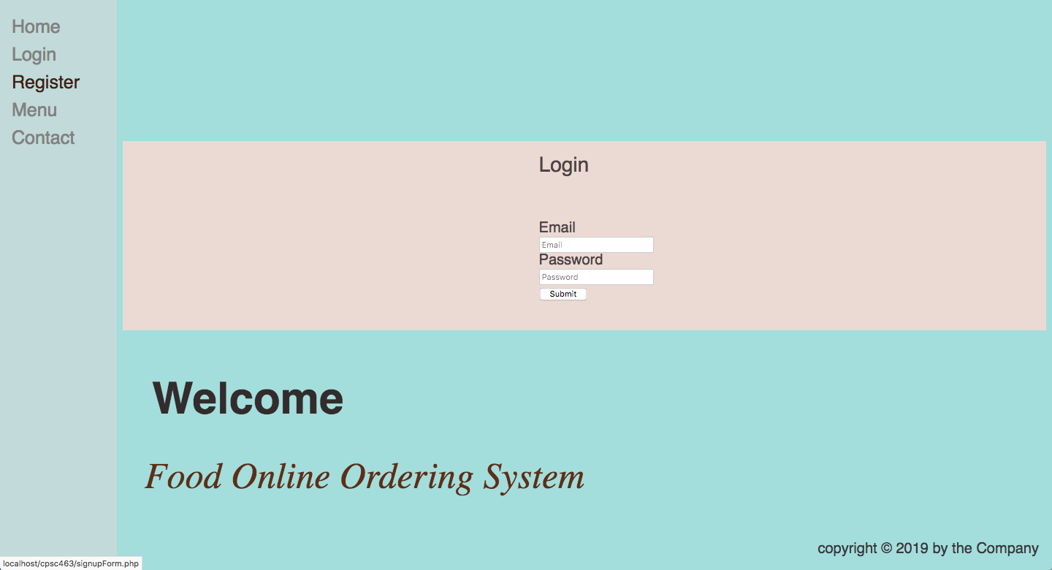

Slide 7
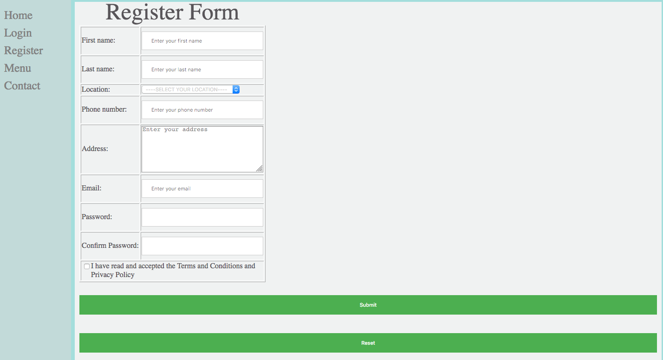

Slide 8
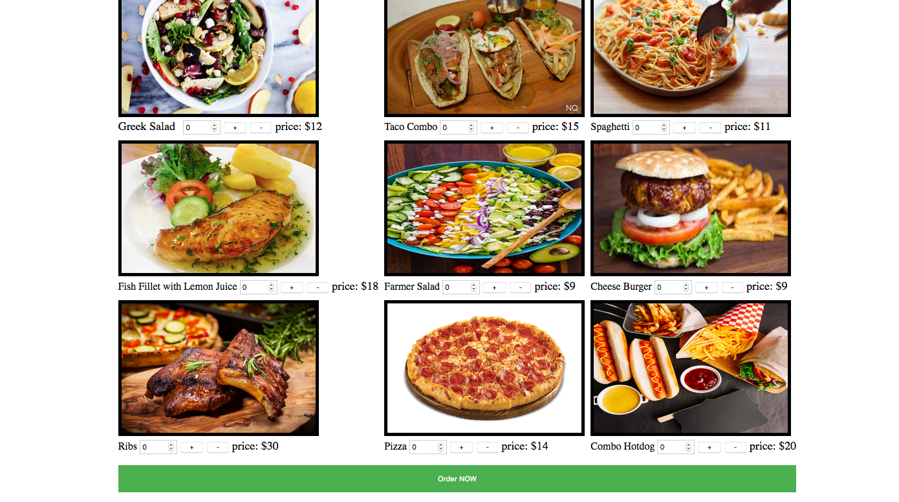

Slide 9
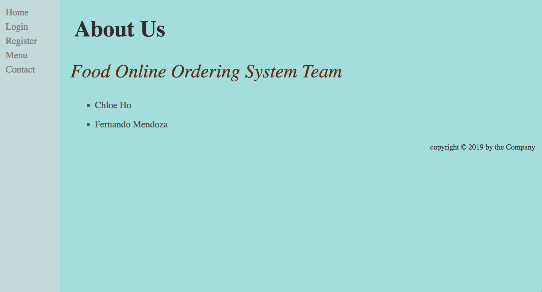

Slide 10
White box Testing
Registration updates database
Description: This is testing to see whether the function call “mysqli_query($conn, $sql)” is able to successfully update the content in the user database.
$conn = mysqli_connect("localhost","root","","food").
$sql = "INSERT INTO user VALUES ('$fname', '$lname', '$location', '$mob', '$addr', '$email', '$pw', '$cpw','$user_activation_code','not verified');"
It is nested inside an email check
Assumptions:
User entered a firstname over 4 letters
User entered a last name over 4 letters
User selected a location: Orange, LA, or Fullerton
User entered a phone number of a valid size
User entered email: must be real to validate account and can’t already be in user database
User entered a password of 8 characters and re entered correct password
User selected term and conditions checkbox

Slide 11


Slide 12
Black box Testing
Test cases:
Login to the account using verified email address.
Login to the account using unverified email address
Login to the account using non-existing email address
Login to the account using a wrong password
Description:
The login page takes 2 inputs that is email and password of an existing user
The value entered in the email and password field are authenticated with the values in the database using PHP and select operation. If the email and its corresponding password do not match, then a message is displayed.
If the values in the database match with the values entered by the user, then the user is successfully logged in.
Links are shown which allow the user to place an order, change his password, or logout. Also the navigation area displays the user’s email.

Slide 13
Backlog
Online payment
Password_hash
Randomize tracking number
Locate the current map
Verify address exists

