Slide 1
TECHNICAL HANDOFF · 17 AUG 2026
3 layers
Battery-Bus Autonomous
Digital Twin
Supervisory LLM → grid state machine → converter/plant
120 s
Matched deterministic and guarded LLM/UDP trial
Agent architecture, operating tutorial, control layers, and recorded baseline-versus-LLM results
1 fallback
Malformed response handled without loss of bus support
Prepared for transfer to a new owner and machine

Slide 2
The handoff package is organized around three jobs
Use it to run the system, understand the implementation, and reproduce the evidence.
Run
Understand
Reproduce
Neutral launchers create the environment, start the GUI or CLI, execute an offline smoke test, and launch the full MATLAB comparison.
PROJECT_MAP.md and this deck connect the assistant loop, DT runner, Python guard, UDP contract, and Simulink controller.
The delivered models, raw CSV/JSONL logs, timing samples, plots, and experiment scripts support a repeatable comparison.
135
files
50 MB
including raw trial data
No working files moved
ORIENTATION
02

Slide 3
One codebase supports conversation and controlled experiments
The general assistant and the MATLAB comparison share the DT runner and local model endpoint.
GENERAL ASSISTANT
MATCHED EXPERIMENT
User / GUI
Agent loop
MATLAB run
Paced plant
assistant_gui.py
prompt + memory + RAG + tools
run_full_comparison.m
two 120 s model cases
Shared autonomy core
run_dt_runner.py · policy.py · constraints.py · udp_backend.py
LM Studio · port 1234
Simulink · UDP 55000/55001
ARCHITECTURE
03

Slide 4
The package keeps stable internals and adds clear entry points
The tested model filenames are intentionally retained; the outer structure is deployment-oriented.
BatteryBus_Autonomy_Handoff_20260817/
├─ README_START_HERE.md
├─ assistant_gui.py · assistant_cli.py
├─ setup_environment.bat
├─ run_offline_smoke_test.bat
├─ run_matlab_comparison.bat
├─ Modules/
│ ├─ Core · Prompt · RAG · Tools · GUI
│ └─ Digital_Twins/
│ ├─ runner · policy · guards · UDP
│ ├─ 3 tested SLX variants + original
│ └─ comparison_experiment/
├─ results/comparison/
│ ├─ raw data · timing · LLM trace
│ └─ figures/ PNG + PDF
├─ research/
└─ presentation/
Start here
README_START_HERE.md points a new owner to setup, smoke testing, the GUI, and the MATLAB comparison.
Compatibility choice
The legacy “DT_enviroment” spelling remains inside model filenames because scripts and compiled references were tested with those names.
Deliberately excluded
Virtual environments, build caches, autosaves, duplicate models, archived packages, and the 124 MB paper library are not part of this deployment copy.
ARCHITECTURE
04

Slide 5
A user request becomes a bounded tool execution
The LLM can choose a tool and parameters, but the runner and control layers determine what is actually applied.
1
2
3
4
5
6
Request
Context
Tool choice
DT mission
Guarded loop
Answer
CLI or GUI
memory + RAG
tool_catalog.py
tool_runner.py
runner + constraints
status + artifacts
Key separation
The conversational model can initiate run_autonomous_DT, but it does not write directly to the converter. The standalone mission runner logs every proposal, guard adjustment, applied command, and fallback.
Prompt
Tool call
Guard
Audit
AGENT
05

Slide 6
Autonomous mode is a closed loop with an explicit contract
Telemetry, supervisory intent, local enforcement, and evidence are separate objects.
Observation
LLM policy
Python guard
UDP command
Local control
Artifacts
time · SOC · Vbus
load · source · faults
mode + watts
reason + confidence
schema · limits · slew
headroom · low-SOC rules
compact JSON
sequence + validity
state + final P ref
stale-command fallback
CSV · report · JSONL
CPU + timing
Sign convention
+P = battery discharges to the bus · −P = battery charges · HOLD = 0 W · SAFE = disabled / 0 W
Every layer preserves the raw value it received and the value it passed downstream.
AGENT
06

Slide 7
Four prerequisites make the package portable
Install the platform pieces first; the package creates its own Python environment.
1 · Windows + Python
2 · MATLAB
3 · LM Studio
4 · Local ports
Windows 10/11
Python 3.10+
Internet or cached wheels
Writable package folder
MATLAB + Simulink
Electrical toolboxes used by the model
R2024b was the tested release
Local server and CLI
Model downloaded
Tested identifier:
llama-3-groq-8b-tool-use
1234/TCP for the model API
55000/UDP commands
55001/UDP observations
55002/UDP monitor
First command
setup_environment.bat
The script creates .venv, installs both requirements files, and runs four focused smoke tests.
TUTORIAL
07

Slide 8
A five-minute check separates software setup from control debugging
Prove the runner and reporting path before opening MATLAB or starting the LLM.
1
2
3
4
Set up
Smoke test
Inspect
Start UI
setup_environment.bat
run_offline_smoke_test.bat
logs/dt_runner_mock_smoke_report.md
start_assistant_gui.bat
Expected: .venv + passing tests
Expected: CSV + Markdown report
Check command and event timeline
Open the Autonomous DT tab
Do not diagnose UDP, Simulink, and model inference at the same time. This staged check gives each failure a clear owner.
TUTORIAL
08

Slide 9
Validate the local state machine before granting supervisory input
This model must run on its own; that proves fast control and safety do not depend on the LLM.
SAFE_LOCAL
BUS_SUPPORT
CHARGE
HOLD
fault, invalid data, or stale supervisory command
bus sag or source deficit receives priority
valid request + SOC need + source headroom
nominal default when no higher-priority action applies
Priority flows left to right only after each higher-risk condition is ruled out.
run_state_machine_dt_smoke
Model: Modules/Digital_Twins/DT_enviroment_state_machine.slx
Expected: no LLM, no UDP process, no safety stop, and logged local state transitions.
TUTORIAL
09

Slide 10
One MATLAB command rebuilds, runs, measures, and plots both cases
The delivered scripts preserve the original recorded run and write new evidence to a separate folder.
Build
Start LLM
Baseline
LLM/UDP
Summarize
two model copies
headless LM Studio
120 s paced run
120 s paced run
tables + figures
run_matlab_comparison.bat
New output
results/latest_comparison/
Expect roughly 5 minutes on the tested machine.
Recorded reference
results/comparison/
TUTORIAL
10

Slide 11
Autonomous mode works because the time scales are separated
Each layer has a different decision horizon and a different kind of authority.
LLM SUPERVISOR
Chooses an operating intent and requested power from summarized telemetry.
10 s decision interval
supervisory intent
GRID STATE MACHINE
Enforces bus support, charge eligibility, SOC bounds, source headroom, saturation, and stale-command fallback.
1 ms local sample
final local reference
CONVERTER + PLANT
Executes the feasible reference and produces voltage, current, SOC, and power measurements.
fast / continuous dynamics
The LLM is not—and should not be—the fast electrical controller.
CONTROL LAYERS
11

Slide 12
The local controller owns the final state and power reference
Supervisory intent is treated as one input among live electrical conditions.
1
Fault or stale?
2
Bus/source deficit?
3
Charge allowed?
4
Otherwise
SAFE_LOCAL
BUS_SUPPORT
CHARGE
HOLD
Physical constraints remain deterministic
Final authority
• SOC window and target
• source limit minus 25 W reserve
• charge headroom and no-backfeed behavior
• battery power saturation
• command validity and age
• bus-voltage and instrumentation faults
CONTROL LAYERS
12

Slide 13
Each state produces a deterministic battery-power command
The LLM requests a mode and magnitude; the 1 ms state controller calculates the reference actually sent onward.
STATE / CODE
ROLE
CONTROL OUTPUT
PHYSICAL MEANING
SAFE_LOCAL · 3
Fail closed on invalid telemetry, hard limits, stale/invalid command, or SAFE request.
P_batt_ref = 0 W
No charge or discharge request.
BUS_SUPPORT · 2
Protect bus voltage and source reserve; may also honor a feasible DISCHARGE request.
P_ref = clip(max(P_local, P_request), 0, 480 W)
P_local = deficit + 5 e_v + 2 I_v
Positive power: battery discharges into the DC bus.
CHARGE · 1
Accept a CHARGE request only when SOC, voltage, and source headroom permit it.
P_ref = -min(|P_request|, headroom, 300 W)
Negative power: bus/source charges the battery.
HOLD · 0
Default state when neither support nor eligible charging is required.
P_batt_ref = 0 W
Battery remains neutral.
Supervisor modes are requests: CHARGE = -1 · HOLD = 0 · DISCHARGE = +1 · SAFE = 99
CONTROL LAYERS
13

Slide 14
State switching uses fixed priority and hysteresis
The controller reevaluates conditions every 1 ms, retains its current state, and changes state only when a listed guard becomes true.
1 SAFETY
2 BUS SUPPORT
3 CHARGE
4 HOLD
TRANSITION RULES
HYSTERESIS LIMITS CHATTER
ANY → SAFE_LOCAL
Invalid signal; SOC ≤10% or ≥95%; bus ≤250 V or ≥500 V; invalid command; or SAFE request.
Voltage bands
SAFE_LOCAL → HOLD
On the next valid, non-SAFE sample. This creates a deterministic recovery step before other operation.
HOLD → BUS_SUPPORT
Bus ≤397 V, source at limit, nominal load ≥475 W, or supervisor requests DISCHARGE.
395
397
399 V
Charge abort
Support enters
Support clears / charge enters
HOLD → CHARGE
CHARGE requested, SOC <39.9%, headroom >1 W, and bus ≥399 V.
Source-reserve band
CHARGE → BUS_SUPPORT
Bus ≤395 V, source at limit, load ≥475 W, or DISCHARGE requested.
Enter support at ≥475 W
Clear only at ≤465 W
BUS_SUPPORT → CHARGE / HOLD
Only after bus ≥399 V, source clear, load ≤465 W, and no DISCHARGE request; then charge if eligible, else hold.
Separate enter/exit thresholds prevent rapid switching.
CONTROL LAYERS
14

Slide 15
A proposal passes two deterministic boundaries before actuation
Malformed, unsafe, or stale LLM output is converted into a safe, auditable command.
Raw response
Schema / parse
Python policy guard
Simulink state machine
mode · watts · reason
valid JSON and finite values
limits · slew · SOC · headroom
conditions override intent
Parse failure
Unsafe proposal
Stale command
Record the error, call deterministic fallback, and transmit a bounded command.
Clamp or replace the request and preserve both raw and guarded values in the audit log.
The local state machine enters SAFE_LOCAL after the configured validity window.
UDP telemetry is compact (<512 bytes); full-resolution evidence remains in local files.
CONTROL LAYERS
15

Slide 16
The comparison changes only supervisory intent
Plant, load profile, state machine, sample time, limits, and instrumentation are matched.
LOAD PROFILE
1
2
3
0 s
50 s
100 s
200 W
500 W
600 W
initial load
source reserve activates
~25 W bus support
clear source deficit
~125 W support
Matched
120 s · 1× pacing · 1 ms local loop · same battery/source/load/measurements
Different
Baseline: fixed 100 W charge intent from t=0 | LLM: new guarded intent every 10 s
EXPERIMENT
16

Slide 17
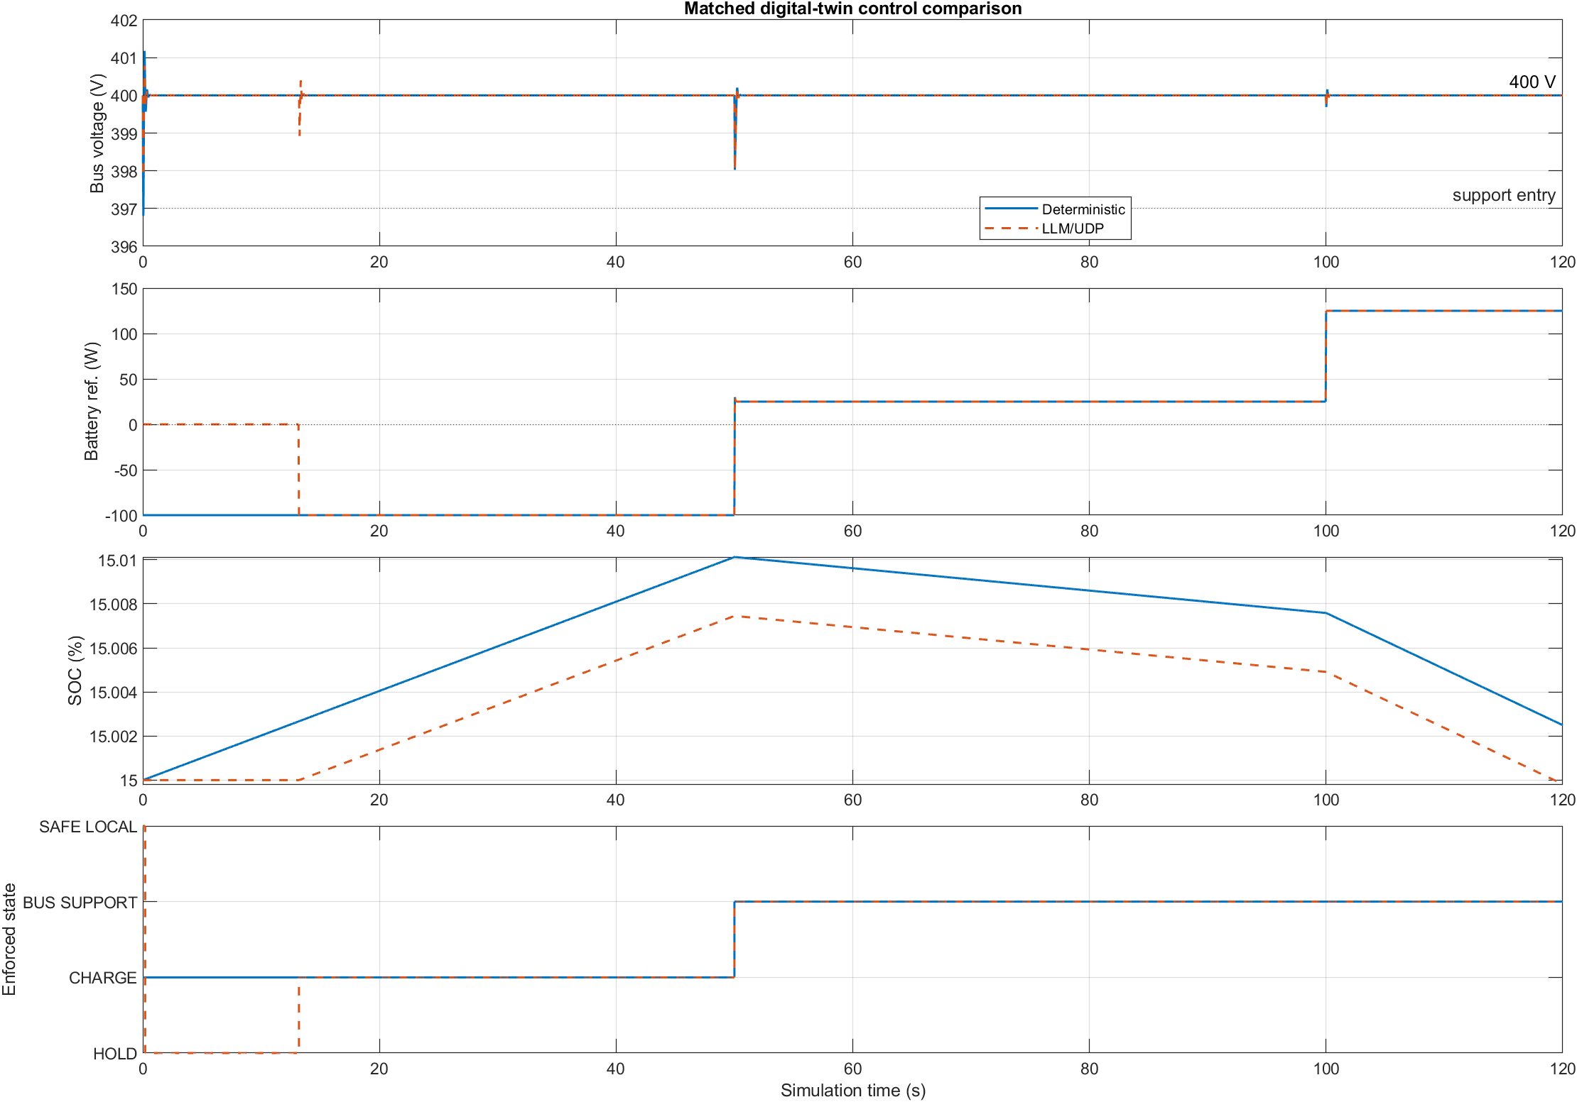
Both cases preserved bus behavior; the main difference was supervision
0.0853 V
Baseline voltage RMSE
0.0714 V
Guarded LLM voltage RMSE
−100…125 W
Same reference range
Single run; do not treat the RMSE difference as statistical evidence of superiority.
RESULTS
17

Slide 18
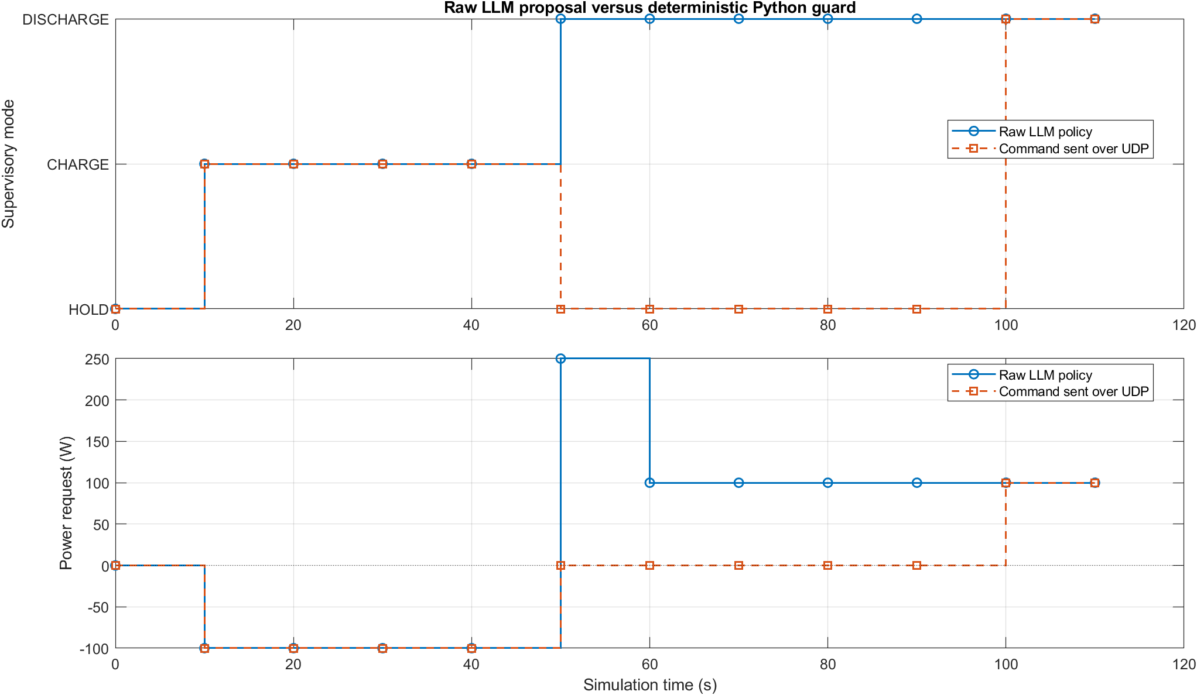
The audit trail shows the LLM was interpreted—not blindly followed
50 s
LLM proposed DISCHARGE at 250 W. The Python guard sent HOLD; Simulink still supplied ~25 W local bus support.
100 s
The 600 W load created a clear deficit. A guarded 100 W request was accepted; local control raised the reference to 125 W.
110 s
An empty/malformed response triggered one deterministic fallback. Bus support continued without a safety stop.
Raw proposal → guarded command → locally enforced state
RESULTS
18

Slide 19
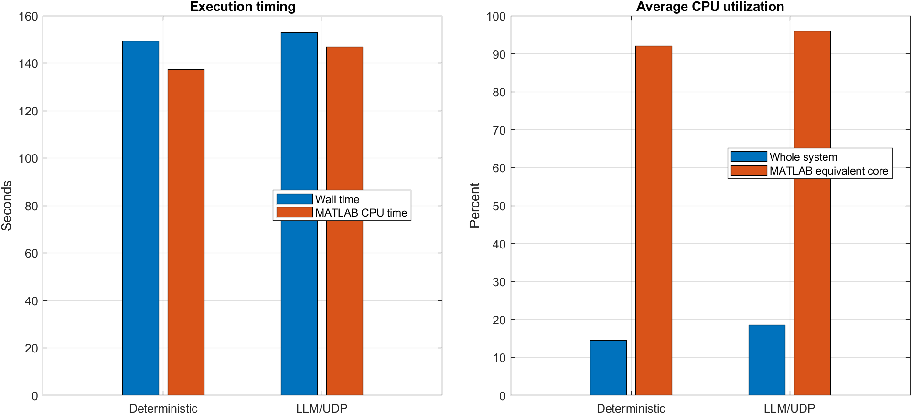
LLM supervision added modest wall time and measurable external CPU work
Recorded timing
Metric
Baseline
LLM/UDP
Wall time
149.26 s
152.94 s
MATLAB CPU
137.38 s
146.77 s
System CPU
14.46%
18.50%
LM Studio CPU
0.14 s
15.95 s
LLM calls
0
11
Latency mean / p95 (s)
—
1.57 / 3.22
Fallbacks
0
1
Inference work occurs outside MATLAB; system/process sampling is therefore essential.
RESULTS
19

Slide 20
The research result is guarded supervisory autonomy—not faster control
The local state machine already handled the essential load transitions.
Demonstrated
Not demonstrated
• an LLM can propose battery operating modes
• deterministic guards can constrain unsafe intent
• local control can override supervisory requests
• malformed responses can fall back safely
• the full authority chain can be audited
• statistical superiority over classical control
• direct high-frequency LLM control
• hardware-in-the-loop or physical-system validation
• robustness across many loads, SOCs, models, or seeds
• certified safety
Strong paper framing: an auditable interface for LLM supervision across control time scales, with deterministic local authority and fallback.
INTERPRETATION
20

Slide 21
Most failures can be isolated with four checks
Use the staged path; avoid changing the agent, network, and model at the same time.
No telemetry
No model calls
Simulink running? Ports 55000/55001 aligned? One listener? Firewall allowed?
Policy=llm? Port 1234 reachable? Identifier matches loaded model? Valid observation arrived?
Safety stop
Odd behavior
Inspect missing/NaN telemetry, bridge faults, command age, SOC/voltage limits, and model diagnostics.
Compare raw LLM, guarded UDP, local state, and final reference before tuning thresholds.
Operations reference: docs/OPERATIONS_GUIDE.md
OPERATIONS
21

Slide 22
The GUI is reusable across digital twins
Select a runner and model, then provide only the inputs that the selected digital twin owns.
1 · Run
2 · Model inputs
3 · Connection
4 · Agent
Backend + policy
Agent tick + duration
Real-time pacing
CSV + report
Runner script
Model file + identifier
DT-specific arguments
Local logic stays in model
UDP hosts + ports
Timeout + resend
Optional reset
Telemetry republish
API endpoint
Model + sampling
Fallback behavior
JSONL trace
Live control path
Agent request -> runner output -> local control -> DT feedback
Runner-provided summaries keep the display generic; battery defaults can be replaced without rebuilding the GUI.
GUI
22

Slide 23
NEXT OWNER
Central handoff claim
Reproduce first.
Then widen the evidence.
The LLM selects supervisory intent. Deterministic software and the local Simulink controller retain final authority.
01
Run the smoke test
Prove the package and reporting path.
02
Repeat the comparison
Capture versions, seeds, latency, and CPU distributions.
03
Expand scenarios
Vary initial SOC, load profiles, faults, and model responses.
04
Advance validation
Move to HIL/physical telemetry only after repeatability.
README_START_HERE.md · PROJECT_MAP.md · results/comparison/ · presentation/

