Slide 1
Lecture 21: ML Optimizers
Slides by Boehm and Surve

Slide 2
Announcement
Open office hours tomorrow after 1pm to talk about projects. Please drop by CS4361.

Slide 3
Today
DB optimizers
ML programs
Optimization Techniques

Slide 4
1. DB Optimizers
Section 1

Slide 5
Logical vs. Physical Optimization
Section 1
SQL Query
Relational Algebra (RA) Plan
Logical optimization:
Find equivalent plans that are more efficient
Intuition: Minimize # of tuples at each step by changing the order of RA operators
Physical optimization:
Find algorithm with lowest IO cost to execute our plan
Intuition: Calculate based on physical parameters (buffer size, etc.) and estimates of data size (histograms)
Optimized RA Plan
Execution

Slide 6

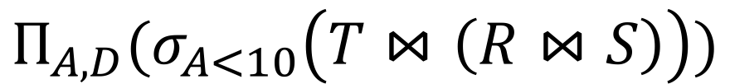
Translating to RA
Section 1
R(A,B) S(B,C) T(C,D)
$$Π_{A,D}$$
SELECT R.A,S.D
FROM R,S,T
WHERE R.B = S.B
AND S.C = T.C
AND R.A < 10;
σ_{Α<10}
T(C,D)
R(A,B)
S(B,C)
$$Π_{A,D}(σ_{A<10}\left(T⋈\left(R⋈S\right)\right))$$

Slide 7
Optimizing RA Plan
Section 1
Push down selection on A so it occurs earlier
R(A,B) S(B,C) T(C,D)
$$Π_{A,D}$$
SELECT R.A,S.D
FROM R,S,T
WHERE R.B = S.B
AND S.C = T.C
AND R.A < 10;
σ_{Α<10}
T(C,D)
R(A,B)
S(B,C)
$$Π_{A,D}(σ_{A<10}\left(T⋈\left(R⋈S\right)\right))$$

Slide 8

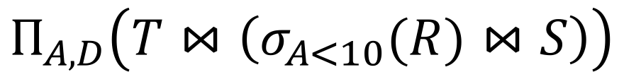
Optimizing RA Plan
Section 1
Push down selection on A so it occurs earlier
R(A,B) S(B,C) T(C,D)
SELECT R.A,S.D
FROM R,S,T
WHERE R.B = S.B
AND S.C = T.C
AND R.A < 10;
$$Π_{A,D}$$
T(C,D)
σ_{Α<10}
S(B,C)
$$Π_{A,D}\left(T⋈\left(σ_{A<10}(R)⋈S\right)\right)$$
R(A,B)

Slide 9
Optimizing RA Plan
Section 1
Push down projection so it occurs earlier
R(A,B) S(B,C) T(C,D)
SELECT R.A,S.D
FROM R,S,T
WHERE R.B = S.B
AND S.C = T.C
AND R.A < 10;
$$Π_{A,D}$$
T(C,D)
σ_{Α<10}
S(B,C)
$$Π_{A,D}\left(T⋈\left(σ_{A<10}(R)⋈S\right)\right)$$
R(A,B)

Slide 10
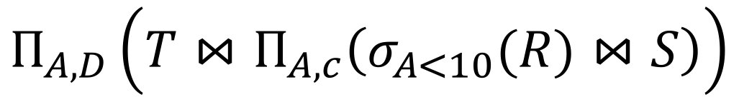


Optimizing RA Plan
Section 1
We eliminate B earlier!
R(A,B) S(B,C) T(C,D)
In general, when is an attribute not needed…?
$$Π_{A,D}$$
SELECT R.A,S.D
FROM R,S,T
WHERE R.B = S.B
AND S.C = T.C
AND R.A < 10;
$$Π_{A,C}$$
T(C,D)
$$Π_{A,D}\left(T⋈Π_{A,c}\left(σ_{A<10}(R)⋈S\right)\right)$$
σ_{Α<10}
S(B,C)
R(A,B)

Slide 11
Physical Optimization
Section 1
Physical optimization:
Find algorithm with lowest IO cost to execute our plan
Intuition: Calculate based on physical parameters (buffer size, etc.) and estimates of data size (histograms)
Index-based selections
Different join algorithms

Slide 12
2. ML Programs

Slide 13
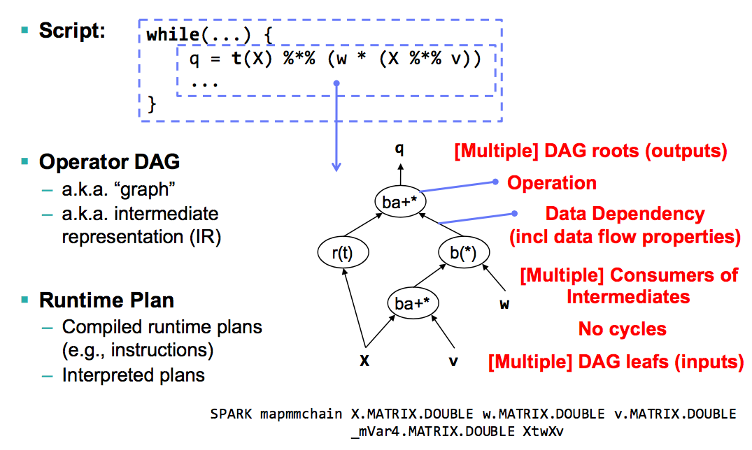
ML Program Compilation
Section 2

Slide 14
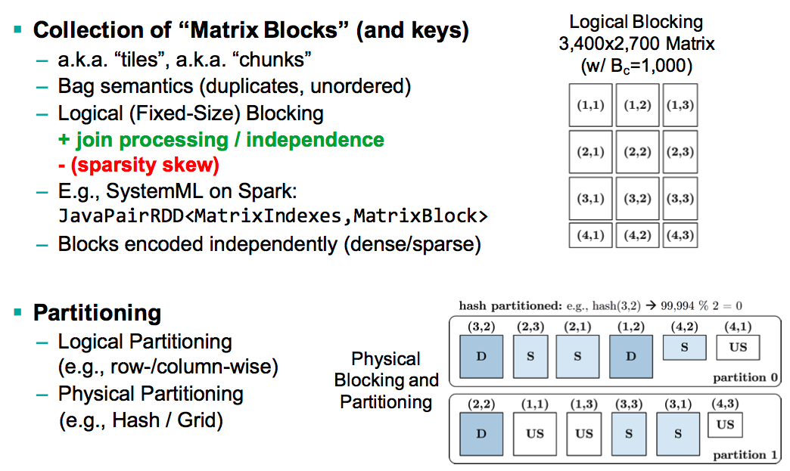
Distributed Matrix Representation
Section 2

Slide 15
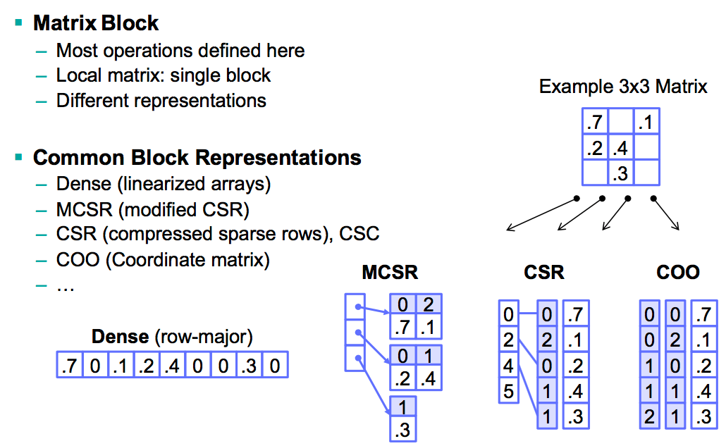
Distributed Matrix Representation (2)
Section 2

Slide 16
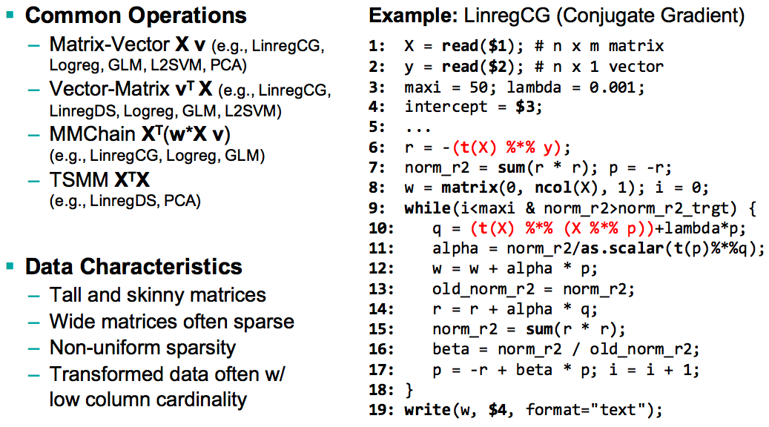
Common Workload Characteristics
Section 2

Slide 17
3. Optimization Techniques

Slide 18
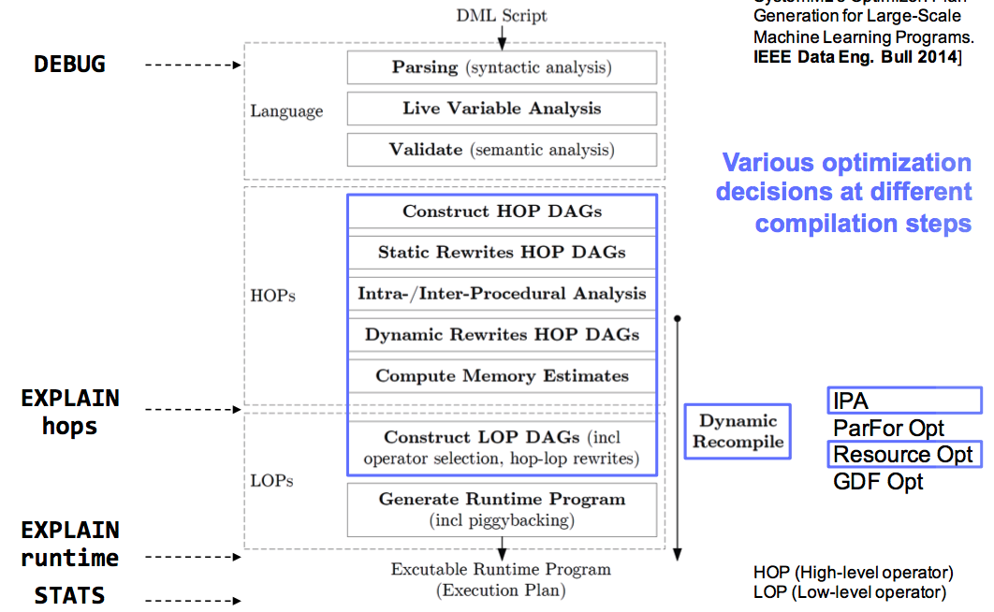
SystemML’s Compilation Chain
Section 3
Notes:
HOP = high-level operations
LOP = low-level operations

Slide 19
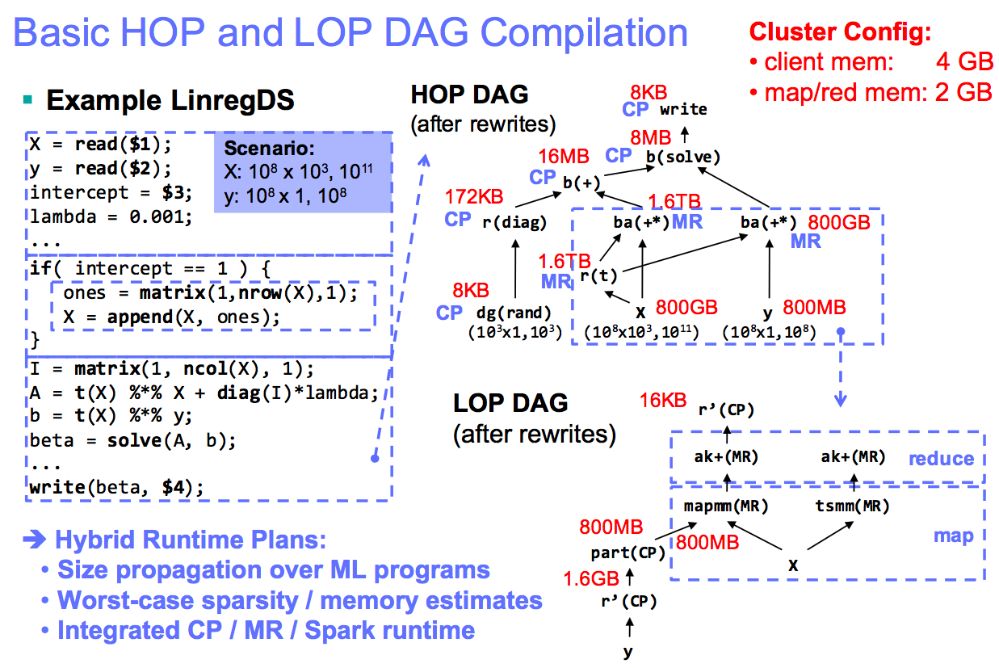
Basic HOP and LOP DAG Compilation
Section 3

Slide 20
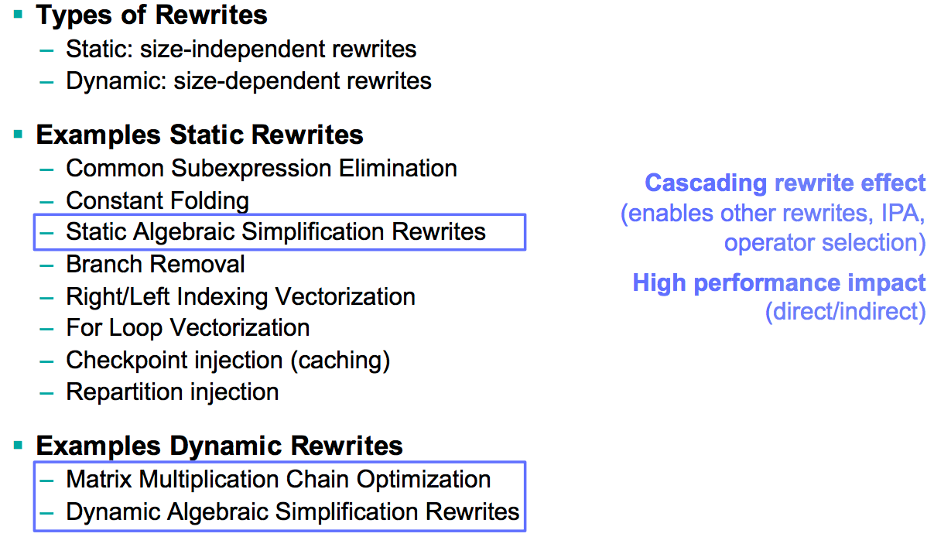
Static and Dynamic Rewrites
Section 3

Slide 21
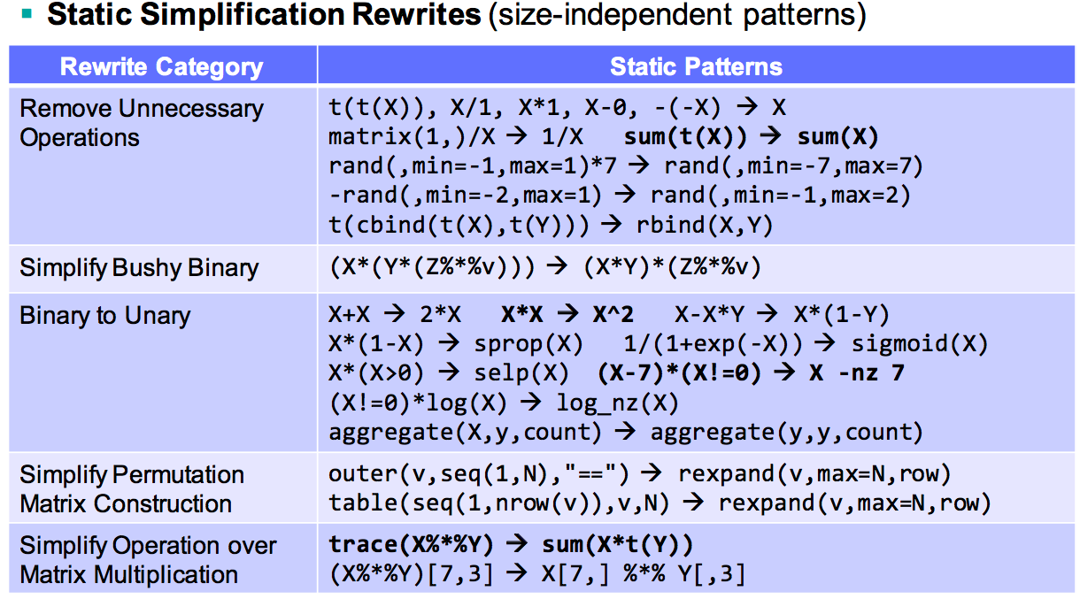
Example Static Rewrites
Section 3

Slide 22
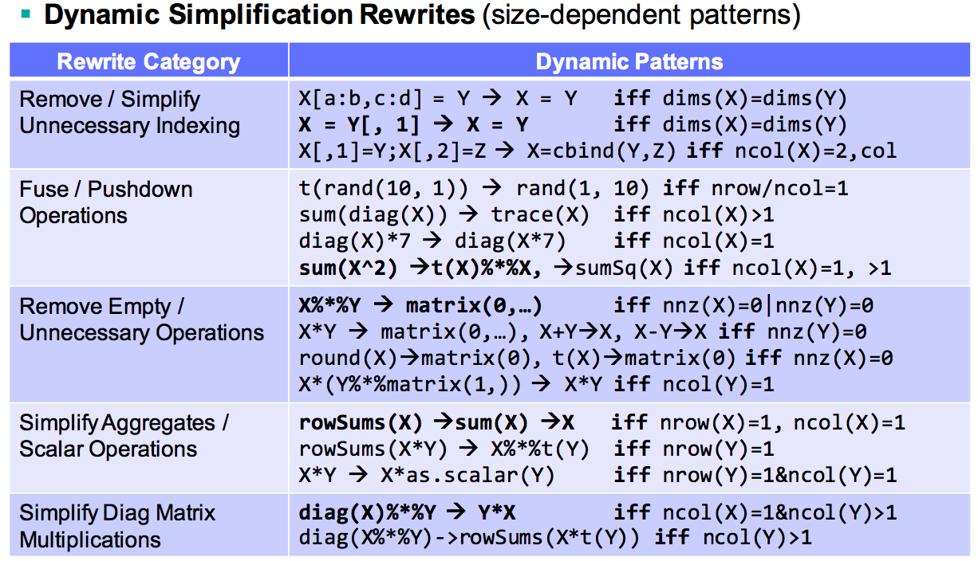
Example Dynamic Rewrites
Section 3

Slide 23
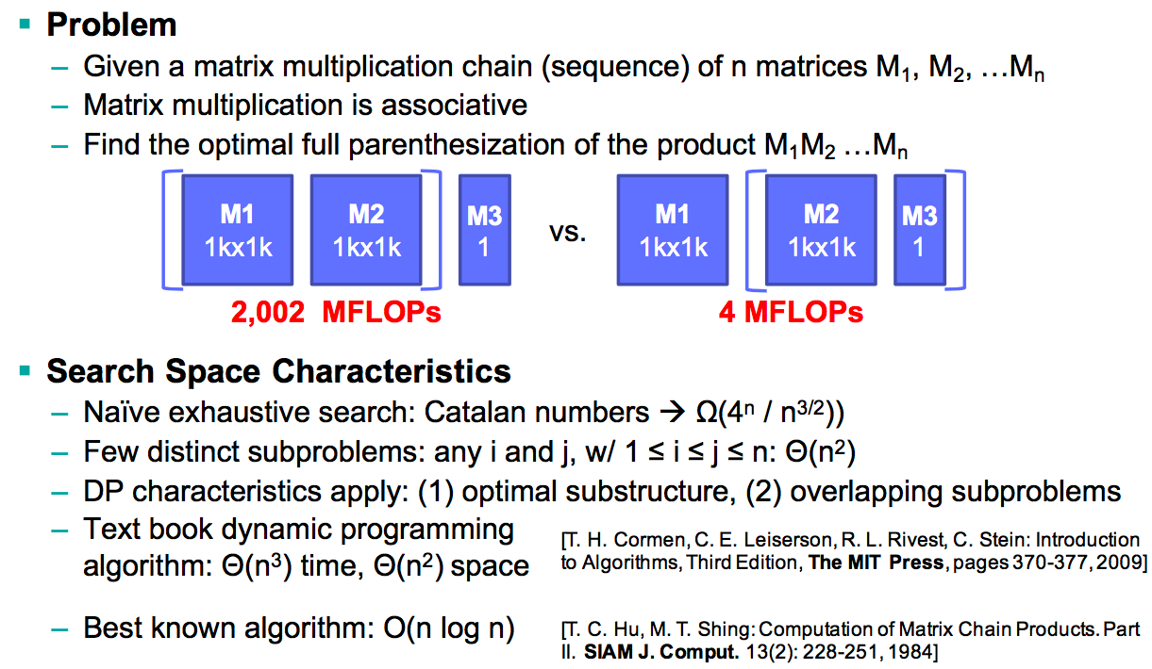
Matrix Multiplication Chain Optimization
Section 3

Slide 24
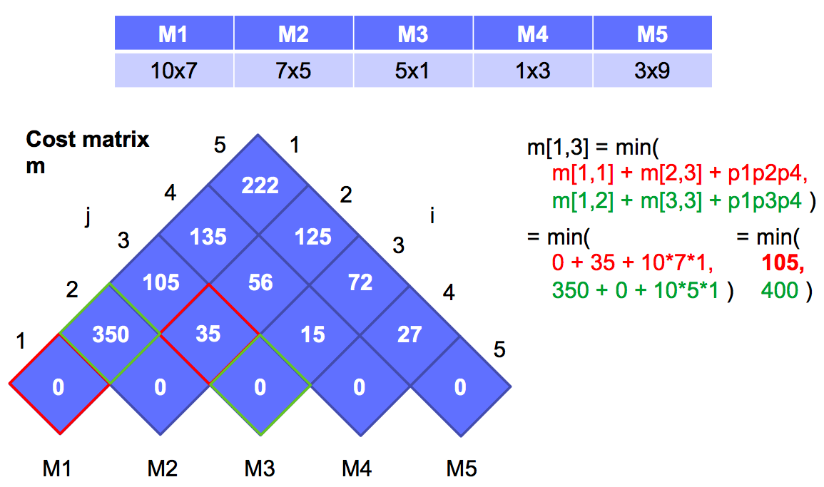
Matrix Multiplication Chain Optimization (2)
Section 3

Slide 25
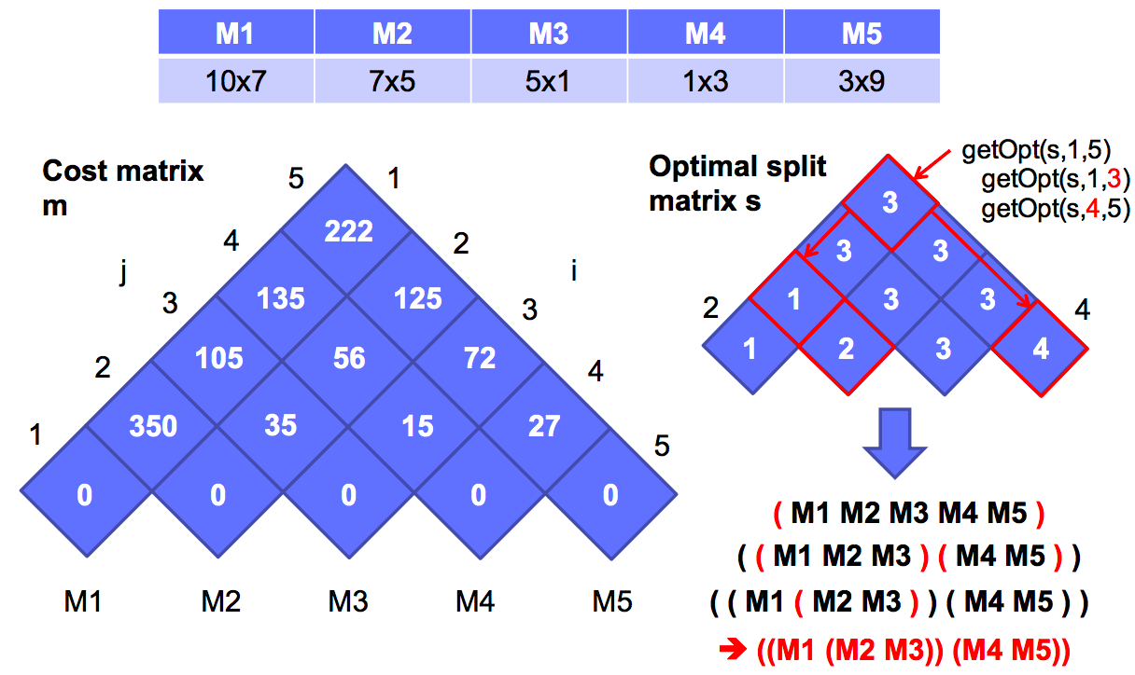
Matrix Multiplication Chain Optimization (3)
Section 3

Slide 26
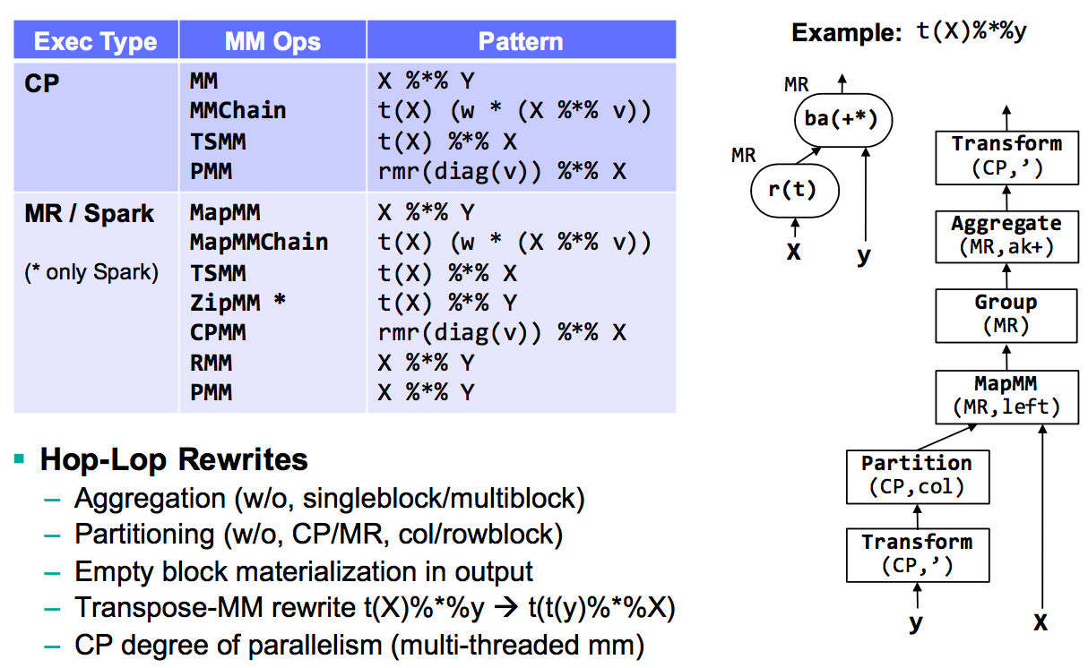
Example Operator Selection: Matrix Multiplication
Section 3

Slide 27
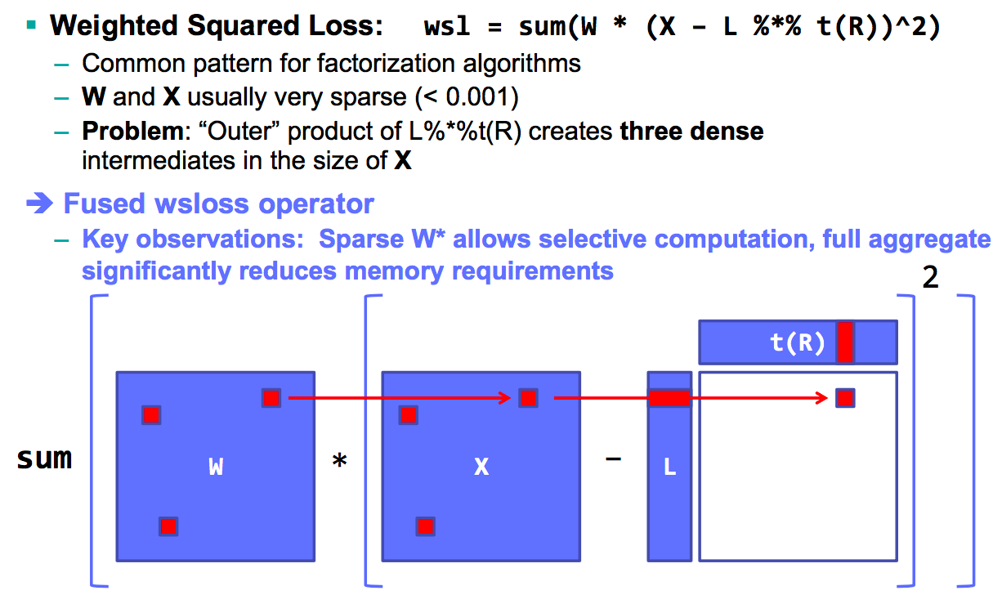
Fused Operators: WSLoss
Section 3

Slide 28
More optimizations
Section 3
Dynamic Recompilation to address unknown/changing sizes
Sparsity of intermediates
Decisions:
Split HOP DAGs for recompilation
Mark HOP DAGs with unknown sizes / sparsity

Slide 29
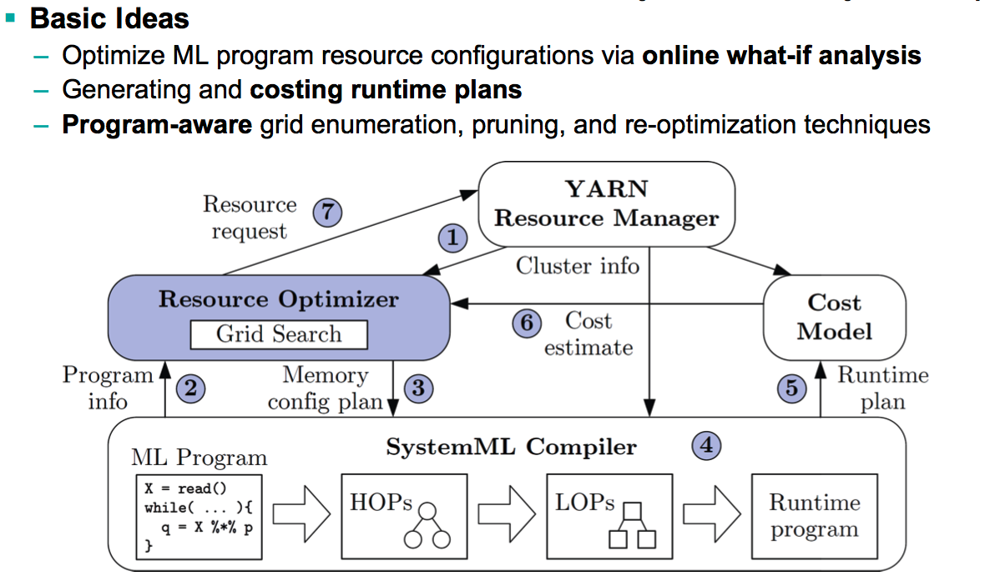
Resource Optimizer
Section 3

Slide 30
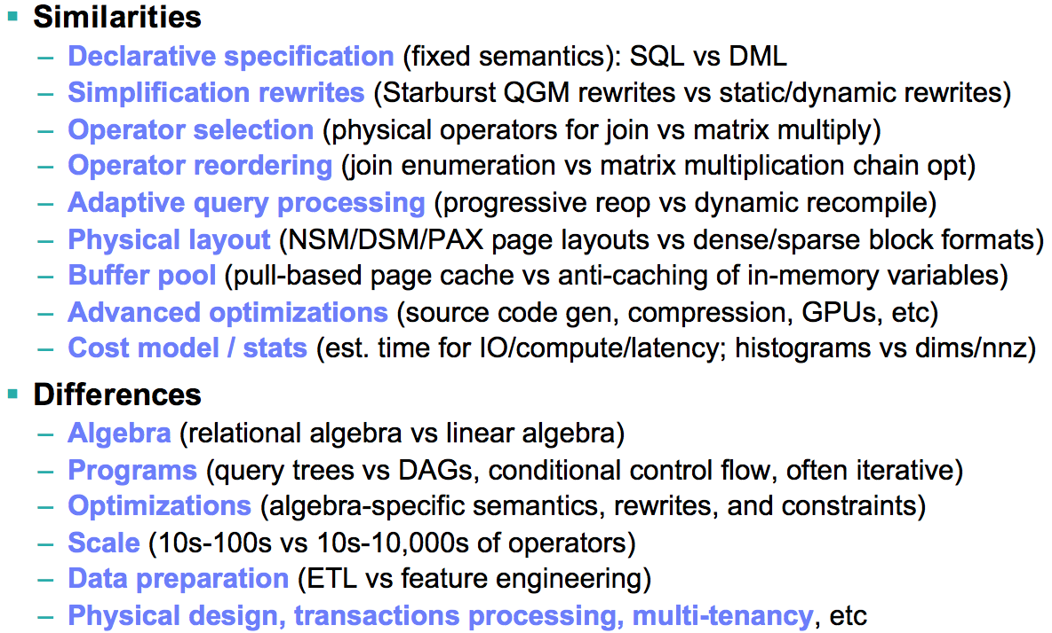
From SystemR to SystemML – A Comparison

