Slide 1
Lecture 9: Entity Resolution

Slide 2
Today’s Agenda
Overview of Data Integration
Entity Resolution (ER)
Pairwise ER

Slide 3
1. Data Integration
Section 1

Slide 4
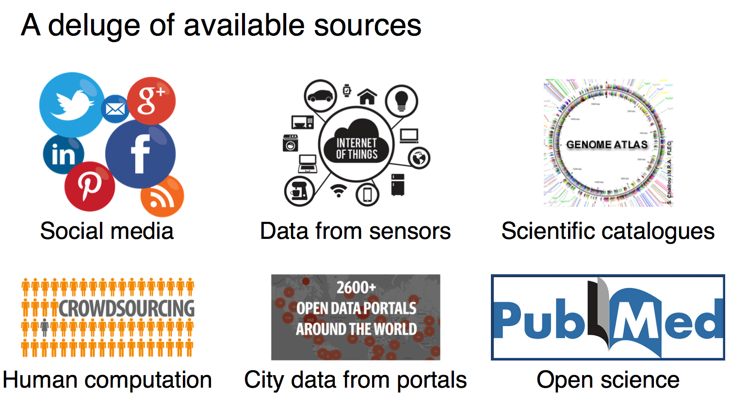
Data, data, data…
Section 1

Slide 5
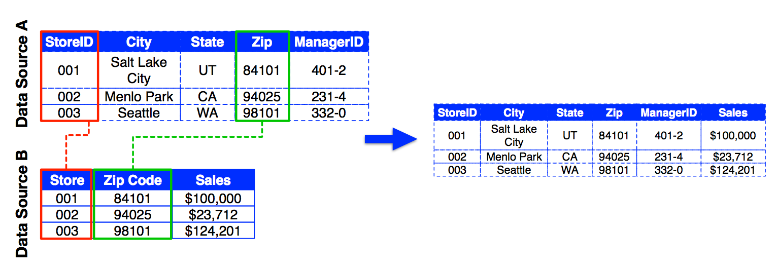
Data Integration = Value
Section 1
Step 0: Source Selection
Step 1: Schema Alignment
Step 2: Entity Resolution
Step 3: Data Fusion

Slide 6
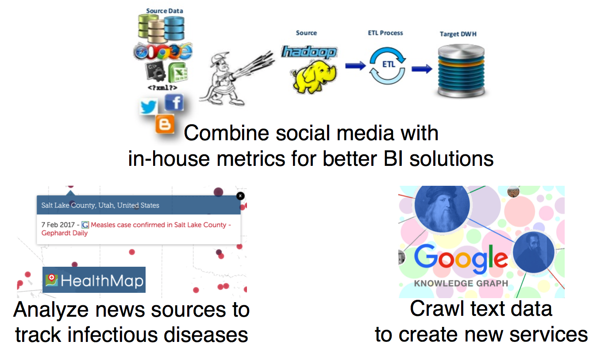
Modern Data Integration
Section 1

Slide 7
2. Entity Resolution
Section 2

Slide 8
What is Entity Resolution?
Section 2
Problem of identifying and linking/grouping different manifestations of the same real world object.
Examples:
Different ways of addressing the same person in text
Web pages with different descriptions of the same business
Different photos of the same person

Slide 9
Entity Resolution has itself duplicate names
Section 2
Record linkage, duplicate detection, fuzzy match, reference reconciliations, object consolidation, entity clustering, reference matching, merge/purge, deduplication, coreference resolution, object identification, approximate match….

Slide 10
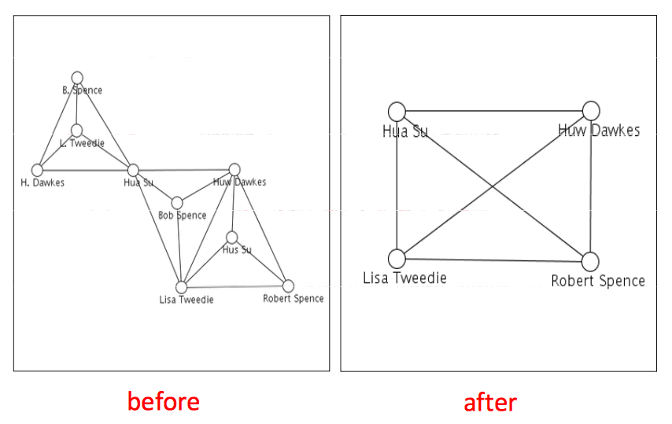
Examples
Section 2

Slide 11

Examples
Section 2
Name/attribute ambiguity

Slide 12
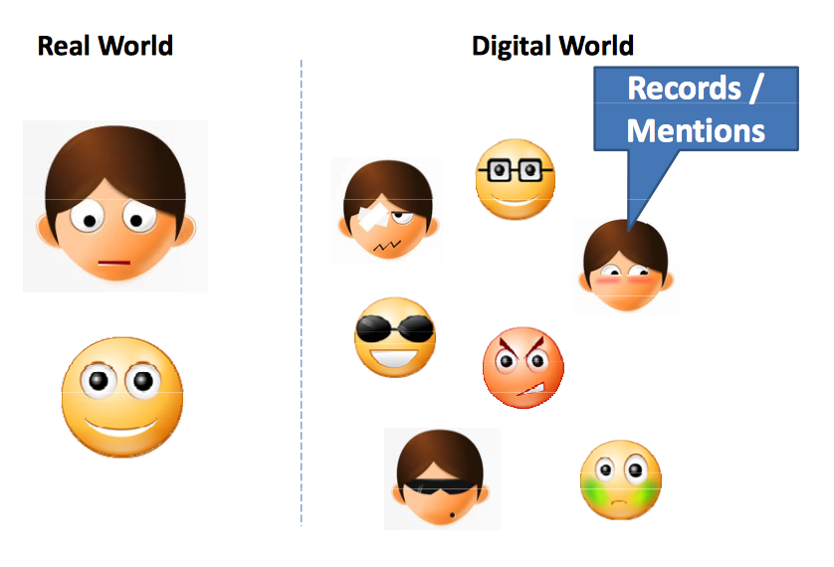
Abstract Problem Statement
Section 2

Slide 13
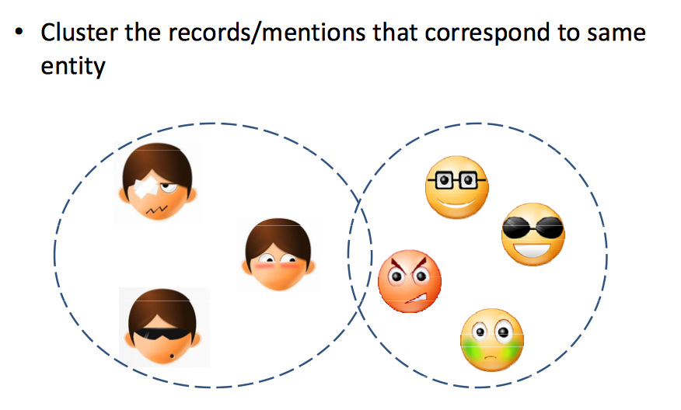
Deduplication
Section 2

Slide 14
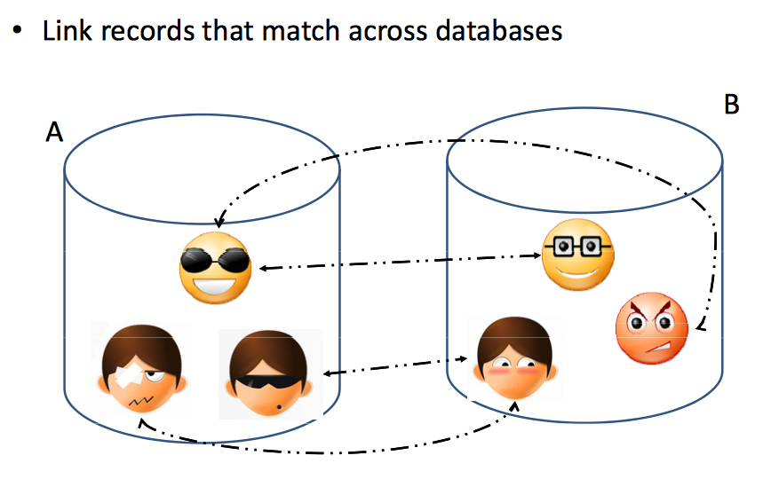
Record linkage / Entity Matching
Section 2

Slide 15
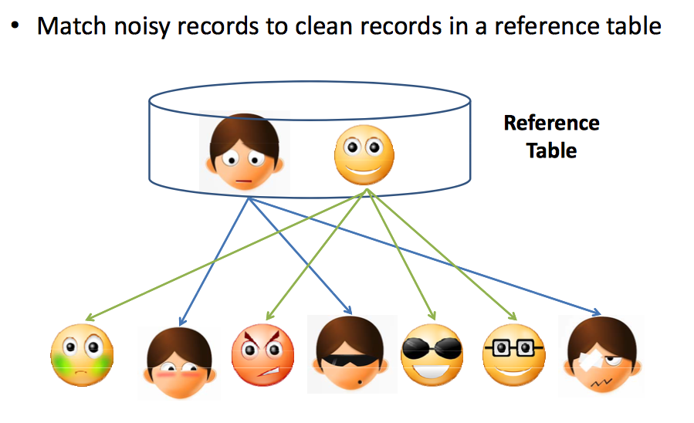
Reference Matching
Section 2

Slide 16
Reference Matching
Section 2

Slide 17
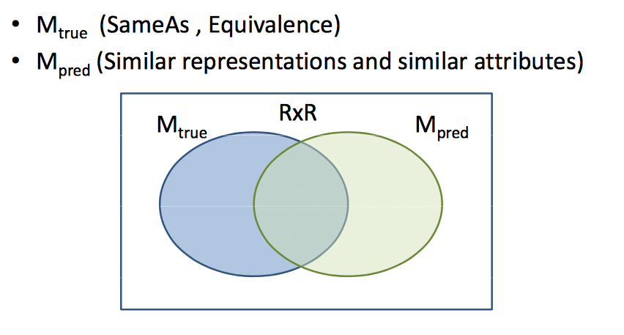
Solving ER
Section 2

Slide 18
Metrics
Section 2
Pairwise metrics:
Precision/Recall, F1
# of predicted matching pairs
Cluster level metrics:
Purity, completeness, complexity
Precision/recall/F1: cluster-level, closest cluster

Slide 19
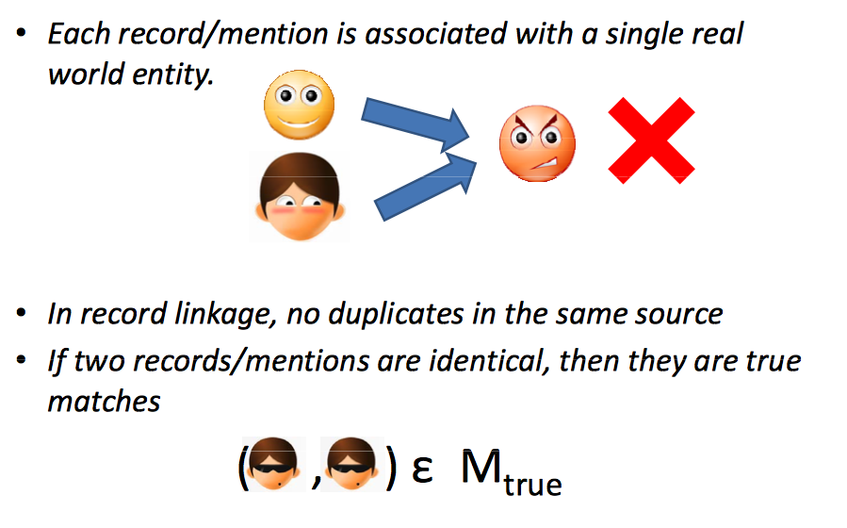
Typical Assumptions
Section 2

Slide 20
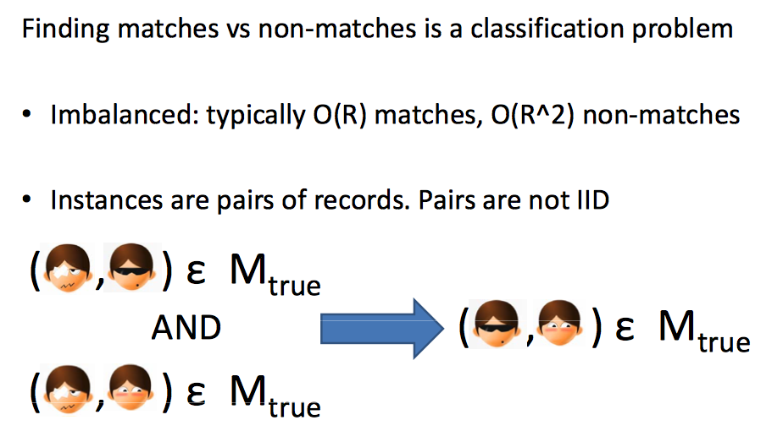
ER vs. Classification
Section 2

Slide 21
ER vs. (Multi-relational) Clustering
Section 2
Computing entities from records is a clustering problem
In typical clustering algorithms (k-means, LDA, etc.) number of clusters is a constant or sub linear in R
In ER: number of clusters is linear in R, and average cluster size is a constatnt. Significant fraction of clusters are singletons.

Slide 22
3. Pairwise ER
Section 3

Slide 23
Pairwise Match Score
Section 3
Problem: Given a vector of component-wise similarities for a pair of records (x,y) compute P(x and y match).
Solutions:
Weighted sum of average of component-wise similarity scores.
Threshold determines match or non-match
Hard to pick weights – Hard to tune a threshold
Rules about what constitutes a match
Finding the right set of rules is hard

Slide 24
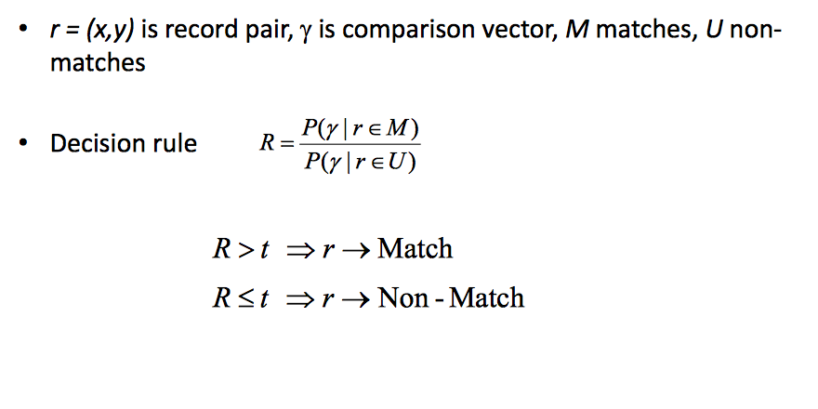
Basic ML Approach
Section 3

Slide 25
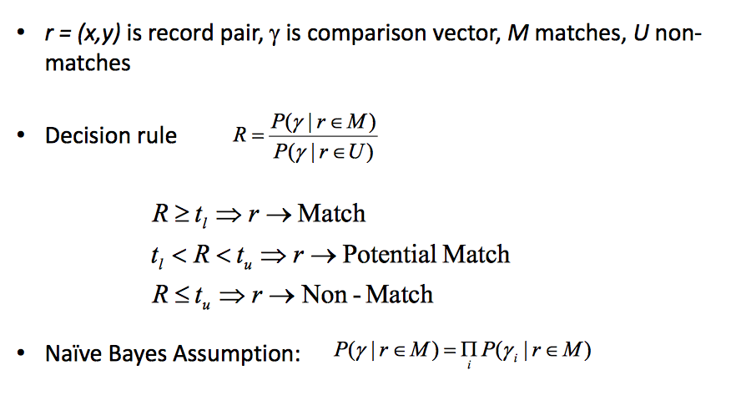
Fellegi & Sunter Model
Section 3

Slide 26
ML Pairwise Approaches
Section 3
Supervised ML algorithms:
Decision trees
Support vector machines
Ensembles of classifiers
Conditional random fields
Issues:
Training set generation
Imbalanced classes – many more negatives than positives (even after eliminating obvious non-matches with Blocking)

Slide 27
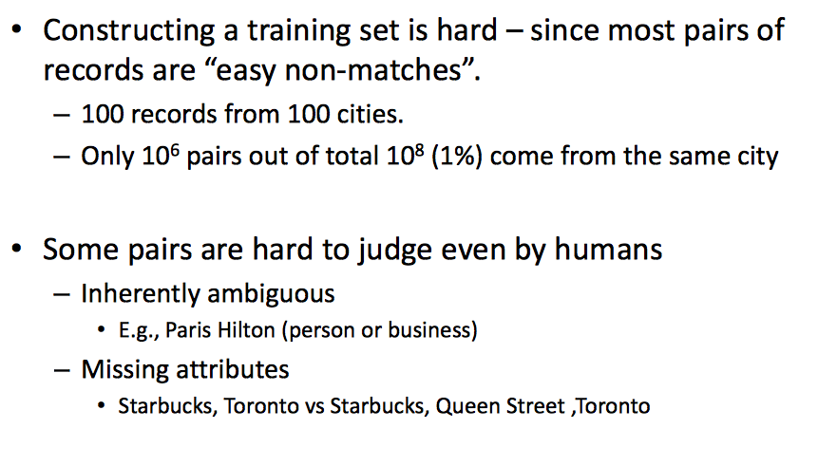
Creating a Training Set is a key issue
Section 3

Slide 28
Avoid creating a dataset
Section 3
Unsupervised / Semi-supervised methods
EM, generative models
Active learning
Ensemble methods, active learning to optimize for precision/recall
crowdsourcing

Slide 29
Summary
Section 3
Many algorithms for independent classification of pairs of records as match/non-match
ML based classification & Fellegi-Sunter
Pro: advanced state of the art
Con: building high fidelity training sets is a hard problem
Active learning and Crowdsourcing for ER are active areas of research (next lecture)

