Slide 1
Lecture 6: Data Versioning
Credit: Some slides by Chavan et al.

Slide 2
Today’s Lecture
Data Hubs
Dataset Versioning

Slide 3
1. Data Hubs
Section 1

Slide 4
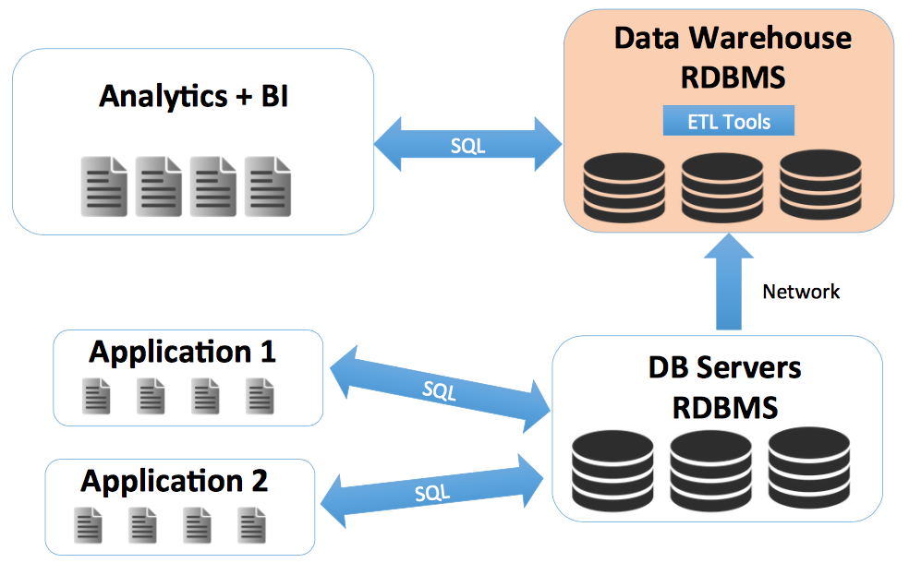
From old-school applications…
Section 1

Slide 5
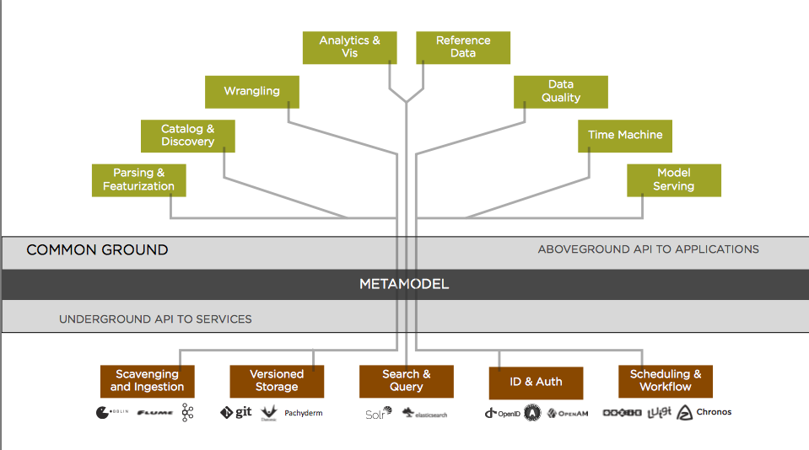
…to the vision of Ground
Section 1

Slide 6
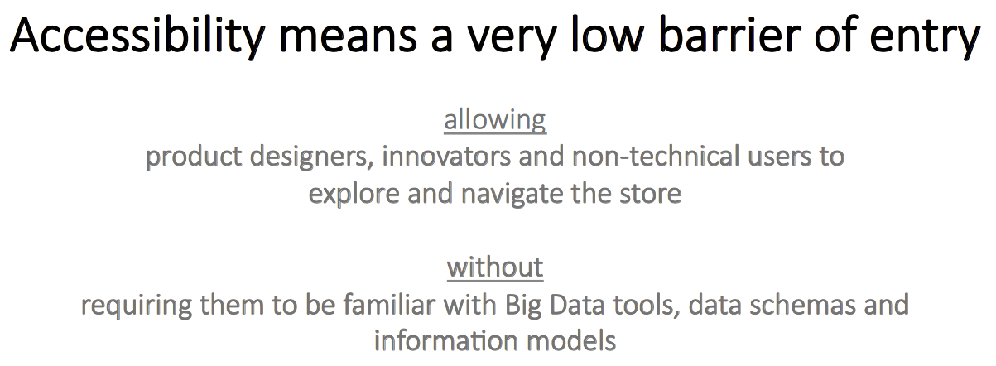
Accessibility: The key challenge
Section 1

Slide 7
Core challenges
Section 1
A new architecture for storing large numbers of diverse datasets
Managed on behalf of different users/groups with sharing/collaboration capabilities
Support for different formats
Data movement
Easy ingest, cleaning, and visualization
Data versioning - lineage
Infrastructure to host a large number of data-processing apps (ModelHub later!)

Slide 8
2. Dataset Versioning
Section 2

Slide 9
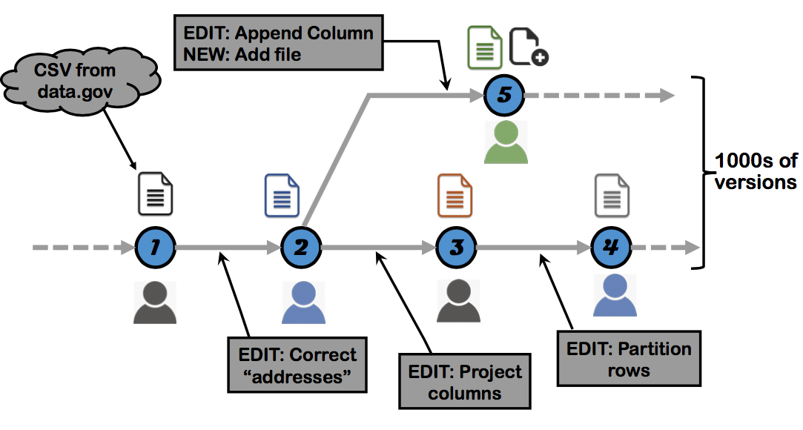
A typical data analysis workflow
Section 2

Slide 10
The dataset versioning hell
Section 2
Many private copies of the datasets lead to massive redundancy in storage
No easy way to keep track of dependencies
No mechanisms to support and record manual conflict resolution
No way to analyze/compare/query versions (across users)

Slide 11
Dataset version control desiderata
Section 2
Branch, update, merge, transform
Large unstructured or structured datasets
Main challenges:
How can we store thousands of versions of datasets compactly?
How to access any version, on-demand, efficiently?

Slide 12
Version Control Systems
Section 2
We already have Git/SVN and many more
Versioning algorithms optimized to work with code-like data
Sparse
Local changes (focused in specific parts of the file)
Scenario: What if we reformat a date that appears in all tuples of a structured dataset?

Slide 13
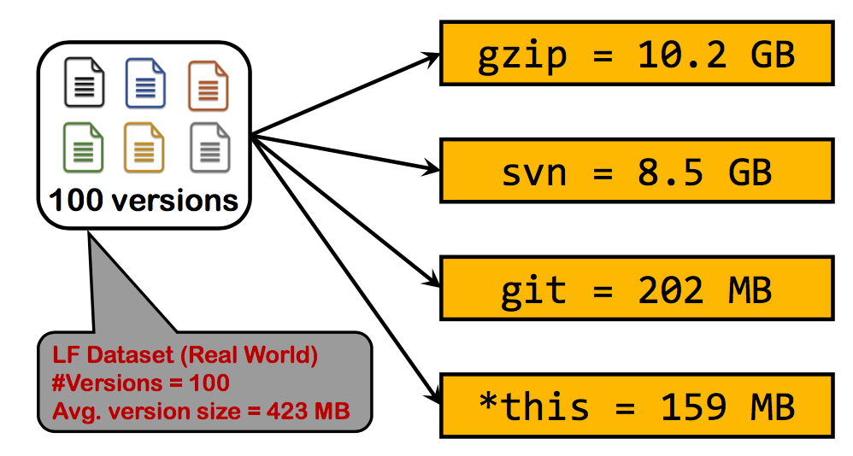
Version Control Systems in practice
Section 2
Even git uses large amounts of RAM for large files!

Slide 14
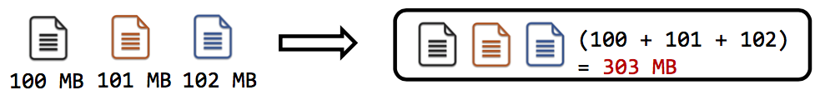
It’s all about costs
Section 2
Storage cost is the space required to store a set of versions

Slide 15
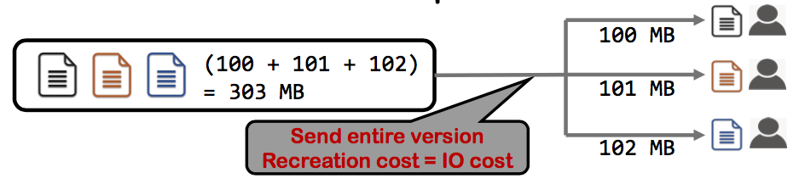
It’s all about costs
Section 2
Recreation cost is the time required to access a version

Slide 16
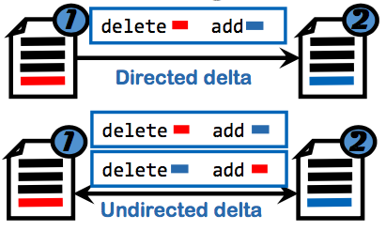
How to recreate version
Section 2
Use deltas: A delta between versions is a file which allows constructing one version given the other.
A delta has its own storage cost and recreation cost
Example delta ops: Unix diff, xdelta, XOR, etc.

Slide 17
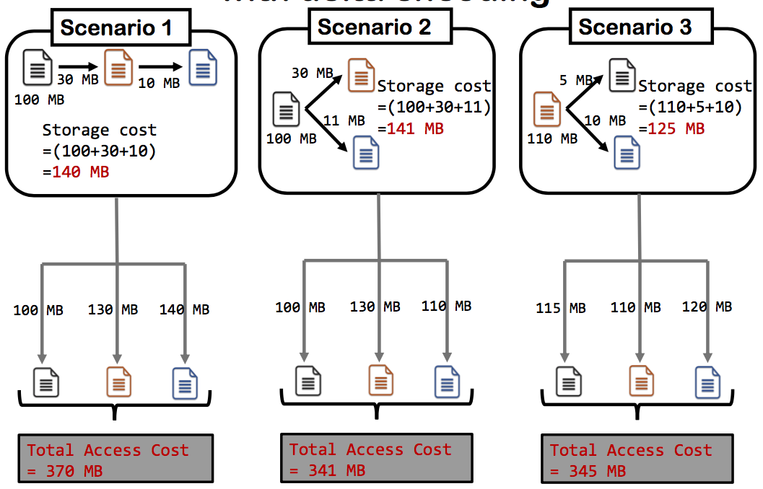
Storage/Recreation Tradeoff (with delta encoding)
Section 2

Slide 18
Problem
Section 2
Given
Set of versions
Partial information about deltas between versions
with
deltas being directed/undirected
deltas having different storage and recreation costs
PROBLEM: Find a storage solution that:
Minimizes total recreation cost within storage budget
Minimizes maximum recreation cost within a storage budget

Slide 19
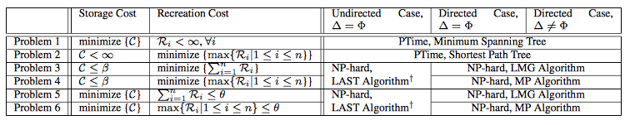
Multiple versions
Section 2
Let’s focus on directed deltas with identical storage and recreation costs

Slide 20
Baseline
Section 2

Slide 21
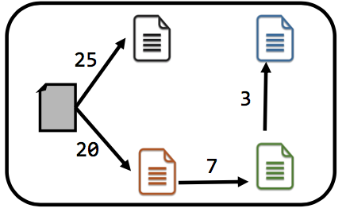
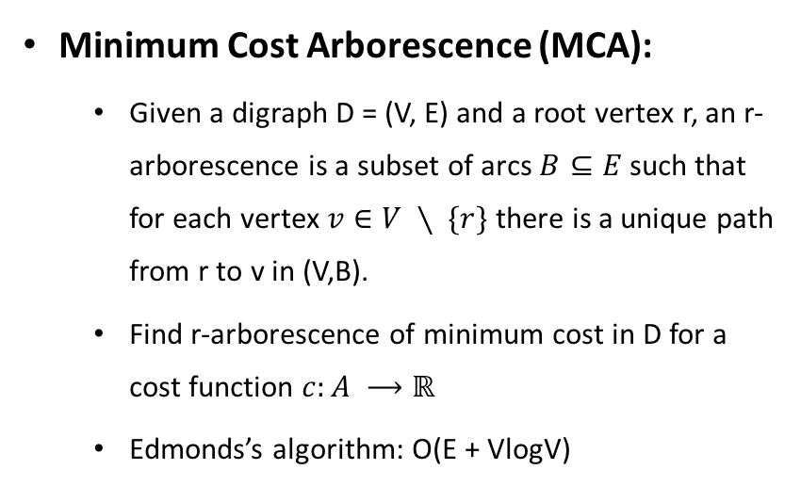
Baseline
Section 2
Minimum Cost Arborescence (MCA):
Given a digraph D = (V, E) and a root vertex r, an r-arborescence is a subset of arcs $B⊆E$ such that for each vertex $v∈V ∖ \{r\}$ there is a unique path from r to v in (V,B).
Find r-arborescence of minimum cost in D for a cost function $c:A ⟶ℝ$
Edmonds’s algorithm: O(E + VlogV)
Version 1: Minimize Storage Cost
Recreation Cost: No constraints

Slide 22
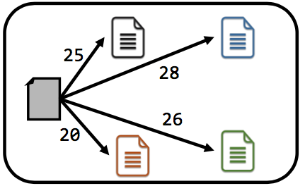
Baseline
Section 2
Shortest Path Tree (SPT)
Dijkstra’s algorithm: O(E VlogV)
Version 2: Minimize Recreation Cost
Storage Cost: No constraints

Slide 23

Local Move Greedy (LMG) heuristic
Section 2
GOAL: Minimize total recreation cost
Start with MCA
Iterate until storage budget reached:
For each new delta, compute
Choose the delta with the highest ρ value

Slide 24
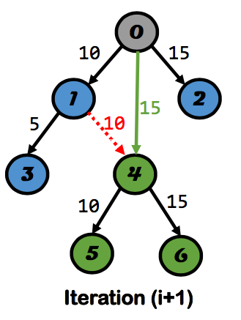
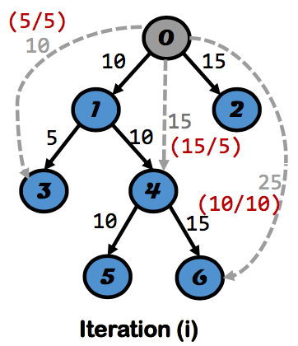


Local Move Greedy (LMG) heuristic
Section 2

Slide 25
More heuristics
Section 2
Local Move Greedy (LMG)
Modified Prim’s (MP): Incrementally build a tree by adapting Prim’s algorithm
Light Approximate Shortest path Three (LAST*): Balance minimum spanning tree and shortest path three

Slide 26
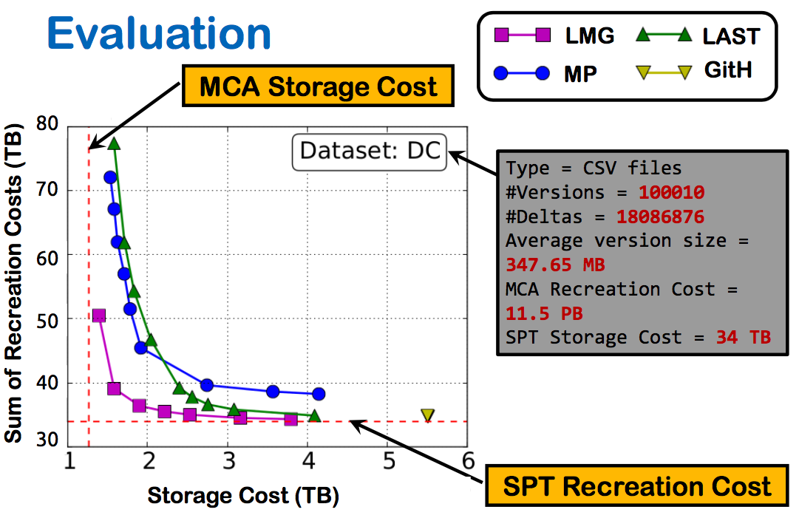
Evaluation
Section 2
Storage budget of 1.1x the MCA reduces total recreation cost by 1000x

