Slide 1
Lecture 18: SQL and UFDs

Slide 2
Today
LA on top of RA
Declarative LA
A System’s Perspective

Slide 3
1. LA on top of RA
Section 1

Slide 4
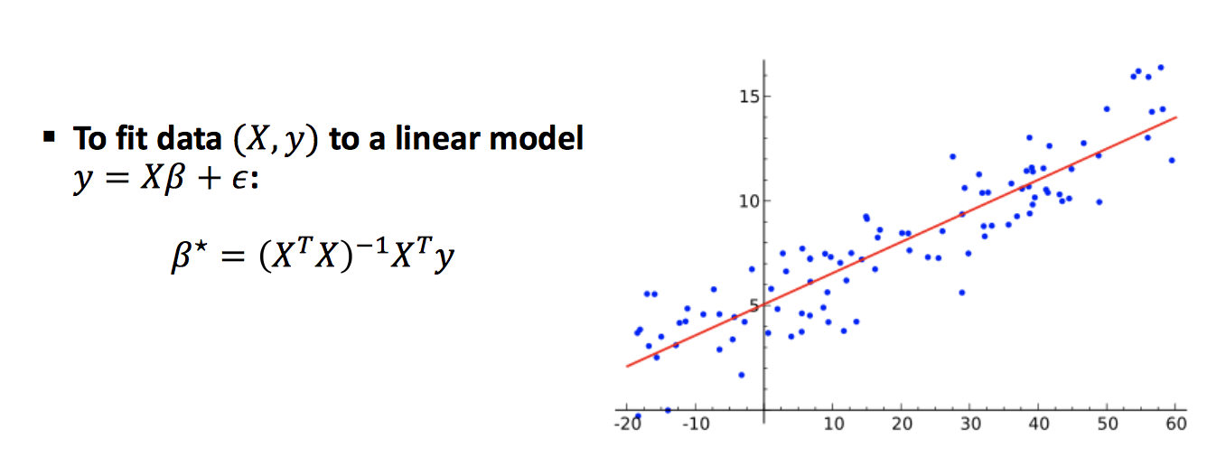
Simplest declarative ML program
Section 1 > MLD
Ordinary Least Squares

Slide 5
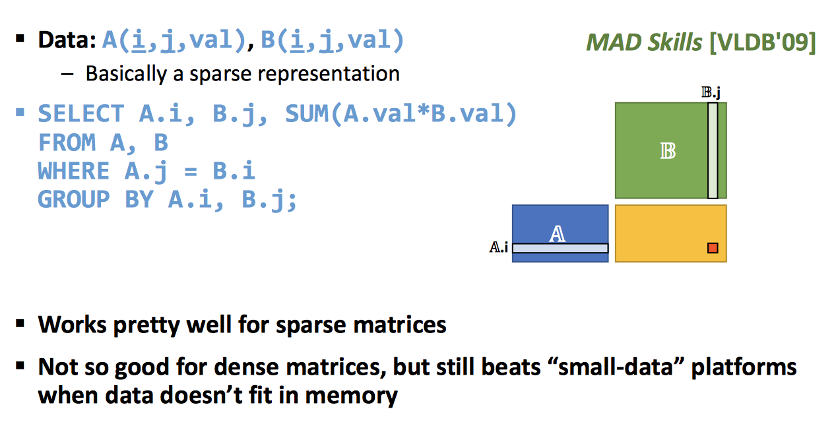
Matrix Multiply
Section 1 > MLD

Slide 6
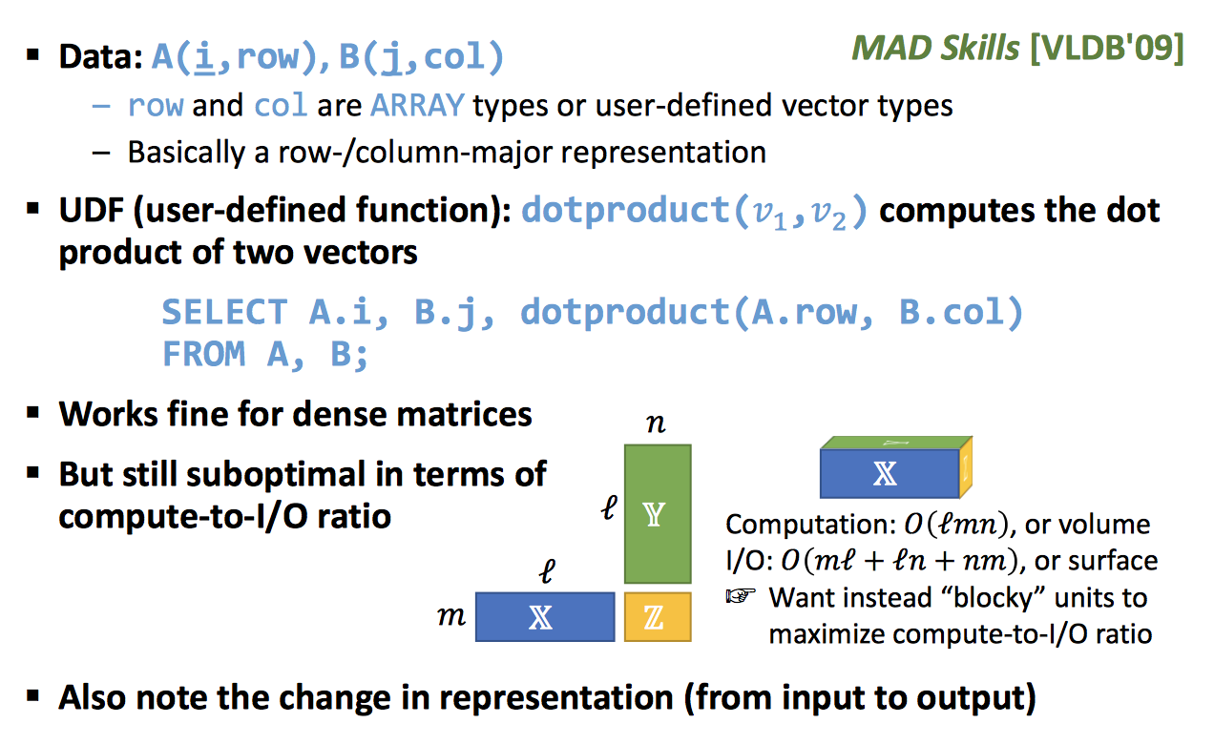
Matrix Multiply v2
Section 1 > MLD

Slide 7
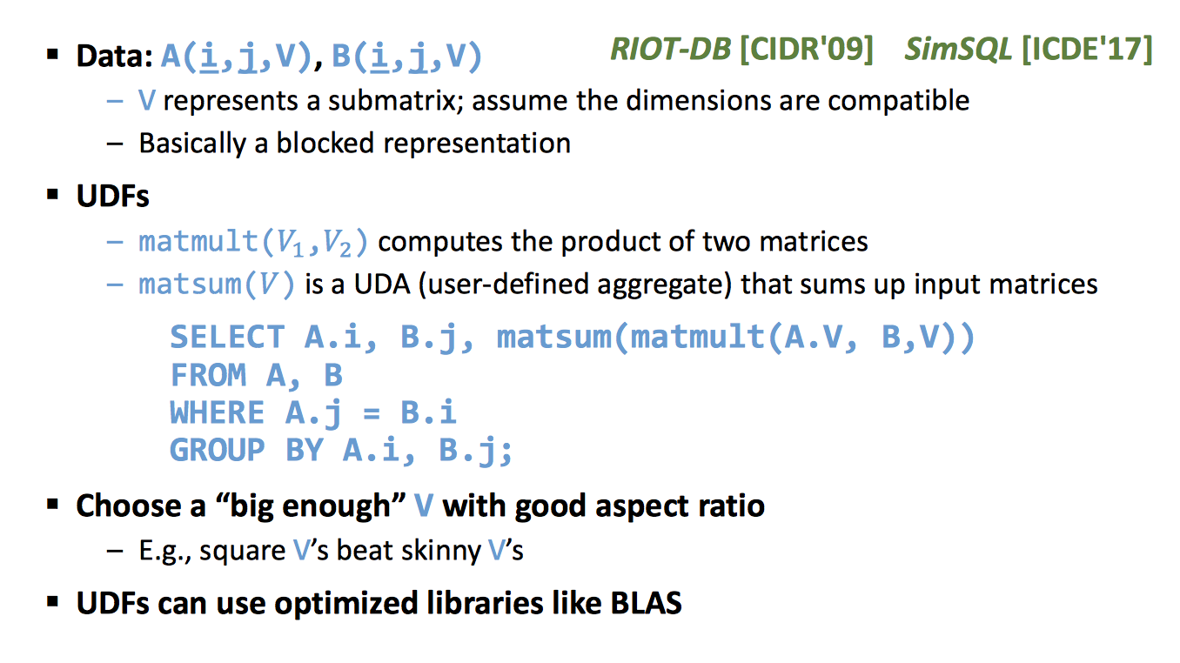
Matrix Multiply v3
Section 1 > MLD

Slide 8
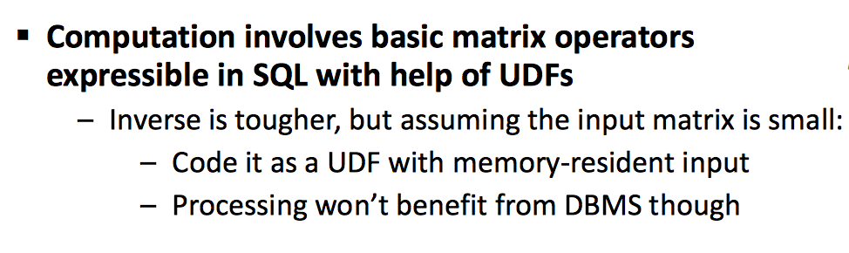
Simplest declarative ML program
Section 1 > MLD
Ordinary Least Squares

Slide 9


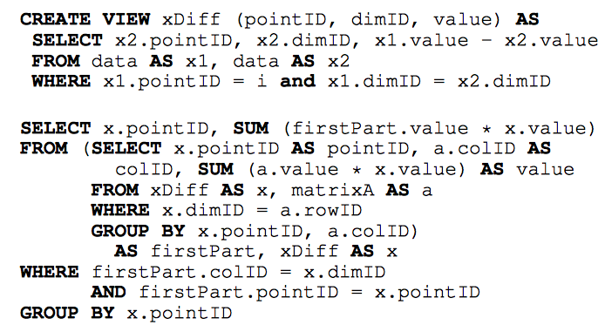
Challenges
Section 1 > MLD
Complexity of writing LA on top of SQL

Slide 10
Challenges
Section 1 > MLD
Performance
Dense data
Number of data dimensions is large
DBs follow an iterator-based model
Fixed cost per tuple
We need vectors-based processing

Slide 11
2. Declarative LA
Section 2

Slide 12


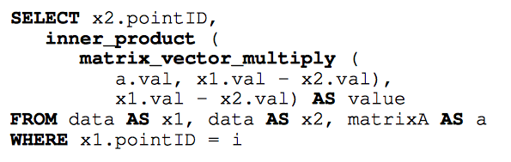
New Types in the Data Model
Section 2
Labeled scalar
Vector
Matrix

Slide 13


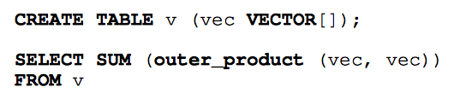
Extensions
Section 2

Slide 14
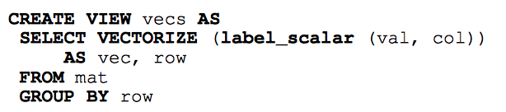

Extensions
Section 2
Create a single tuple with a single matrix from
Solution

Slide 15
3. A System’s Perspective
Section 3

Slide 16
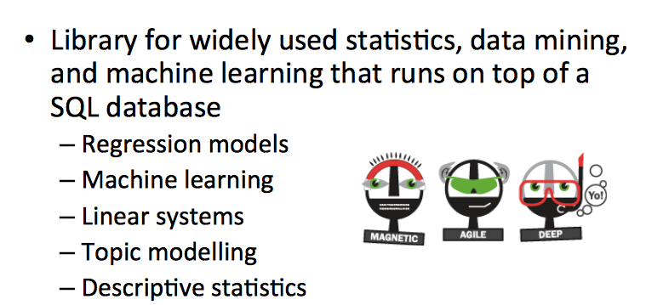
MADlib
Section 3

Slide 17
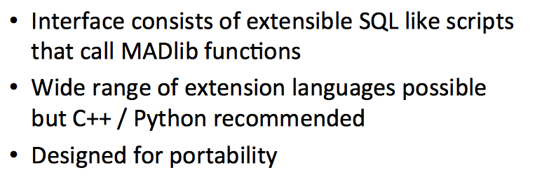
Interface
Section 3

Slide 18
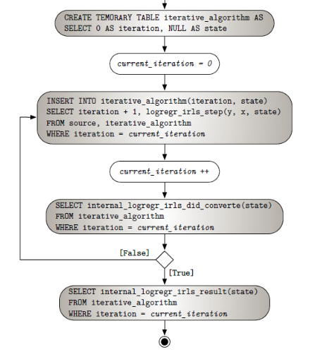
Example: Logistic Regression
Section 3

Slide 19
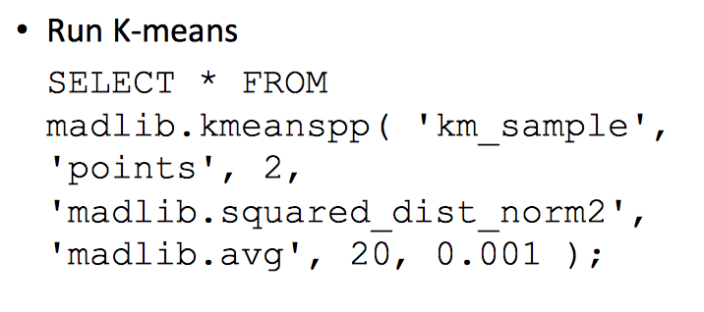
Example: K-means
Section 3

Slide 20
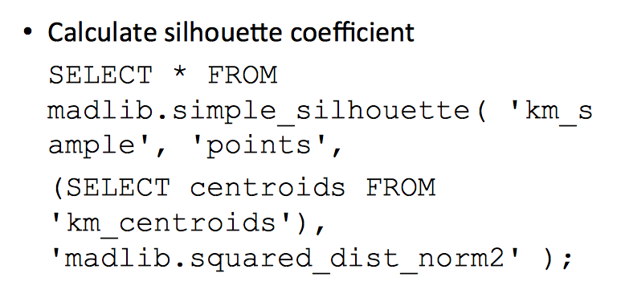
Example: K-means
Section 3

Slide 21
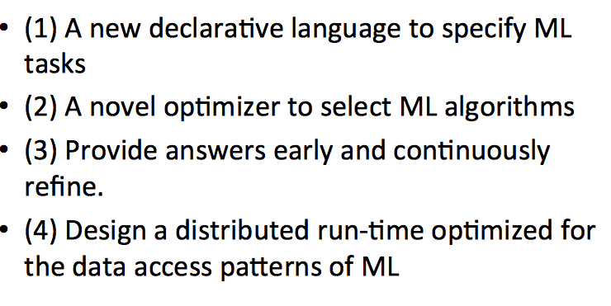
Mlbase: A Distributed ML system
Section 3

Slide 22
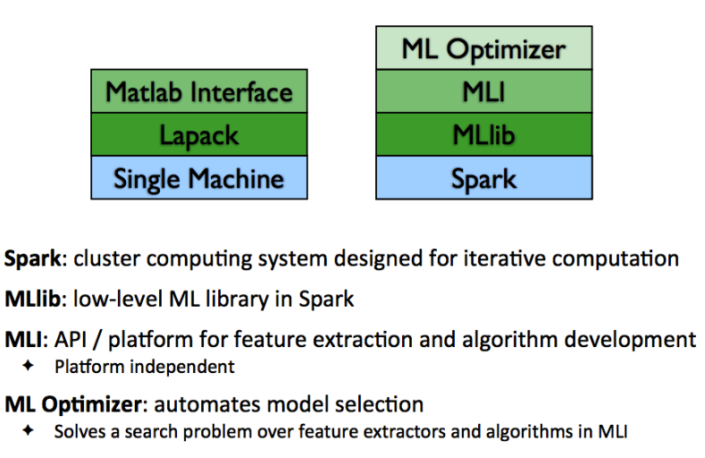
MLbase Stack
Section 3

Slide 23
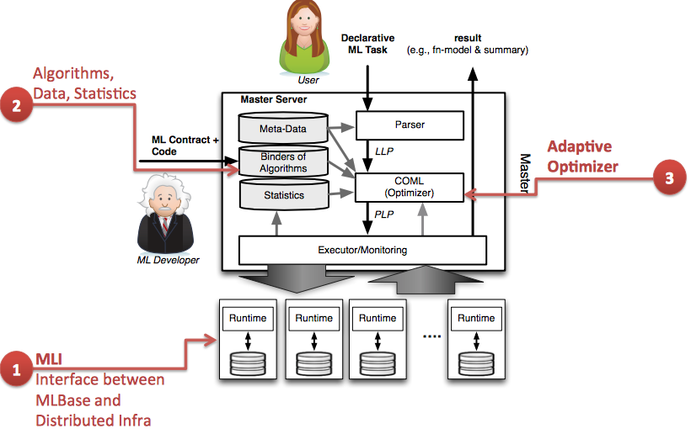
MLbase Architecture
Section 3

Slide 24
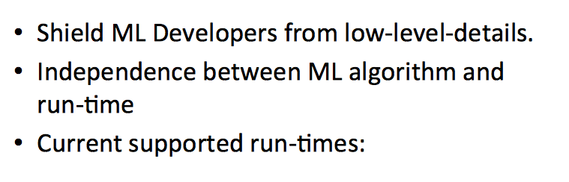
ML Interface
Section 3

Slide 25
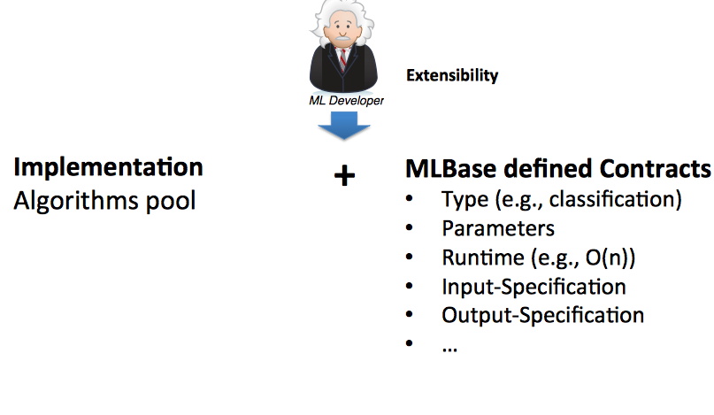
Algorithms Pool
Section 3

Slide 26
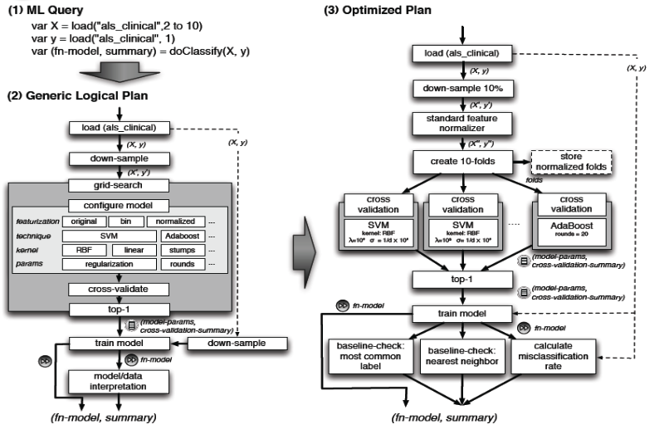
Query Optimization
Section 3

Slide 27
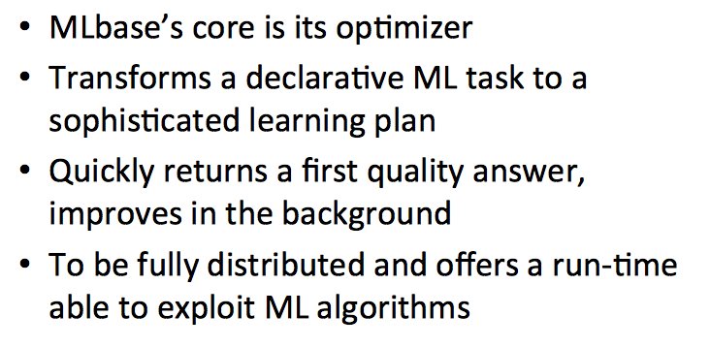
Conclusion

