Slide 1
Lecture 16: Probabilistic Databases
Slides by Gerome Miklau
Based on a tutorial by Dan Suciu

Slide 2
Today’s Agenda
Motivation
Probabilistic Data Semantics
Representation Systems
Complexity

Slide 3
1. Motivation
Section 1

Slide 4
Motivating Applications
Section 1
Text extraction & record linkage
Inconsistent data
Ranking query answers

Slide 5
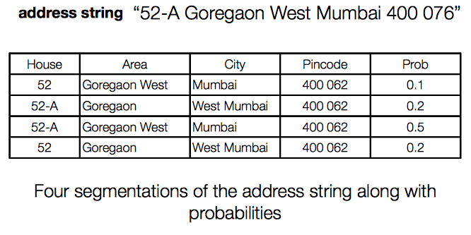
Text extraction
Section 1

Slide 6
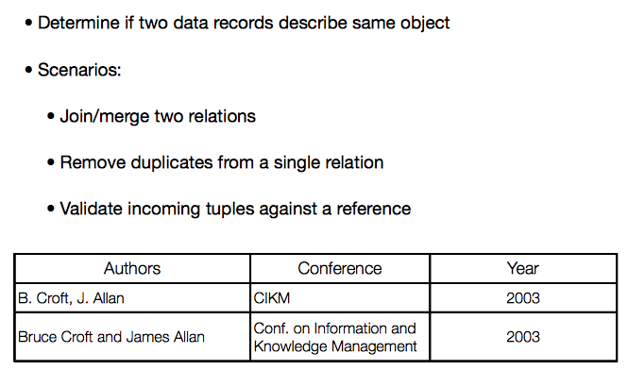
Record Linkage
Section 1

Slide 7
Inconsistent Data
Section 1
Goal: consistent query answers from inconsistent databases
Applications:
Integration of autonomous data sources
Un-enforced integrity constraints
Temporary inconsistencies

Slide 8
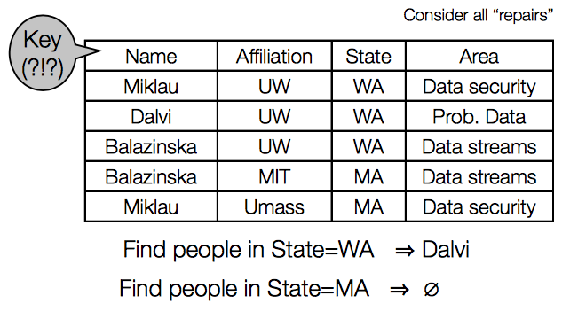
Repair semantics
Section 1

Slide 9
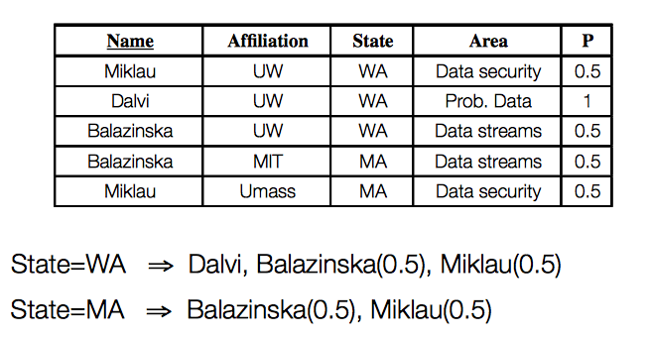
Alternative probabilistic approach
Section 1

Slide 10
Ranking query answers
Section 1
Database is deterministic
Query answers are uncertain:
Query terms loosened due to user’s lack of understanding of the data or schema
The query returns a ranked list of tuples; user interested in top-k

Slide 11
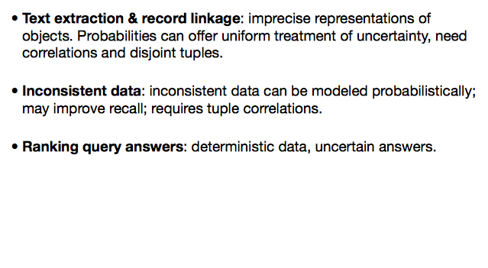
Summary: motivating applications
Section 1

Slide 12
2. Probabilistic Data Semantics
Section 2

Slide 13
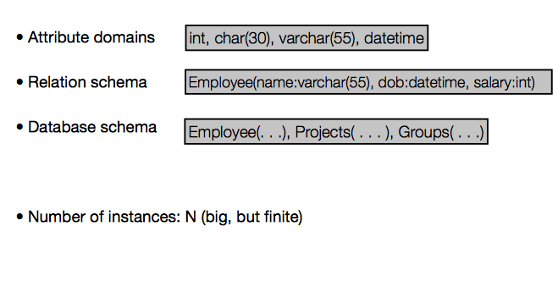
Possible worlds semantics
Section 2

Slide 14
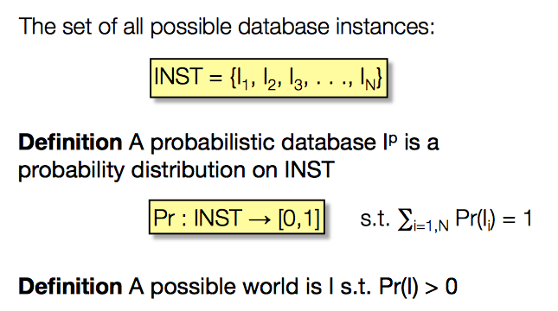
The definition
Section 2

Slide 15
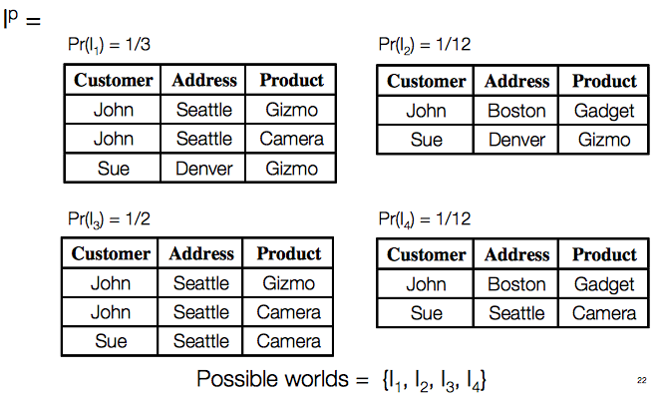
Example
Section 2

Slide 16
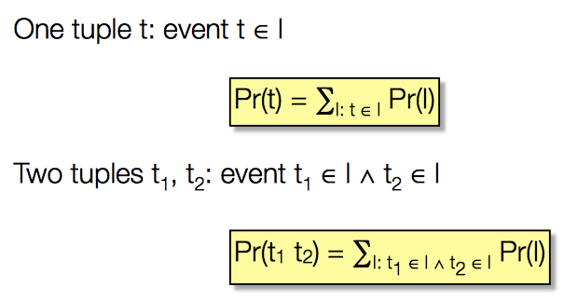
Tuples as Events
Section 2

Slide 17
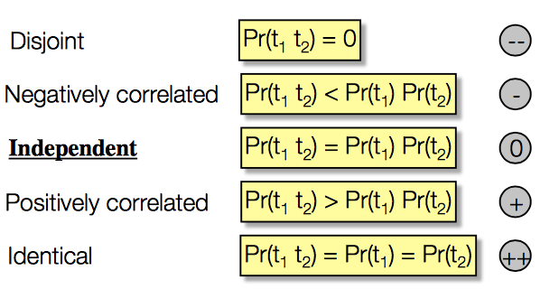
Tuple correlation
Section 2

Slide 18
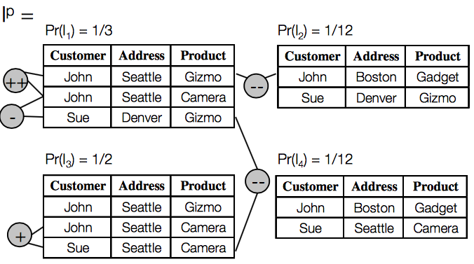
Example
Section 2

Slide 19

Query semantics
Section 2

Slide 20
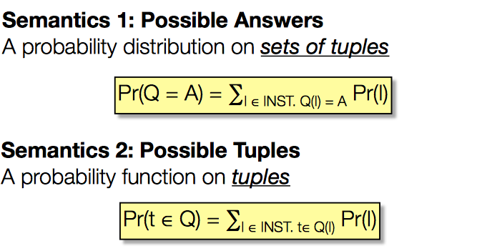
Query semantics
Section 2

Slide 21
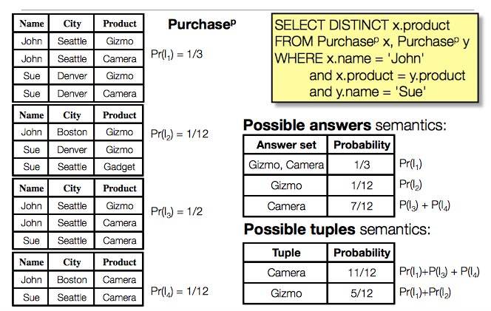
Example: Query Semantics
Section 2

Slide 22
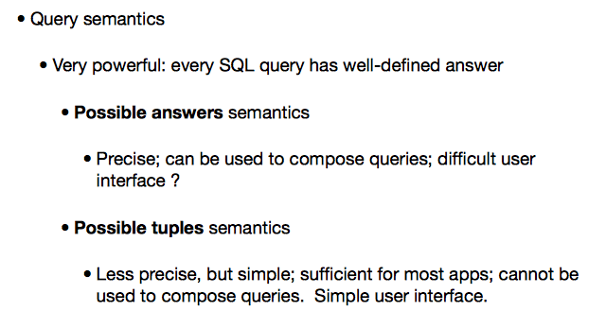
Query semantics
Section 2

Slide 23
3. Representation Systems
Section 3

Slide 24
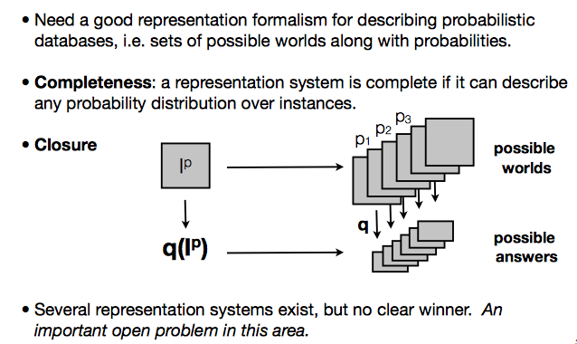
Representation systems
Section 3

Slide 25
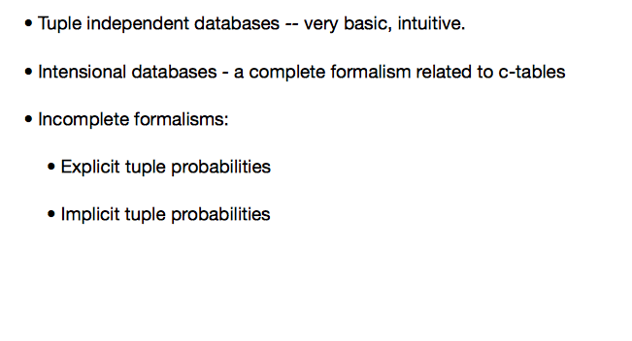
Representation systems
Section 3

Slide 26
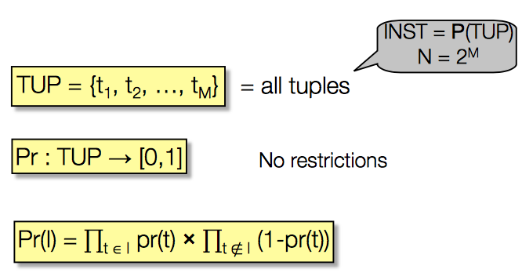
Tuple independent probabilistic database
Section 3

Slide 27
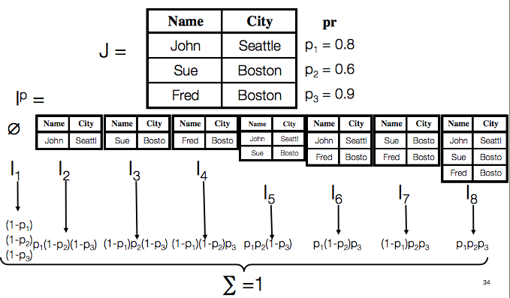
Tuple Prob. -> Possible Worlds
Section 3

Slide 28
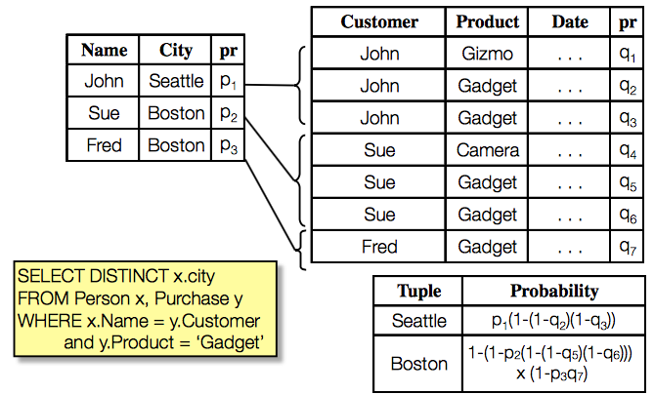
Tuple Prob. -> Query evaluation
Section 3

Slide 29
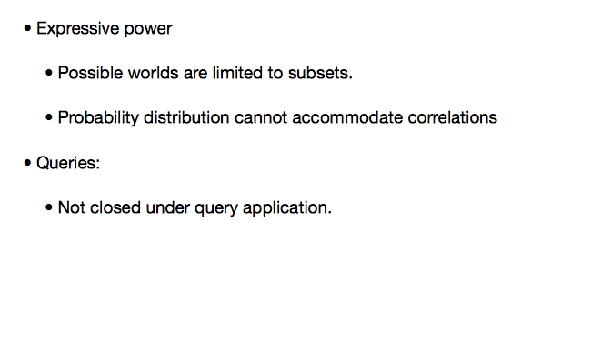
Tuple-independent distributions
Section 3

Slide 30
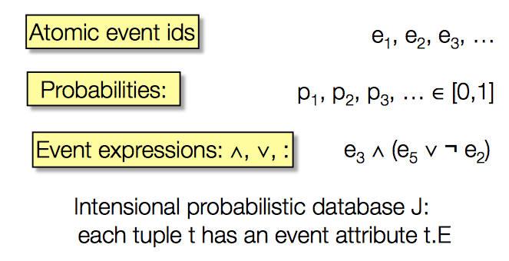
Intensional database
Section 3

Slide 31
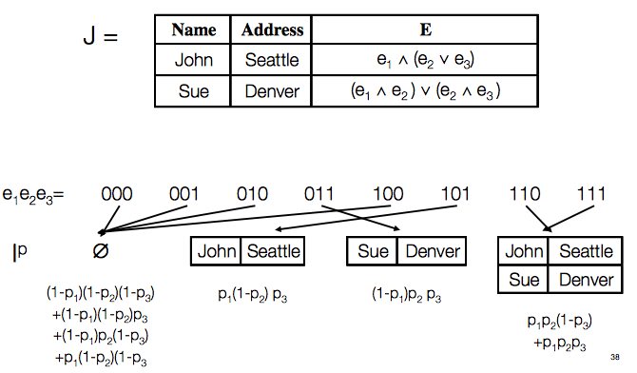
Intensional DB => Possible Worlds
Section 3

Slide 32
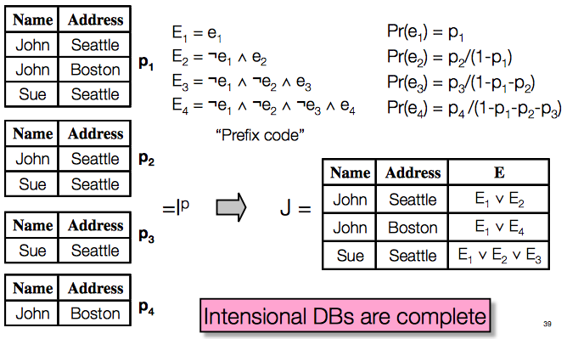
Possible Worlds => Intensional DB
Section 3

Slide 33
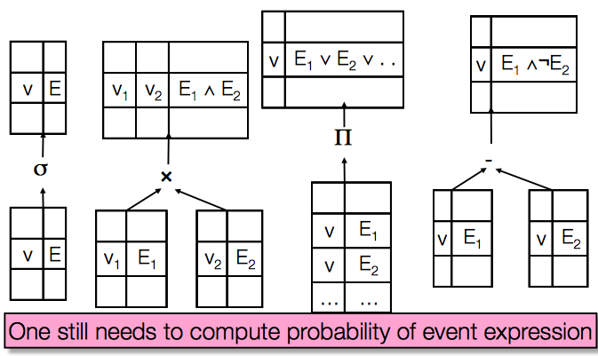
Closure under operators
Section 3

Slide 34
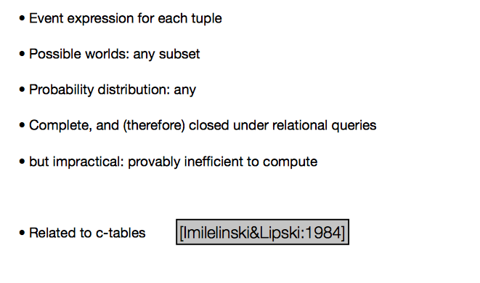
Summary of Intensional Databases
Section 3

Slide 35
4. Complexity
Section 4

Slide 36
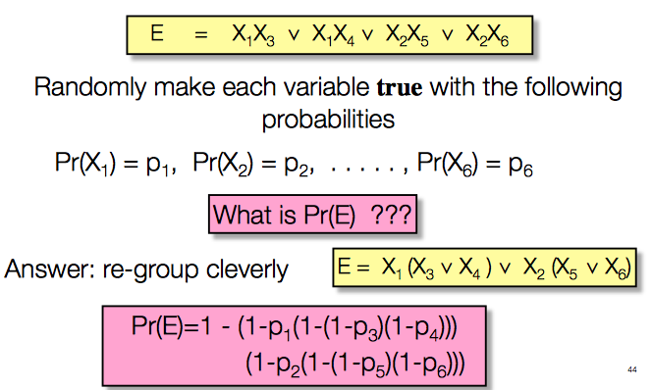
Probability of boolean expressions
Section 4

Slide 37

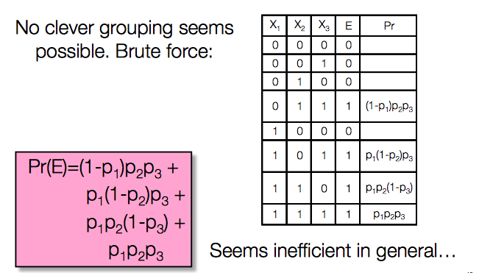
Example
Section 4

Slide 38
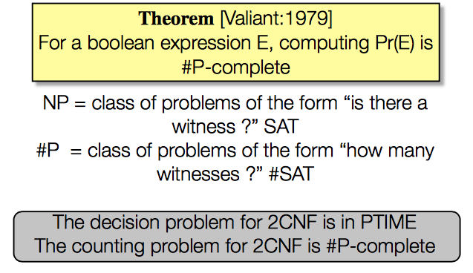
Complexity of Boolean Expression Probability
Section 4

Slide 39
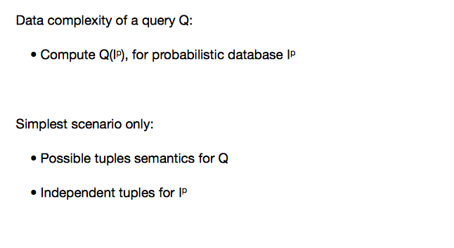
Query complexity
Section 4

Slide 40
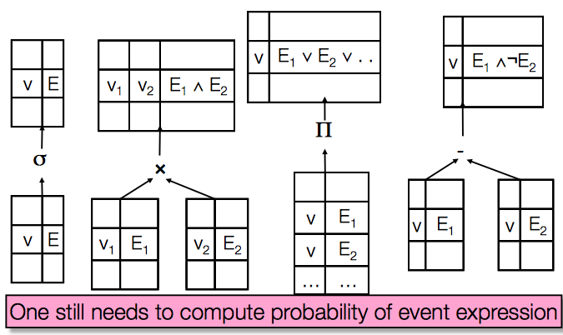
Intensional query evaluation
Section 4

Slide 41
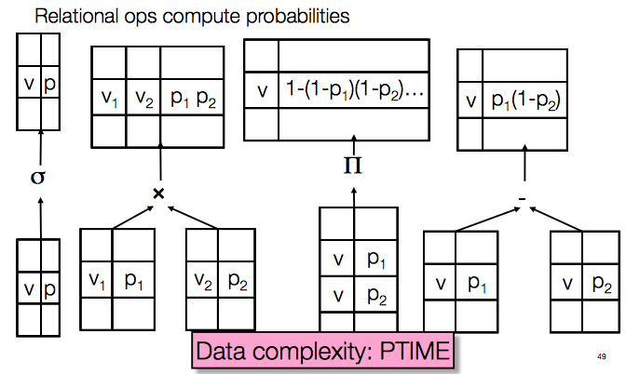
Extensional query evaluation
Section 4

Slide 42
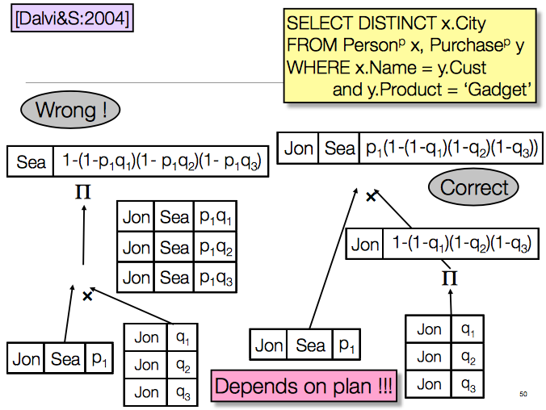
Section 4

Slide 43
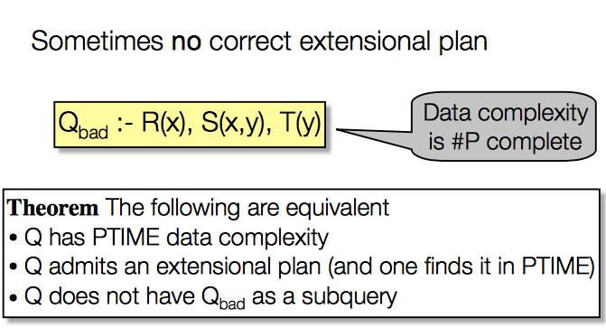
Query complexity
Section 4

Slide 44
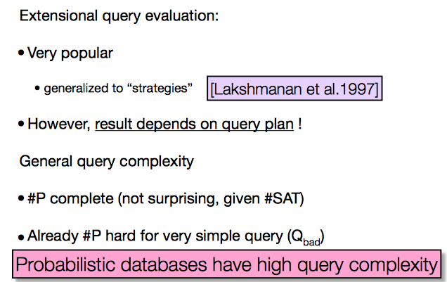
Summary on query complexity
Section 4

