Slide 1
Lecture 15: Data Cleaning for ML

Slide 2
Announcements
Intermediate report due right after spring break: 4/3
Required elements: https://cs.stanford.edu/people/widom/paper-writing.html
Introduction
Related work
Outline of contribution and technique
Experimental setup https://drive.google.com/drive/folders/1tdPe6H77DL0lHb7JOvl2In-xc5Cahx3u
Project meetings next week
Send me emails if you want to meet

Slide 3
Today’s Agenda
Recap on ML models
Training under noise

Slide 4
1. Recap on ML models
Section 1

Slide 5
What is ML all about?
Section 1
Minimization of a modular loss
Example for a linear model

Slide 6
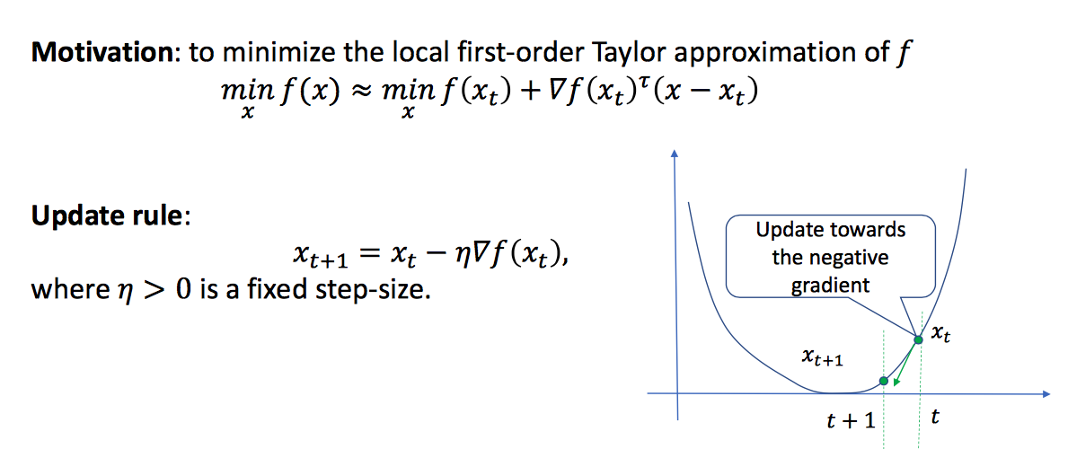
Gradient Descent [Cauchy 1847]
Section 1

Slide 7
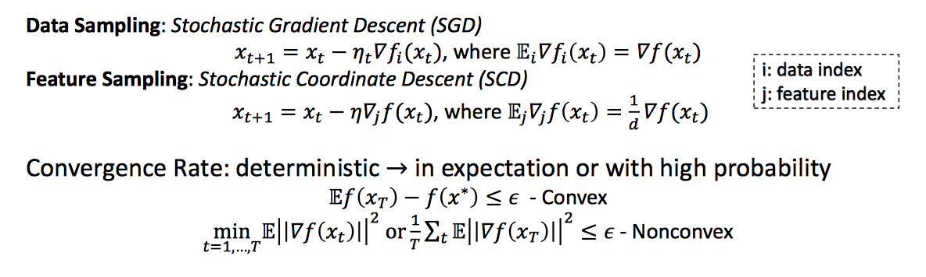
Stochastic Methods
Section 1

Slide 8
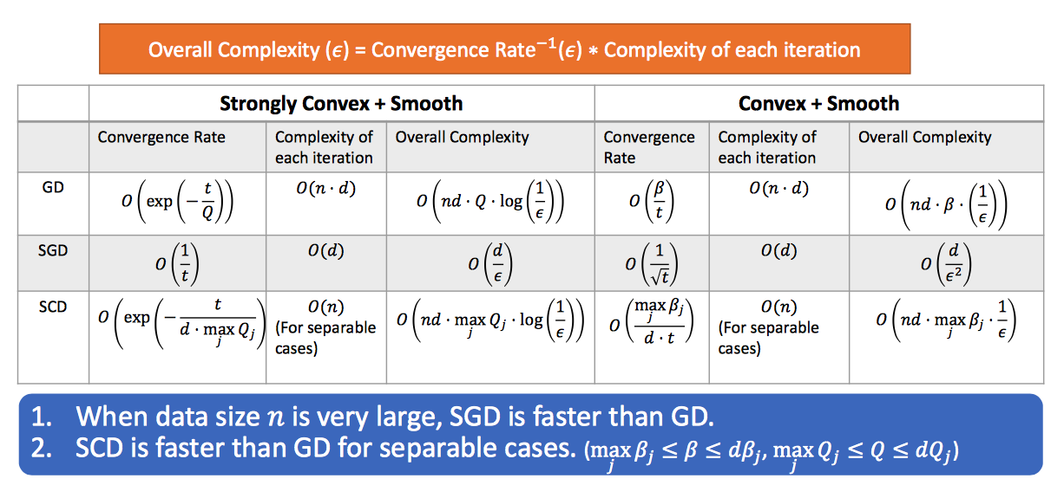
Convergence Rate and Computational Complexity
Section 1

Slide 9
2. Training under noise
Section 2

Slide 10
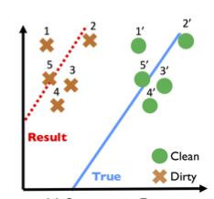
What is the problem with noise?
Section 2
Optimizing for data obtained by a different distribution.
Empirical risk is different.

Slide 11
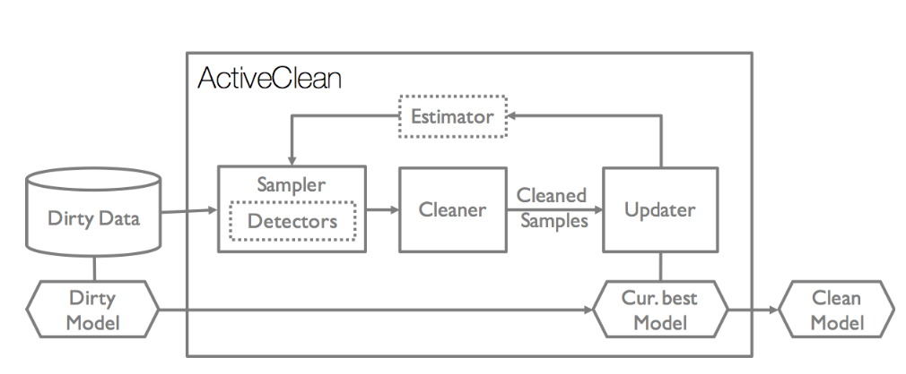
How can we deal with noise?
Section 2

Slide 12
How can we deal with noise?
Section 2

Slide 13
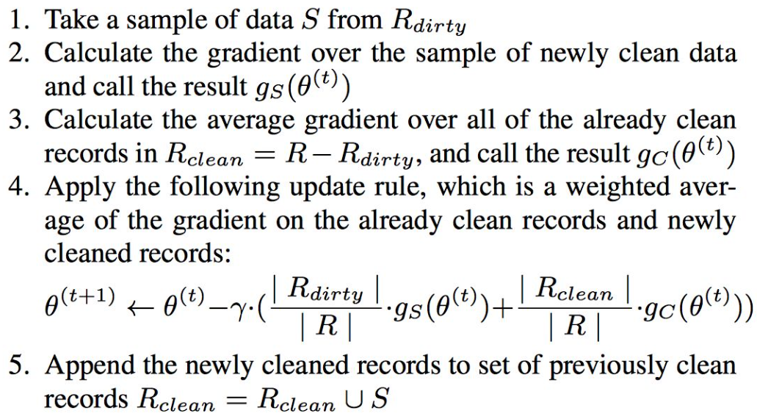
Model update
Section 2

Slide 14


Estimating the gradient
Section 2

Slide 15
Detecting Dirty Data
Section 2
Detector returns:
Whether a record is dirty
And if it is dirty, which attributes have errors
Enumerate set of records that violate at least one rule:
Clean data = union between the set of clean data and records that satisfy all rules
Dirty = violate at least one rule
Adaptive methods for detection = train a classifier

Slide 16
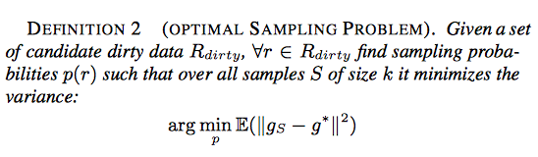

Selecting which records to clean
Section 2
Sampling problem
Minimize the variance of the sampled gradient
Use a detector to estimate cleaned values

Slide 17

Selecting which records to clean
Section 2
Estimator:
Estimate clean gradient using the dirty gradient and previous cleaning actions
Linear approximation of gradient: uses average change of each feature value

Slide 18
Strengths? Weaknesses?
Section 3
Discussion time!

