Slide 1
Lecture 24: Model Hub

Slide 2
Announcements
No class on Thursday: Push for the projects.
Presentations next week:
15+3 minutes per group
Should be like a conference presentation
Motivation, problem + background, approach, results
Tuesday 5/1: Groups 1 - 4
Thursday 5/3: Groups 5 - 8

Slide 3
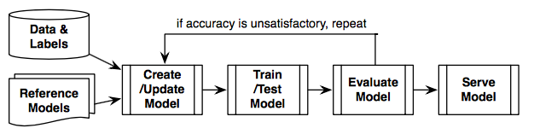
Deep learning everywhere
Everyone is using DL models
Multiple users/models even for the same task
Train, evaluate, and serve.

Slide 4
Beyond training
Current tools focus on model building, training, and evaluation of single model
How do we reason about model variations?
Different architectures, features
Questions/Tasks:
How to understand and compare models?
How to adjust models? Hyperparameter tuning
Model versioning: reuse weights for warm start
Parameter archiving
Model results

Slide 5
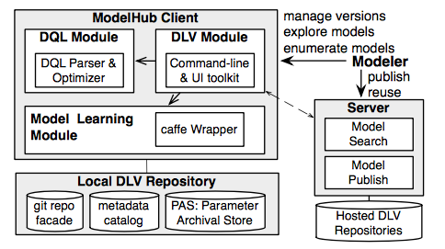
ModelHub
ModelHub: Manage DL lifecycle artifacts.
Model versioning: store and query models
Model network adjustment and hyper parameter tuning
Deep learning model sharing to exchange model repositories and enable publishing, sharing and reuse.

Slide 6
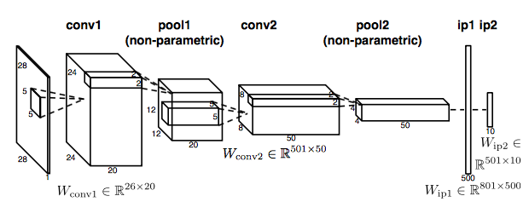
Representing DNNs
Function relationships (f_{i}, f_{i-1}). A DNN is a DAG
Layers or arithmetic operations can be functions

Slide 7
Version Control System
A model version:
Network definition
Collection of weights
Metadata: hyperparameters, accuracy, loss
Other files: scripts, datasets
Use the versioning ideas from Datahub

Slide 8
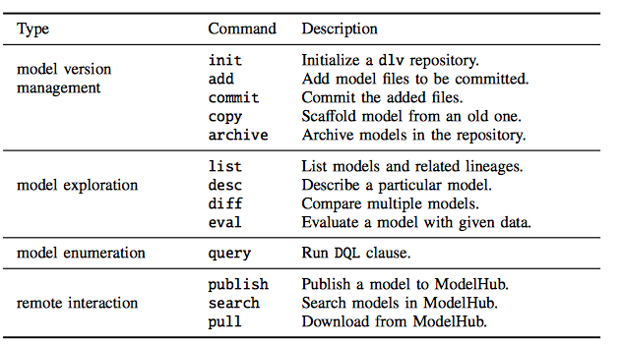
Model versioning operations
Model exploration queries
Model enumeration queries
Remote Interaction

Slide 9
Query Facilities: Explorations Queries
List Models and related lineages
Obtain commit descriptions and parent versions
Describe model
Show extracted metadata from a model version
Compare models
diff over models: compare DNN models (architectures)
Evaluate a model

Slide 10
Query Facilities: EnumerationQueries
Select models from repo
Slice models to get components
Construct new models by mutating existing ones
Try new configs on existing models
Design a domain-specific language for ModelHub. Based on SQL.

Slide 11
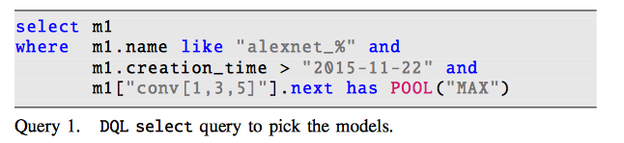
DQL examples

Slide 12
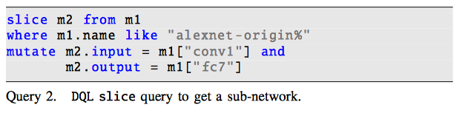
DQL examples

Slide 13
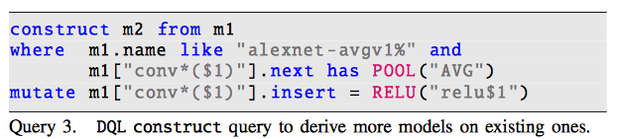
DQL examples

Slide 14
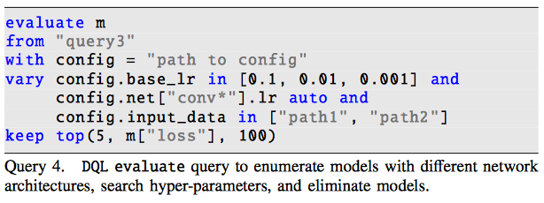
DQL examples

Slide 15
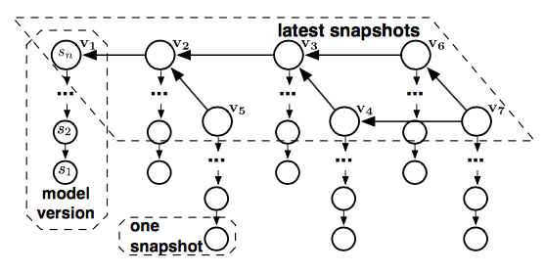
Parameter Archival Storage
Use a version graph
Snapshots corresponds to model instances during training
Nodes V correspond to model versions
Question: How do you store all this data?

Slide 16
Challenges
Similarity among fine-tuned models (e.g., similar parameters)
Co-usage constraints
Low-precision tolerance (DNNs tolerate small variances)
Unbalanced access frequencies (not all models are great)

Slide 17
Float Data
Use standard tricks:
Lower the precision
Used fixed point encoding
Quantization
Still high-entropy of float numbers
Separate high-order and low-order bits
Float matrix is stored in multiple chuncks:8 high-order bits first rest are segmented in one byte per chunk.
Delta encoding between checkpointed snapshot in one model and latest snapshots across multiple model versions.

Slide 18
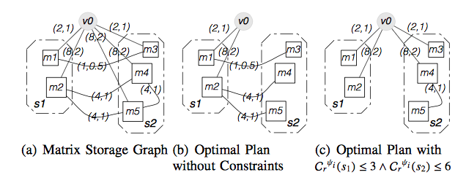
Matrix Storage and Graph Plan
Same problems now as versioning control we saw before.
Optimize for average snapshot recreation or storage cost

Slide 19
Model Evaluation
Apply DNN on a data point to get the prediction
For exploration: Decompress and evaluate a model
Expensive!
Segmented parameters: you know min – max for that range
If prediction is the same then no need to access lower order bytes
Think of stability

Slide 20
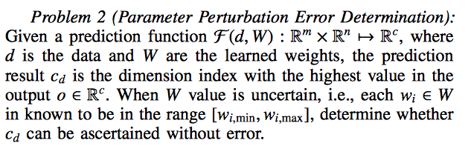
Model Evaluation

Slide 21

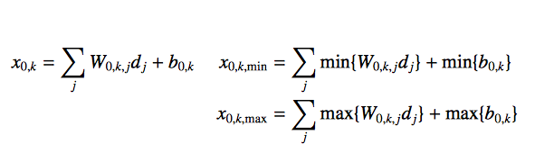
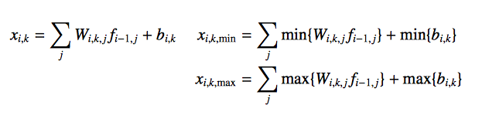
Progressive Model Evaluation

Slide 22
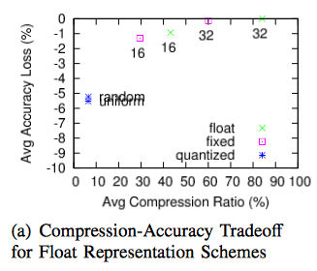
Evaluation

Slide 23
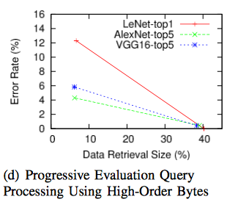
Evaluation

Slide 24
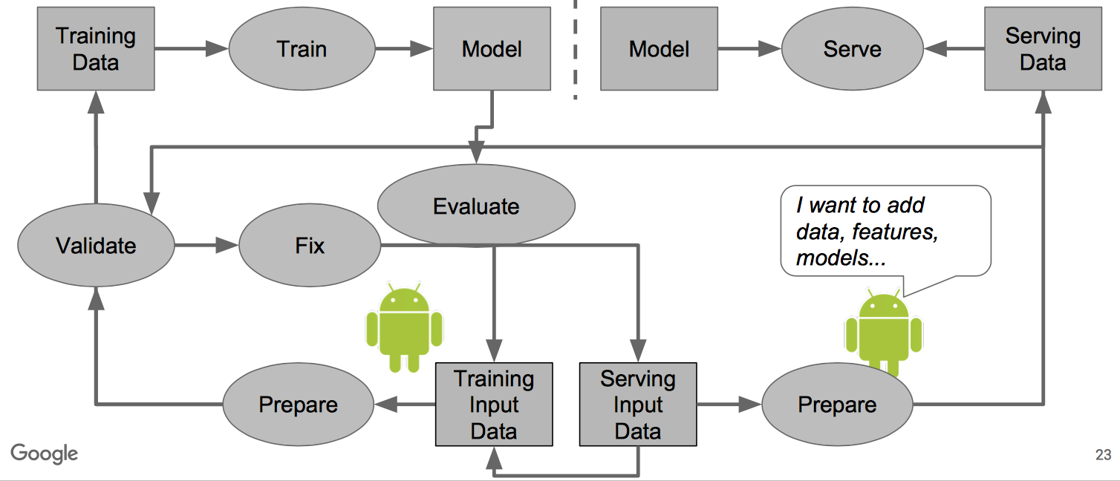
Conclusions

Slide 25
Reminder
No class on Thursday: Push for the projects.
Presentations next week:
15+3 minutes per group
Should be like a conference presentation
Motivation, problem + background, approach, results
Tuesday 5/1: Groups 1 - 4
Thursday 5/3: Groups 5 - 8

