Slide 1
Lecture 20: Scaling Inference with RDBMS
Slides by Niu et al.

Slide 2
Today
Markov Logic
Scaling up grounding with RBDMS
Scaling up search with partitioning
Main-memory Statistical Analytics

Slide 3
1. Markov Logic
Section 1

Slide 4
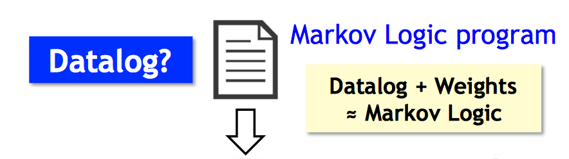
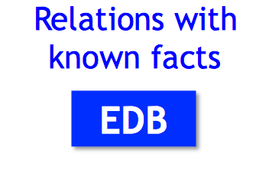
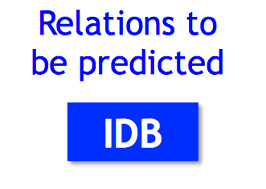


Data Model
Section 1

Slide 5
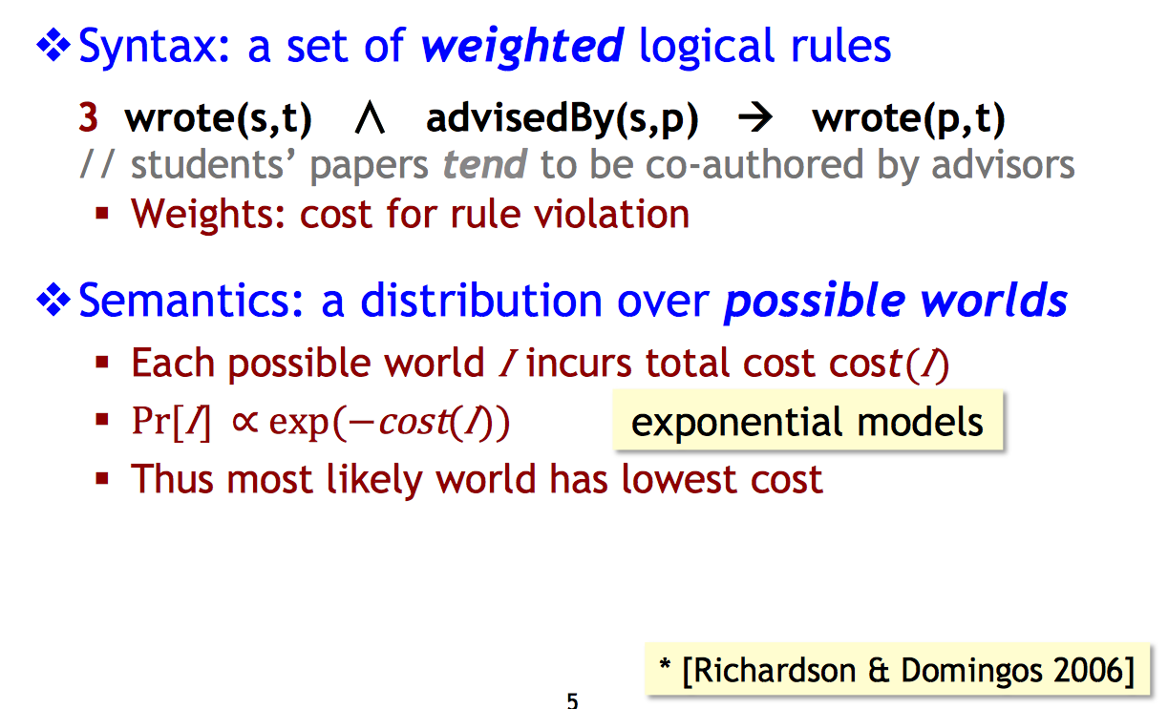
Markov Logic*
Section 1

Slide 6
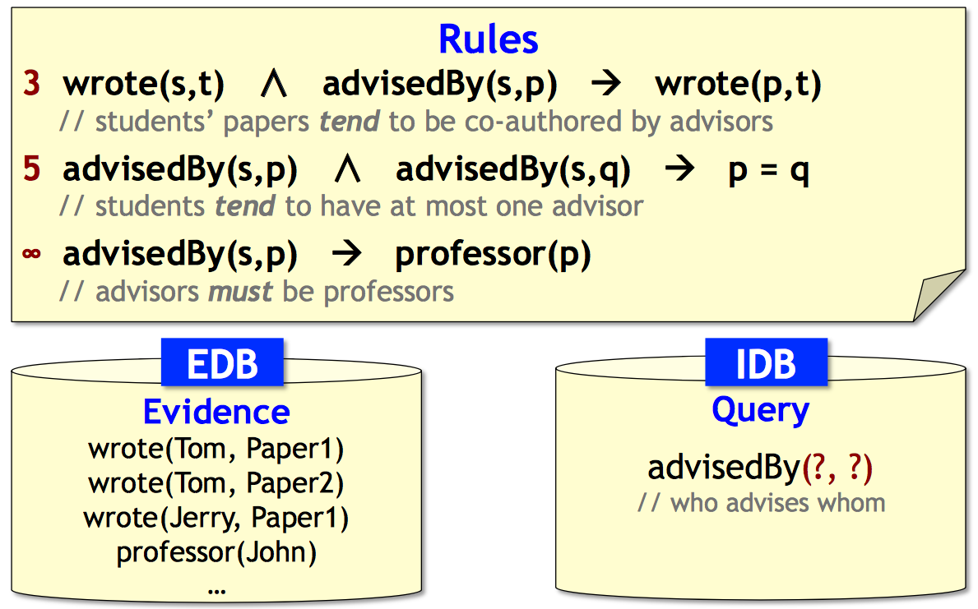
Markov Logic by Example
Section 1

Slide 7
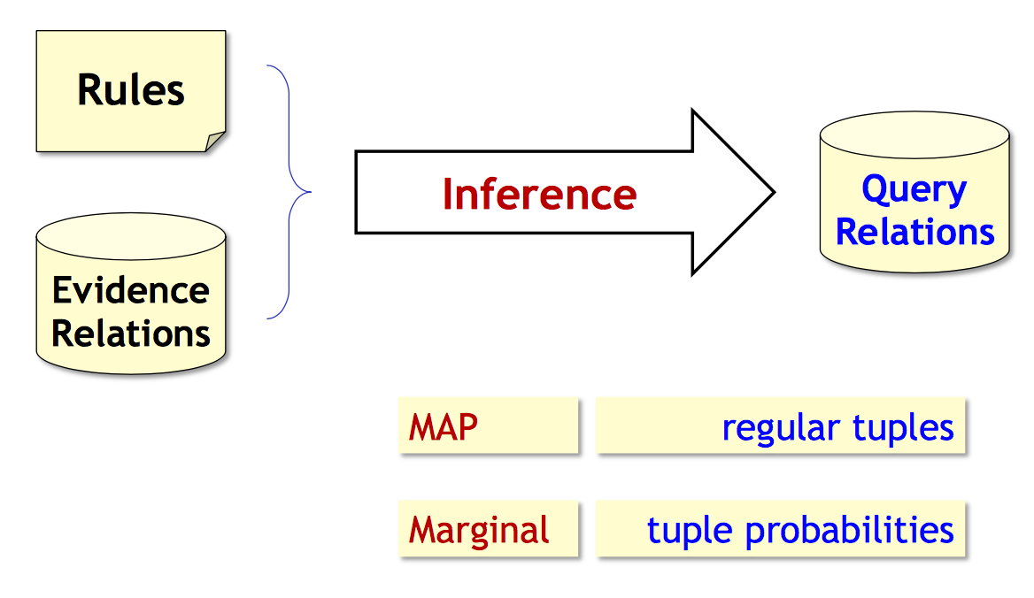
Inference
Section 1

Slide 8
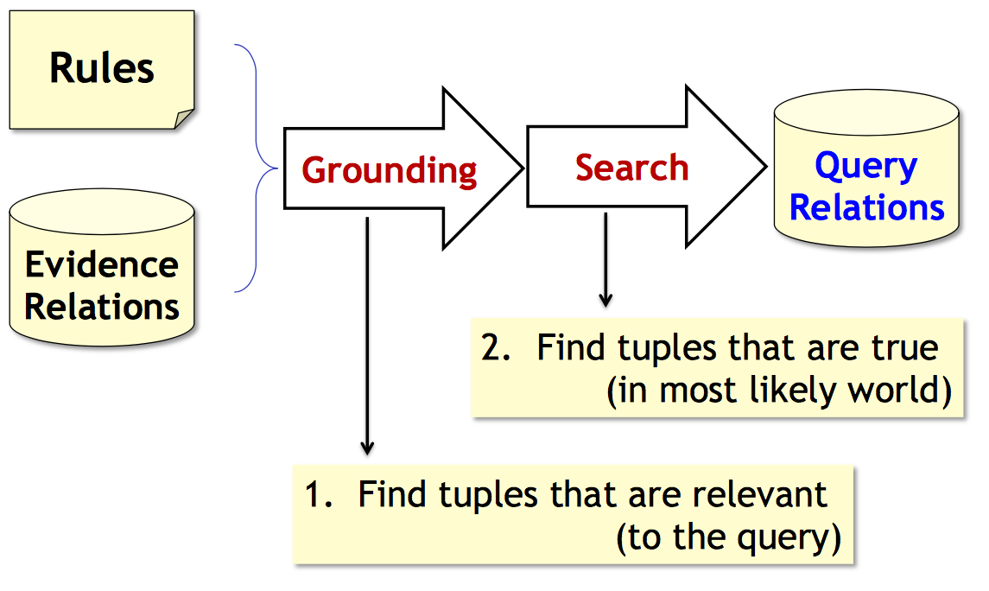
Inference
Section 1

Slide 9
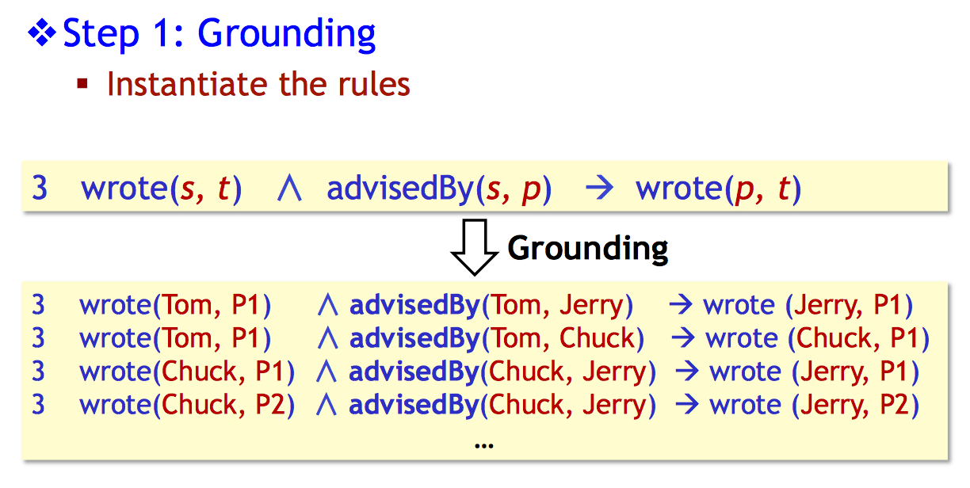
How to Perform Inference
Section 1

Slide 10
How to Perform Inference
Section 1

Slide 11
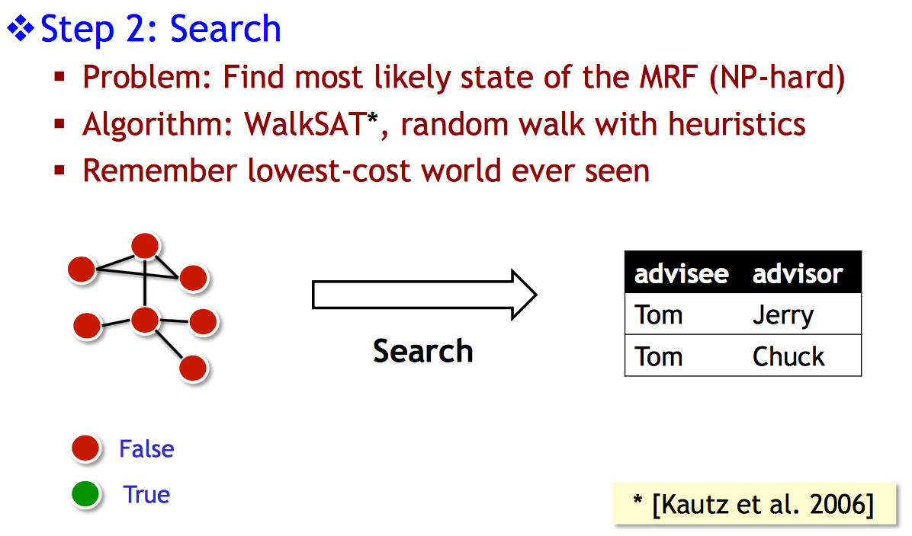
How to Perform Inference
Section 1

Slide 12
2. Scaling up Grounding with RDBMS

Slide 13
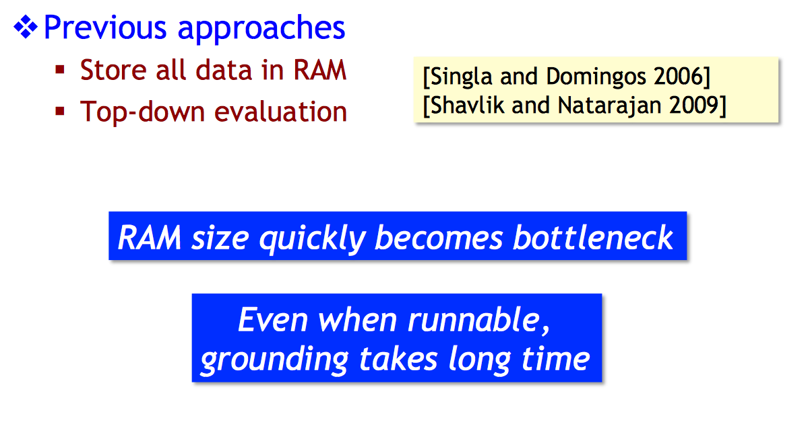
Challenge
Section 2

Slide 14
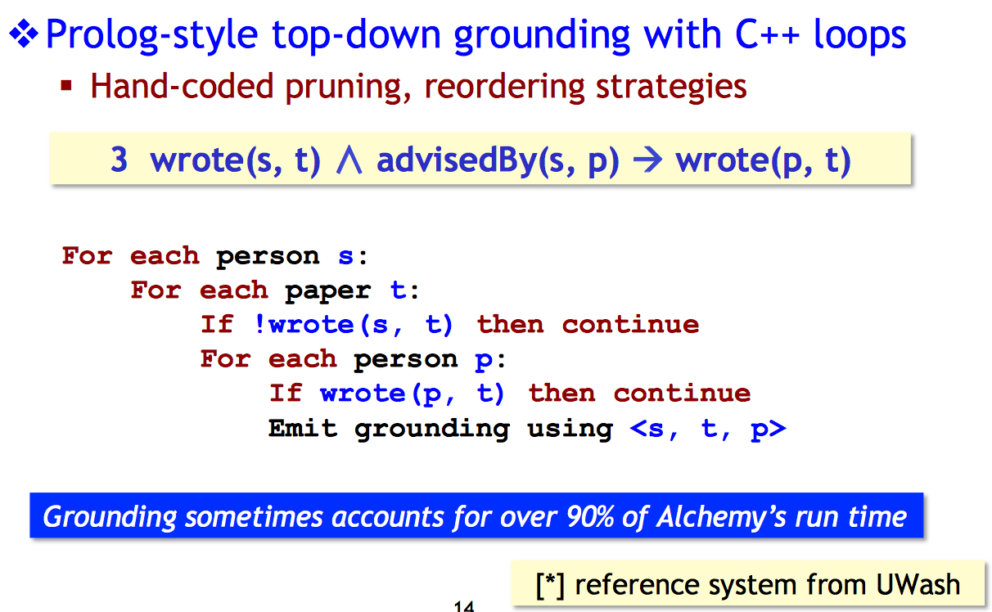
Grounding in Alchemy*
Section 2

Slide 15
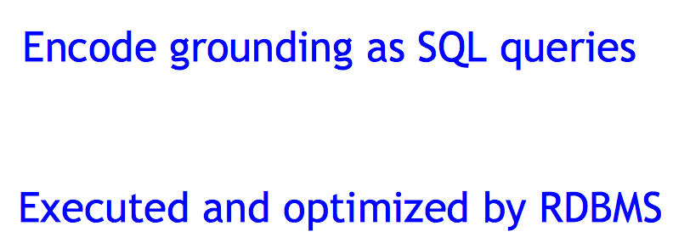
Grounding with RDBMS
Section 2

Slide 16
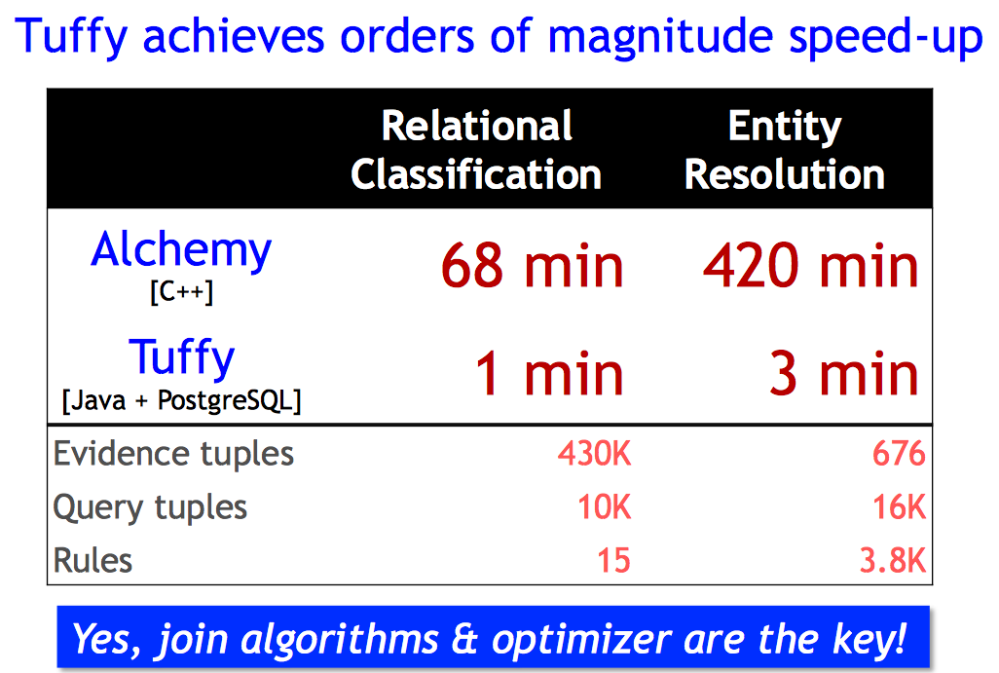
Grounding Performance
Section 2

Slide 17
3. Scaling Search

Slide 18
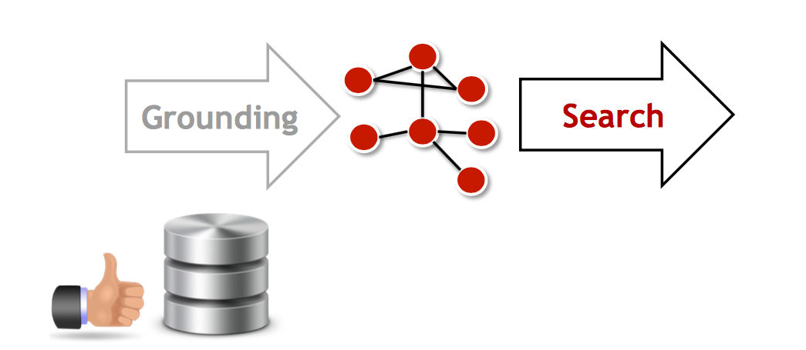
Scaling Search
Section 3

Slide 19
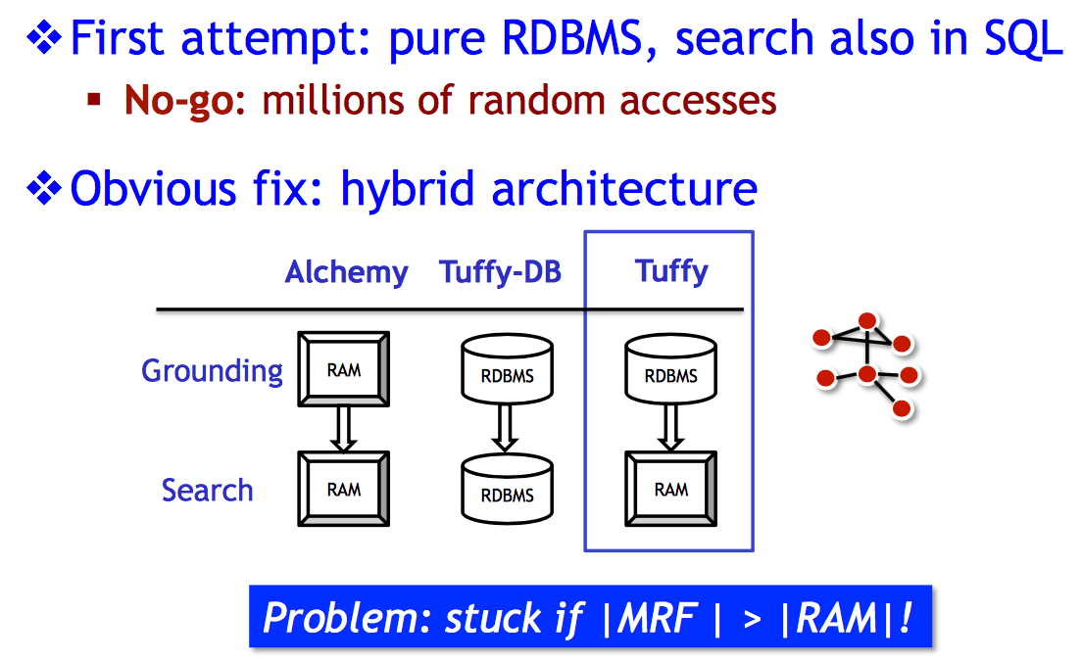
Scaling Search
Section 3

Slide 20
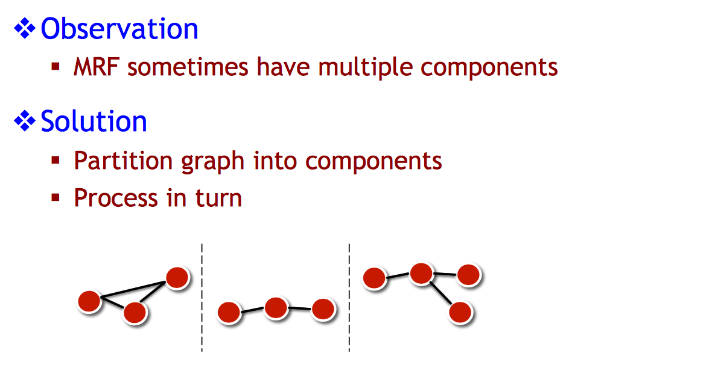
Partition to Scale up Search
Section 3

Slide 21
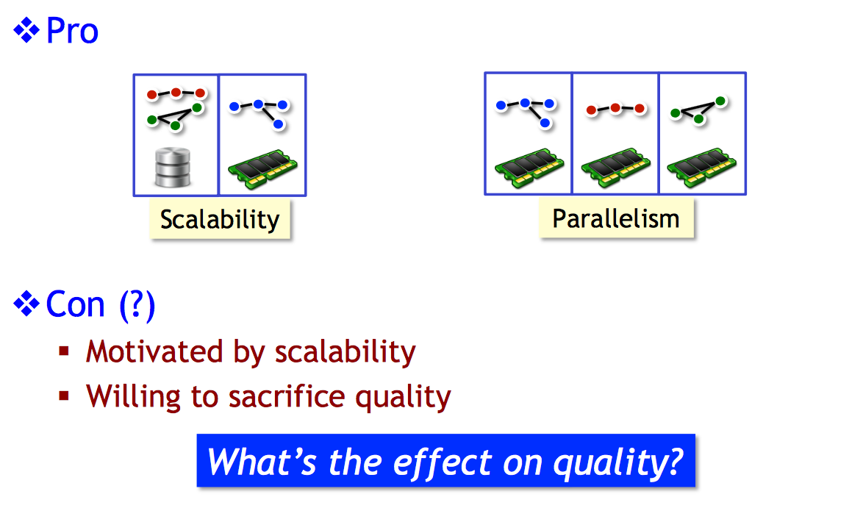
Effect of Partitioning
Section 3

Slide 22
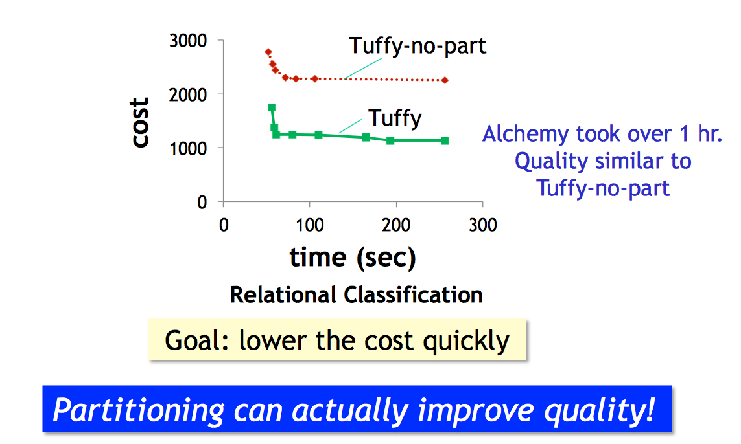
Partitioning vs Quality
Section 3

Slide 23
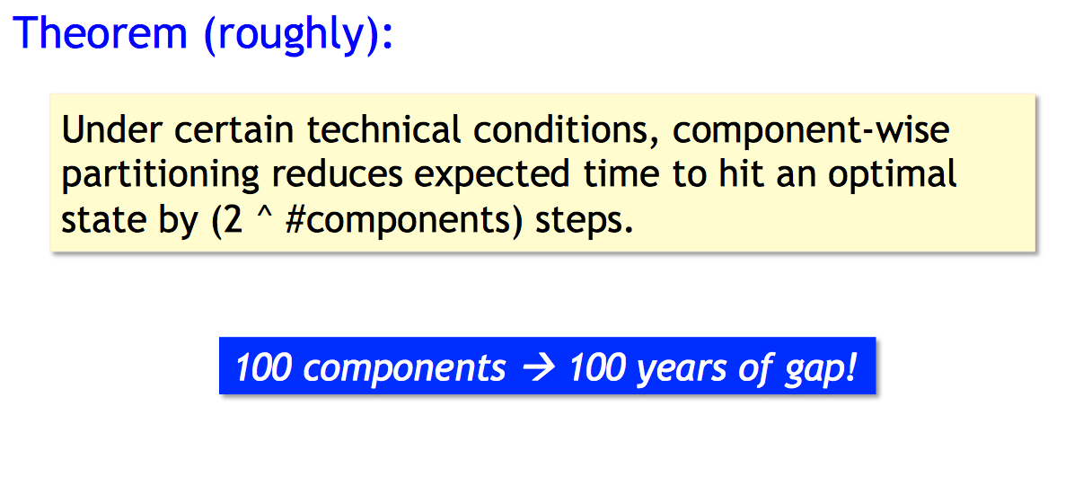
Partitioning Improves Quality
Section 3

Slide 24
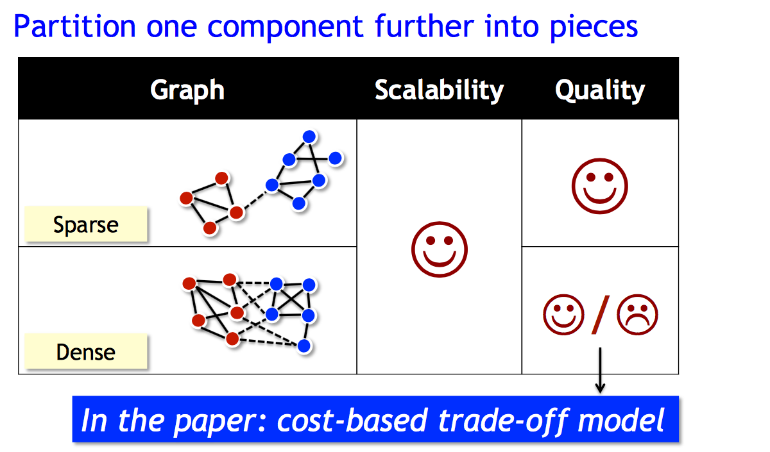
It’s all about tradeoffs
Section 3

Slide 25
4. Main-Memory Statistical Analytics

Slide 26
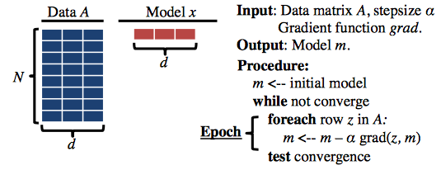
Memory Model and SGD
Section 3

Slide 27
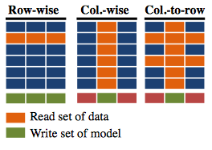
Access Methods
Section 3

Slide 28
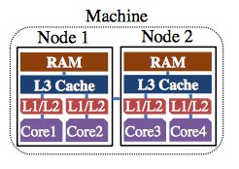
Modern Architectures
Section 3

Slide 29
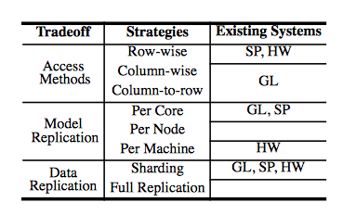
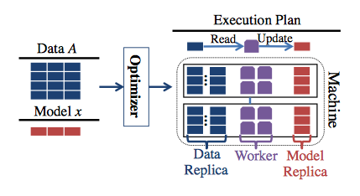
It’s all about tradeoffs
Section 3

Slide 30
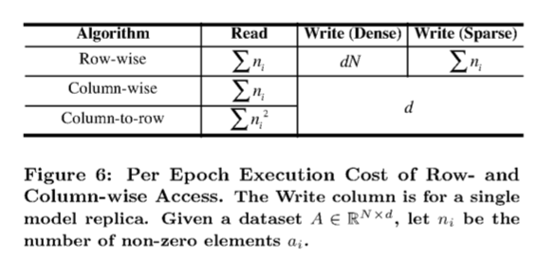
It’s all about tradeoffs
Section 3

Slide 31
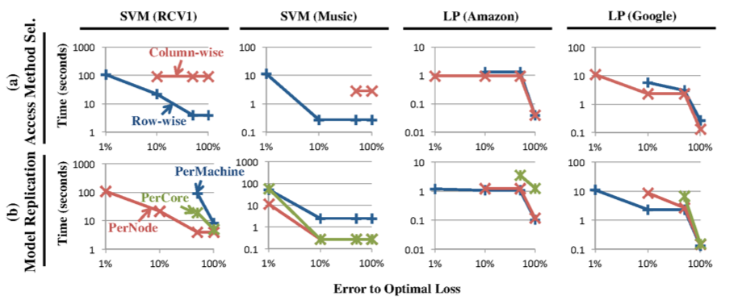
It’s all about tradeoffs
Section 3

Slide 32
Conclusion
Optimized data access makes a difference
It’s critical to understand and exploit tradeoffs
Modern hardware introduces new opportunities

