Slide 1
Lecture 13: Error Detection

Slide 2
Today’s Agenda
Data Errors and Detection
Qualitative Error Detection
Combining Error Detectors

Slide 3
1. Data Errors and Detection
Section 1

Slide 4
What is a Data Error?
Section 1

Slide 5
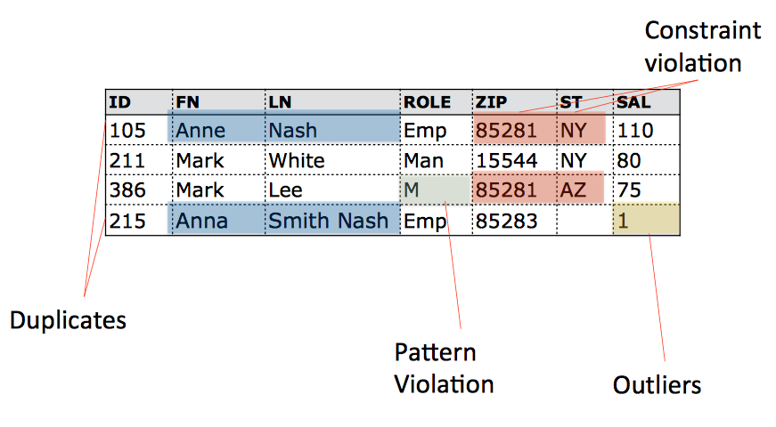
What is a Data Error?
Section 1

Slide 6
Error Detection Strategies
Section 1
Rule-based detection algorithms
Constraint violations, FDs, CFDs, Denial Constraints
Pattern verification and enforcement
Syntactic patterns (date formatting)
Semantic patterns (location names WI)
Quantitative methods
Statistical outliers
Deduplication

Slide 7
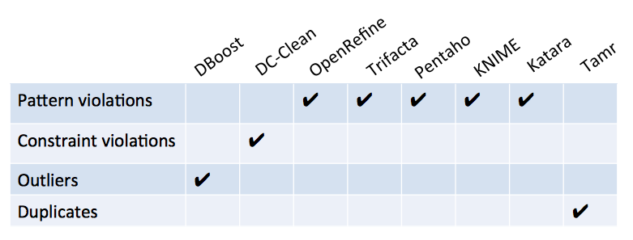
Variety of tools
Section 1

Slide 8
2. Qualitative Error Detection
Section 2

Slide 9
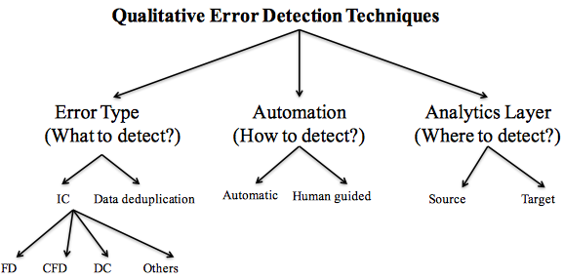
Error Detection Taxonomy
Section 2

Slide 10
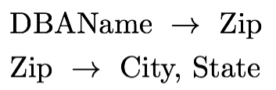
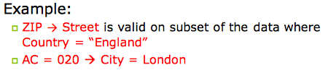
FDs and CFDs
Section 2
Functional dependency (FD):
Conditional Functional Dependency (CFD):
A functional dependency on a subset of the data

Slide 11
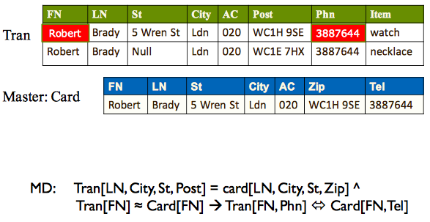
Matching Dependencies (MDs)
Section 2

Slide 12
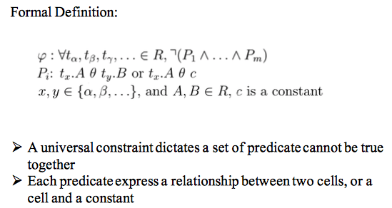
Denial Constraints (DCs)
Section 2

Slide 13
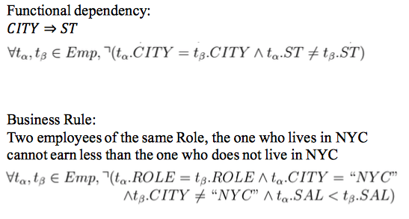
Denial Constraints (DCs)
Section 2

Slide 14
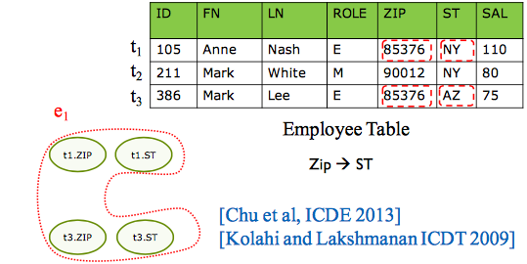
Constraints and Detection
Section 2
Hypergraph-based approach: Each cell in the DB is a vertex, each set of tuples violating a constraint form a hyperedge

Slide 15
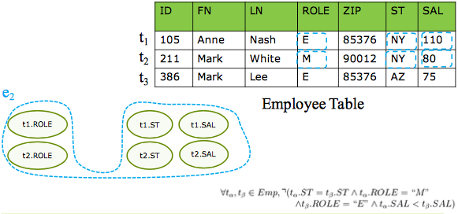
Constraints and Detection
Section 2
Hypergraph-based approach: Each cell in the DB is a vertex, each set of tuples violating a constraint form a hyperedge

Slide 16
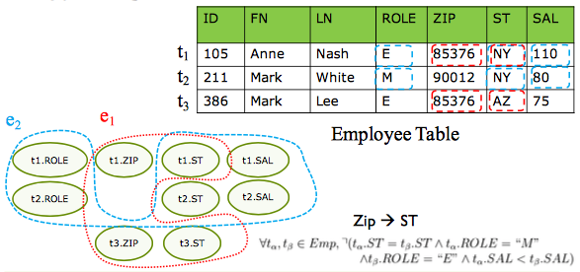
Constraints and Detection
Section 2
Hypergraph-based approach: Each cell in the DB is a vertex, each set of tuples violating a constraint form a hyperedge

Slide 17
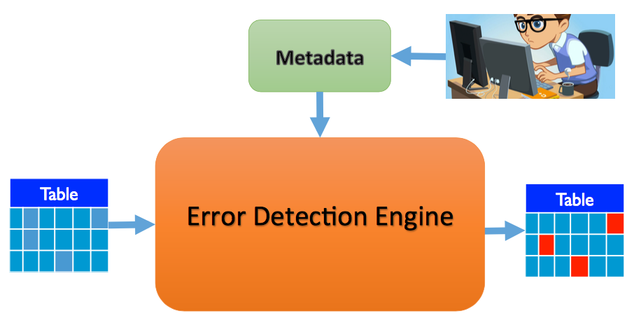
Error detection engine
Section 2

Slide 18
3. Combining Error Detectors
Section 3

Slide 19
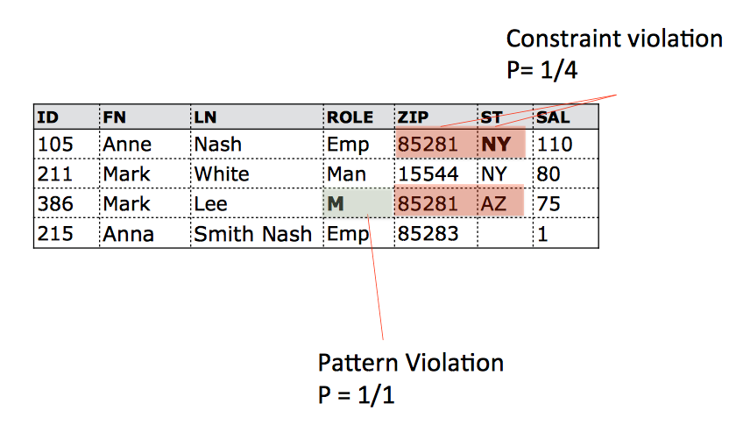
Lots of Detectors
Section 3

Slide 20
Combining Tools
Section 3
Naïve: A least k tools agree on a value to be an error
Introduces precision recall tradeoff
Ordered: Apply tools as a chain
Run all tools on samples
Pick the tool with the highest precision
Apply and verify the results
Update prevision and recall of other tools
Repeat

Slide 21
What’s next
Section 3
We need real ensembles for error detectors
Discovery of integrity constraints is challenging
Mining is not robust to noise
Data exploration and metadata discovery is needed

