Slide 1
Lecture 12: Data Wrangling

Slide 2
Announcements
Discussion Leaders
Project meetings
Meeting tomorrow: https://doodle.com/poll/c2p4vha97tqsi8e6
If tomorrow does not work email me with your availability

Slide 3
Today’s Agenda
Interactive Data Cleaning
Data Transformations
Suggesting Transformations

Slide 4
1. Interactive Data Cleaning
Section 1

Slide 5
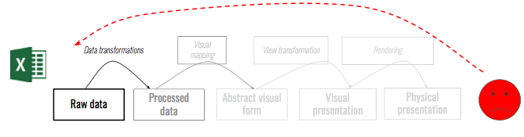
Wrangling with Data
Section 1
Before analysis, data must be brought into a usable form.

Slide 6
Wrangling with Data
Section 1
Data wrangling: restructure data, identifying and correcting erroneous/missing values, find outliers.

Slide 7
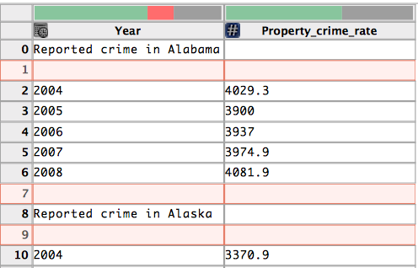
Example Scenario
Section 1

Slide 8
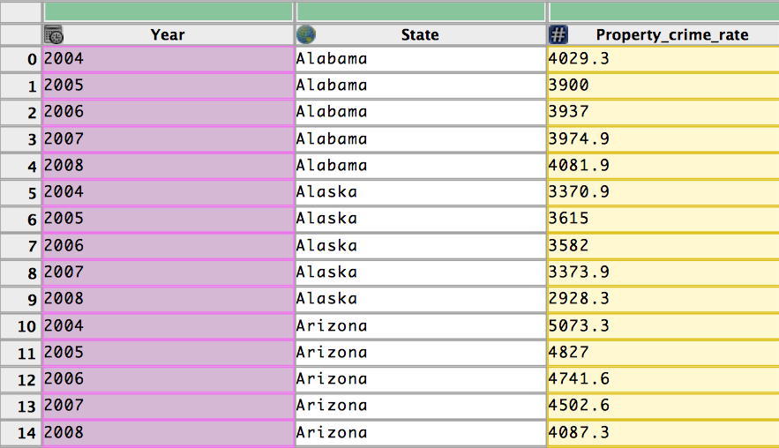
Example Scenario
Section 1

Slide 9
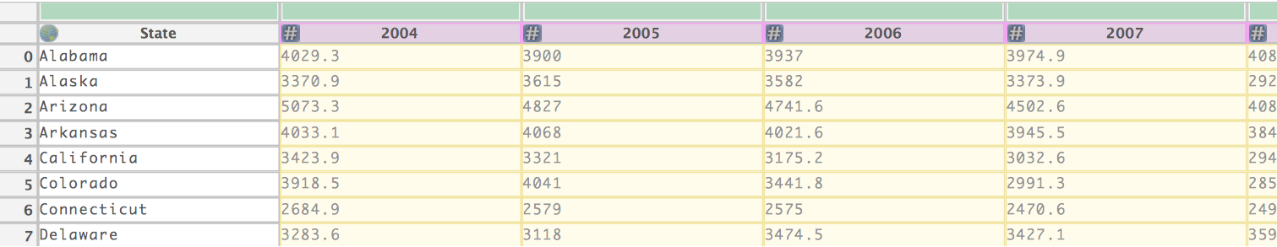
Example Scenario
Section 1

Slide 10
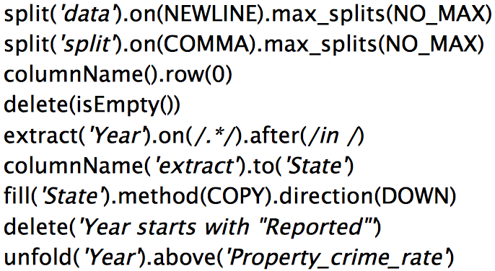
Example Scenario
Section 1

Slide 11
Challenges
Section 1
Transforms for restructuring/validating data can be complicated to specify in scripts.
e.g. Regular expressions to split strings, validate data format.
Reuse and revision of transforms for data updates and changing schemas not possible with scripts or manual editing.
Data wrangling should also output a record of transforms used.

Slide 12
Proposed Solution
Section 1
Provide a transformation language with a handful operators
A mixed-initiative method: instead of mapping an interaction to a single transform, we surface likely transforms as an ordered list of suggestions. Then use visual interfaces for users to navigate—prune, refine, and evaluate—these suggestions to find a desired transform.

Slide 13
2. Data Transformations
Section 2

Slide 14
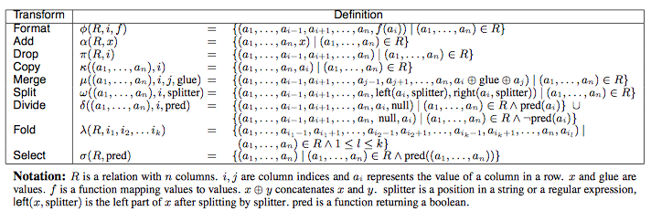
Transformations over relational data
Section 2

Slide 15
Additional transformations
Section 2
Map: transforms map one input data row to zero or multiple output rows.
one to zero transform: delete.
one to one transform: extracting, cutting, splitting
one to many transforms: splitting data into multiple rows
Lookups and joins: incorporate data from external tables. Two types of join: equi-joins and approximate joins with string-edit distance
Reshape: transforms manipulate table structure and schema. Two operators: fold and unfold.
Positional transforms: includes functions for fill and lag operations. Fill operations generate values based on neighboring values in a row or column and so depend on the sort order of the table. The lag operator shifts the values of a column up or down by a specified number of rows.

Slide 16
User-friendly transformations
Section 2
The goal is to enable analysts to author expressive transformations with minimal difficulty.
Approach:
Provide more than a spreadsheet interface.
Suggest data transforms: use natural language descriptions and visual transform preview.
Verification on sample to help users discover data quality issues.

Slide 17
User-friendly transformations
Section 2
Direct manipulation of and interaction with the data.
Menu-based transform selection.
Manual editing of transform parameters.
Six basic interactions between the user and the data table.
Select row.
Select column.
Click bars in the data quality meter.
Select text in a cell.
Edit a value in the table.
Assign column name, data type, or semantic role.

Slide 18
3. Suggesting Transformation
Section 3

Slide 19
An inference engine
Section 3
Inputs to the engine consist of user interactions; the current working transform; data descriptions such as column data types, semantic roles, and summary statistics; and a corpus of historical usage statistics.
Transform suggestions proceed in three phases:
Inferring transform parameters from user interaction
Generating candidate transforms from inferred parameters
Ranking the results
To generate transformations, rely on a corpus of usage statistics

Slide 20
Usage corpus and transform equivalence
Section 3
The corpus consists of frequency counts of transform descriptors and initiating interactions.
Transforms are considered equivalent in this way:
they have an identical transform type
they have equivalent parameters as defined below
Four types of parameters: row, column, text selection and enumerable.
row selections are equivalent: if they both contains filtering conditions or match all rows in the table.
column selection are equivalent if they refer to columns with the same data type or semantic rules.
Text selections are equivalent if both are index-based selections or contain regular expressions
enumerable parameters are equivalent if they match exactly

Slide 21
Inferring transform parameters from user interaction
Section 3
Infer three types of transform parameter: row, column or text selection
For each type, enumerate possible parameter values, resulting in a collection of inferred parameter set.
Parameter’s value is independent of each other.
row selection is based on row indices and predicate matching.
column selection returns columns users have interacted with.
text selection is either simple index ranges or inferred regular expressions

Slide 22
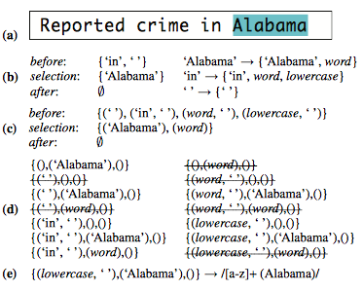
Regular expression inference
Section 3

Slide 23
Generating suggested transform
Section 3
For each parameter sets, loop over each transform type in the language, emitting the types that can accept all parameters in the set
To determine values for missing parameters, query the corpus for the top-k parameterisations that cooccur most frequently with the provided parameter set.
Filter the suggestions set to remove degenerate transform that would have no effect on the data

Slide 24
Ranking suggestions
Section 3
Ranking according to five criteria:
First three criteria rank transform by their type
Remaining two transforms within type
First three criteria by transform type:
explicit interactions, if a user choose a transform in the menu, assign higher ranking to that transform.
specification difficulty, label row and text selection as hard, other as easy, sort according to count of hard parameter
based on their corpus frequency, conditioned on their initiating user interaction
Remaining two criteria with transform type:
sort by frequency of equivalent transforms in the corpus
sort transforms in ascending order using simple measure of transform complexity, transform complexity is defined as the sum of complexity scores for each parameter. The complexity of row selection predicate is the number of clauses it contains, the complexity of a regular expression is defined to be the number of tokens.
Surface diverse transform types in the final suggestion list. No types accounts for more than 1/3 of the suggestions.

Slide 25
Summary
Section 3
Data wrangler: a mixed-initiative interface that maps user interactions to suggested data transforms and presents natural language descriptions and visual transform previews to help assess each suggestion.
Take-aways: simplicity is power, visual interfaces are crucial for data cleaning
Limited to formatting and alignment errors. Many different types of errors in real systems.

