Slide 1
Lecture 22: Compressed Linear Algebra for Large Scale ML
Slides by Memar

Slide 2
Announcement
Thanks to those that dropped by on Friday.
Those that didn’t come: I hope you are cooking something awesome.
If you still want to meet email me.
Interesting read: https://lemire.me/blog/2018/04/17/iterating-in-batches-over-data-structures-can-be-much-faster/

Slide 3
Today
Compression
Column encoding
Compressed LA

Slide 4
1. Compression
Section 1

Slide 5
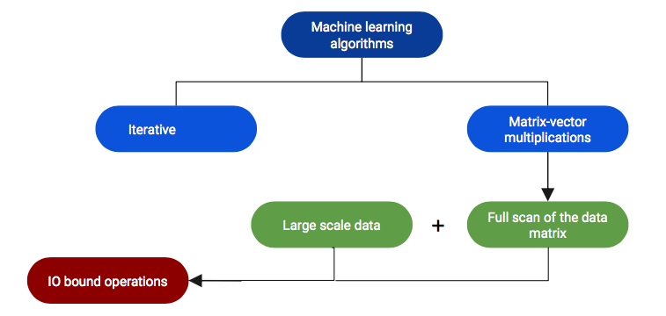
Motivation
Section 1

Slide 6
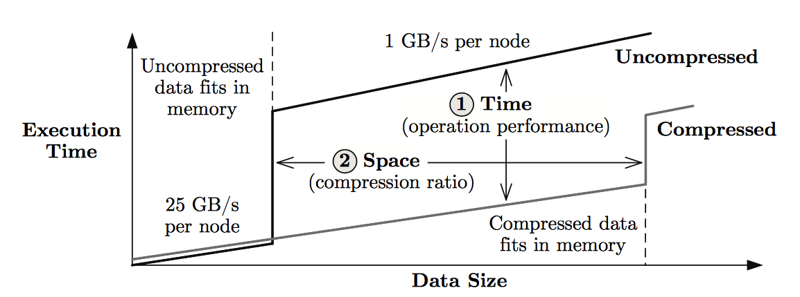
Solution: Fit more data into memory
Section 1

Slide 7
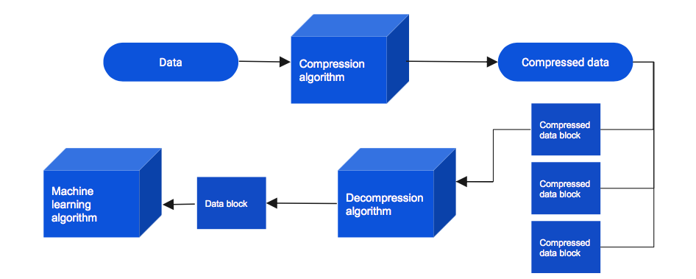
Solution: Fit more data into memory
Section 1

Slide 8
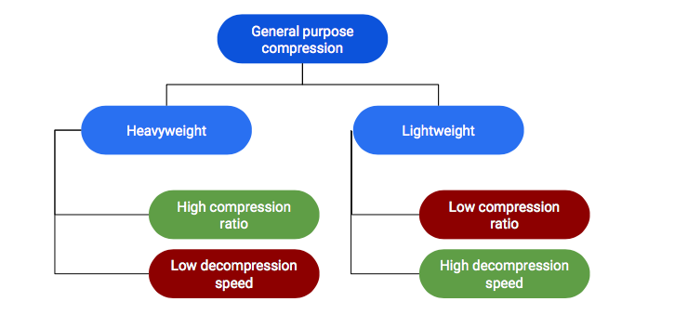
Compression techniques
Section 1
Notes:
Heavyweight -> decompression is slow Gzip
Lightweight -> moderate compression ratios -> fast decompression

Slide 9
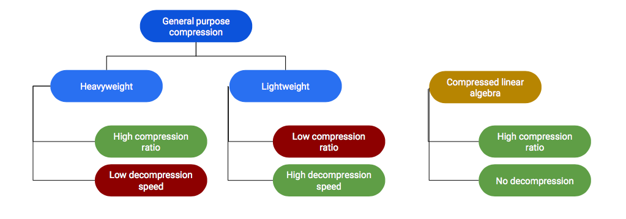
Compression techniques
Section 1
Notes:
Heavyweight -> decompression is slow Gzip
Lightweight -> moderate compression ratios -> fast decompression

Slide 10
2. Column encoding

Slide 11
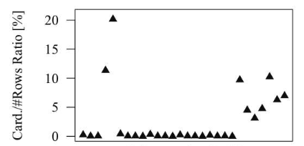
Column-wise compression: Motivation
Section 2
Column-wise compression leverages two key characteristics: few distinct values per column and high cross-column correlations.
1. Low column cardinalities

Slide 12
Column-wise compression: Motivation
Section 2
Column-wise compression leverages two key characteristics: few distinct values per column and high cross-column correlations.
Low column cardinalities
Non-uniform sparsity across columns
Tall and skinny matrices (more common)

Slide 13
Column encoding formats
Section 2
Uncompressed Columns (UC)
Offset-List Encoding (OLE)
Run-Length Encoding (RLE)

Slide 14
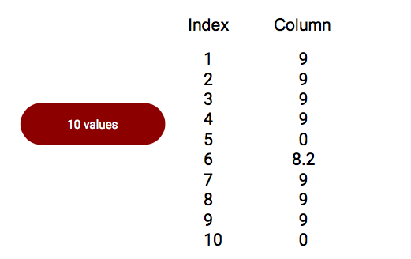
Uncompressed Column
Section 2

Slide 15
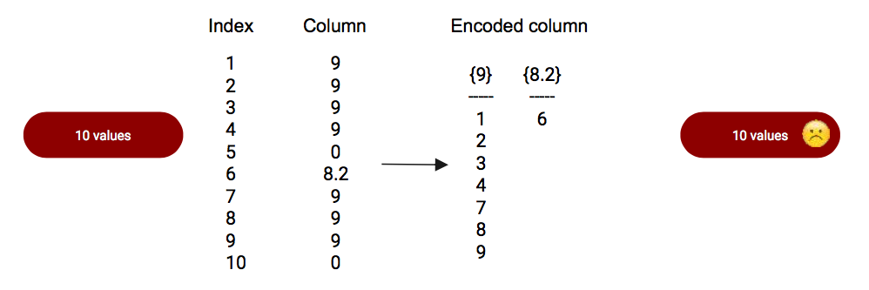
Offset-List Encoding
Section 2

Slide 16
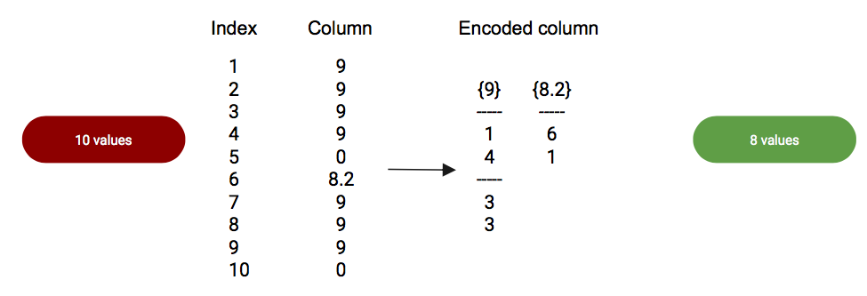
Run-Length Encoding
Section 2

Slide 17
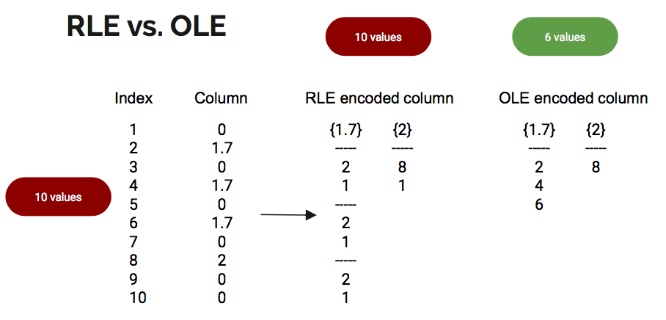
It’s all about tradeoffs!
Section 2

Slide 18

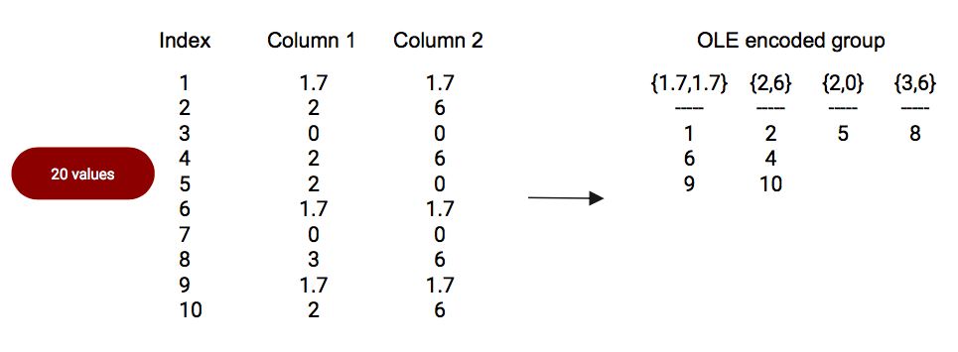
Column co-coding
Section 2

Slide 19
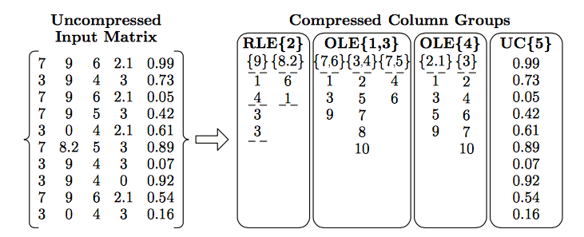
Combining compression methods
Section 2

Slide 20
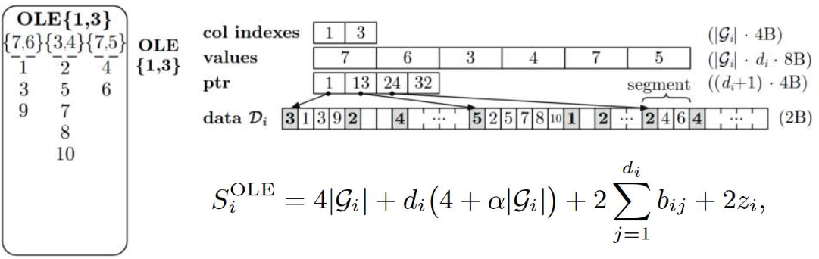
Data layout: OLE
Section 2

Slide 21
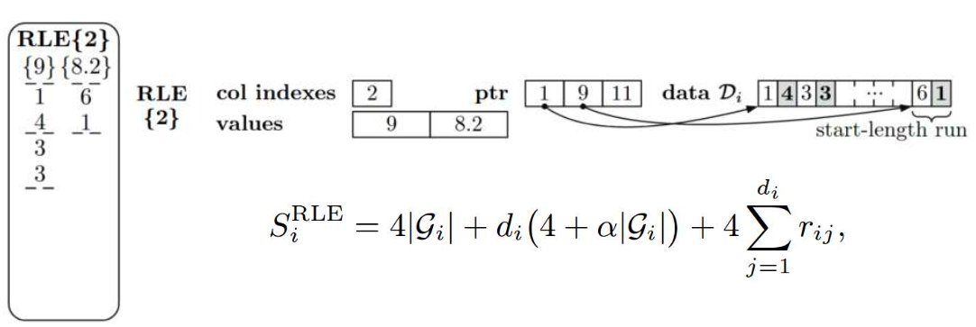
Data layout: RLE
Section 2

Slide 22
3. Compressed LA

Slide 23
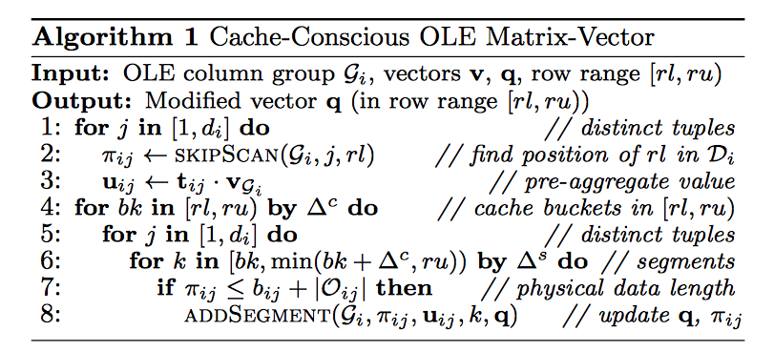
Matrix-vector multiplication
Section 3
Notes:
HOP = high-level operations
LOP = low-level operations

Slide 24
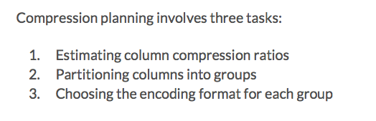
Compression planning
Section 3
Notes:
HOP = high-level operations
LOP = low-level operations

Slide 25
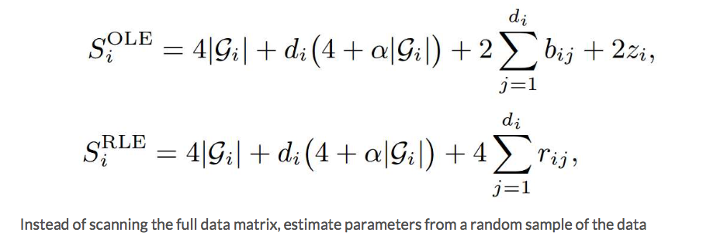
Estimating column compression ratios
Section 3

Slide 26

Partitioning columns into groups
Section 3

Slide 27
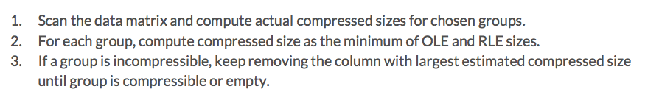
Choosing the encoding format for each group
Section 3

