Slide 1
Lecture 4: From Data Cubes to ML
Credit: Slides by Jogklekar et al. and Kahng et al.

Slide 2
Today’s Lecture
Data Cubes and OLAP
Data Cube Operations
Data Cubes and ML

Slide 3
1. Data Cubes and OLAP
Section 1

Slide 4
Data Warehouses
Section 1
What is a data warehouse (informally)?
A decision support database that is maintained separately from the organization’s operational database
Support information processing by providing a solid platform of consolidated, historical data for analysis.
“A data warehouse is a subject-oriented, integrated, time-variant, and nonvolatile collection of data in support of management’s decision-making process.”—W. H. Inmon
Notes:
English physician and a leader in the adoption of anaesthesia and medical hygiene

Slide 5
Data Warehouses – Subject Oriented
Section 1
Organized around major subjects, such as customer, product, sales
Focusing on the modeling and analysis of data for decision makers, not on daily operations or transaction processing
Provide a simple and concise view around particular subject issues by excluding data that are not useful in the decision support process
Notes:
English physician and a leader in the adoption of anaesthesia and medical hygiene

Slide 6
Data Warehouses – Integrated
Section 1
Constructed by integrating multiple, heterogeneous data sources
relational databases, flat files, on-line transaction records
Data cleaning and data integration techniques are applied.
Ensure consistency in naming conventions, encoding structures, attribute measures, etc. among different data sources
E.g., Hotel price: currency, tax, breakfast covered, etc.
When data is moved to the warehouse, it is converted.
Notes:
English physician and a leader in the adoption of anaesthesia and medical hygiene

Slide 7
Data Warehouses – Time Variant
Section 1
The time horizon for the data warehouse is significantly longer than that of operational systems
Operational database: current value data
Data warehouse data: provide information from a historical perspective (e.g., past 5-10 years)
Every key structure in the data warehouse
Contains an element of time, explicitly or implicitly
But the key of operational data may or may not contain “time element”
Notes:
English physician and a leader in the adoption of anaesthesia and medical hygiene

Slide 8
Data Warehouses – Nonvolatile
Section 1
A physically separate store of data transformed from the operational environment
Operational update of data does not occur in the data warehouse environment
Does not require transaction processing, recovery, and concurrency control mechanisms
Requires only two operations in data accessing:
initial loading of data and access of data
Notes:
English physician and a leader in the adoption of anaesthesia and medical hygiene

Slide 9
OLTP vs OLAP
Section 1
Notes:
English physician and a leader in the adoption of anaesthesia and medical hygiene

Slide 10
From Tables to Data Cubes
Section 1
A data warehouse is based on a multidimensional data model which views data in the form of a data cube
A data cube, such as sales, allows data to be modeled and viewed in multiple dimensions
Dimension tables, such as item (item_name, brand, type), or time(day, week, month, quarter, year)
Fact table contains measures (such as dollars_sold) and keys to each of the related dimension tables
In data warehousing literature, an n-D base cube is called a base cuboid. The top most 0-D cuboid, which holds the highest-level of summarization, is called the apex cuboid. The lattice of cuboids forms a data cube.
Notes:
English physician and a leader in the adoption of anaesthesia and medical hygiene

Slide 11
Cube: A Lattice of Cuboids
Section 1
all
0-D (apex) cuboid
time
item
location
supplier
1-D cuboids
time,location
item,location
location,supplier
time,item
2-D cuboids
time,supplier
item,supplier
time,location,supplier
3-D cuboids
time,item,location
time,item,supplier
item,location,supplier
4-D (base) cuboid
time, item, location, supplier
Notes:
English physician and a leader in the adoption of anaesthesia and medical hygiene

Slide 12
Concept Hierarchies
Section 1
Example: Location
all
all
region
Europe
...
North_America
country
Germany
...
Spain
Canada
...
United States
city
Frankfurt
...
Vancouver
...
Toronto
office
L. Chan
...
M. Wind
Notes:
English physician and a leader in the adoption of anaesthesia and medical hygiene

Slide 13
Multidimensional Data
Section 1
Sales volume as a function of product, month, and region
Dimensions: Product, Location, Time
Hierarchical summarization paths
Region
Industry Region Year
Category Country Quarter
Product City Month Week
Office Day
Product
Month
Notes:
English physician and a leader in the adoption of anaesthesia and medical hygiene

Slide 14
A Sample Data Cube
Section 1
Date
Total annual sales
of TVs in U.S.A.
1Qtr
2Qtr
3Qtr
4Qtr
sum
Product
TV
PC
U.S.A
VCR
sum
Canada
Country
Mexico
sum
Notes:
English physician and a leader in the adoption of anaesthesia and medical hygiene

Slide 15
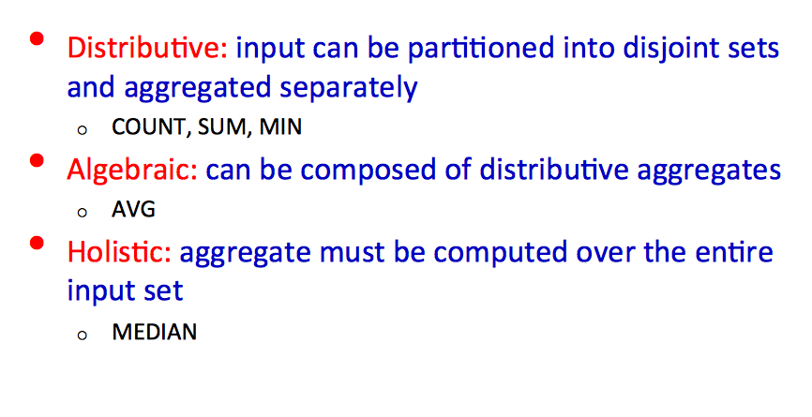
Types of Aggregates
Section 1
Notes:
English physician and a leader in the adoption of anaesthesia and medical hygiene

Slide 16
2. Data Cube Operations
Section 2

Slide 17
Typical operations
Section 1
Roll up (drill-up): summarize data
by climbing up hierarchy or by dimension reduction
Drill down (roll down): reverse of roll-up
from higher level summary to lower level summary or detailed data, or introducing new dimensions
Slice and dice: project and select
Pivot (rotate):
reorient the cube, visualization, 3D to series of 2D planes
Other operations
drill across: involving (across) more than one fact table
drill through: through the bottom level of the cube to its back-end relational tables (using SQL)

Slide 18
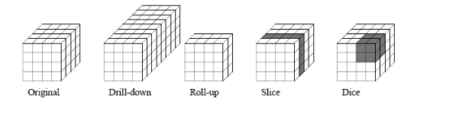
Typical operations
Section 1
Harinarayan et al. Implementing Data Cubes Efficiently, SIGMOD 1996

Slide 19
OLAP Drill-Down
Section 1
Limitations: (1) Too many values, (2) Single column

Slide 20
3. Modern Data Cubes
Section 3

Slide 21
What you will learn about in this section
Section 3
Smart Drill Down
Data Cubes and ML

Slide 22
Smart Drill-Down
Section 3
Present k most interesting rules (patterns)
Find interesting portions faster
User tunable
Interactive
Instantiate multiple columns
Complementary functionality!

Slide 23
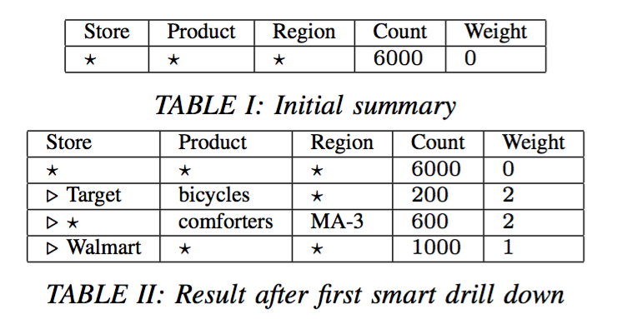
Example
Section 3

Slide 24
Example
Section 3

Slide 25
Example Summary
Section 3
Display best list of k (= 3) rules
Preference for
Higher Count
Higher Weight
Low overlap

Slide 26
Definitions
Section 3
Rule: Tuple of values and *’s
Count(r): Number of tuples satisfying rule r
Size(r): Number of non-star values in r
Rule-List: Ordered list of rules
MCount(r,R): In a list R, number of tuples satisfying r but no rule before r

Slide 27

Definitions (cont’d)
Section 3
Subrule(r₁,r₂): Strictly more specific rule
e.g. (a,b,*) is a subrule of (a,*,*)
Weight W: User-defined interestingess
W(r) ≥ 0
Monotone: Subrule(r₁,r₂) => W(r₁) >= W(r₂)

Slide 28
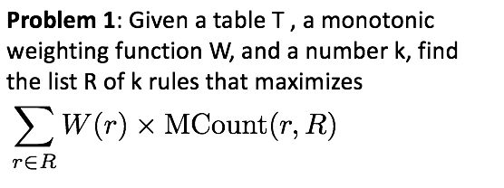
Smart Drill Down: Formal Problem
Section 3

Slide 29
Ordering Rules Optimally
Section 3
Theorem: Let R, R’ be rule-lists with same set of rules, where rules in R are sorted by weight (decreasing). Then

Slide 30
Ordering Rules Optimally
Section 3
Theorem: Let R, R’ be rule-lists with same set of rules, where rules in R are sorted by weight (decreasing). Then
Thus, always sort rules by weight!
Find best set rather than list.
Still NP-Hard

Slide 31
Submodularity
Section 3
Define
where S is rule-set, R is weight-sorted rule-list
Then Score is submodular
i.e. let
Whenever

Slide 32
Submodularity
Section 3
Define
where S is rule-set, R is weight-sorted rule-list
Submodular Maximization:
Maximize Score(S) such that |S| = k

Slide 33
Submodularity
Section 3
Define
where S is rule-set, R is weight-sorted rule-list
Submodular Maximization:
Maximize Score(S) such that |S| = k
Greedy Algorithm
S = {}
r₁ = argmax_{r} (MarginalValue(r,S))

Slide 34
Submodularity
Section 3
Define
where S is rule-set, R is weight-sorted rule-list
Submodular Maximization:
Maximize Score(S) such that |S| = k
Greedy Algorithm
S = {r₁}
r₂ = argmax_{r} (MarginalValue(r,S))

Slide 35
Submodularity
Section 3
Define
where S is rule-set, R is weight-sorted rule-list
Submodular Maximization:
Maximize Score(S) such that |S| = k
Greedy Algorithm
S = {r₁, r₂}
r₃ = argmax_{r} (MarginalValue(r,S))

Slide 36
Submodularity
Section 3
Define
where S is rule-set, R is weight-sorted rule-list
Submodular Maximization:
Maximize Score(S) such that |S| = k
Theorem: Greedy algorithm achieves a
approximation

Slide 37
Find best marginal rule
Section 3
Brute-force: Compute marginal value for all rules?
Too expensive
Key Insight
If r₂ is sub-rule of r₁,

Slide 38
Find best marginal rule
Section 3
Brute-force: Compute marginal value for all rules?
Too expensive
Max Weight Parameter m_{w}
A Priori-like algorithm
Evaluate all size 1, then 2, and so on
Only evaluate higher size rules that have a chance of being the best

Slide 39
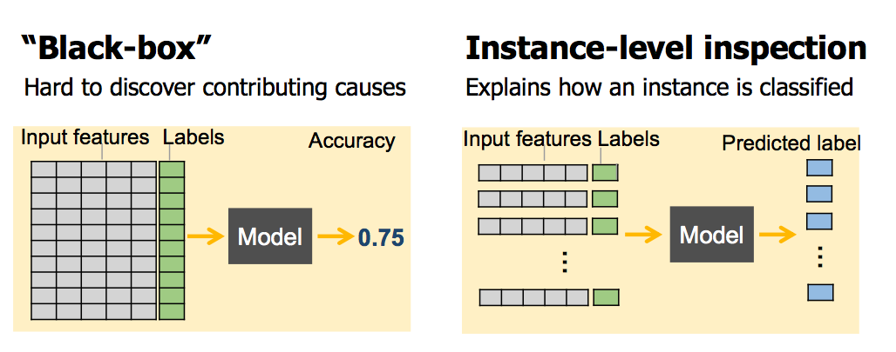
Data Cubes and ML
Explore and choose models not only data!

Slide 40
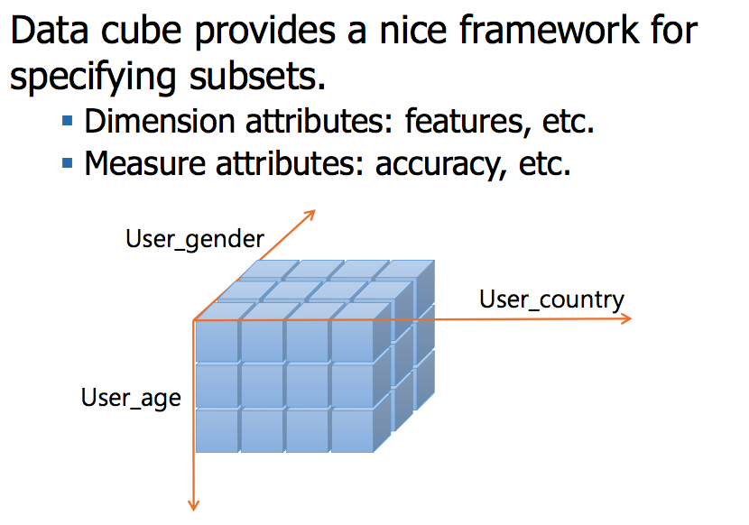
Feature Subsets with MLCube

Slide 41
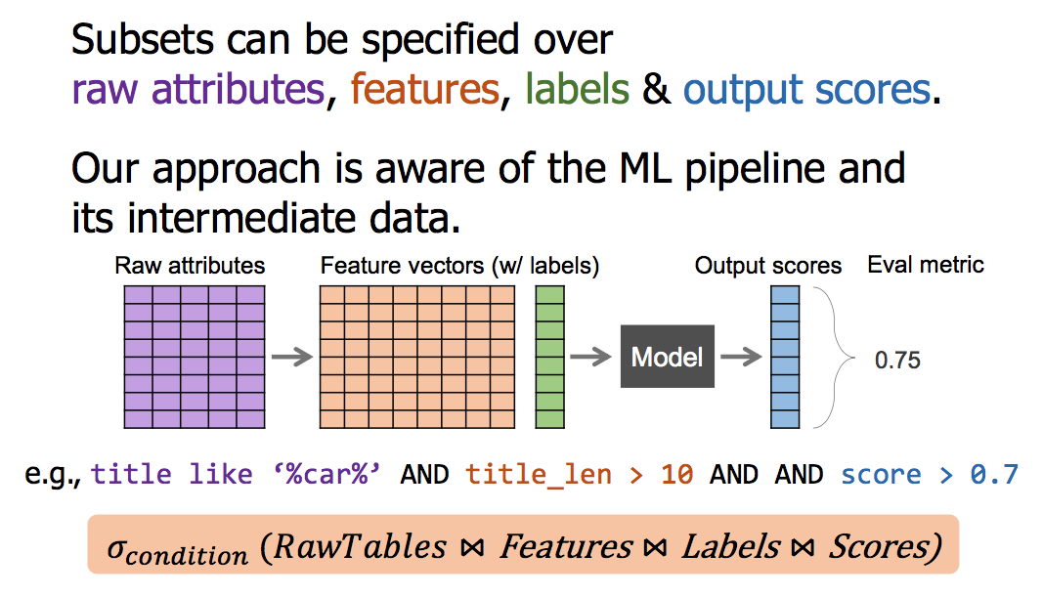
Subset definition

