Slide 1
Lecture 23: Feature Selection

Slide 2
What is Feature Selection?
Feature selection (variable selection, attribute selection…)
Select a subset of relevant predictors for model construction
Remove redundant or irrelevant features
Reasons for Feature selection
Simplification of models to make them easier to interpret
Shorter training times
Enhanced generalization by reducing overfitting (reduction of variance)

Slide 3
What is Feature Selection?
Feature selection is interactive
Features can or cannot be selected due to several factors
e.g., statistical performance, explanatory power, legal reasons, etc.
Analysts write low-level code
In R/Python
R/Python libraries for standard feature selection tasks

Slide 4
RELs and ROPs
REL = R-Extension Layers
Almost all db engine ships a product with some R extension
Oracle – ORE (Oracle R Enterprise)
IBM – SystemML (declarative large scale ML)
SAP – HANA
Hadoop/Teradata – Revolution Analytics
ROP = REL Operations
Matrix-vector multiplication or determinants
Scaling ROPs is a recent industrial challenge

Slide 5
ROP Optimization Limitations
Missed opportunities for reuse and materialization
Selecting materialization strategy is difficult for an analyst
Depends on the reuse opportunities, error tolerance, data size, parallelism
Will vary across datasets for the same task

Slide 6
Key ideas
Subsampling
Transformation materialization
Model caching

Slide 7
Columbus
Support feature selection (FS) dialogue
Identify and use existing and novel optimizations for FS workloads as data management problems
Cost-based optimizer

Slide 8
Columbus
Compiles and optimizes an extension of R for FS
Compiles this language into a set of REL ops
Compiles into the most common ROPs

Slide 9
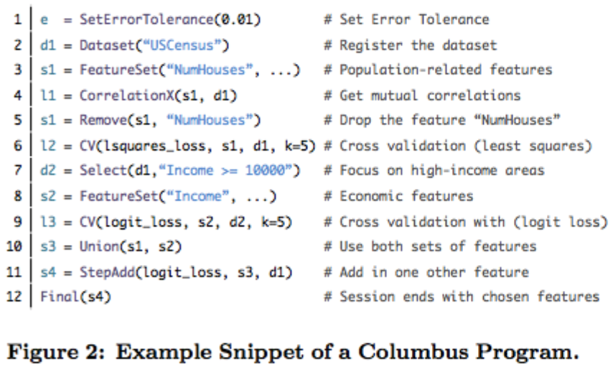
Columbus programs
FS program as a set of high-level constructs
Language is a superset of R

Slide 10
Data Types
Three major data types
A data set
Relational table R(A1, … Ad)
A feature set F
Subset of attributes
A model for a feature set
Vector that assigns each feature a real-valued weight

Slide 11
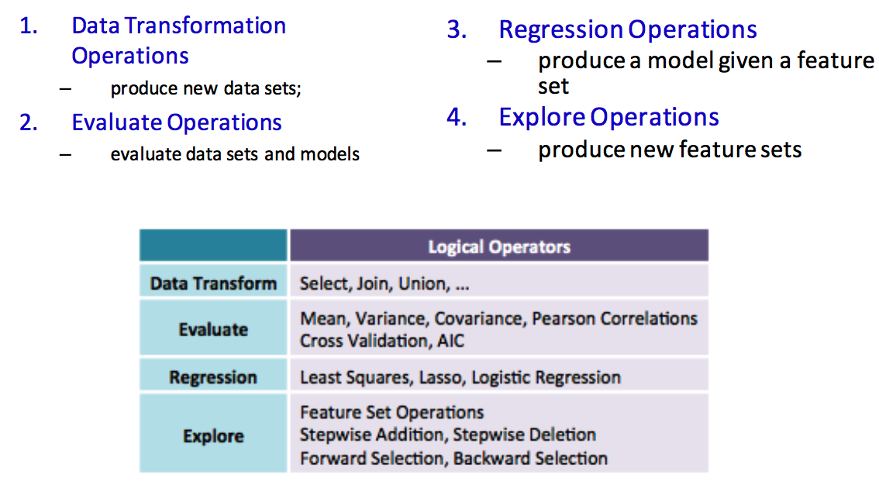
Operations

Slide 12
Data Transform
Standard data manipulations to slice and dice
Select, join, union
Columbus is schema aware and aware of the cardinality of these operations
Operations executed and optimized directly using a standard RDBS or main-memory engine
A data frame in R is used to store data tables. List of vectors of equal length
Frames can be interpreted either as a table or an array.
Move from one to another freely

Slide 13
Evaluate
Obtain various numeric scores
Given a feature set including descriptive scores for the input feature set
E.g., mean, variance, pearson correlations, cross-validation error, and Akaike Information Criterion
Columbus can optimize these calculations by batching several together

Slide 14
Regression
Obtain a model given a feature set and data
e.g., models trained by using logistic regression or linear regression
The result of a regression operation is often used by downstream “explore” operations, which produces a new feature set based on how the previous set performs
These operations take a termination criterion
# of iterations or error criterion

Slide 15
Explore
Enable an analyst to traverse the space of feature sets
Optimizations leverage the fact that we operate on features in bulk

Slide 16
Basic Blocks
A user’s program is compiled into a DAG with two types of nodes
R functions
Opaque to Columbus
Basic blocks
Unit for optimization
Tasks

Slide 17
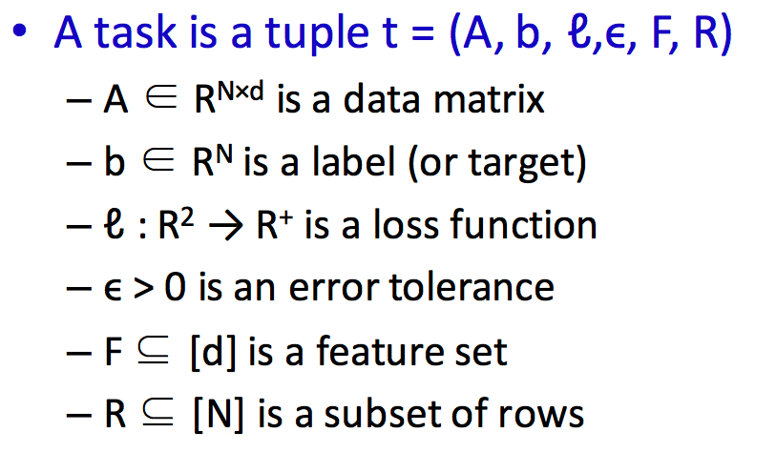
Task

Slide 18
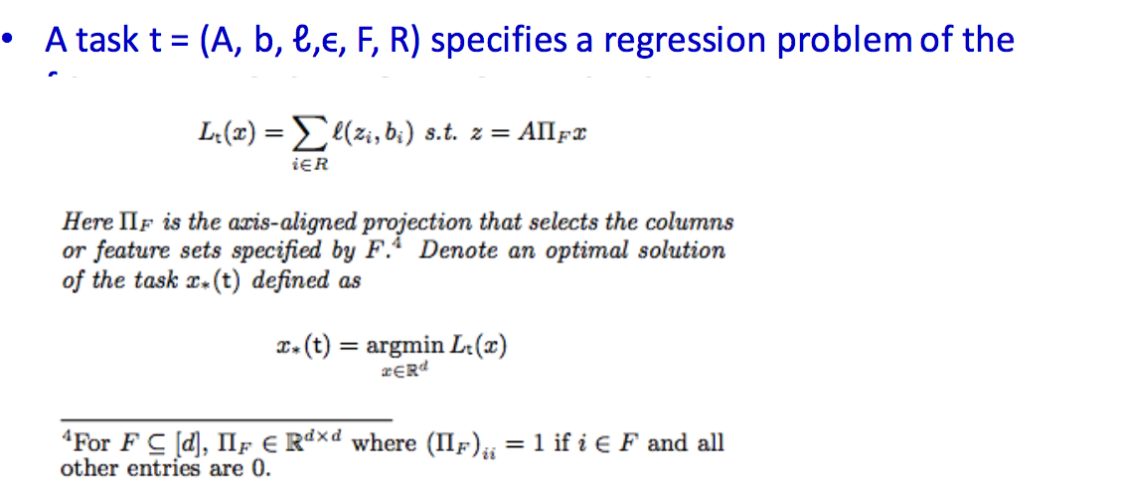
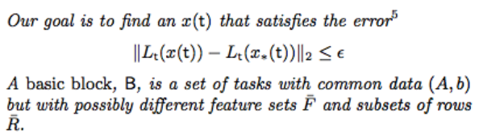
Task and Basic Block

Slide 19
Example

Slide 20
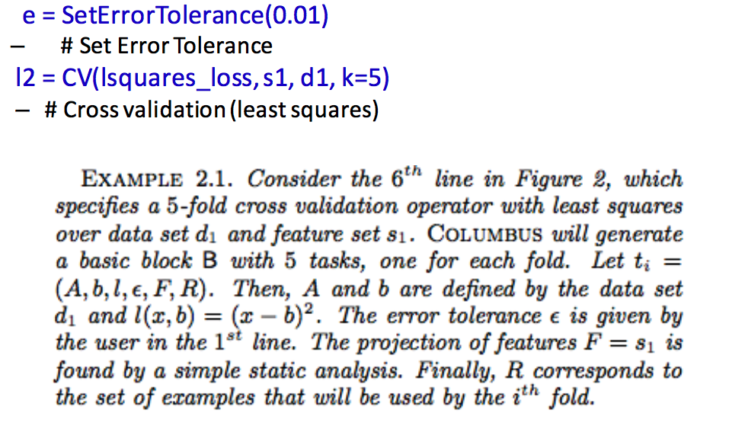
Example

Slide 21
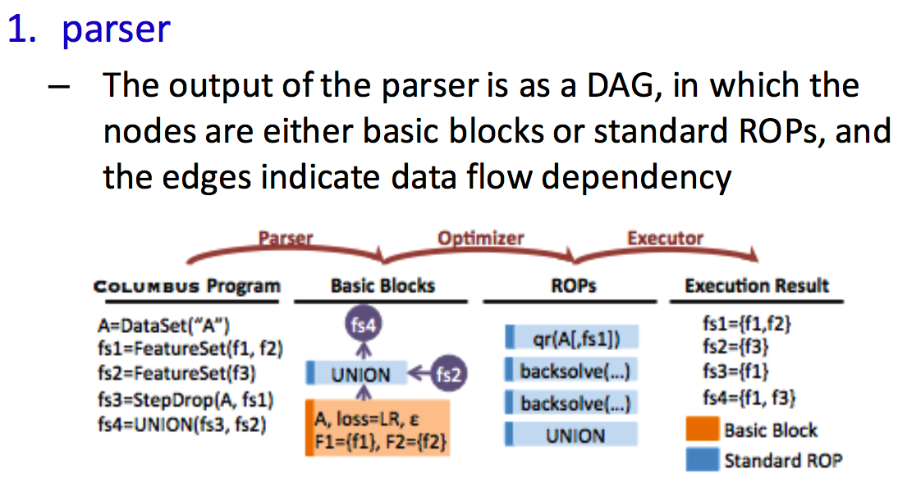
Executing a Columbus program

Slide 22
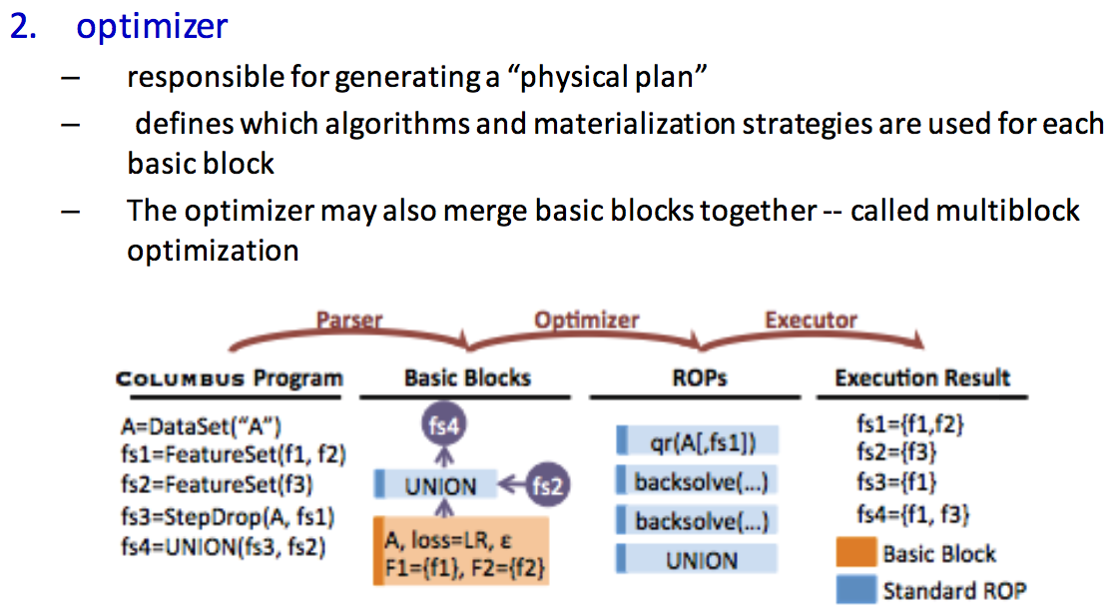
Executing a Columbus program

Slide 23
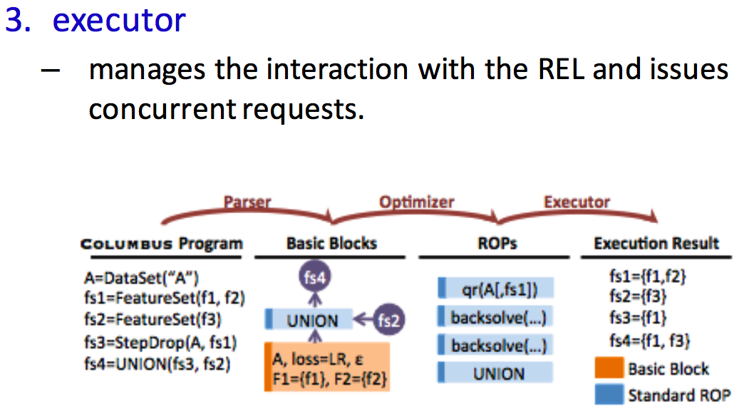
Executing a Columbus program

Slide 24
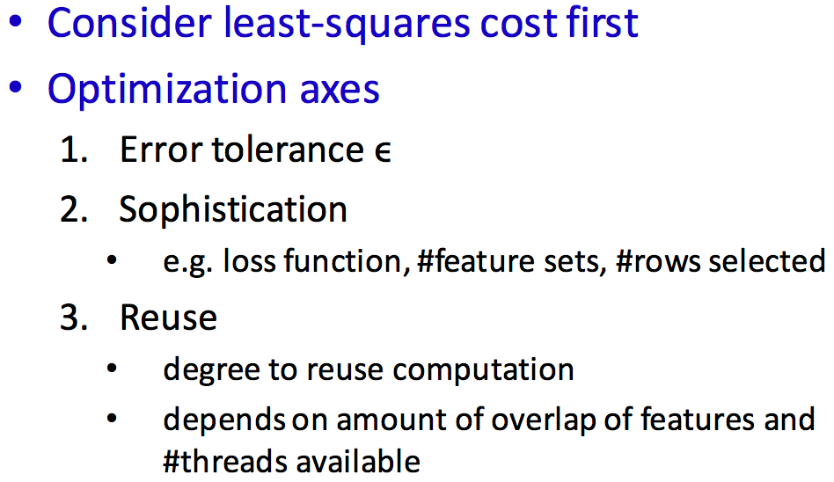
Optimizer

Slide 25
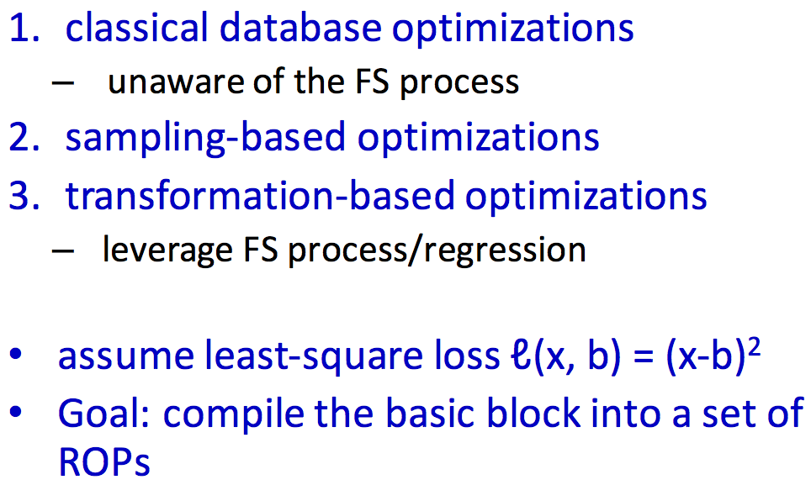
A Single, Linear Basic Block

Slide 26
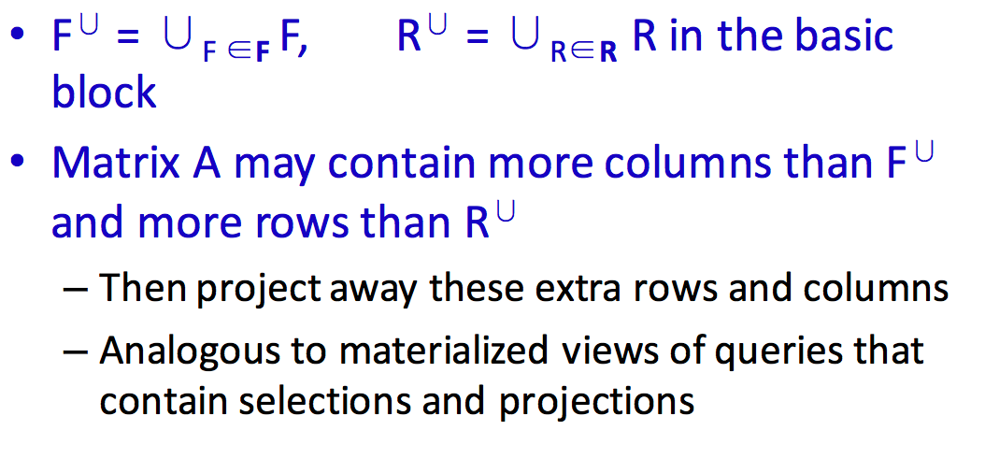
Classical DB Optimizations

Slide 27
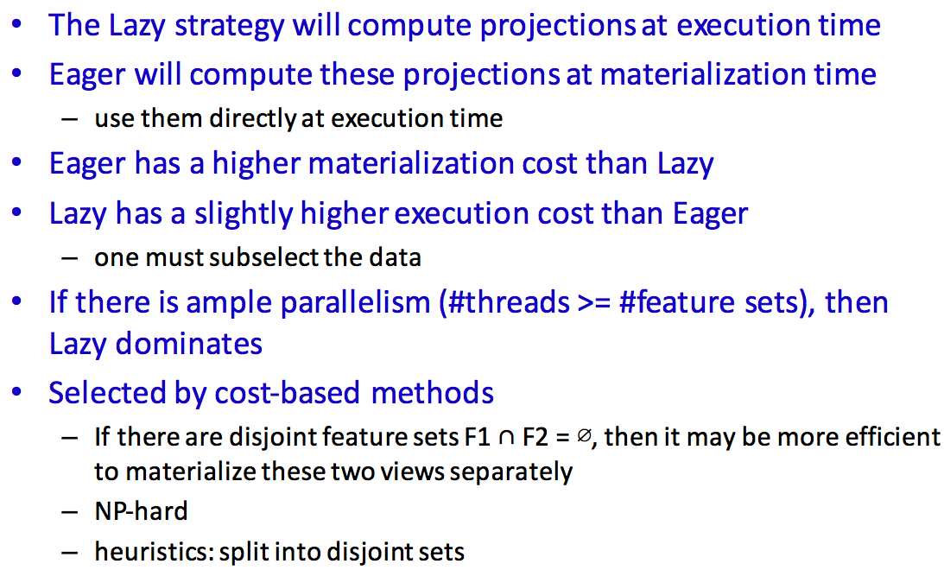
Lazy and Eager strategies

Slide 28
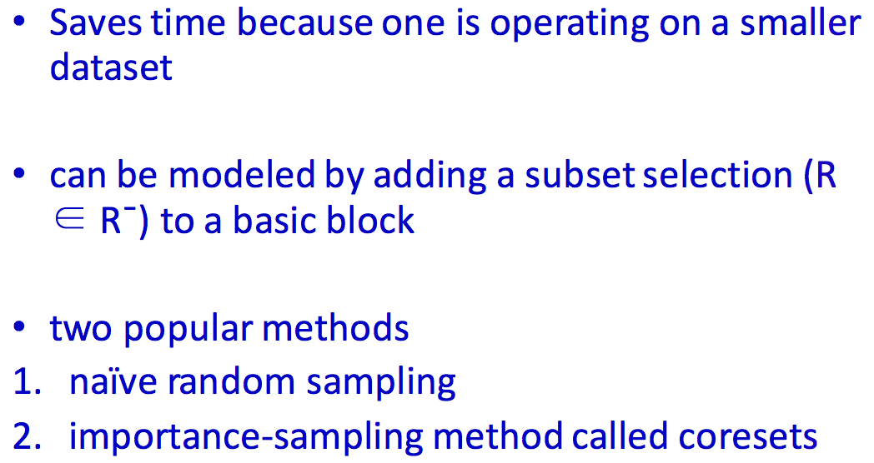
Sampling-based Optimizations

Slide 29
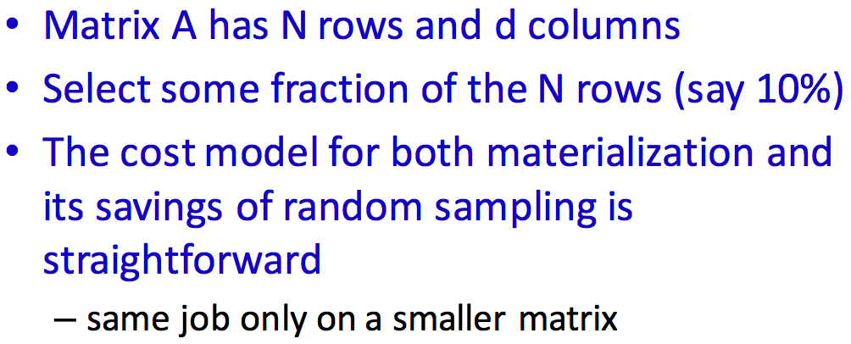
Naïve Sampling

Slide 30
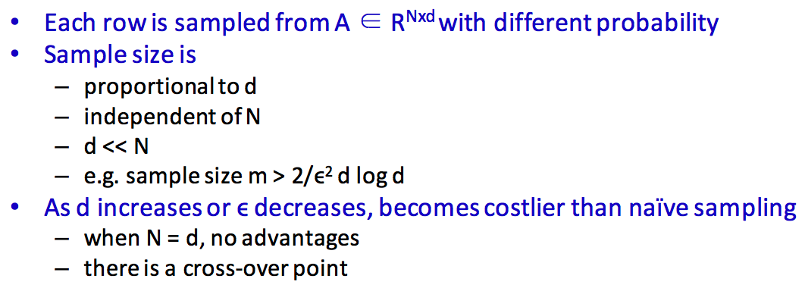
Coresets

Slide 31
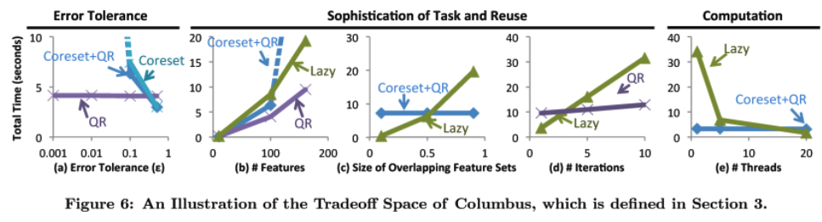
Coresets

Slide 32
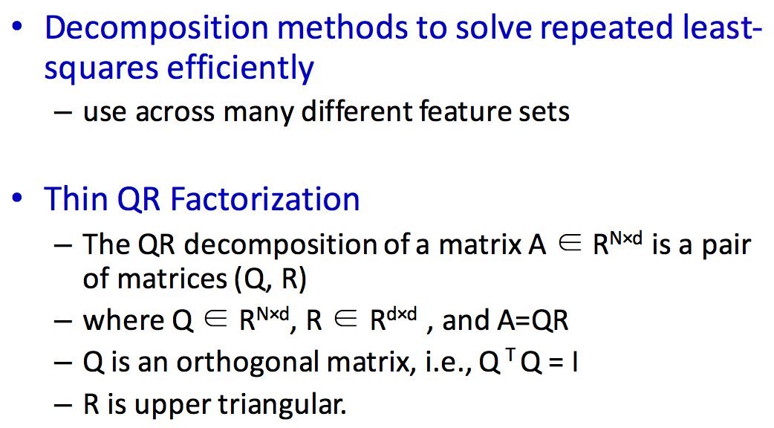
Transformation-Based Optimizations: QR

Slide 33
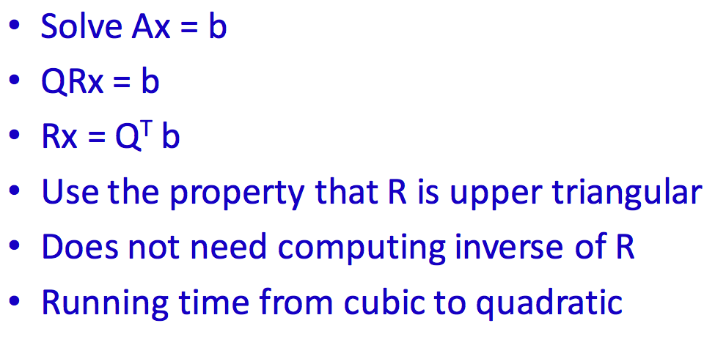
QR in Columbus

Slide 34
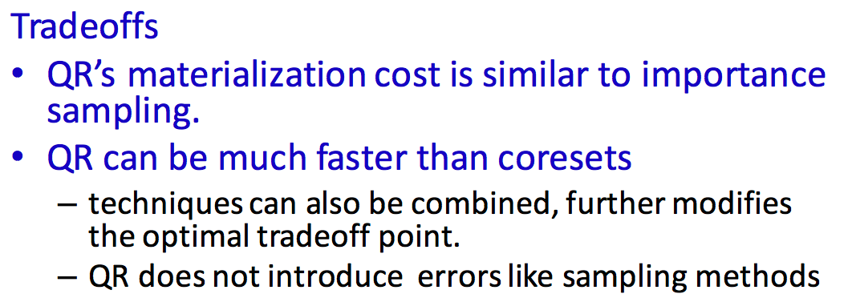
Transformation-Based Optimizations/QR

Slide 35
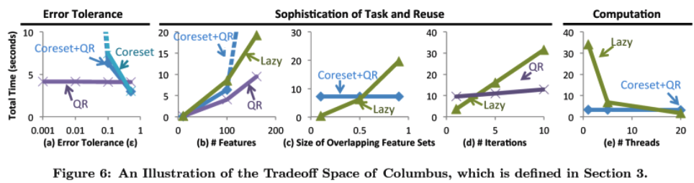
Transformation-Based Optimizations/QR

Slide 36
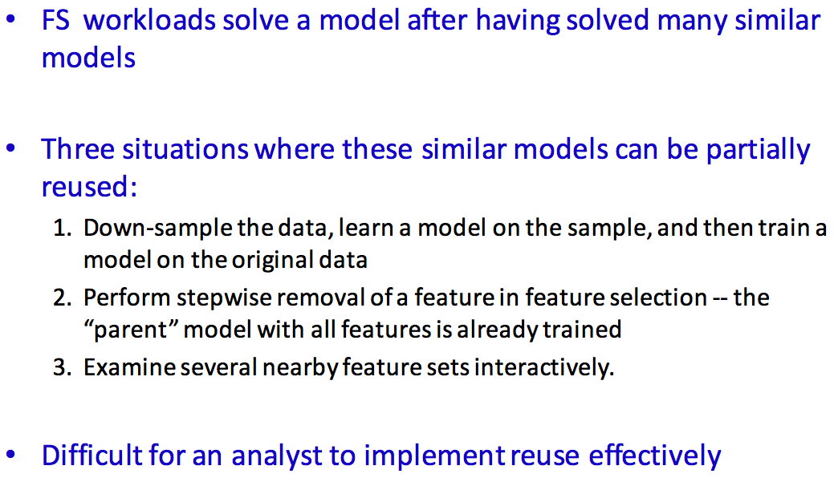
Warm-starting by Model Caching

Slide 37
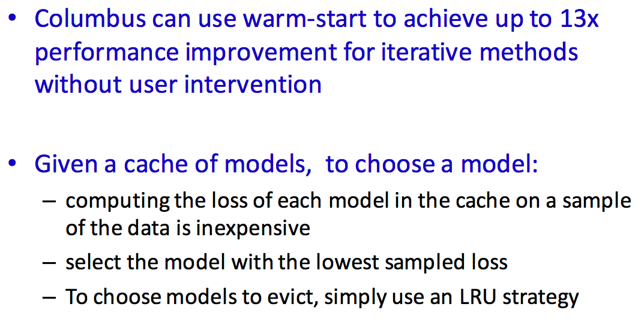
Warm-starting by Model Caching

Slide 38
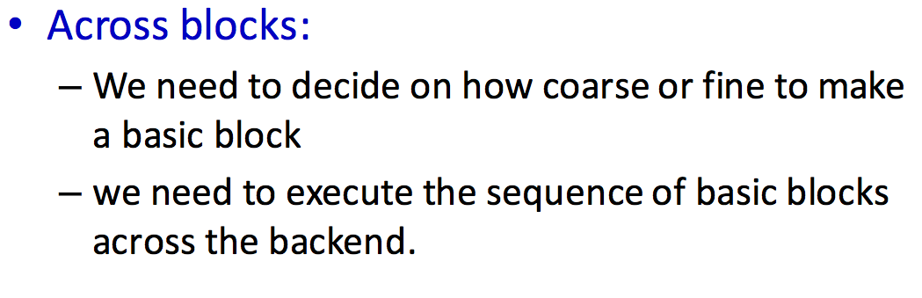
Multi-block Optimization

Slide 39
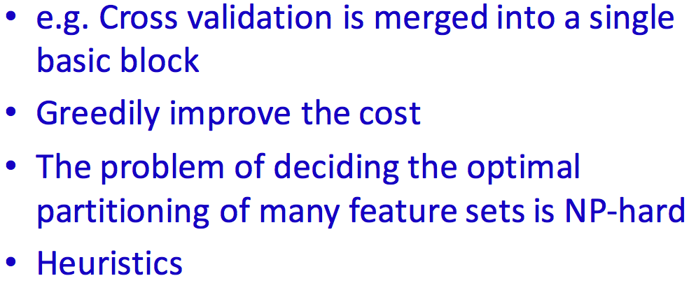
Multi-block Logical Optimization

Slide 40
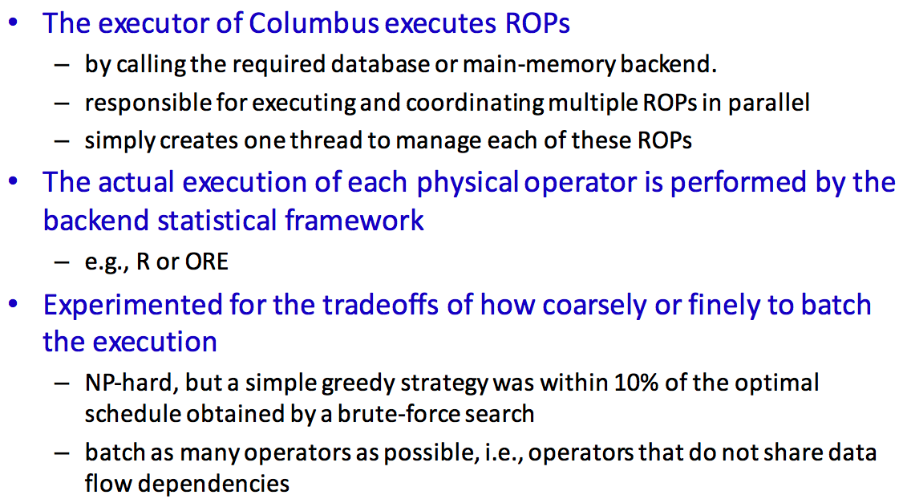
Cost-based Execution

Slide 41
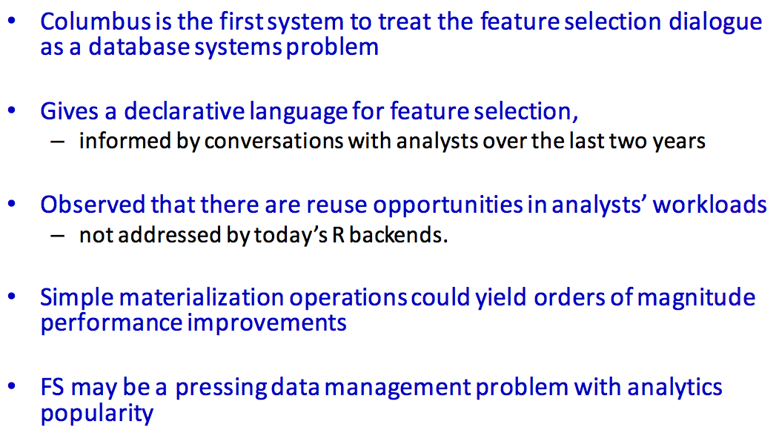
Conclusion

