Slide 1

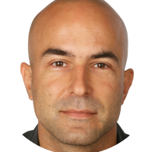
Stateful Serverless Azure Durable Function
Robert Meyer
FULLSTACK-DEVELOPER
@roeb
Thomas Freudenberg
[TITLE]
@thoemmi

Slide 2
DOMUS Software AG
[Hier bastel ich gerade etwas]

Slide 3





Microsofts Serverless World
On-Premises
IaaS
PaaS
Serverless

Slide 4

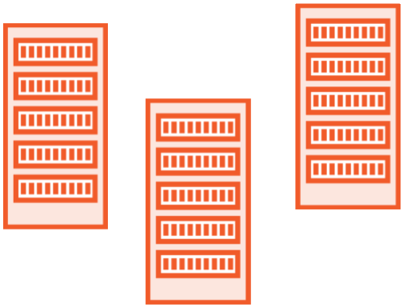

What is Serverless?
Deploy without having to worry about infrastructure
Automatic scaling
Consumption-based pricing model

Slide 5




Serverless Components in Azure
PREVIEW
Functions
Logic Apps
Event Grid
SQL Server
Serverless Compute
Serverless Workflows
Serverless Events
Serverless Database

Slide 6



What is Azure Functions?
Triggers
Timer
Queue Message
HTTP Trigger
Languages C#, F#
JavaScript
Java
Bindings Blob Storage
CosmosDb
SendGrid

Slide 7
Azure Functions
@Thomas: Kannst du dir das hier zurecht bauen?

Slide 8
Demos Azure Functions
@Thomas: Kannst du dir das hier zurecht bauen?

Slide 9
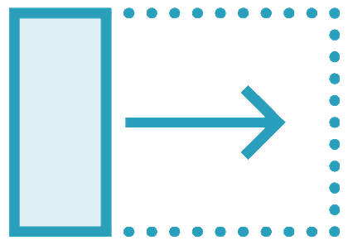
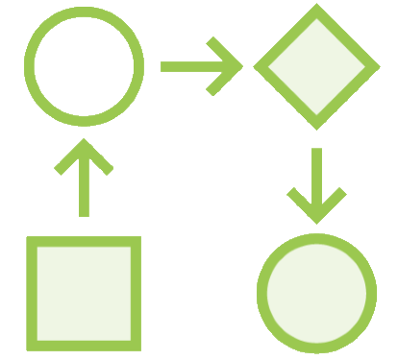
What are Durable Functions?
An extension to
Azure Functions
Write “stateful” functions in a “serverless” environment
Define workflows in code

Slide 10

Durable Functions or Logic Apps?
Functions
Logic Apps
Both allows implementing advanced patterns
C#, F# and JavaScript
Bindings
Visual Designer and WDL
200+ Connectors

