Slide 1


Stateful Serverless Azure Durable Function
Robert Meyer
FULLSTACK-DEVELOPER
@roeb
Thomas Freudenberg
[TITLE]
@thoemmi

Slide 2
DOMUS Software AG
[Hier bastel ich gerade etwas]

Slide 3





Microsofts Serverless World
On-Premises
IaaS
PaaS
Serverless

Slide 4

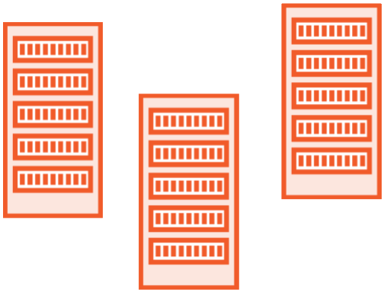

What is Serverless?
Deploy without having to worry about infrastructure
Automatic scaling
Consumption-based pricing model

Slide 5




Serverless Components in Azure
PREVIEW
Functions
Logic Apps
Event Grid
SQL Server
Serverless Compute
Serverless Workflows
Serverless Events
Serverless Database

Slide 6

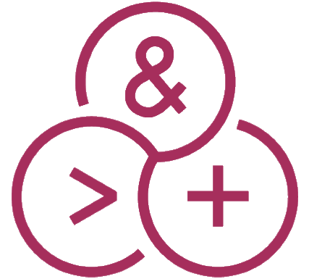

What is Azure Functions?
Triggers
Timer
Queue Message
HTTP Trigger
Languages C#, F#
JavaScript
Java
Bindings Blob Storage
CosmosDb
SendGrid

Slide 7
Azure Functions
@Thomas: Kannst du dir das hier zurecht bauen?

Slide 8
Demos Azure Functions
@Thomas: Kannst du dir das hier zurecht bauen?

Slide 9
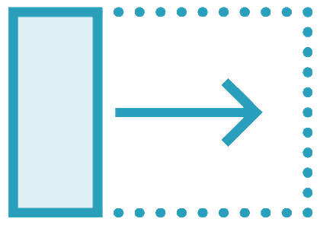
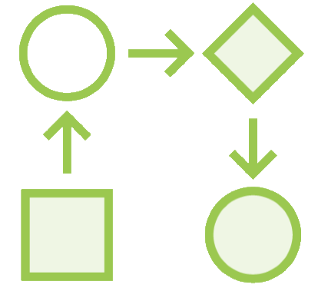
What are Durable Functions?
An extension to
Azure Functions
Write “stateful” functions in a “serverless” environment
Define workflows in code

Slide 10


Durable Functions Basics
Define Workflows in code
Parallel executions
Error handling
Easily understood “Orchestrator Function”
Supports many Workflow patterns
Human interactions
Fan-out/Fan-in
Solves the state problem
Tracks the workflow progress
Much better in Azure Durable Functions 2.0

Slide 11
How Durable Functions work
Activity Function 1
Orchestration Client
Activity Function 2
HTTP Triggered Azure Function
Orchestrator Function
Activity Function 2

Slide 12
Chaining with Durable Functions
Orchestrator Function
Activity Function 1
// call the first activity await CallActivityAsync("Activity1"); // call the second activity await CallActivityAsync("Activity2"); // call the third activity
await CallActivityAsync("Activity3");
Activity Function 2
Activity Function 2

Slide 13

Orchestrator Function Rules
Durable Functions uses Azure Storage
Storage Queues
Messages to trigger the next function
Storage Tables
Store state of orchestrations
Task Hub
The storage used by Durable Functions
You can use multiple task hubs
They can share a storage account

Slide 14
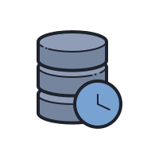
Durable Functions State Storage
Durable Functions uses Azure Storage
Storage Queues
Messages to trigger the next function
Storage Tables
Store state of orchestrations
Task Hub
The storage used by Durable Functions
You can use multiple task hubs
They can share a storage account

Slide 15

Demo: Simple Durable Functions Workflow
How to create a Durable Function Project
Approval Workflow with Durable Functions

Slide 16

Benefits of Durable Functions
Define workflows in code
Easy to implement complex workflows
Consolidate exception handling
Check on progress or cancel workflow
Manage state for you

Slide 17

Pains of Durable Functions
Deployment with breaking changes
Versioning
Monitoring of the entire workflow or individual components
Keep Alive

Slide 18

Durable Functions or Logic Apps?
Functions
Logic Apps
Both allows implementing advanced patterns
C#, F# and JavaScript
Bindings
Visual Designer and WDL
200+ Connectors

