Slide 1
Spark-GPU: An Accelerated In-Memory Data Processing Engine on Clusters

Slide 2
Abstract
Apache Spark is an in-memory data processing system that supports both SQL queries and advanced analytics over large data sets
Spark-GPU transforms a general-purpose data processing system into a GPU-supported system
Spark-GPU determines the suitability of workloads for GPU with a task scheduling capability between CPU and GPU

Slide 3
Something Impressive
A GPU version’s RDD which becomes the fundamental data structure to integrate Spark and GPU
Some basic operators which any other complicated instructions base on
More convenient GPU sharing to optimize the performance when executing multiple queries
A reasonable set of strategies that can generate a optimized execution plan for CPU-GPU hybrid structure

Slide 4
Introduction Background
R&D for data processing to handle increasingly big volumes of data has been rapidly advanced in two stages
Stage 1: Scalable systems based on scale-out models have been developed.
An example is Hadoop, which is an open source implementation of MapReduce.
Stage 2: High performance in data processing.
The efforts mainly come for best utilizing advanced and low cost commodity devices such as multicores, GPUs and SSDs
Apache Spark is a representative open-source, distributed in-memory data processing system which has gained popularity for its improved performance over Hadoop
With in-memory data processing, the performance bottleneck of data analytics applications has shifted from disk I/O and network to computations
Data analytics application is of rich data parallelism, as well as GPU is suitable to execute parallel programs

Slide 5
Spark-GPU overview Challenges
Spark uses the iterator model to execute applications
The one-element-a-time model is simple and flexible but it doesn’t match the parallel architecture of GPU
Spark is implemented in a managed language and runs on top of Java Virtual Machine with automatic memory management and garbage collection
Data in Spark are represented as Java/Scala objects and are stored on the heap memory of JVM
However, GPU programs are usually implemented with GPU programming models which cannot access data stored in Java heap memory
Existing cluster resource managers such as Yarn and Mesos manage GPUs in a coarse-grained way, which exclusively assigns a GPU to a task
Operating system doesn’t provide virtual memory management for GPU device memory
Instead, each GPU program manages GPU device memory itself
In this case, when multiple GPU programs are running concurrently on GPUs, they may crash due to insufficient GPU device memory

Slide 6
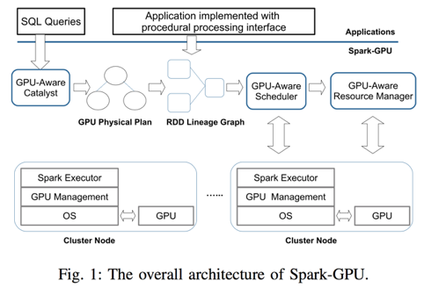
Spark-GPU overview An overview of Spark-GPU
Spark-GPU extends Spark’s iterator model to support block processing on GPUs, which can better exploit GPU’s massive parallelism and high memory bandwidth
Spark-GPU extends Spark’s SQL module to offload SQL queries to GPUs
Spark-GPU extends Spark’s cluster manager and task scheduler to manage GPUs in the cluster in order to efficiently execute data analytics applications on GPUs

Slide 7
Execution model and data format How to maximize GPU’s performance?
Each GPU kernel should be launched with a large number of GPU threads
It can utilize GPU computing resources and hide GPU memory access latency to achieve high throughput
Data should be accessed in a coalesced manner, where consecutive GPU threads access consecutive GPU memory locations to fully utilize GPU’s memory bandwidth

Slide 8
Execution model and data format GPU-RDD
The concept of RDD:
an RDD (Resilient Distributed Dataset) is a read-only, partitioned collection of records. RDDs can be created through deterministic operations on either data on stable storage or other RDDs. RDD is a fault-tolerant collection of elements that can be operated on in parallel.
What about GPU-RDD? It’s the RDD which buffers all its data in either row format or column format in native memory
Each GPU-RDD provides 2 interfaces to access the data: one is the standard RDD interface, which returns one element each time the interface is called; the other is a block interface, which returns the addresses of its buffered data.
GPU-RDDs can be devised from existing RDDs or other GPU-RDDs
By default data in GPU-RDDs are stored in column format since it may better utilize GPU’s memory band- width. However, applications can always choose row format when creating GPU-RDDs if it guarantees better performance

Slide 9
Execution model and data format GPU-RDD
BlockRecords:
It contains both buffered data and the corresponding metadata such as the number of elements in the partition, data types and others. It corresponds to one partition if data in the RDD.
Spark-GPU uses this to represent data in a GPU-RDD
Spark-GPU utilizes native memory instead of Java heap memory to buffer data in GPU-RDDs
It saves one data copying operation inside Java heap memory. Data in native memory can be directly transferred to GPUs to process.
It doesn’t increase the overhead of Java memory management.
Large usage of Java heap memory leads to more frequent garbage collection activities, which can significantly degrade the system’s performance.
GPU-RDD’s native memory is released either by JVM at the time when the object is garbage collected or by applications that explicitly execute memory release function calls
Instead of buffering data for each GPU-RDD, Spark-GPU only keeps the native memory for the last GPU-RDD of the consecutive GPU-RDDs. All native memory used by other GPU-RDDs will be immediately released.

Slide 10
Execution model and data format GPU Processing with GPU-RDDs
Spark-GPU supports several built-in GPU-RDD operations such as filter and map that are executed on GPUs. These built-in operations have data parallelism and are usually used in data preprocessing.
To conduct more complex GPU-RDD operations on GPUs, users need to implement their own customized functions, each of which computes one partition of data in the RDD (represented by one BlockRecord).
Each GPU customized function must consist of a native function that is implemented in CUDA or OpenCL, and a Scala wrapper on top of the native function.
The native function utilizes GPUs to implement the core functionality of the customized function.
The Scala wrapper provides an interface that can be executed in Spark- GPU and interacts with the native function through Java Native Interface (JNI).

Slide 11
Execution model and data format GPU Processing with GPU-RDDs
In general, the following steps are needed to offload an operation on GPU-RDD to GPUs:
(1) copying data from Java heap to native memory to create the GPU-RDD
(2) transferring data to GPU device memory
(3) computing on GPUs
(4) transferring results from GPU device memory to native memory
(5) copying results from native memory to Java heap
-> Note that step 5 only happens when the GPU-RDD’s standard data access interface is called.
To decide if an operation can benefit from GPUs, three factors should be considered
(1) whether the operation is compute-intensive
(2) whether the operation accesses the same data multiple times
(3) whether there are multiple consecutive GPU operations on the data
If any of the three factors hold, the operation should be considered to be offloaded to GPUs.

Slide 12
Query Processing on GPUs GPU Query Operators
GPU scan
GPU scan operator implements selection operation on in-memory data, which will return all data that satisfy the query predicates.
To use the GPU scan operator, data must be either explicitly cached in Java heap memory or stored in native memory.
3 steps to compute the major selection operation
(1) evaluating query predicates
query predicates are evaluated and a 0/1 vector is maintained to keep track of data that satisfy the predicates.
(2) calculating output position
a prefix sum is calculated on the 0/1 vector to decide the start writing positions for GPU threads in the result buffer to avoid synchronizations when writing the results.
(3) projecting the results
based on the 0/1 vector and prefix sum, data that satisfy the query predicates are generated.

Slide 13
Query Processing on GPUs GPU Query Operators
GPU broadcast Join and Hash Join
Broadcast join:
(1) broadcasts the smaller one of the two input tables
(2) it joins the broadcasted table with each data partition of the other table.
Hash join:
(1) it repartitions the data based on the hash values of join keys, which will shuffle data in both tables
(2) it joins each pair of repartitioned data

Slide 14
Query Processing on GPUs GPU Query Operators
GPU broadcast Join and Hash Join
Spark-GPU hash join:
Phase 1: build
In the build phase, a hash table is built on one table. We store the hash table in a continuous memory inside GPU such that it can be searched efficiently.
Each hash table entry is a (id, value) pair where id denotes the hash key and value denotes the position of data in the partition.
We scan the build table twice to avoid synchronizations when building the hash table
The first scan simply counts the number of keys that are hashed to each hash value
The second scan directly to writes to the hash table memory without synchronizations based on the prefix sum of the first scan results

Slide 15
Query Processing on GPUs GPU Query Operators
GPU broadcast Join and Hash Join
Spark-GPU hash join:
Phase 2: probe
The join key column from the other table is scanned to probe the hash table and a 0/1 vector is maintained to indicate which data should be projected.
Similar to GPU scan operator, a prefix sum is calculated on the vector such that the results can be generated without synchronizations.

Slide 16
Query Processing on GPUs GPU Query Operators
GPU Aggregation
The GPU aggregation operator is implemented as a partial aggregation followed by a global aggregation.
The partial aggregation directly aggregates each partition of the input data, which significantly reduces the amount of data to be shuffled.
After that, the aggregation results of each partition is shuffled and the final aggregation results are calculated.
Spark-GPU only executes partial aggregation on GPUs since the number of data elements to be aggregated in global aggregation is usually small.

Slide 17
Query Processing on GPUs GPU Query Operators
GPU Aggregation
Hash aggregation in GPU:
All group-by keys are converted into strings to calculate hash values.
When calculating the aggregation results, we use standard GPU library’s atomic operations to synchronize GPU threads when they are updating aggregation results for the same group.
Since atomic operations on 64-bit words with type long and double are not supported on many GPUs, Spark- GPU converts data with type long or double to float before aggregation on GPUs and converts the result type back when aggregation finishes.

Slide 18
Query Processing on GPUs GPU Query Operators
GPU Sort
GPU sort operator first sorts each data partition on GPUs. Then it shuffle-sorts data in all partitions.
Since sort is usually executed after aggregation in SQL queries, the number of data elements to sort is relatively small. In this case, GPU shared memory can be used for sorting. Keys (i.e. columns in query’s order-by clause) are sorted first on GPUs.
If there are multiple order by columns in the query, data will be sorted by each column one by one. After the keys are sorted, the results can be generated using a gather operation

Slide 19
Query Processing on GPUs GPU-Aware Query Optimizer
Given an SQL query, the query optimizer finds the best execution plan with existing query operators.
Spark’s query optimizer is designed with a set of rules and strategies.
Rules are used to generate optimized logical query plan
Strategies are used to generate optimized execution plan
To generate query execution plans with both CPU operators and GPU operators, Spark-GPU extends Spark’s query optimizer by adding a set of new GPU strategies.
Given a logical plan, the criteria to determine whether to use a GPU query operator are
(1) GPU can improve the operator’s performance;
(2) there exist a chain of GPU query operators that process the data in native memory before copying the data back to Java heap.
If either of the above criteria holds, the query optimizer will choose a GPU query operator. Otherwise it will use Spark’s existing CPU query operators.

Slide 20
Query Processing on GPUs GPU-Aware Query Optimizer
Strategies
Join operators are offloaded to GPUs. If the size of one join table is smaller than Spark’s broadcast threshold, GPU broadcast join operator is used. Otherwise GPU hash join operator is used. The rationale is that the performance of join operator is bounded by memory accesses. It can benefit from GPU’s high memory bandwidth, thus GPU join operators will always be used.
The children of GPU broadcast join should use GPU operators whenever possible. The rationale is to push as many operations as possible to GPUs when data are in native memory. Note that this doesn’t work for other join operators since they will shuffle data from both tables.
If an aggregation can be divided into a partial aggregation and a global aggregation, GPU aggregation operator will be used because aggregation is compute intensive operation. The child of the GPU aggregation will also be executed with GPU query operators if possible.
If the child of sort is a GPU operator, GPU sort operator will be used. The rational is to push as many operations as possible to GPUs when data are in native memory.
Note that not all query operations are suitable for GPUs. For example, if a query only contains a simple scan operator, it will be executed on CPUs.

Slide 21
Query Processing on GPUs Optimizations

Slide 22
GPU Resource Management The advances & obstacle of GPU Sharing
Advances
GPU sharing improves the performance of GPU applications on Spark-GPU
increasing computation/PCIe ratio will decrease the performance benefits obtained from sharing GPUs
Obstacle
operating system and GPU drivers lack support of virtual memory management for GPUs
The way to solve that problem: User-Level Management: a library to manage GPU memory

Slide 23
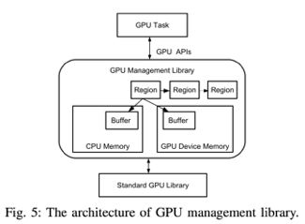
GPU Resource Management User-Level Management Library
2 design goals:
the library should be transparent to both GPU programs and the operating system.
the overhead of memory management should be as low as possible
The library manages GPU memory based on the concept of regions.
A region contains a GPU buffer and a CPU buffer.
The CPU buffer is used for storing the data in the GPU buffer when the library decides to swap out the region.
When a task tries to allocate GPU memory, a new region with a CPU buffer is created. The region’s GPU buffer is not created until the task tries to access the data in the buffer in the kernel.
When there are not enough GPU memory, the library scans the existing regions and swaps out an unused region.

Slide 24
GPU Resource Management GPU Abstraction and Task Scheduling
Spark-GPU enables GPU sharing in the cluster.
It abstracts each GPU into multiple logical GPUs. Each logical GPU can run one GPU task.
GPU’s sharing granularity is configurable.
Users need to explicitly set the number of available GPUs on each node and how many GPU tasks can be concurrently executed on each GPU.
Note that the total number of GPU tasks that can be concurrently executed on one node cannot exceed the total number of CPU cores on the node
each GPU task needs a CPU core to initiate the task.
Spark-GPU schedules tasks based on RDD lineage graph
To schedule tasks to GPUs, the scheduler checks if a stage contains any RDD that is created by a GPU operation (e.g., an SQL GPU operator and a GPU-RDD operation).
If a stage contains any GPU operation, it will only be scheduled to nodes that have GPUs and that have at least one available CPU core.
GPU tasks on the same node are scheduled to the GPU in a FIFO way

Slide 25
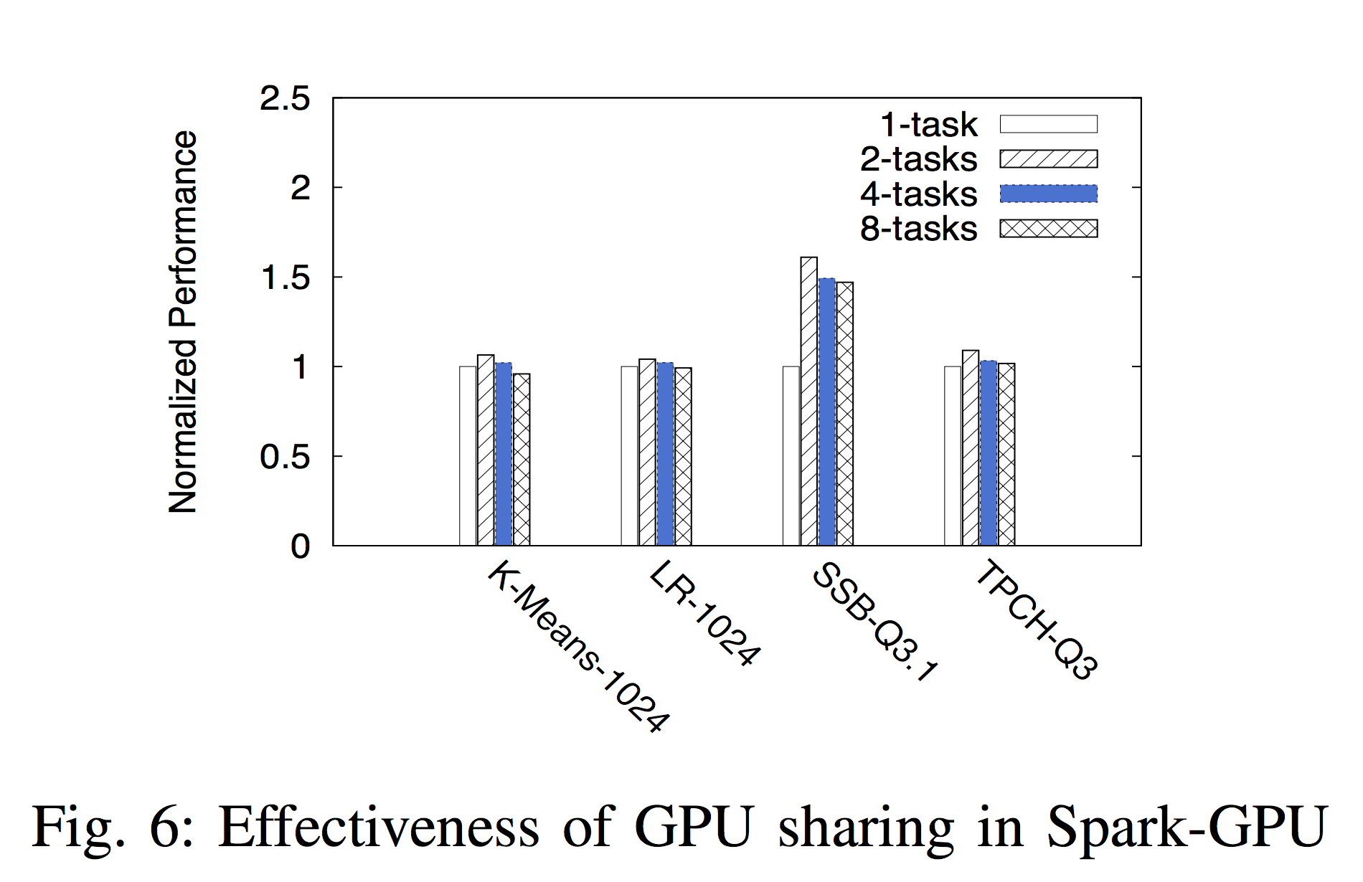
Experiment

Slide 26
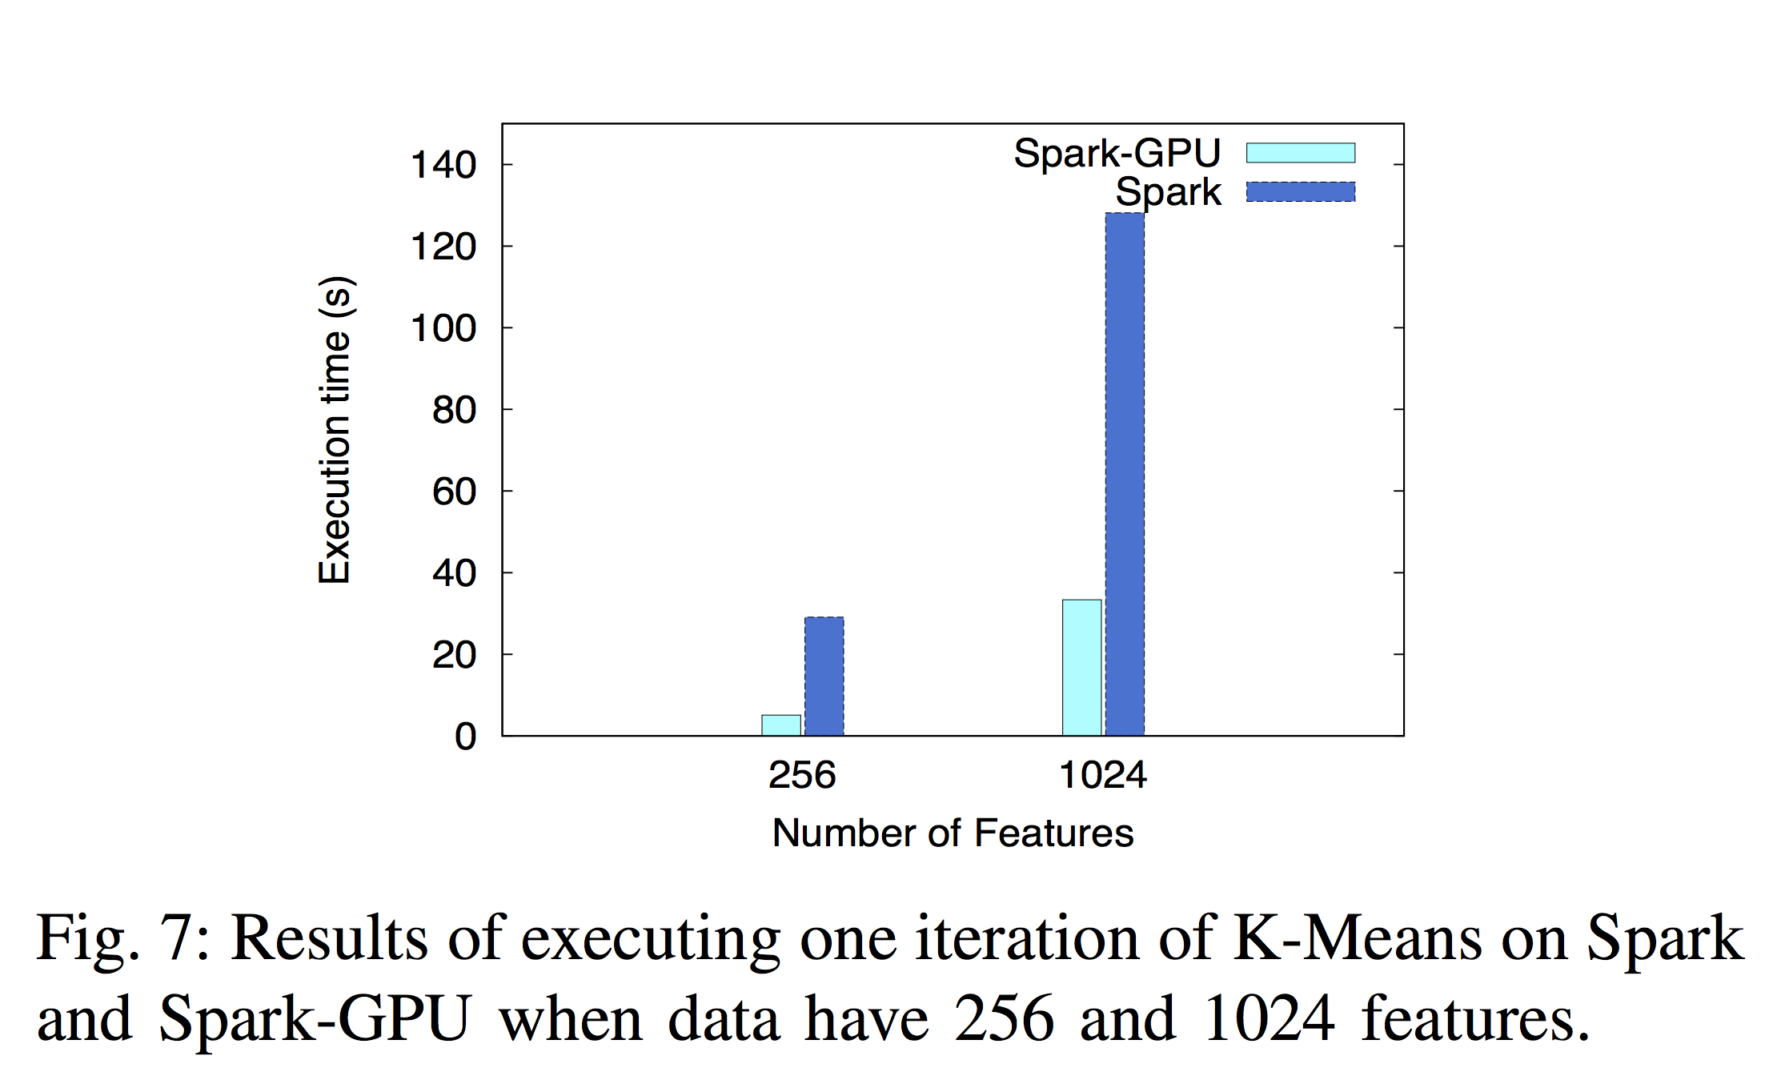
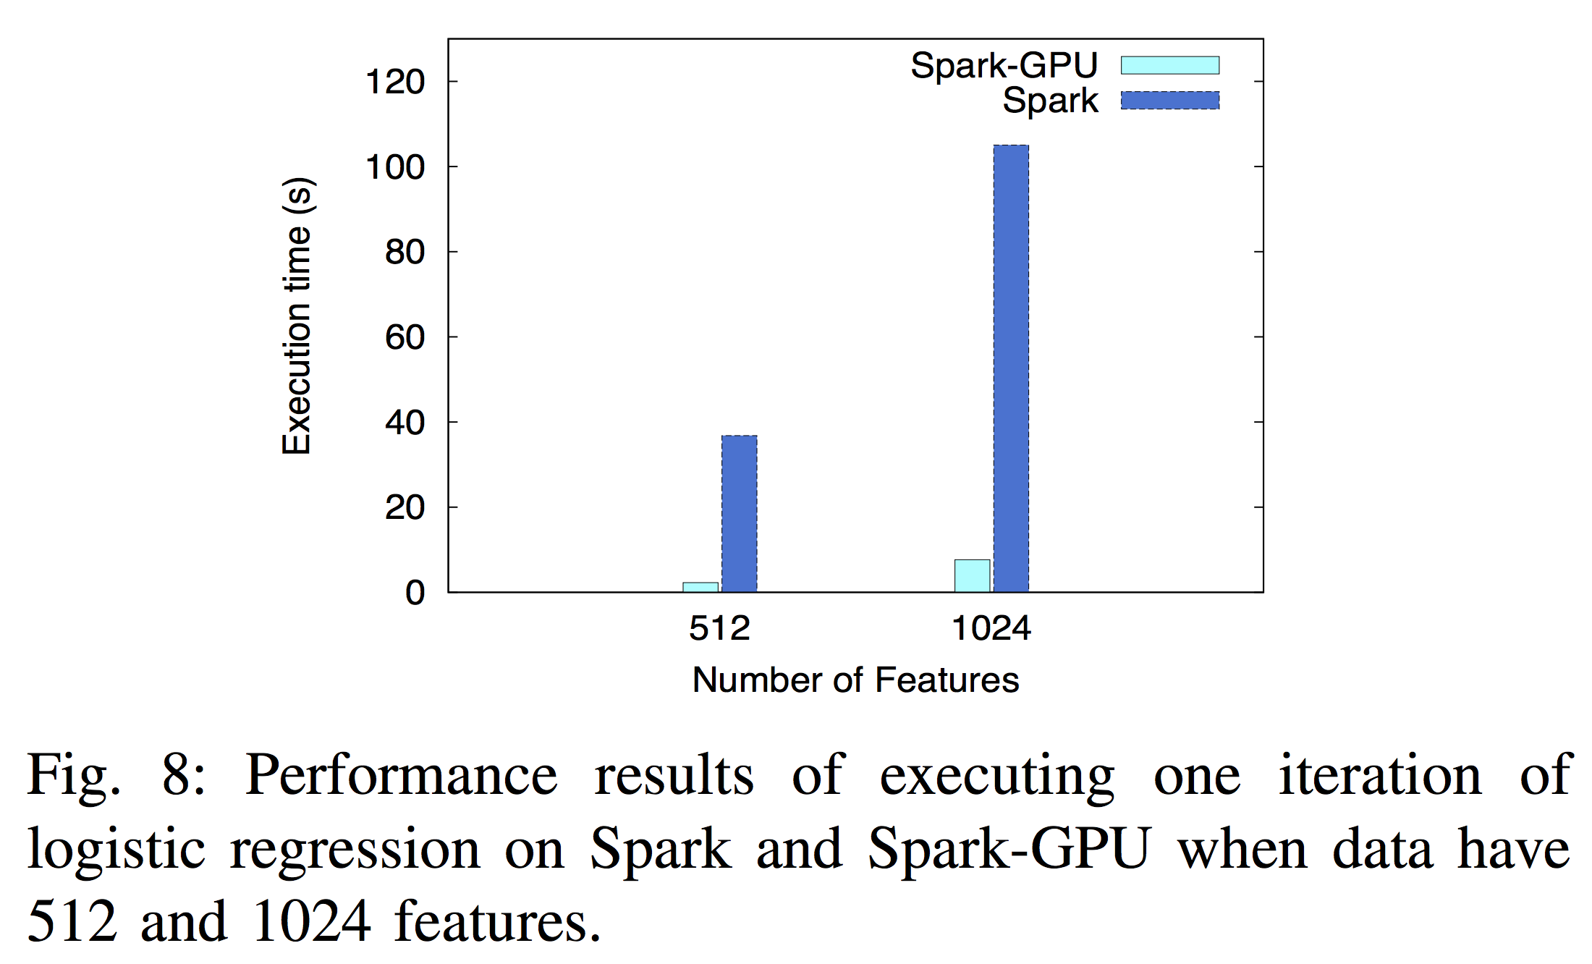
Experiment

Slide 27
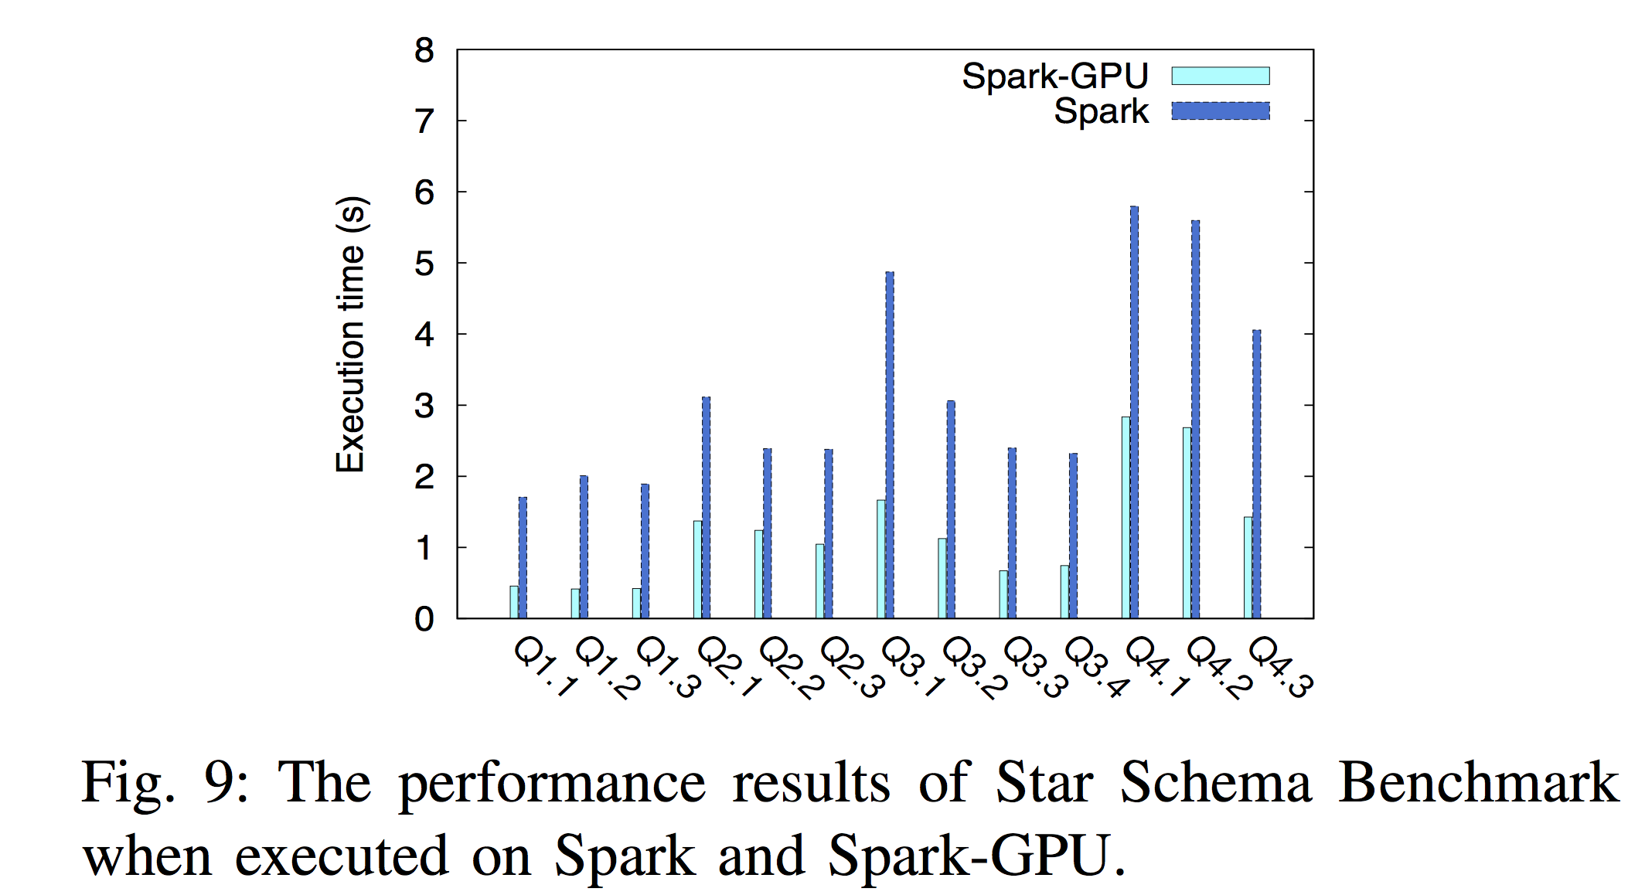
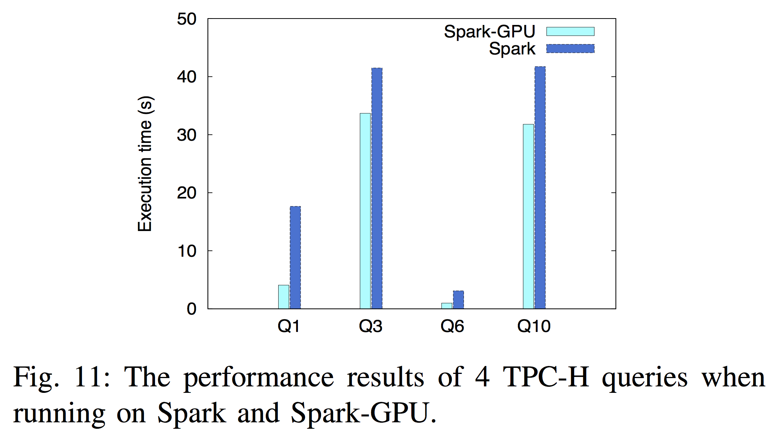
Experiment

Slide 28
Summary
This is a better solution of distributed system since it much stronger than normal Spark
GPU is a reasonable choice even in distributed system

Slide 29
THX

