Slide 1
Optimizing GPU-accelerated Group-By and Aggregation

Slide 2
ABSTRACT
In this paper, we study in depth offloading to a GPU the grouping and aggregation operator, often the dominant operation in analytics queries after joins.
We primarily focus on the design implications of a hash-based implementation, although we also compare it against a sort-based approach.

Slide 3
INTRODUCTION
As is true for traditional CPU-based database processing, the best implementation and parameter settings for GPU processing depend upon
(a) the given SQL query
(b) the data distribution (such as cardinality and skew)
(c) the hardware it is run on.
But often entirely new approaches and algorithms are necessary to adequately exploit the massive parallelism GPUs offer.
Such as exploiting different types of memory on the device (global memory and local scratchpad memory) versus the CPU’s memory, and the division of work among processor clusters and threads
To make matters worse, there are also more performance parameters, such as the size of the kernel grid and the trade-off between the number of threads and the resulting share of resources each thread will get.

Slide 4
INTRODUCTION
Our study provides
(1) a detailed performance analysis of grouping and aggregation on the GPU as the number of groups in the result varies
(2) an analysis of the truncation effects of hash functions commonly used in hash-based grouping
(3) a simple parametric model for a wide range of workloads with a heuristic optimizer to automatically pick the best implementation and performance parameters at execution time

Slide 5
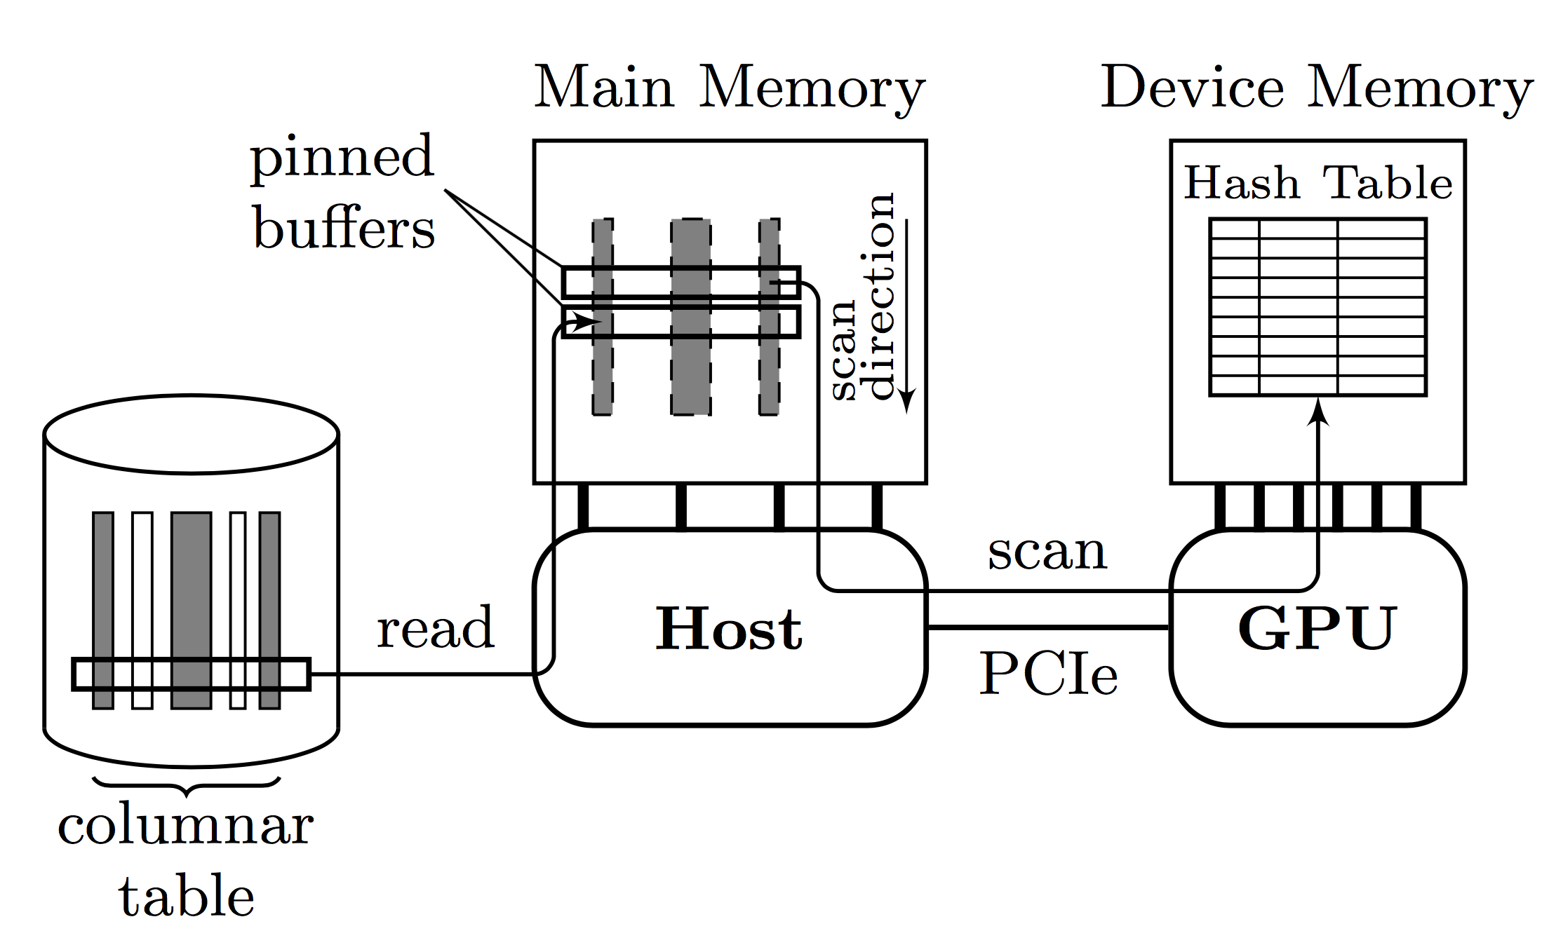
GPU GROUPING AGGREGATION System Setup
Data transfers from the SSDs into the host memory and into the GPU have to be overlapped for maximum efficiency. This is achieved by first splitting the rows to be scanned into strides with a fixed number of rows.
A stride of an INTEGER column usually amounts to ≈ 32MB.

Slide 6
GPU GROUPING AGGREGATION System Setup
In a first stage, the columns of the next stride are read from the SDDs into pinned buffers in the host memory, one buffer per column.
The current stride that was read in the previous step is available in a second set of column buffers.
Since all column buffers are backed by pinned memory, they are directly accessible from the GPU in the second stage via zero-copy access (available via Universal Virtual Addressing (UVA) in NVIDIA GPUs) as shown in Figure 1

Slide 7
GPU GROUPING AGGREGATION System Setup
3 step approach:
(1) SSD to host memory
(2) explicit host to device memory copy
(3) column scan out of device memory.

Slide 8
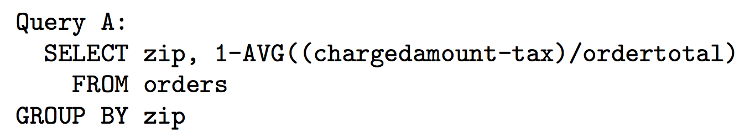
GPU GROUPING AGGREGATION Group-By Implementation
a high-level overview of the implementation of the group-by operator.
This query calculates the average discount offered to customers grouped by zip code. Here, we assume that zip is an INTEGER while the other three columns are of type REAL

Slide 9
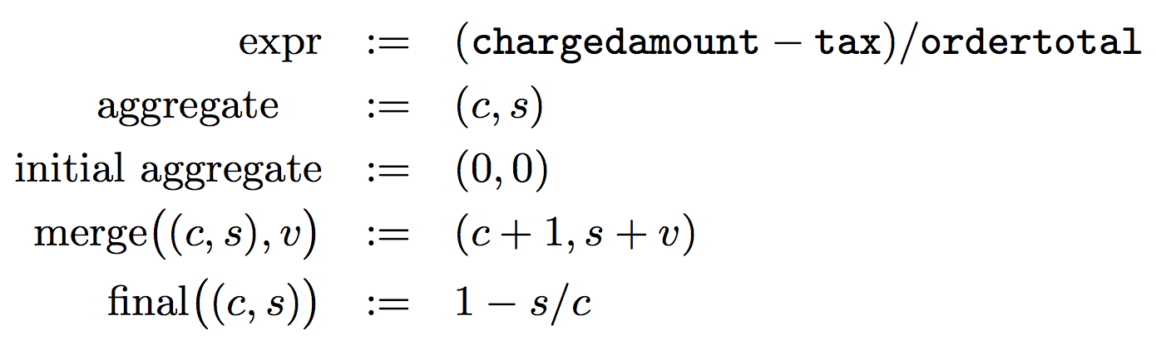
GPU GROUPING AGGREGATION Group-By Implementation
a high-level overview of the implementation of the group-by operator.
expr is the argument expression in the AVG aggregate

Slide 10
GPU GROUPING AGGREGATION Group-By Implementation
a high-level overview of the implementation of the group-by operator.
The state for this aggregate is a tuple (c, s) consisting of a count c of values and sum s of values. The initial state of the aggregate is (0, 0). The merge function adds a new value v to the aggregate. The value v is the result of evaluating expr. At the end of the aggregation, the finalizer function calculates the result 1-AVG(..) specified in the SELECT clause of the query from the final aggregation state (c, s).

Slide 11
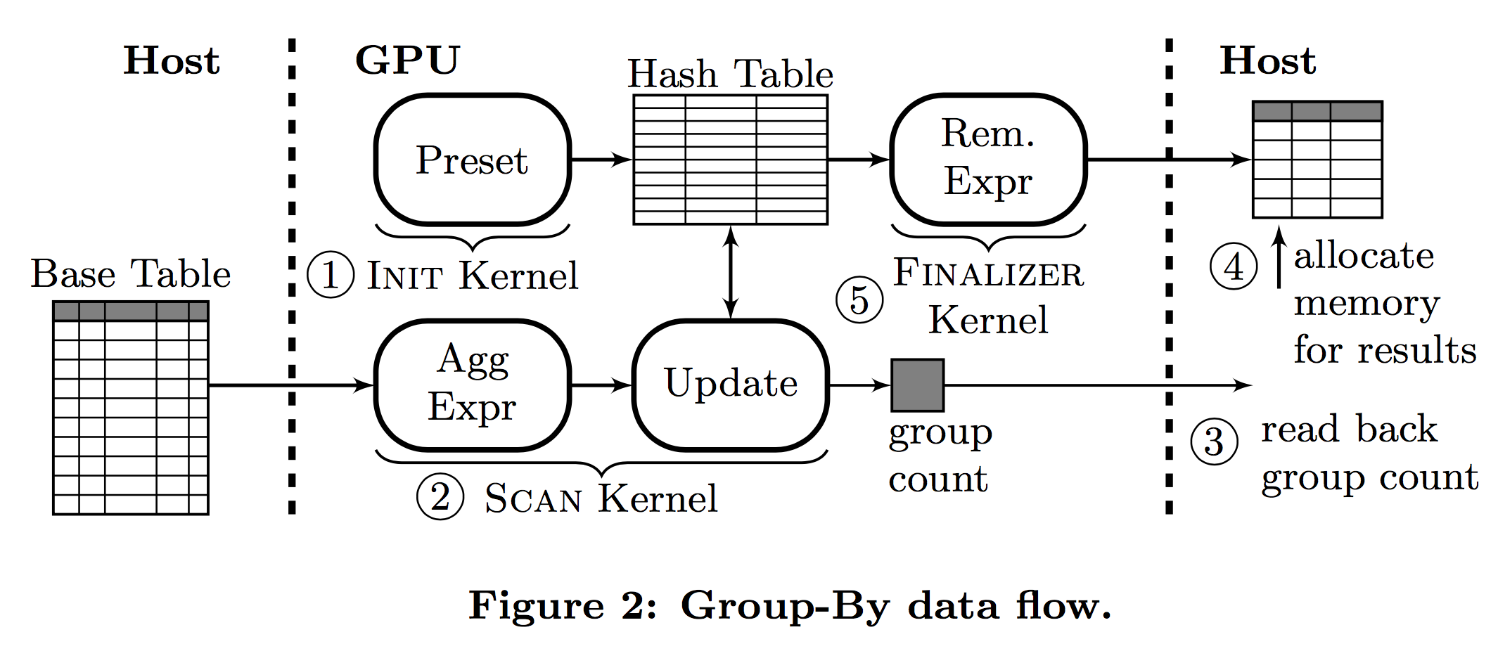
GPU GROUPING AGGREGATION Group-By Implementation
The Init kernel in step 1 in the figure initializes the hash table, i.e., it sets all keys equal to EMPTY and initializes the aggregation state.

Slide 12
GPU GROUPING AGGREGATION Group-By Implementation
The majority of the time is spent in the Scan kernel during step 2 , in which the group-by aggregation is performed. In the Scan kernel, the GPU threads first load the column values, each one from a separate row, and compute the argument expressions of the aggregate functions.

Slide 13
GPU GROUPING AGGREGATION Group-By Implementation
After the scan over the input data is complete and the Scan kernel has terminated, the group counter is read back into the host (Step 3 in Figure 2).
This result count is used in Step 4 to allocate a sufficiently large result buffer in the host memory that can hold the results of the group-by operation.

Slide 14
GPU GROUPING AGGREGATION Group-By Implementation
Afterwards, the Finalizer kernel is launched in step 5 . It scans the hash table and the remaining expressions on all non-empty buckets.

Slide 15
GPU GROUPING AGGREGATION Group-By Implementation
Generation of Group-By Kernels
The three kernels for the grouping operator are query dependent.
The Init kernel depends on grouping keys and the aggregate functions
The Scan kernel on the aggregate function and expressionsT
he Finalizer kernel on the aggregate function and ultimately on the SELECT clause.
The kernels need to be generated ahead of time as “prepared SQL statements” or as dynamic statements at execution time.
There are various ways by which these kernels can be gen- erated at execution time
One possibility is by using the OpenCL clCreateProgramWithSource(..) API call

Slide 16
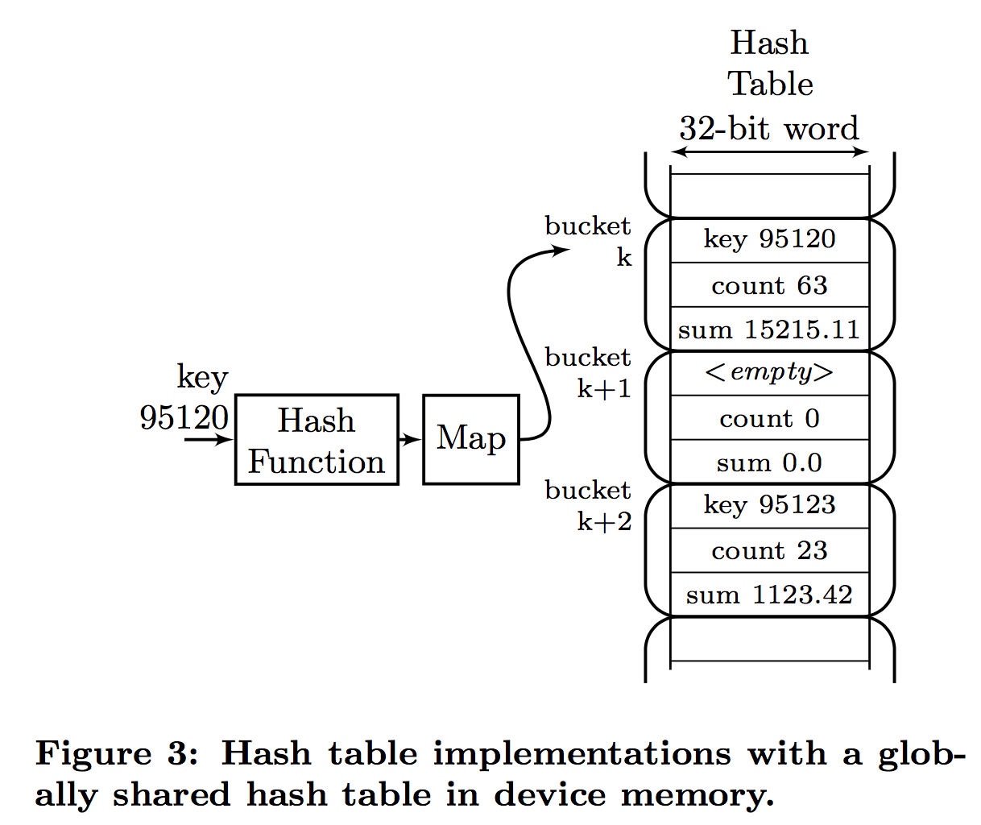
GPU GROUPING AGGREGATION Group-By Implementation
Hash Table: Open-Addressing with Linear Probing
The hash table is an array of hash buckets that contain three 32-bit elements for the example query: the key and the two aggregates, count and sum.
During an update for a given key, the hash value of the key is computed and mapped (by remainder division or by selecting a subset of the bits from the hash value) to one of the hash buckets k.
In this simple scheme, collisions are resolved with linear probing, i.e., if the bucket is already occupied by another key, the next free buckets k + 1, k + 2, etc., are searched until either that key or an empty bucket is found.

Slide 17
GPU GROUPING AGGREGATION Group-By Implementation
Hash Table: Open-Addressing with Linear Probing
When an empty bucket is found, it will be initialized by
(1) placing the key into the table
(2) incrementing the count from the initial value (zero), and adding the argument value to the sum field.
Since the hash table is globally shared by all threads running on the different processors, the update of that bucket’s fields have to be performed atomically

Slide 18
GPU GROUPING AGGREGATION Group-By Implementation
Unfortunately, the GPU does not provide hardware support for transactional memory, and latching the entire hash bucket for the duration of every attempted update would severely limit parallelism and hence performance.
Instead, we can decompose the single atomic operation into atomic updates of each of the bucket’s three fields. For the latter, modern GPUs do provide some hardware support.

Slide 19
GPU GROUPING AGGREGATION Group-By Implementation
there are several questions and concerns whether this approach would also work for a broader range of group-by queries.
What is the value of the EMPTY marker?
Which are the supported types and aggregate functions?
How is the hash table sized?
How are overflows of the hash table handled?
What is the support for wider and combined keys?

Slide 20
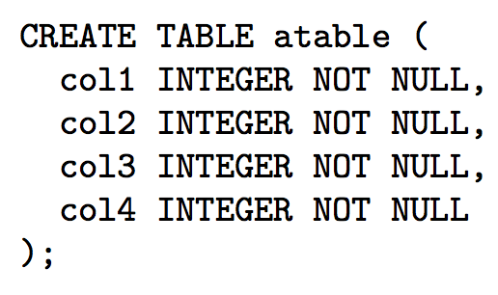
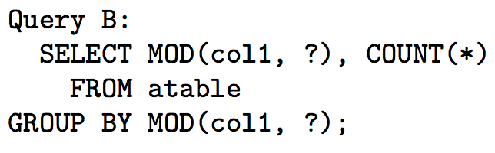
OBSERVATIONS
The group-by was performed on a table with 335 million rows consisting of four INTEGER columns:
To analyze the performance as a function of the number of groups, we use the following query that uses the MOD parameter to limit the number of groups output:

Slide 21
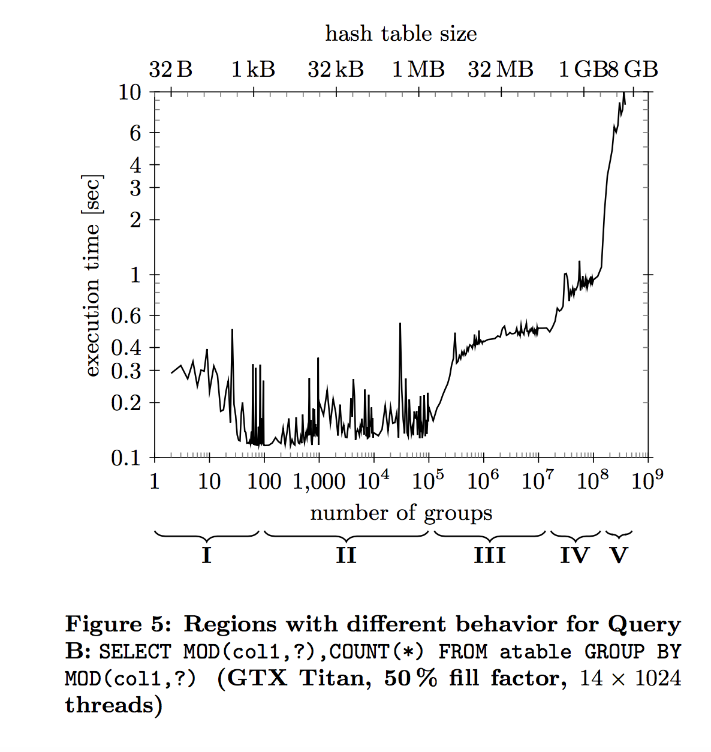
OBSERVATIONS
Region I: Contention.
Region II: L2 & Spiky Performance.
Region III: Hash Table > L2
Region IV. We are not sure what happens in region IV.
Region V: TLB issues.

Slide 22
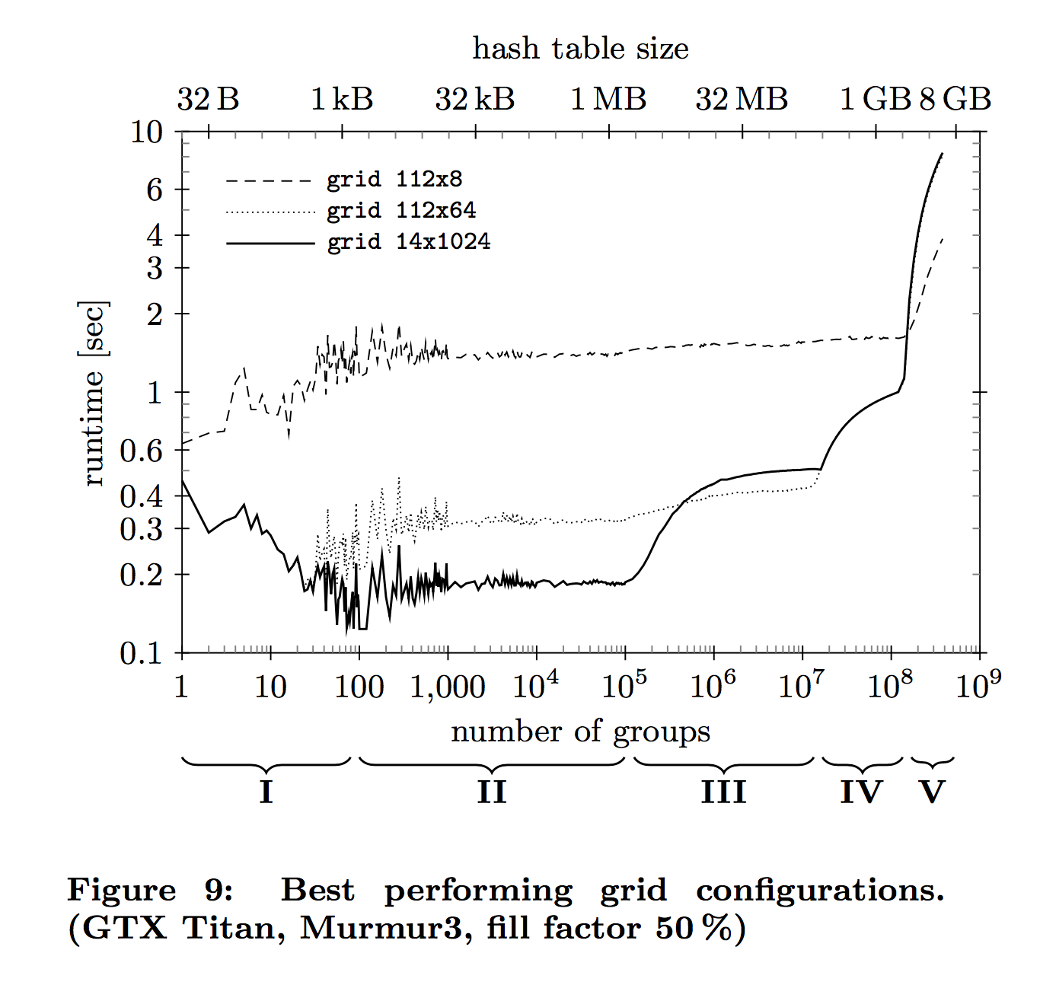
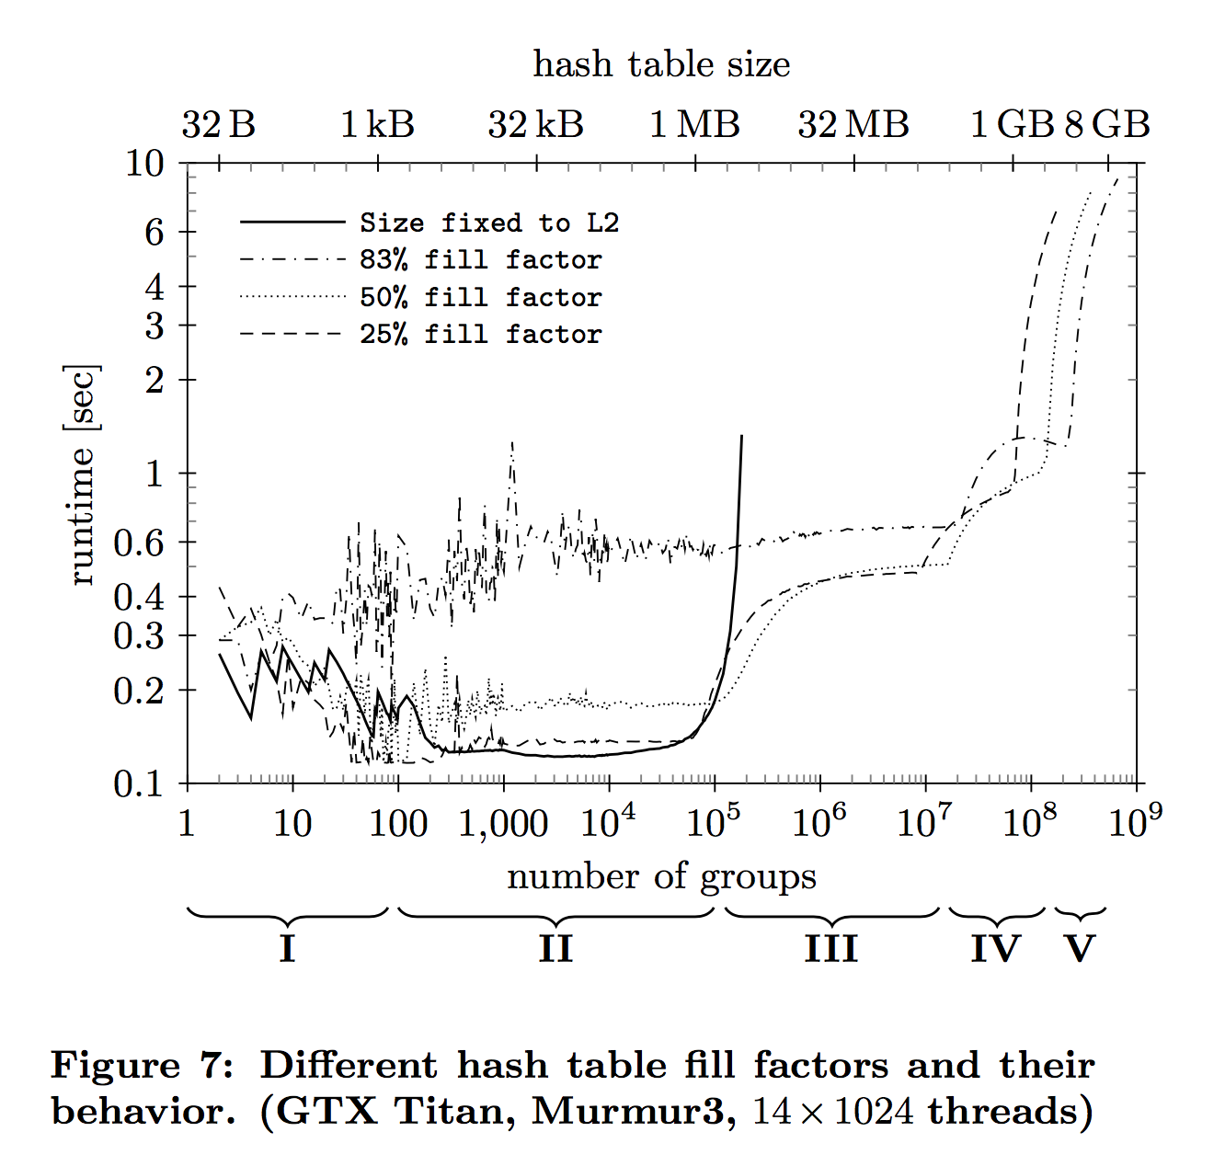
CONFIGURATION PARAMETERS

Slide 23
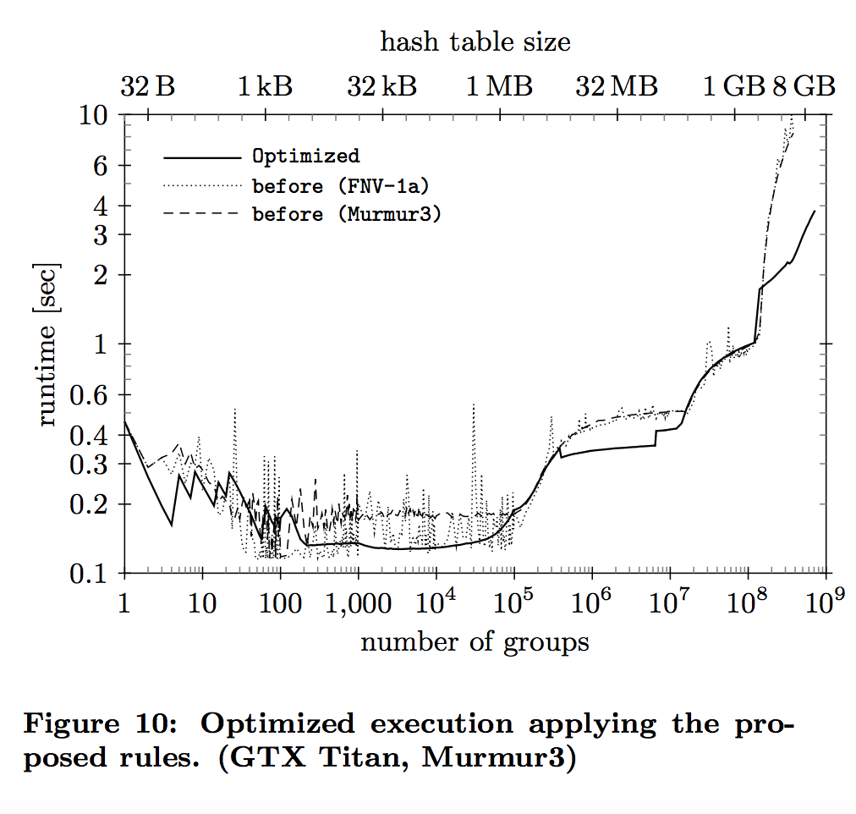
CONFIGURATION PARAMETERS

Slide 24
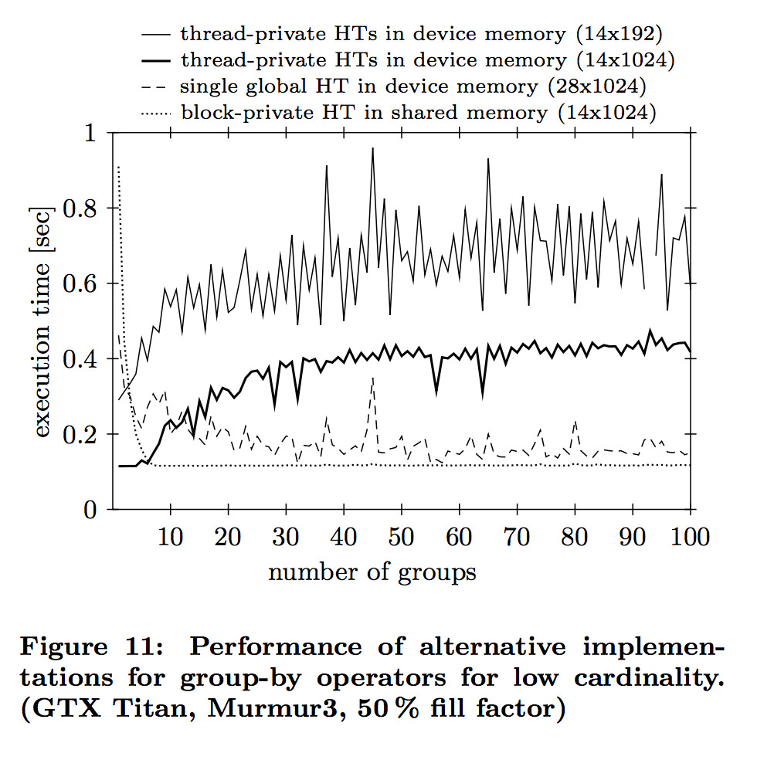
ALGORITHMIC APPROACHES Hash table placement
In order to reduce contention on the atomic when the group-by contains few groups, we introduce multiple hash tables into which the groups are inserted during the scan.
Before calling the Finalizer kernel, the partial aggregates from the different hash tables are aggregated and inserted into a final global hash table.

Slide 25
ALGORITHMIC APPROACHES Hash table placement
Two placement strategy
In the first strategy, we place the hash tables into processor-specific shared memories.
Each of these hash tables is only shared by the threads running in a particular thread block on a processor. The advantage is two- fold: By distributing the inserts/updates over multiple hash tables, we reduce the contention on the atomic updates. Additionally, shared memories are co-located with the processors and are faster than the shared L2 cache.

Slide 26
ALGORITHMIC APPROACHES Hash table placement
Two placement strategy
In the second placement strategy, we provide a private hash table to each worker thread, such that no sharing occurs.
Since there are many threads on each processor, the hash table cannot be placed into shared memory for capacity reasons. Instead, we place the hash tables in device memory.

Slide 27
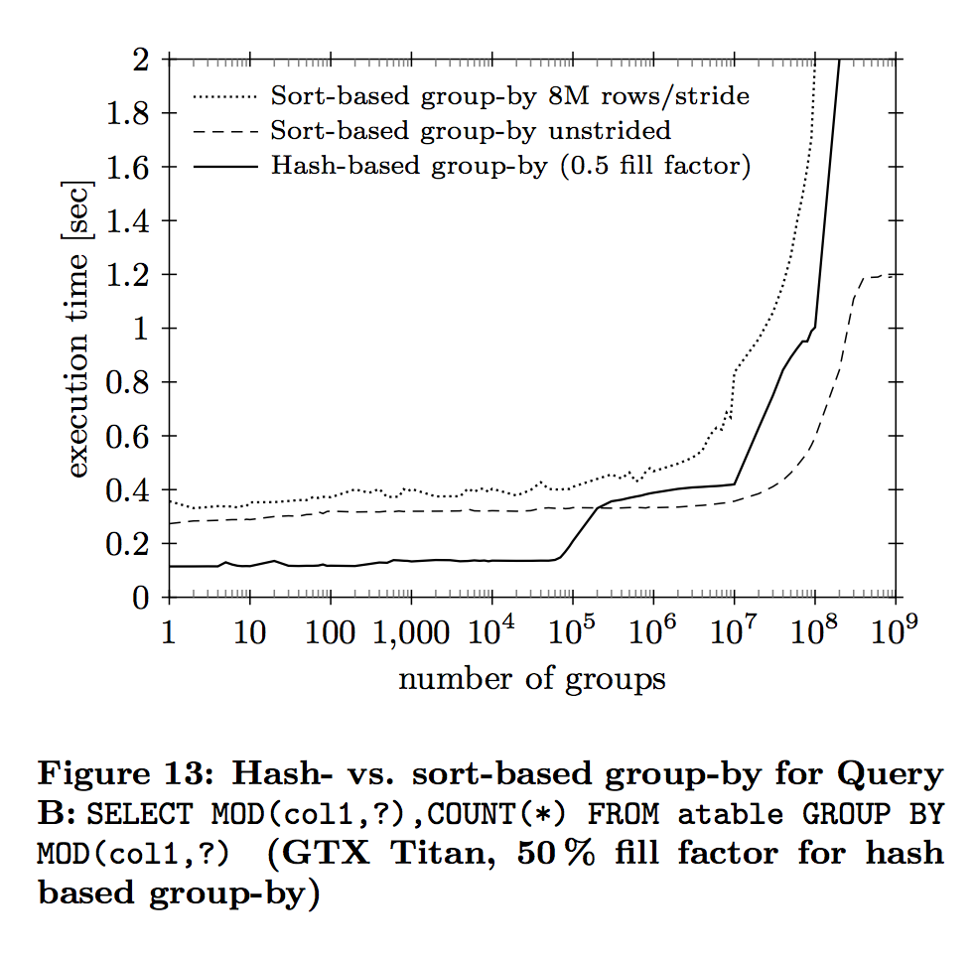
ALGORITHMIC APPROACHES Sort vs. Hash-based Group-By
Instead of hashing, grouping can also be implemented using sorting

Slide 28
CONCLUSION

Slide 29
THX

