Slide 1
Materialized View Selection: A Survey
Xiang Li
Informatik 5, RWTH Aachen University
lixiang@dbis.rwth-aachen.de

Slide 2
Index
Theoretical Perspectives
A Taxonomy of View Selection Approaches
Configuration Evolution
Resource Constrains
Optimization Goals
Candidate Views
Static View Selection
Dynamic View Selection

Slide 3
Theoretical Perspectives
What is View Selection?
A Optimization problem: tuple (S, V, M, Q)
S: the schema together with some size estimation model
V: the set of all the possible views to choose from
M: a quantity denoting the space available for materializing views
Q: a set of queries
The problem is to find a subset of V that optimizes the queries against Q while the storage requirement is no larger than M.

Slide 4
Theoretical Perspectives
The overall evaluation cost: E(V) = Σ_{q∈Q}E(q, V) * f_{q}
View maintenance cost: U(V) = Σ_{v∈V}U(v) * f_{v}
=>
Total cost: C(V) = E(V) + αU(V)
Two cost expressions lead to two optimization goals

Slide 5
Theoretical Perspectives
The simplest form of this problem in a hypercube
Views are organized in a “lattice” structure (which represents a very simple relationship between views)
Limitation of the amount of views selected rather than the total space they occupied
Even this form has a reduction from the Set Cover Problem (which means this form is at least not easier than a NP-hard problem)
Furthermore, it is shown that regarding query response time no polynomial approximation algorithm can guarantee a result better than n^{1−ε} ∀ε > 0, if P ≠ NP

Slide 6
Theoretical Perspectives
Summary:
It’s impossible to guarantee performance of the original problem using approximation algorithms.
Even the simplest form of this problem is still not easier than a NP-hard Problem.

Slide 7
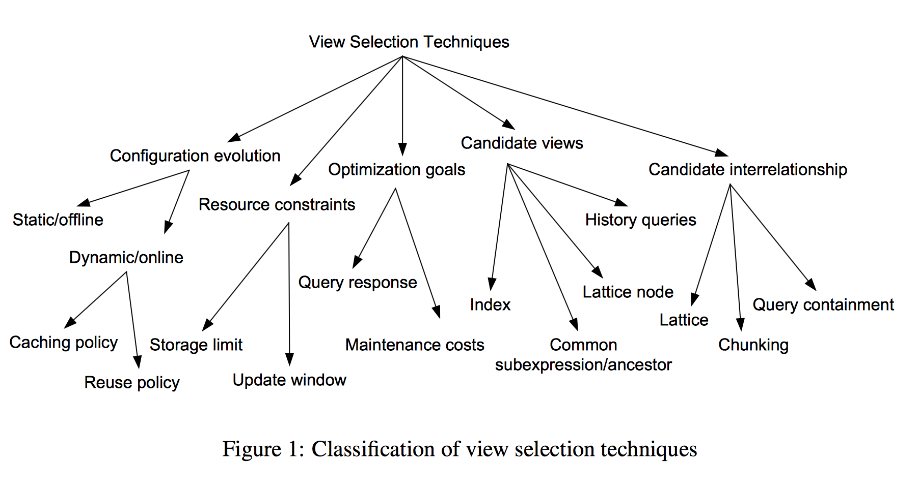
A Taxonomy of View Selection Approaches

Slide 8
Classification of View Selection Approaches Configuration Evolution
It’s about whether the selected views evolve over time
Static
Dynamic
Caching policy
Reuse policy

Slide 9
Classification of View Selection Approaches Resource Constraints
Storage limit
Update window

Slide 10
Classification of View Selection Approaches Optimization Goals
Final goals: query response time
Too expensive to achieve
Some relevant measures such as the benefit of a unit storage space
It has been shown that materializing additional views may reduce the overall maintenance costs in presence of a set of pre-determined materialized views

Slide 11
Classification of View Selection Approaches Optimization Goals
With the costs of extra storage decreasing dramatically, the update window, however, keeps shrinking.
Therefore, many approaches aim at optimizing maintenance costs instead of query response.
It is also easy to incorporate both query evaluation costs and materialized view maintenance costs in the goal function.

Slide 12
Classification of View Selection Approaches Candidate Views
In general, there are prohibitively many views that can be materialized.
Even restricted to possible combinations of selections and group-bys, the number of candidate views is already exponential in terms of the size of the queries.
Most of the static view selection techniques restrict themselves to a given set of candidate views.
For example, a natural scope is defined by all the aggregation possibilities in the data cube, which can be modeled as nodes in a lattice.
Dynamic view selection approaches make use of a windowed query history of users as a candidate domain.

Slide 13
Classification of View Selection Approaches Candidate Views
Another type of candidates are the views that are common subexpressions or ancestors of queries.
They are not optimal for a single query, but they can benefit more than one query and hence be a globally optimal choice.
Moreover, indexes can be also deemed as a special type of views.

Slide 14
Classification of View Selection Approaches Interrelationship Modeling
Selection of one view may render materialization of another view useless, while several views may have overlapping information and therefore duplications.
Dependencies between aggregations in a data cube are modeled using a lattice.
Analytic queries involving selection and aggregation can be modeled using hyperplanes covering.
Chunks in view selection approaches for MOLAP usually have more intricate relationships such as part-of.
Modern tuning tools shipped with commercial database management systems rely on query optimizers to explore implicit interrelationships between candidate views

Slide 15
Static View Selection
Most of the view selection techniques follow the paradigm of static view selection, which selects views from a given input candidate view set under storage and/or maintenance constraints.
The materialized views, once determined offline, will not change over time.
This line of work is good for cases where the queries are relatively fixed or similar.
When the query patterns of the users change dramatically, view selection has to be redone.

Slide 16
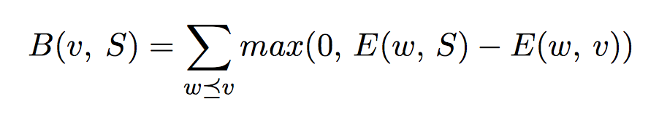
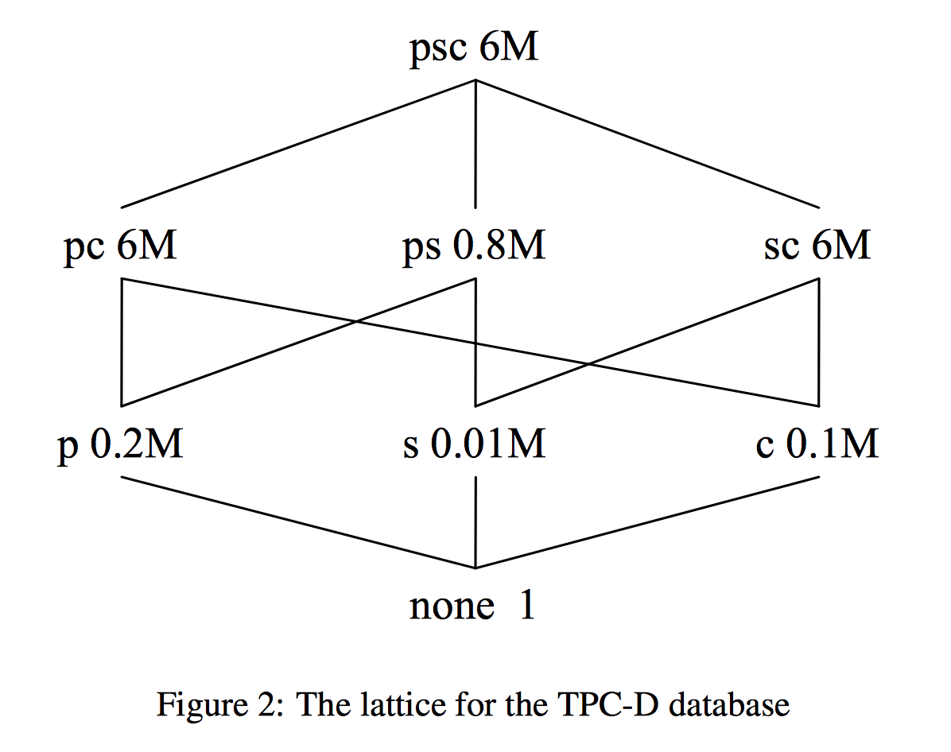
Static View Selection Modeling
Lattice shows the interrelationship between aggregation views as a data cube
A greedy algorithm based on a benefit function which shows if a view is better than all the views in the current chosen set to optimize other views (we call these views “cuboids” here)
Simplified form: NP-complete

Slide 17
Static View Selection Modeling
The framework is extended to accommodate index selection while the query workload is extended to allow both aggregation and selection (slice)
A greedy algorithm is employed to choose at each step a physical structure, either a view or an index, to maximize the benefit per unit space.
In the above case when slice queries are considered, the lattice is no longer sufficient to express the interrelationship of candidate views. A bipartite query-view graph is used in which there are a set of edges between a query and a view, each labeled with the evaluation of the query against the view using a different index
Tradeoff of distribution of storage space between views and indices

Slide 18
Static View Selection Modeling
The interrelationship modeling is further extended to so-called AND-OR view graphs.
A lattice is then a special case called OR view graph, in which each AND-arc consists of only one edge.
Maintenance costs can be incorporated into the framework either as constraints or in the optimization goal.

Slide 19
Static View Selection Result Guarantee
It is shown that the benefit measure of the result of the greedy algorithm is at least 63% of the benefit of the optimal solution without index selection, and 46% with index selection.
Interestingly, Shukla et al. (1998) show that the Benefit-Per-Unit-Space (BPUS) greedy strategy is equivalent to a simpler heuristic algorithm which picks the view with the smallest size at each iteration step. Furthermore, the Pick-By-Size (PBS) algorithm is in O(nlogn) while BPUS is in O(kn2), where n is the size of the candidate view set and k is the number of views selected.

Slide 20
Static View Selection Multiple Query Optimization Techniques
To find reusable common sub-expressions of queries.
It’s a state space search problem, where each state is a multi-query graph specifying Select-Join queries.
Though the exhaustive search gives the optimal view set regarding both query evaluation and maintenance costs, it is exponential and a storage limit is not taken into account.
After that, the work is extended to incorporate storage limit, and to allow for projection in queries.

Slide 21
Static View Selection Heuristic Approach
A view is worth considering if it corresponds to a user query or it is the least common ancestor (in the lattice) of two worthy views.
It is often advantageous to group by key attributes instead of non-key attributes in terms of reuse.
…

Slide 22
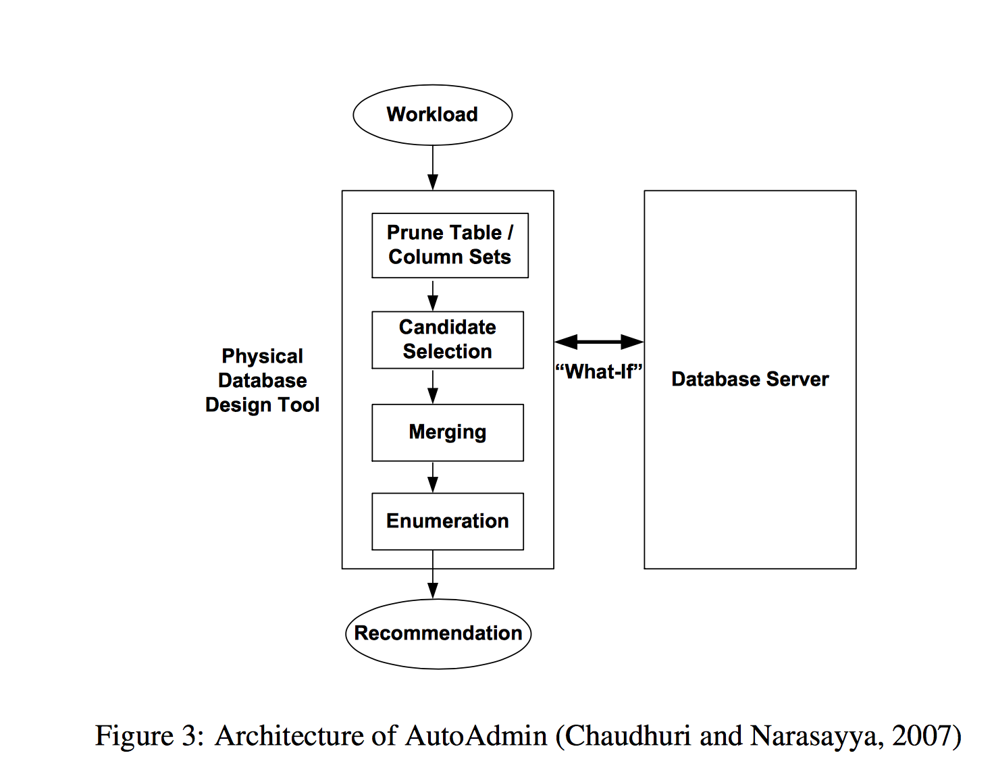
Static View Selection Integration into query optimizer
AutoAdmin

Slide 23
Dynamic View Selection Why we choose it
Static view selection rely on a pre-compiled query workload, and may not perform well for ad hoc queries.
The resource constraints such as space and maintenance time may change over time, while the materialized views are fixed once selected.
Static view selection is usually unable to meet both the space bound and the maintenance bound at the same time.
For example, if space is sufficiently large, we can materialize transient views, which can be dropped before the update window.
In order to adapt to the evolution in reality, administrating efforts such as monitoring and reconfiguration cannot be avoided.

Slide 24
Dynamic View Selection Dynamic View Selection/View Caching
Physical caching refers to the mechanism employed in operating systems and traditional relational databases, where some physical storage unit such as a page or a tuple is kept in cache.
Semantic caching takes advantage of high level knowledge about the data being cached, and keeps track of the semantic description of the cached data.
In particular, caching of views or queries is semantic caching, since the cache manager knows both the data and their query expressions.

Slide 25
Dynamic View Selection Dynamic View Selection/View Caching
Selection queries and the cache space can be divided into disjoint semantic regions bounded by boolean constraints.
Thus, a query q with selection Q can be decomposed into two parts: Q ∧ C and Q ∧ ¬C, where C is a boolean expression for the cache.
The missing part is then computed from the base relations, while the in-cache part can be directly fetched.
Chunk caching is a kind of semantic caching specific to chunk based organization. Chunks have finer granularity than views or tables and are thus more flexible and may be more efficient in answering overlapping queries mainly involving aggregations.

Slide 26
Dynamic View Selection Some famous approachs
WATCHMAN is a cache manager targeted at OLAP. It employs a simple hit-or-miss strategy and relies on temporal locality of queries to gain benefits.
DynaMat is a more advanced system which considers queries using group-bys and equality based selections. Each query is represented by a hyperplane in the hypercube of multidimensional data. A cover-or-miss strategy is employed, that is, a cached view can benefit any query computable from it, which is reduced to coverage of hyperplanes. Due to the restricted query type, an R-tree like view index can be built over the cached views to search in the cache to answer queries.

Slide 27
Dynamic View Selection View Reusing
Another most significant issue in view caching is the admission and replacement control
i.e., how to decide which view is admitted and which view is replaced.
Whenever there is not enough free space for caching a new query, a candidate replacement subset of cached queries is chosen and the benefit of the candidate subset is compared to the benefit of the new query.
cost save ratio (CSR) measures the percentage of total query costs saved due to hits in the cache.

Slide 28
Dynamic View Selection View Reusing Strategies
One well known strategy is Least Recently Used (LRU), which discards the oldest data cached.
The strategy is extended to LRU-K to take advantage of recent access patterns.
CLOCK algorithm: an efficient approximation of LRU

Slide 29
Dynamic View Selection View Reusing
There are two ways to use the benefit metric and the recency metric simultaneously.
One way is to consider the recency and benefit in parallel: first use LRU to select a candidate set and then use benefit to decide on replacement.
The other way is to use an aging strategy to obtain benefit in the recent time window and then use the windowed benefit for both candidate set selection and replacement decision.

Slide 30
THX

