Slide 1
Relational Query Coprocessing on Graphics Processors

Slide 2
Abstract
Many of the GPU features are specialized for graphics processing
the massively multithreaded architecture
the Single-Instruction-Multiple-Data processing style
the execution model of a single application at a time
GPUs rely on a bus of limited bandwidth to transfer data to and from the CPU, do not allow dynamic memory allocation from GPU kernels, and have little hardware support for write conflicts
GDB is an in-memory relational query coprocessing system
A set of highly optimized data-parallel primitives such as split and sort is designed and based on that common relational query processing algorithms are implemented
The algorithms utilize the high parallelism as well as the high memory bandwidth of the GPU, and use parallel computation and memory optimizations to effectively reduce memory stalls

Slide 3
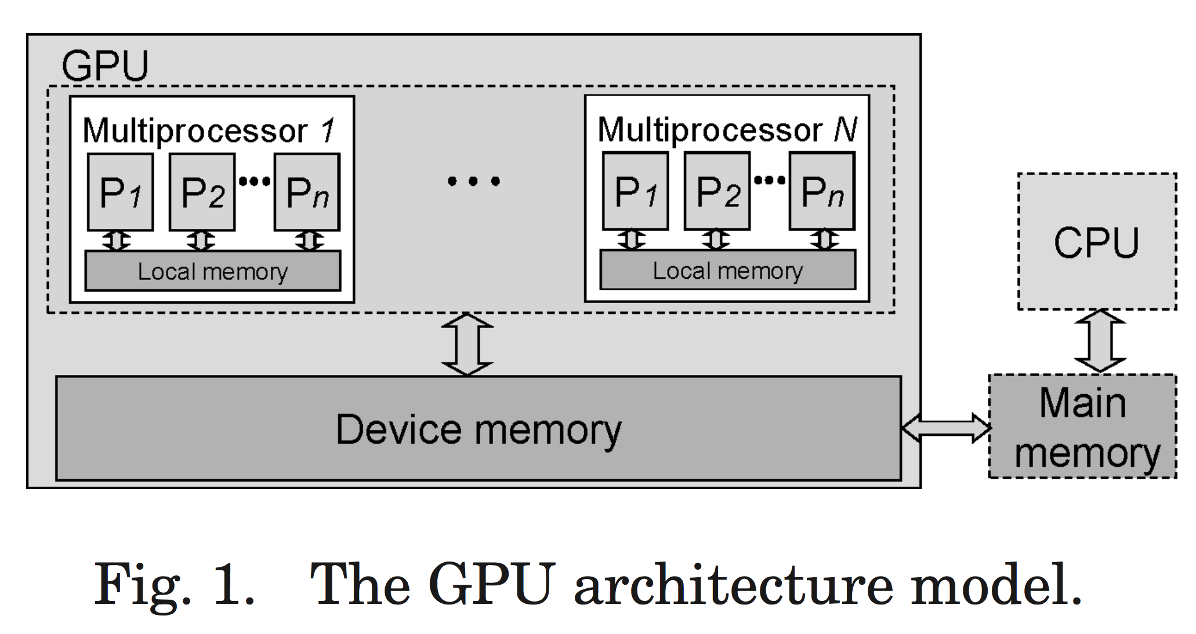
Background and Related Work GPU

Slide 4
Background and Related Work GPU
To develop GPU programs, developers write 2 kinds of code, the kernel code and the host code
The host code runs on the CPU to control the data transfer between the GPU and the main memory, and to start kernels on the GPU.
The kernel code is executed in parallel on the GPU.
3 steps of a computation task on GPU
1. The host code allocates GPU memory for input and output data, and copies input data from the main memory to the GPU memory.
2. The host code starts the kernel on the GPU. The kernel performs the task on the GPU.
3. When the kernel execution is done, the host code copies results from the GPU memory to the memory.

Slide 5
Background and Related Work GPGPU
Some prior APIs such as OpenGL, DirectX and so on are used to accelerate database
GPGPU languages: CUDA, OpenCL(although didn't appeared when this paper was published)

Slide 6
Background and Related Work Architecture-Aware Query Processing
Cache-conscious techniques(Cache parameter)
Cache-oblivious algorithms(Divide-and-Conquer methodology)
Parallel database systems(shared-nothing or shared-memory architectures)
These systems exploit data parallelism as well as pipelined parallelism in database workloads and utilize the aggregate computation power of multiple processors to improve performance.
Two-phase optimization strategy
1. an optimized sequential query execution plan is created at compile time
2. to optimize the parallelization of the sequential plan chosen from the first phase
Parallel database techniques on multicore CPUs
Query processing techniques on specialized architecture

Slide 7
Design and Implementation of GDB
On the one hand, the GPU has 10x more computation power and memory bandwidth than the CPU.
On the other hand, it relies on the CPU for task initiation, data transfer, and I/O handling.
As a result, even if the execution time of a task on the GPU is much shorter than that on the CPU, the overall performance may not be improved, due to the CPU-GPU transfer cost for input data and result output.
We model the CPU and the GPU as two heterogenous processors connected with a bus of limited bandwidth.
The communication between the CPU and the GPU requires explicit data transfer via the bus

Slide 8
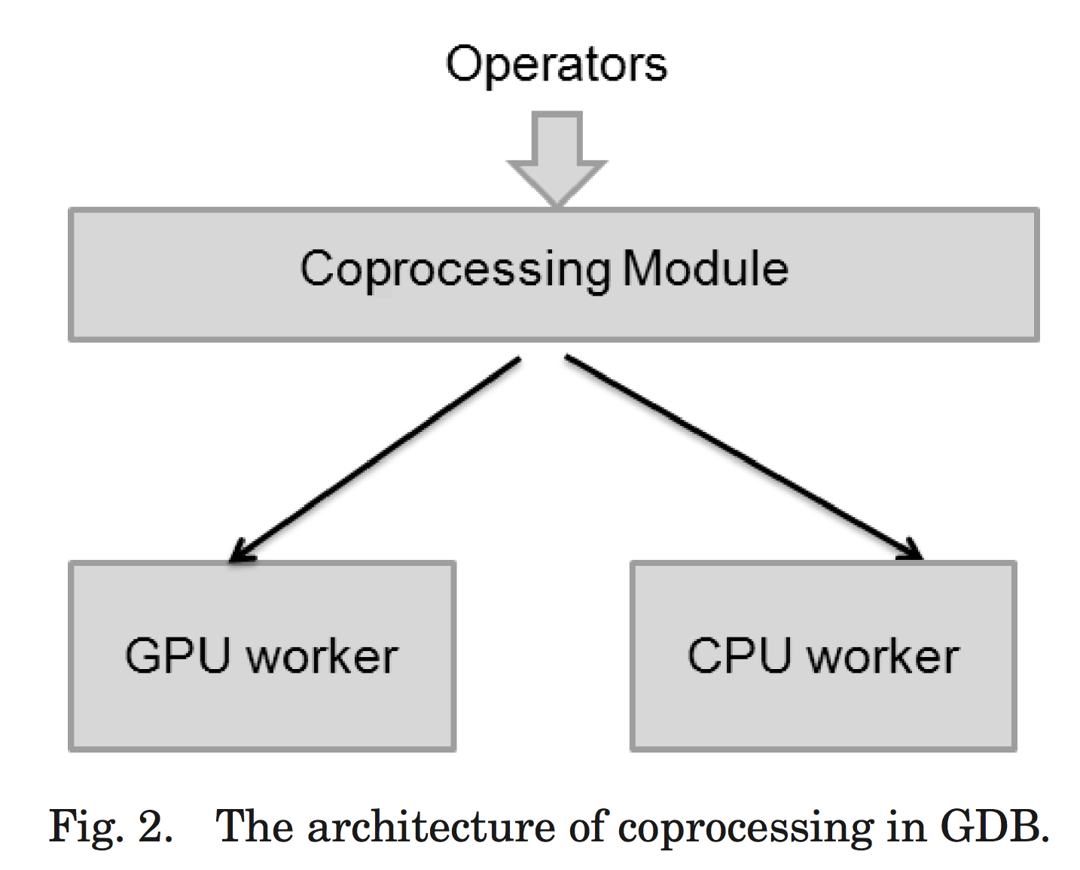
Design and Implementation of GDB
Fig.2 is the architecture of our coprocessing scheme
First a Selinger-style optimizer is used for plan generation
Then, given a query plan, the coprocessing module is responsible for dividing the workload between the CPU and the GPU, and merging the results from the two processors if both processors are involved.
It uses the CPU- and the GPU-based cost estimators to facilitate the workload partitioning
As a result, an operator in the query plan may be executed by the GPU worker, the CPU worker, or both.

Slide 9
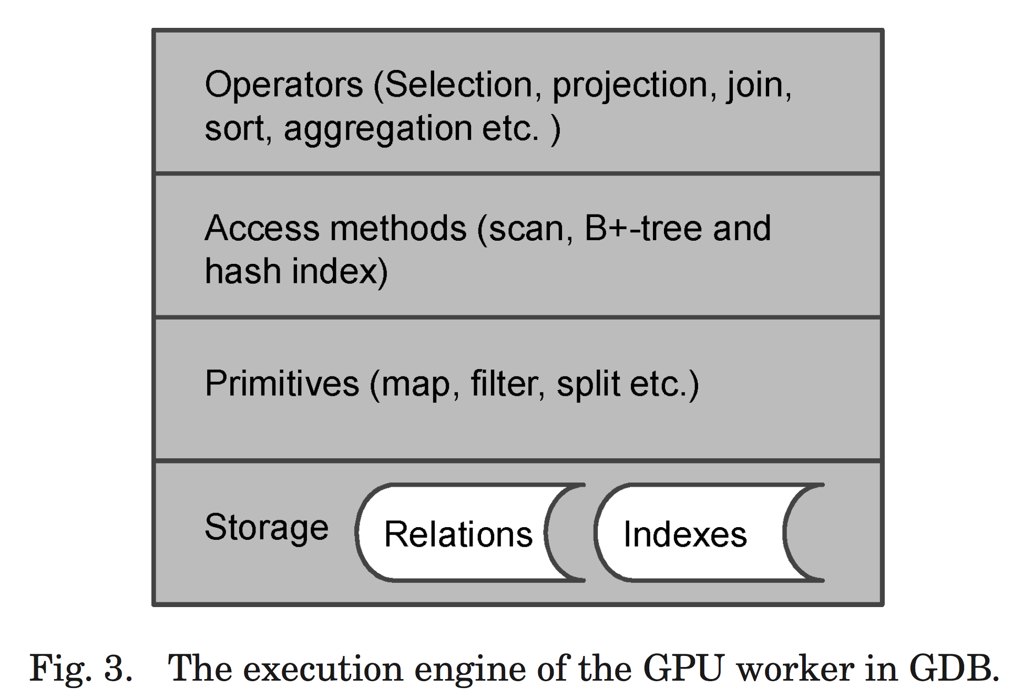
Design and Implementation of GDB GPU worker - Primitives

Slide 10
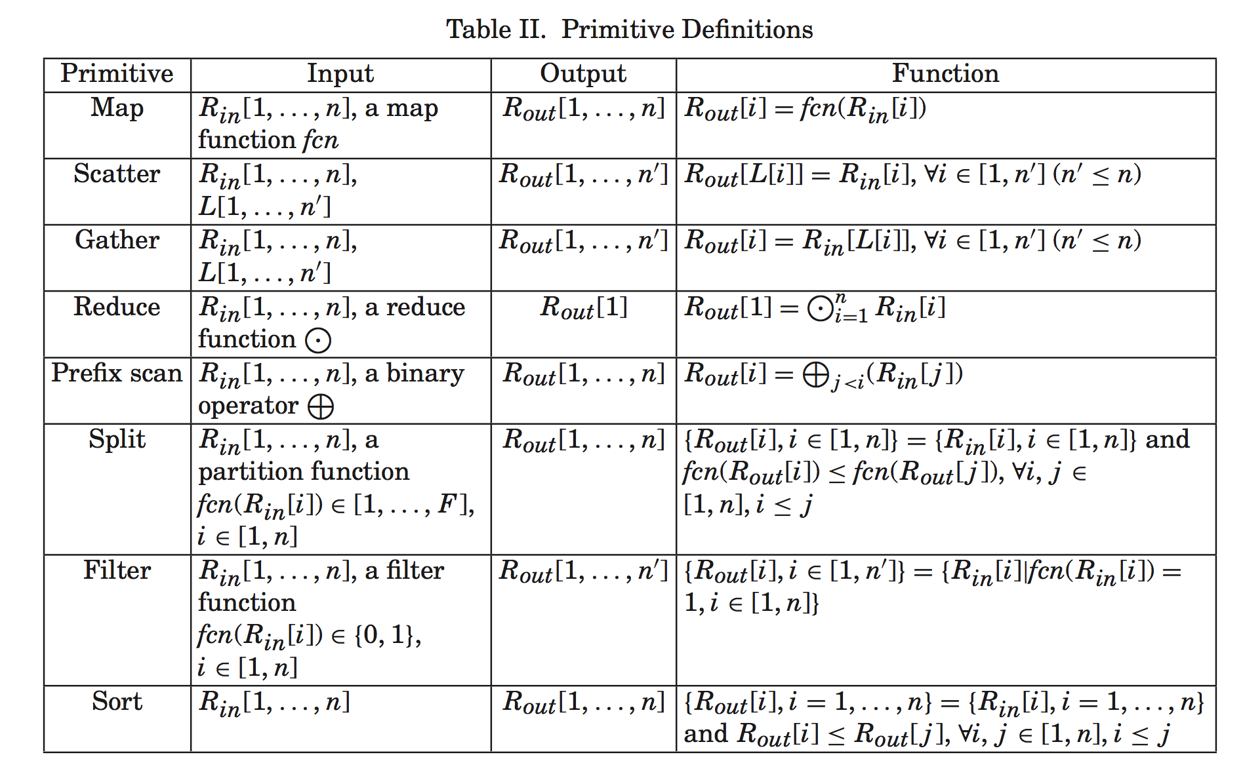
Design and Implementation of GDB GPU worker - Primitives
Primitives: a complete set of data parallel primitives on the GPU for query processing

Slide 11
Design and Implementation of GDB GPU worker - Primitives
The features of the primitives:
They exploit the GPU hardware features, especially the high thread parallelism and the fast local memory to reduce the memory stalls.
They are scalable to hundreds of processors, because all primitives are de- signed without locks and the synchronization cost is low by using the fast local memory.

Slide 12
Design and Implementation of GDB GPU worker - Primitives
Map
A map operation is defined the same as a mapping function in Lisp. Given an array of data tuples and a function, a map applies the function to every tuple.

Slide 13
Design and Implementation of GDB GPU worker - Primitives
Scatter and Gather
A scatter operation performs indexed writes to a relation, for example, hashing. The location array, L, defines a distinct write location for each input tuple.
A gather primitive performs indexed reads from a relation. It can be used, for instance, when fetching a tuple given a record ID, and probing hash tables. The location array, L, defines the read location for each output tuple.

Slide 14
Design and Implementation of GDB GPU worker - Primitives
Prefix scan
A prefix scan operation applies a binary operator to the input relation.
An example of prefix scan is the prefix sum, which is an important operation in parallel databases [Blelloch 1990]: given an input relation (or array) Rin, the value of each output array tuple Rout[i] (2 ≤ i ≤ |Rin| ) is obtained from the sum of Rin[1], . . . , and Rin[i − 1] (Rout[1] = 0).

Slide 15
Design and Implementation of GDB GPU worker - Primitives
Split
A split primitive divides a relation into a number of disjoint partitions according to a given partitioning function. The result partitions are stored in the output relation. Splits are used in hash partitioning or range partitioning

Slide 16
Design and Implementation of GDB GPU worker - Primitives
Sort
The sort operation transforms an array of unordered data into an array of ordered data.
It is used in a number of operators such as order-by and join operators.

Slide 17
Design and Implementation of GDB GPU worker - Primitives
Reduce
A reduce operation computes a value based on the input relation.
For example, a reduction can be used to compute the sum of all the key values in a relation.

Slide 18
Design and Implementation of GDB GPU worker - Primitives
Filter
A filter primitive selects a subset of elements from a relation, and discards the rest. It can be used in the selection operator

Slide 19
Design and Implementation of GDB GPU worker - Access methods

Slide 20
Design and Implementation of GDB GPU worker - Access methods
Table scan
The table scan is implemented using the map primitive. If the relation is sorted, a binary search is performed on the relation according to the sort key

Slide 21
Design and Implementation of GDB GPU worker - Access methods
B+-trees
We adopt the GPU-based CSS-Tree as our tree index.
The CSS-Tree stores the entire tree in an array. This structure fits well into our storage model on the GPU. Additionally, the tree traversal on the CSS-Tree is performed via address arithmetic.
Tree search:
1. searching for the first occur- rence of matching tuples in the indexed relation
2. accessing the indexed relation for matching results.
Multiple keys are processed in parallel on the tree.
The search starts at the root node and steps one level down the tree in each iteration until it reaches the data nodes on the bottom.

Slide 22
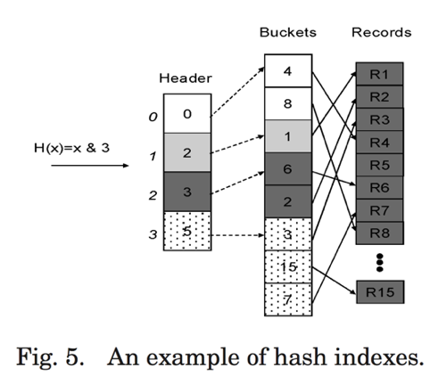
Design and Implementation of GDB GPU worker - Access methods
Hash indexes
The GPU-based hash table consists of two arrays, namely headers and buckets
Each element in the header array maintains the start position to its corresponding bucket.
Each bucket stores the key values of the records that have the same hash value, and the pointers to the records.

Slide 23
Design and Implementation of GDB GPU worker - Relational Operators

Slide 24
Design and Implementation of GDB GPU worker - Relational Operators
Selection
the selection is directly implemented using the filter primitive.
if the selectivity is high, a filter primitive on the relation is performed. Otherwise, the B+-tree index or the hash index can be used

Slide 25
Design and Implementation of GDB GPU worker - Relational Operators
Projection
Given an array of record IDs, the projection operator extracts the tuples from the relation.
We implement the projection using the gather primitive.
The read locations are given by the record IDs.
If duplicate elimination is required, we use sorting to eliminate the duplicates for the projection

Slide 26
Design and Implementation of GDB GPU worker - Relational Operators
Order
We implement order-by operator using the sort primitive

Slide 27
Design and Implementation of GDB GPU worker - Relational Operators
Grouping and Aggregation
We use the sort primitive to perform grouping and the reduce primitive for aggregation

Slide 28
Design and Implementation of GDB GPU worker - Relational Operators
Join
We adopt the four joins, including the nested-loop join with or without indexes, the sort-merge join, and the hash join
To avoid the conflicts between concurrent writes in the result output, all joins use a three-step output scheme
1. each thread counts the number of join results for the partitioned join it is responsible for
2. we compute a prefix sum on the counters to get an array of write locations, each of which is the start location in the device memory for the corresponding thread to write
3. the host code allocates a memory area of the exact size of the join result and each thread outputs the join results to the device memory according to its start write location.

Slide 29
Cost estimation for the GPU
(Full of formula and calculation)

Slide 30
GPU coprocessing
It’s important that consider both GPU performance and the transfer cost between GPU and CPU.
Given a query plan, the coprocessing scheme determines how each operator in a query plan is evaluated using a cost-based approach. There are three modes of evaluating an operator: on the CPU only, on the GPU only, and using both processors, denoted as EXEC_CPU, EXEC_GPU, and EXEC_COP, respectively.
The intuition for coprocessing is that EXEC_CPU is suitable for simple operators such as selections, whereas EXEC_GPU and EXEC_COP are suitable for complex operators such as joins.
In EXEC_GPU, when the data is larger than the GPU device memory, the input needs to be partitioned in order to fit into the GPU device memory.
In EXEC_COP, the workload is divided between the CPU and the GPU.

Slide 31
GPU coprocessing
When generating a coprocessing plan, we adopt the two-phase approach
1. We generate a query plan using a Selinger-style optimizer for the CPU
2. For each operator we determine whether to assign it to the CPU, to the GPU, or partition it to both the CPU and the GPU.
For each operator, the cost model takes into consideration whether the input data is in the main memory or already in the device memory.
If a query plan consists of a small number of nodes (the threshold is ten in our experiment), we consider all the combinations, and pick the plan with the minimum cost.
Otherwise, we decompose the query plan into multiple subqueries, each of which has a small number of nodes less than the threshold.
We determine the optimal query plans for the subqueries in their post order, and obtain the final plan as the combined plan from all the subqueries.

Slide 32
GPU coprocessing
As described in the coprocessing algorithm, partitioning is required in evaluating an operator in EXEC_GPU or EXEC_COP.
3 steps to do:
1. Partitioning
We divide the operator into multiple independent suboperators.
2. Suboperator execution
We execute the corresponding suboperators on the CPU or the GPU.
3. Merging
We merge the results generated by the suboperators into the final result on the CPU.

Slide 33
Experiment

Slide 34
Conclusion

Slide 35
THX

