Slide 1
Optimizing the Query Performance of Block Index Through Data Analysis and I/O Modeling

Slide 2
Why better index ?
What’s the indexing technique
A way to find the necessary data record(s) without shifting through all of the huge dataset.
Some typical & traditional methods to index
B+-tree, bitmap, etc.
Too big size!
Sometimes the indexes themselves is near to or even larger than the original dataset and then causes more storage space occupation and more I/O time on them.
This problem still can be worse with the growth of the size of the dataset.

Slide 3
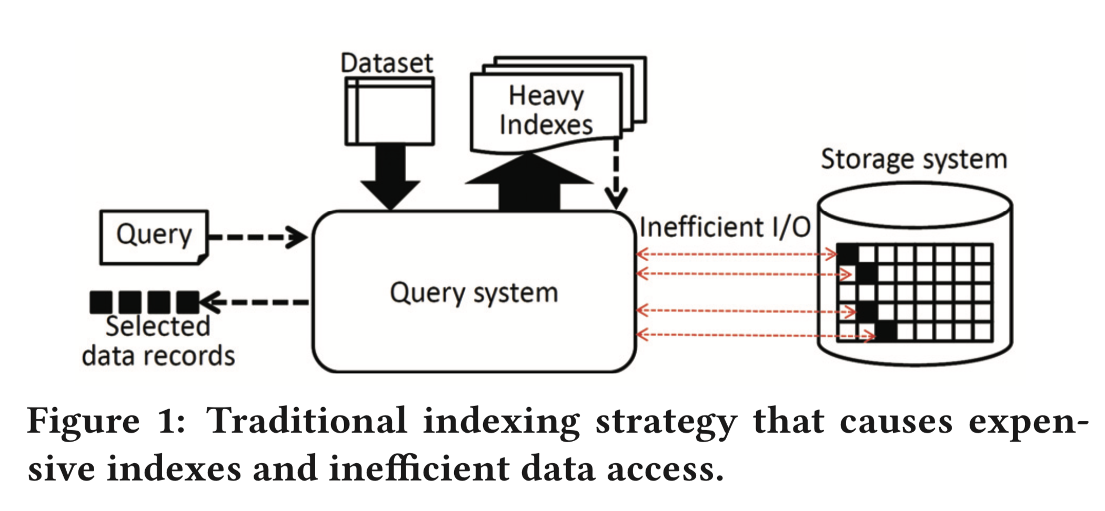
Why better index ?

Slide 4
Relative works
Block Index* based on the block range index technique**
It’s motivated by the fact that scientific datasets are commonly stored and managed by parallel systems and IO libraries, such as Lustre, HDF5, NetCDF, and ADIOS, which are optimized for large chunks sequential I/O instead of small random I/O.
To build indexes at the data block level, and read data from the storage system in a unit of block.
On one hand, it can greatly reduce the size of indexes. On the other hand, the block sequential I/O access pa ern also improves I/O efficiency and simplifies I/O modeling.
*: Apply block index technique to scientific data analysis and i/o systems. In IEEE/ACM International Workshop on Distributed Big Data Management (DBDM) at CCGrid, May 2017.
**: A. Herrera. Minmax indexes. pg hackers.

Slide 5
Relative works
Some Problems: how to obtain the most suitable size of a block?
A bigger block size means less I/O times and higher throughput but more redundant data will be accessed

Slide 6
The aims of the paper
To analyze and optimize the query performance of block index by giving a tight upper bound analysis of the I/O requests from answering a query
Three optimization techniques
merge read
adaptive dynamic schedule
partial sort

Slide 7
Block Index: Basic Design
Basic Design: It partitions a dataset into a set of non-overlapped fixed-size data chunks, called blocks. The indexes are built by recording the maximum and minimum values from each block. (block range index)
Given block indexes, the query procedure consists of three steps:
(1) Index evaluation
(2) Block retrieval
(3) Candidate check.
Notes:
In the first step, indexes are loaded and evaluated against the query range to identify the hit blocks, which are the blocks whose value range have an intersection with the query range. Then in the second step, the hit blocks are read from the storage system and loaded into the memory of reader processes. The data records in these hit blocks are also called, candidates. Finally, a check is performed on the list of candidates, and the data records outside query range are filtered. The positions and values of hits are then returned as the final query result.

Slide 8
Block Index: Challenges and Proposed Solutions
How to decide the proper block size to achieve better I/O throughput efficiency?
Two ways:
a theoretical analysis of the block index by providing a tight upper bound on the size of accessed data and the number I/O requests for answering a query with a given query selectivity.
a technique to improve I/O throughput efficiency by merging the read requests at query time.

Slide 9
Block Index: Challenges and Proposed Solutions
How to prevent redundant data from a block to reduce the total data read size (i.e., the number of candidate records)?
using a more costly index technique, such as inverted index, as the secondary index on a block to compensate the limitation of block index.

Slide 10
Block Index: Challenges and Proposed Solutions
How to balance the I/O workload among reader processes to maximize I/O bandwidth utilization?
Several scheduling algorithm trying to balance it better.

Slide 11
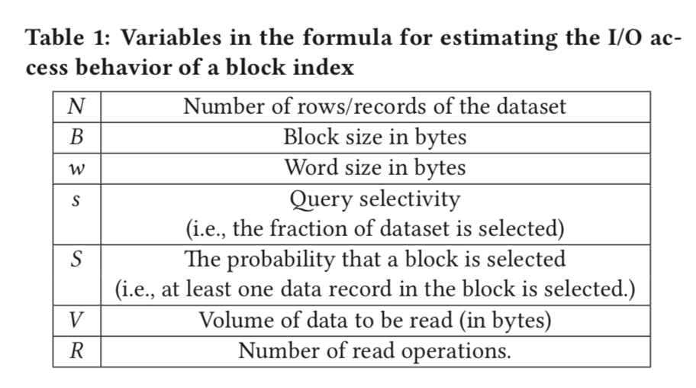
Block Index Performance Modeling

Slide 12
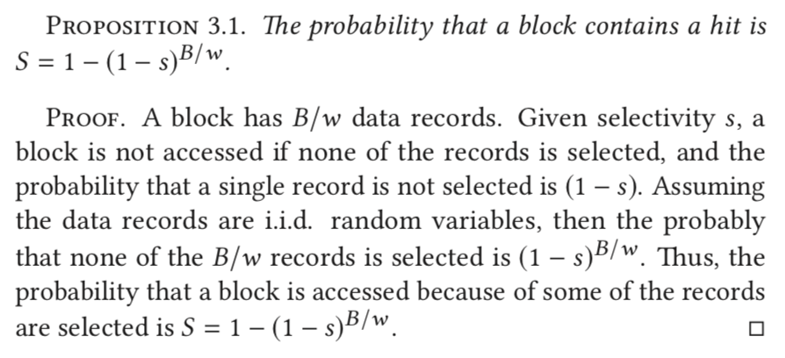
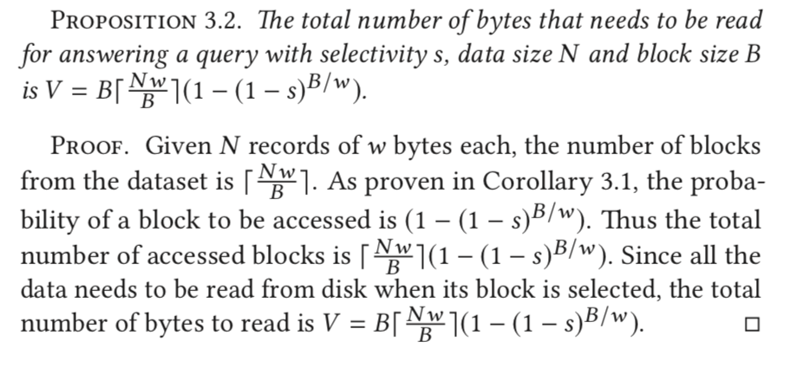
Block Index Performance Modeling

Slide 13
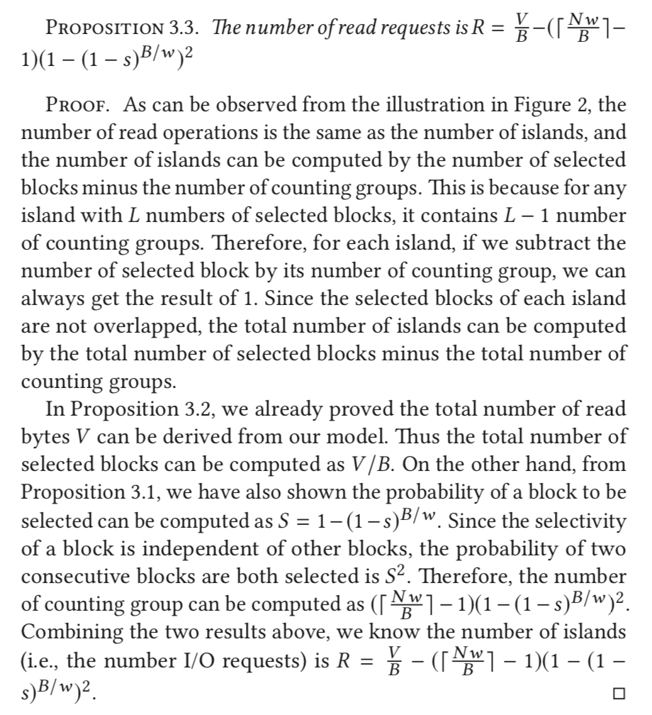
Block Index Performance Modeling

Slide 14
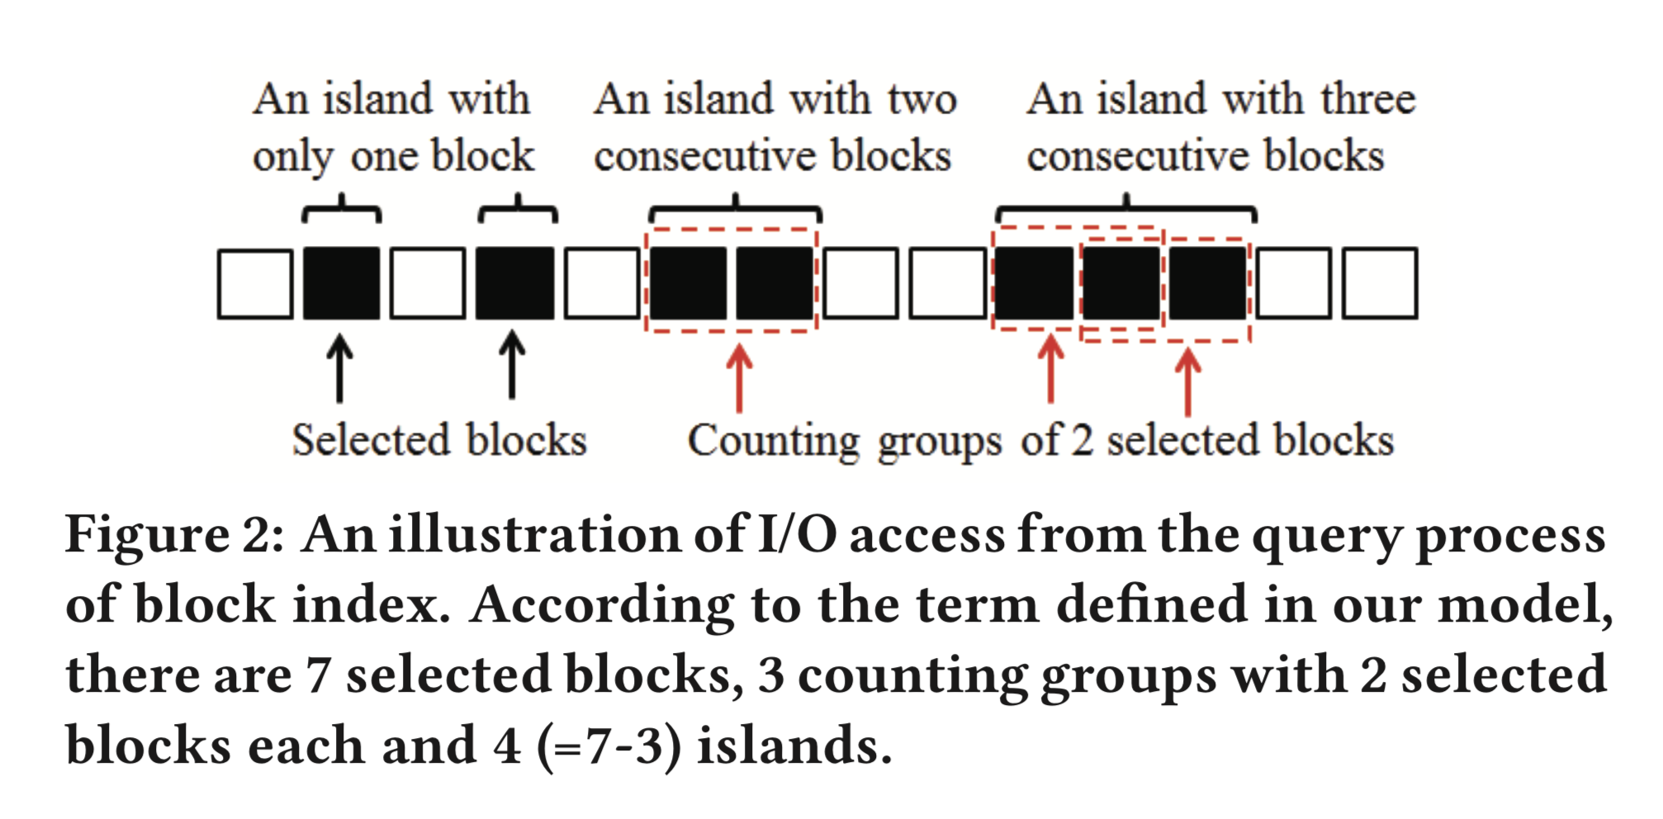
Block Index optimization: Merge Read

Slide 15
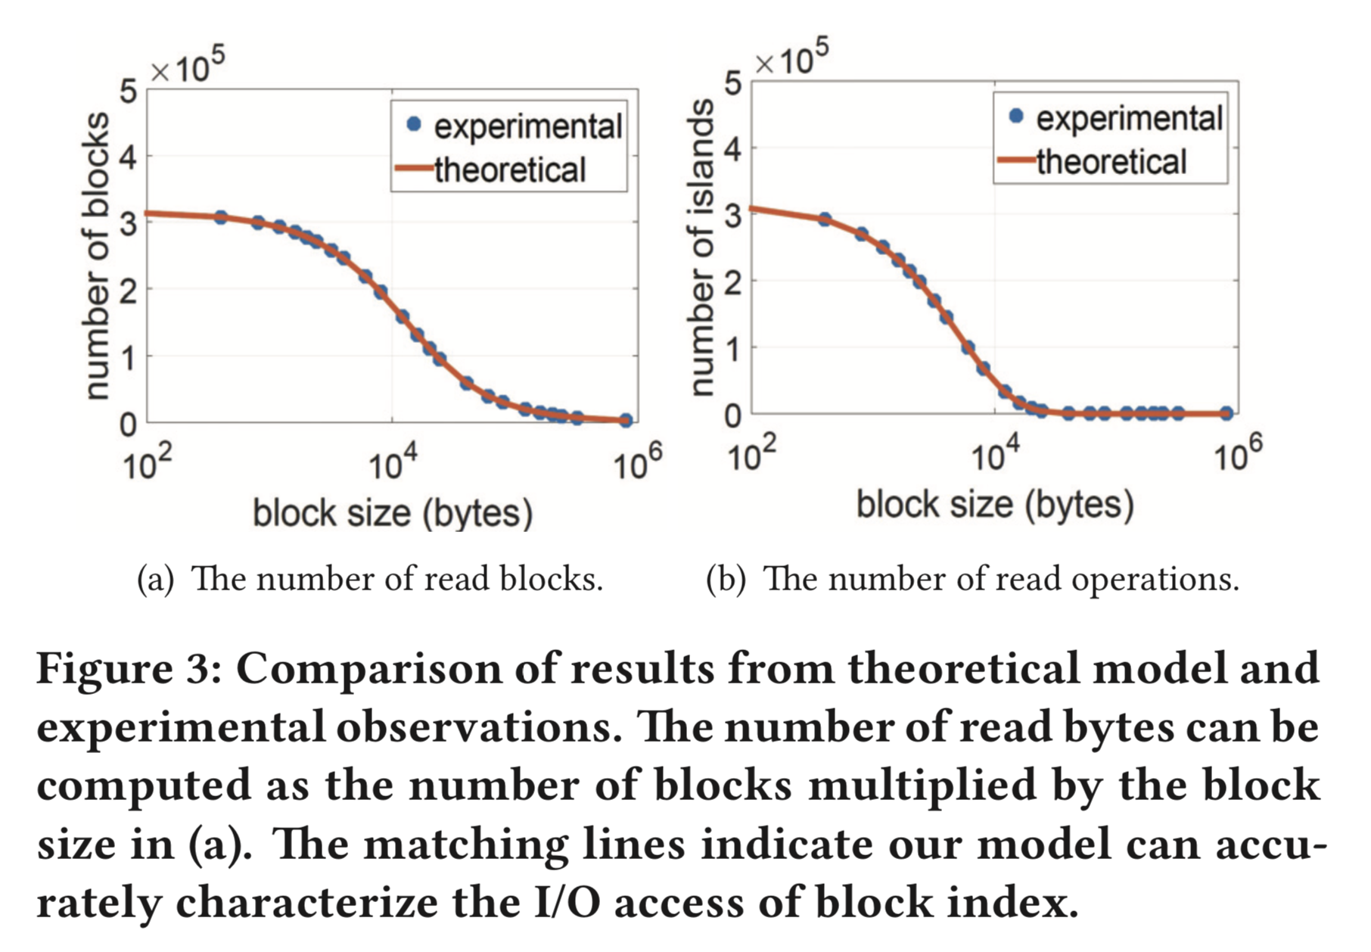
Block Index Performance Modeling

Slide 16
Block Index optimization: Merge Read
To find the optimal set of I/O requests, we prove that it is the same as finding an optimal merge threshold, δ , when the I/O time of a request is modeled as T(n) = α +n/β where n is the size of I/O request, α is a constant I/O latency, and β is the I/O bandwidth.

Slide 17
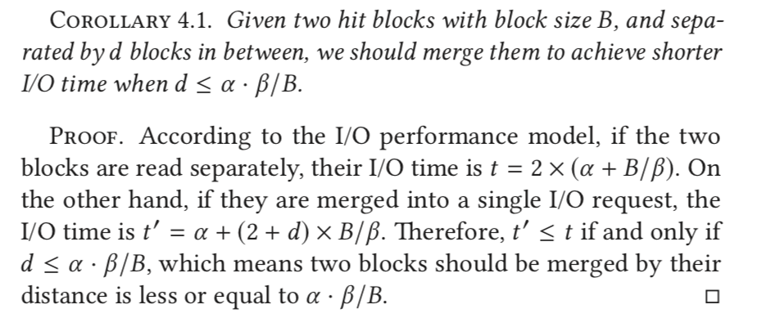
Block Index optimization: Merge Read

Slide 18
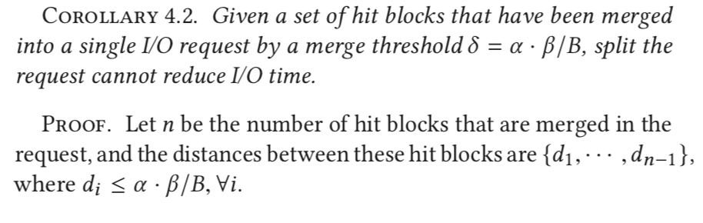
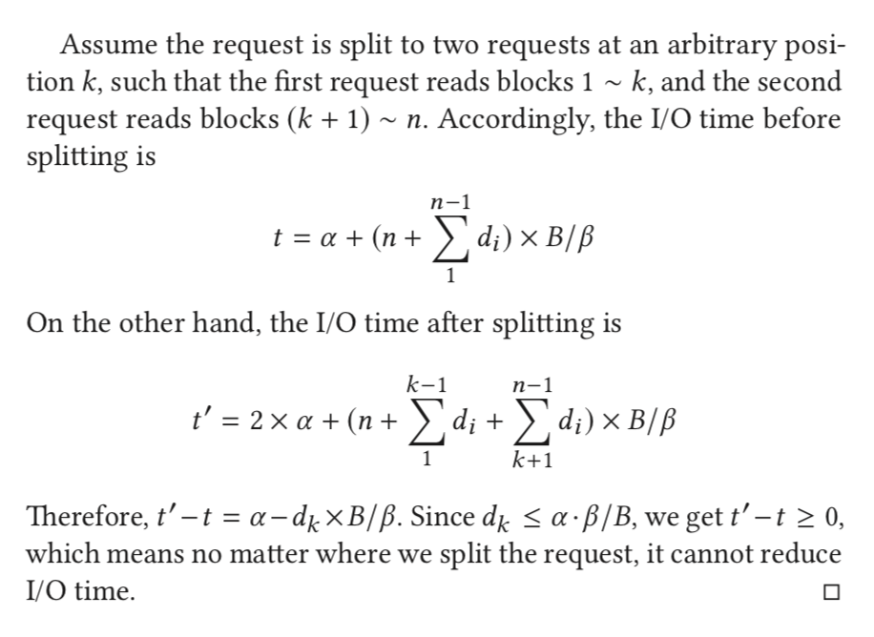
Block Index optimization: Merge Read

Slide 19
Block Index optimization: Merge Read
After this 2 corollaries, similarly, they prove any merged request that contains blocks with a distance larger than the merge threshold δ = α · β/B should be split

Slide 20
Block Index optimization: Adaptive Dynamic Schedule
Static scheduler evenly partitions tasks among processes, and sends the list of assigned tasks to each process in a single message before data retrieval step.
In contrast, dynamic scheduler only schedules one task to a process at a time, and workers dynamically request the next task after they complete the previously assigned tasks.

Slide 21
Block Index optimization: Adaptive Dynamic Schedule
An adaptive dynamic scheduler, which combines the strengths of both static and dynamic schedulers.
They proposed scheduling algorithm is controlled by two parameters θ and λ. Variable θ denotes the percentage of the selected blocks that are scheduled evenly and statically like the static scheduler. The rest of blocks are scheduled dynamically.

Slide 22
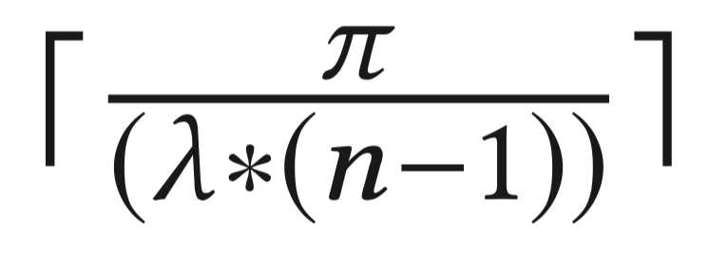
Block Index optimization: Adaptive Dynamic Schedule
An adaptive dynamic scheduler, which combines the strengths of both static and dynamic schedulers.
Furthermore, instead of assigning a fixed number of blocks (or chunk size) to one worker at a time, we use an exponential back-o strategy to decrease the scheduling chunk size over time.
Specifically , the chunk size is computed as where π denotes the number of remaining blocks needing candidate checks, and n is the number of workers.

Slide 23
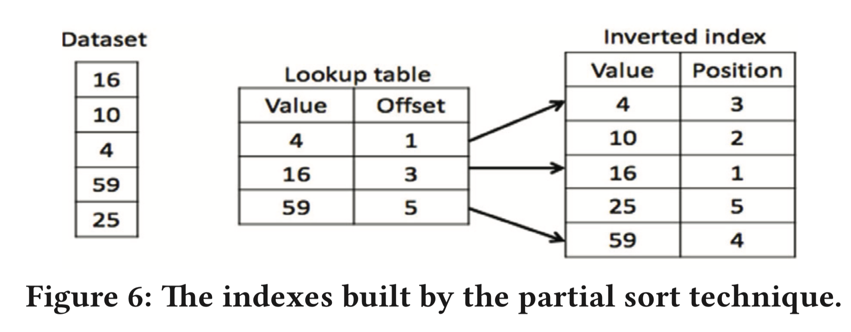
Block Index optimization: Partial Sort

Slide 24
Block Index optimization: Partial Sort
In the indexing procedure, besides building the block index for each block, we also evaluate the variance of a block.
If the variance is higher than a given threshold, we then build the inverted indexes for the block, and add a flag in the block index entry to indicate the block is sorted.

Slide 25
Block Index optimization: Partial Sort
In the query procedure, first we evaluate the block index to identify the hit blocks. then the flag in the block index entry is checked to determine the block is sorted or not. If the block is not sorted, we have to retrieve the whole block from the original dataset. Otherwise, we can read the partial block from the sorted dataset to reduce the I/O amount.
Both the inverted index and block index techniques only generate sequential I/O accesses

Slide 26
Evaluation

Slide 27
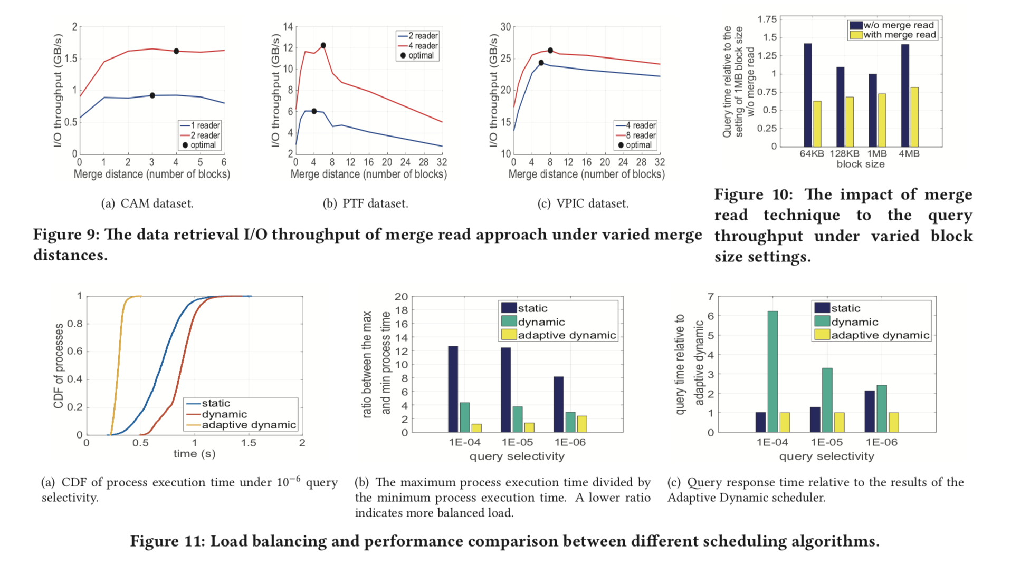

Slide 28
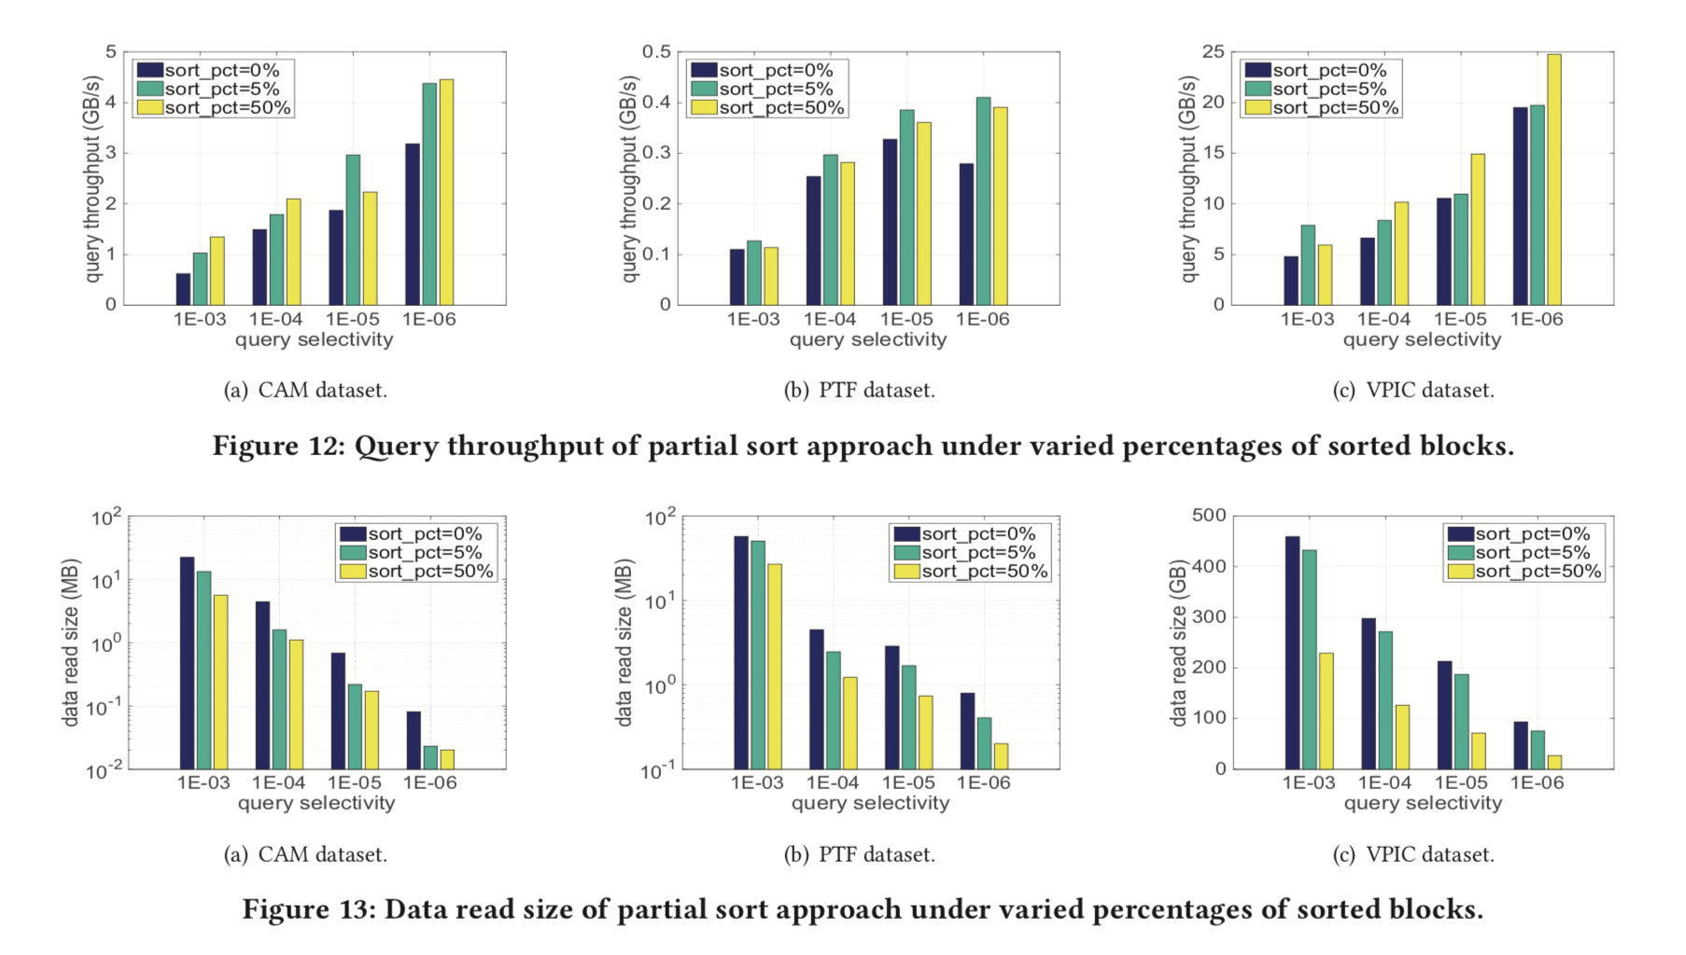

Slide 29
THX

