Slide 1
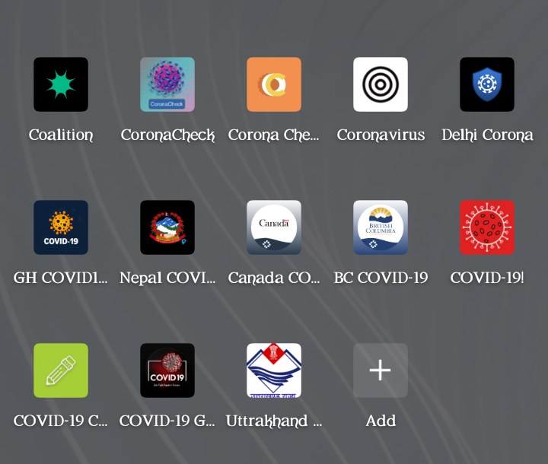


INSTRUCTIONS:
How to Change Photo
Select placeholder photo (hand and laptop photo) or Insert new photo
Select Home>Arrange>Send Backward/Send to Back
Do this step until you see the image appear behind the white blob.
Effectiveness of high quality COVID-19 mobile phone applications in combating the novel coronavirus pandemic
Williams, S., Student Research Network, 2020.
shekinahwilli29@gmail.com

Slide 2


Abstract
Introduction: Global efforts are ongoing in the fight against COVID-19. This study assessed how technology is likely to aid the fight against COVID-19 through identification and review of COVID-19 mobile phone apps.
Methodology: A systematic search of COVID-19 apps was done. Apps were screened and eligible apps were downloaded. A quality review and content analysis of apps was carried out by two reviewers independently using the Mobile Application Rating Scale (MARS). The mean scores in each section of the MARS score was combined to calculate the overall mean app quality total score and used to rate the apps as being high quality or low quality.
Results: 75 relevant apps were identified, majority were of low quality. Only 10 apps met the set eligibility criteria. After review, 70% were high quality apps (MARS score of at least 4) while 30% were low quality apps (MARS score less than 4).
Conclusion: High quality apps will meet users needs better and by inference, be more useful in combating COVID-19. App developers should focus on developing high quality apps in order to better combat COVID-19.
2

Slide 3

Methodology
Mobile Application Rating Scale
Online literature search for previous studies
Systematic search of COVID-19 apps using Google play store. Apps were screened.
Apps that met a determined criteria were downloaded.
Quality review and content analysis of the apps by two reviewers was done independently using the Mobile Application Rating Scale (MARS).
Summation of mean scores in each category of the MARS score to find overall mean app quality total score.
Overall mean app quality total score used to rate the apps as being high quality or low quality.
High quality app – score of greater than or equal to 4/5; low quality - <4
OBJECTIVE QUALITY
Aesthetics Graphics Layout Visual appeal
Engagement Entertainment Interactivity
Funtionality Performance Navigation Ease of Use
Information Quality and Quantity of Information Credibility
SUBJECTIVE QUALITY Stimulates repeat use Worth Recommending

Slide 4
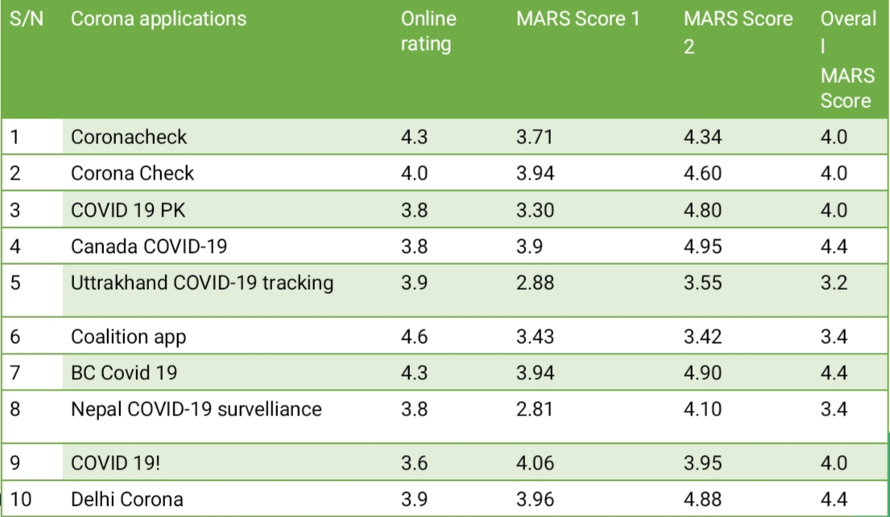
Results
Mobile Application Rating Scale
82 apps after initial search.
75 relevant apps after second screening:
45% were low quality apps (online rating below 4)
35% were high quality apps (online rating of 4 or above)
20% had no online rating
10 apps met a determined criteria after fourth screening
These apps were reviewed using the MARS score
70% had an overall MARS score of greater than or equal to 4 (high quality apps)
30% had an overall MARS score less than 4 (low quality apps).

Slide 5
Conclusion
Findings suggest that a lot of coronavirus apps may not sufficiently meet users’ needs because a large number are low quality apps.
However, high quality apps are more likely to meet users’ needs by way of having better appeal, ease of use, more quality information content, provision of features and services such as assessment of personal COVID-19 risk, tracking and virtual consultation with a health professional.
Therefore, app developers should focus on developing high quality apps in order to effectively combat COVID-19.
Thank You!!

