Slide 1
Validation and Sensitivity Analysis of an Automatic Multizone Assignment Algorithm
Master Thesis Update
Prepared by Sharon Thomas
Supervised by Kevin Waiz

Slide 2
Introduction
Name: Sharon Thomas
DOB: 29.06.1998
Nationality: Indian
Education
2016–2020 – Bachelor of Technology in Civil Engineering, KTU University, India
2022–present – Master of Science in Civil Systems Engineering, TU Berlin, Germany
Past Experiences
Hobbies
Ashvin Project - Digital Building Twins and IoT (TU Berlin)
BASF - Real Estate Transaction Management (Werkingstudent)
One Click Reno - Building Renovation Passport (DEMO Consultants)
Project Module - Virtual Temperature Sensing in Existing Buildings: Calibrating EnergyPlus Models with Sparse Sensor Data (TU Berlin)
Reading
Travelling
Swimming

Slide 3
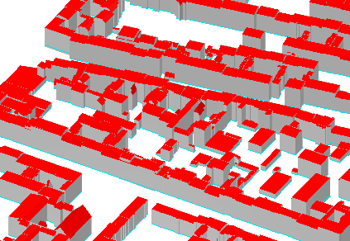
Motivation MZA
Buildings strongly influence the energy demand in district and city scale models
Urban energy simulations often rely on simplified building representations (LOD2/CityGML)
These data sets typically exclude the internal thermal zoning
Source : CityGML for Berlin
Notes:
And therefore require a large building dataset to estimate the energy demand
As a result of insufficient data and computational constrains …
These models capture the outer building area but…
This gap between the simplified models and a need for internal zoning is where the mza becomes relevant

Slide 4
Motivation Validation and Sensitivity Analysis
The Multizone Assignment Algorithm automatically generates thermal zoning for large-scale energy simulation
However, it currently lacks:
Systematic validation of how realistically the algorithm reproduces zoning
Quantitative assessment of how zoning deviations affect thermal simulation results
Identification of key parameters influencing thermal energy demand

Slide 5
Thesis Timeline
Preparation
Data Collection and Preprocessing
Comparison
Simulation
Analysis and Results
Understanding the research topic and scope
Familiarization with the MZA
Identification of relevant datasets
Dataset preprocessing for MZA
Preparation of Ground Truth
Initial zoning comparison and MZA refinement
Systematic comparison of MZA zoning with Ground Truth
Initial simulation analysis to identify key parameters for base archetypes
Full-scale sensitivity analysis
Evaluate results
Final presentation​
4
5
1
3
2

Slide 6
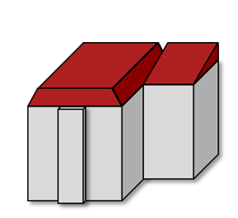


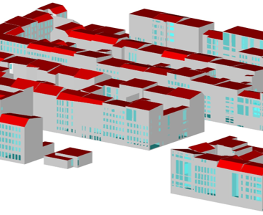

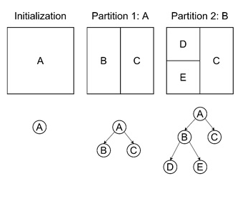
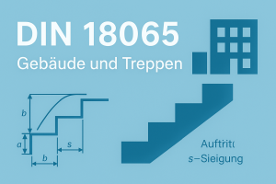

Multizone Assignment Algorithm
Geodata input
Preparation
Data clean up
Coordinate transformation
Front facade detection
Discretization
3D building envelope (LoD2)
Address point and street layout
Orientation
Roof type
Year of construction
…
Inner building data
Staircase measures
Corridor dimensions
Average apartment areas
WWR
+ DIN 18040-2
LBO
Notes:
Geodata
Public data like Citygml and osm - City GML provides: 3D building envelope, roof type, orientation …. - OSM: Streets, address point, building type Inner building data - dimensions/regulations for staircase, corridors, average apartment area with respect to DIN, LBO and Destatis Discretization by Binary space partitioning – divides footprint into smaller leaves until a set granularity is fulfilled

Slide 7
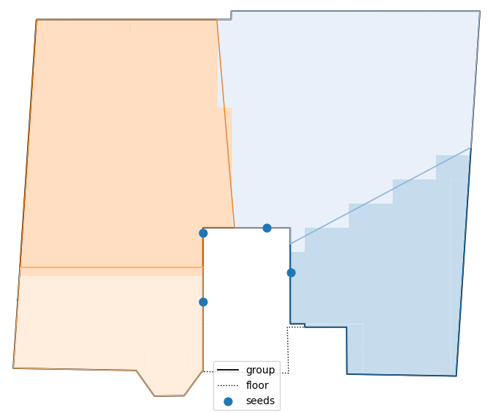
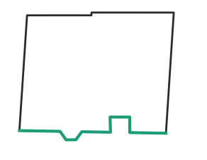
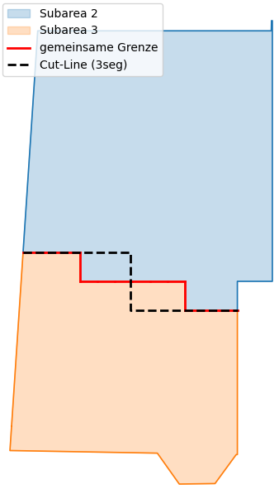
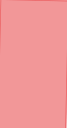
Multizone Assignment Algorithm
Voronoi-Seperation
Postprocessing
Seed placement along the staircase/corridor walls („doors“)
X-iterations (different seed placements)
Continuous evaluation:
Outer wall connection
Adjacend buildings / blocked walls
Windows accordingly? (if LoD3)
Artifacts, area connectivity
Eliminate „jagged patterns“ caused by voronoi (with respect to the restrictions)
Notes:
Staircase positioned along the detected façade
Seeds placed around the staircase/corridor boundaries (like doors)
Each seed acts as a Voronoi cell origin -> creates an initial zoning
We do this process for X-Itearions for different seed placement and continuously checked for necessary constains / errors like artifacts, cutted windows (if included), connection to outer walls …
Postprocessing needed to get rid of step patterns or other problems caused by the seed grow

Slide 8
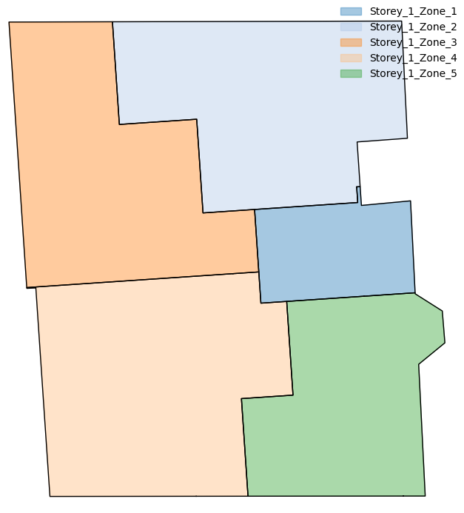
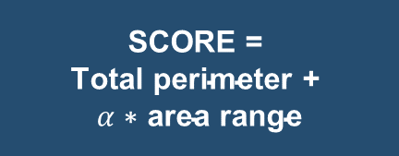
Multizone Assignment Algorithm
Voronoi-Seperation
Result
Seed placement along the staircase/corridor walls („doors“)
X-iterations (different seed placements)
Continuous evaluation:
Outer wall connection
Adjacend buildings / blocked walls
Windows accordingly? (if LoD3)
Artifacts, area connectivity
Highest SCORE
$$\text{SCORE = }$$
$$\text{Total perimeter + }$$
$$α\text{ ∗ area range}$$
Notes:
Score defines the best result by taking the total perimeter and the area share between the zones into account
Alpha: Bigger alpha -> area range more important (usually 2.0)

Slide 9
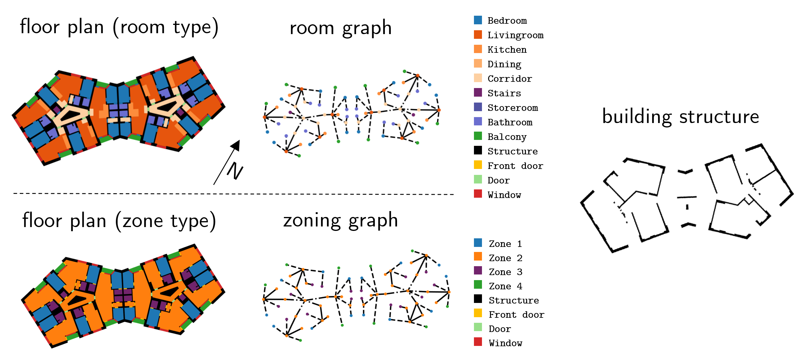
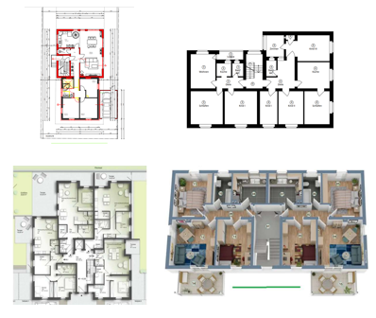
Datasets
Modified Swiss Dwellings (MSD)
Real Estate Data
Floor plan dataset with multimodal representations (image, geometry, graph) derived from real floor plans
Graph based structure enables identification of apartments based on adjacency characteristics
Over 5,000 floor plans
Floor plans collected from real estate websites (Immoscout24).
Provided mainly as PDF documents
Include geometric information such as area and layout proportions
Collected over 40 real floor plans
Source : MSD: A Benchmark Dataset for Floor Plan Generation of Building Complexes, ImmoScout24 – Die Nr. 1 für Immobilien

Slide 10
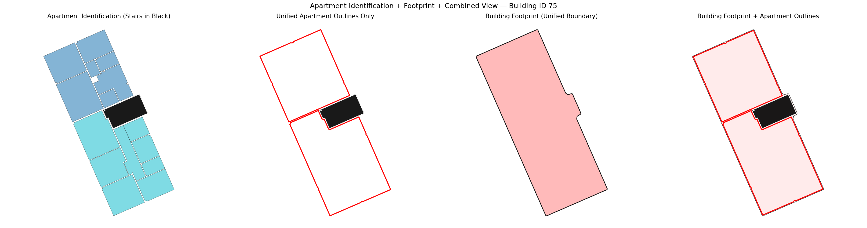
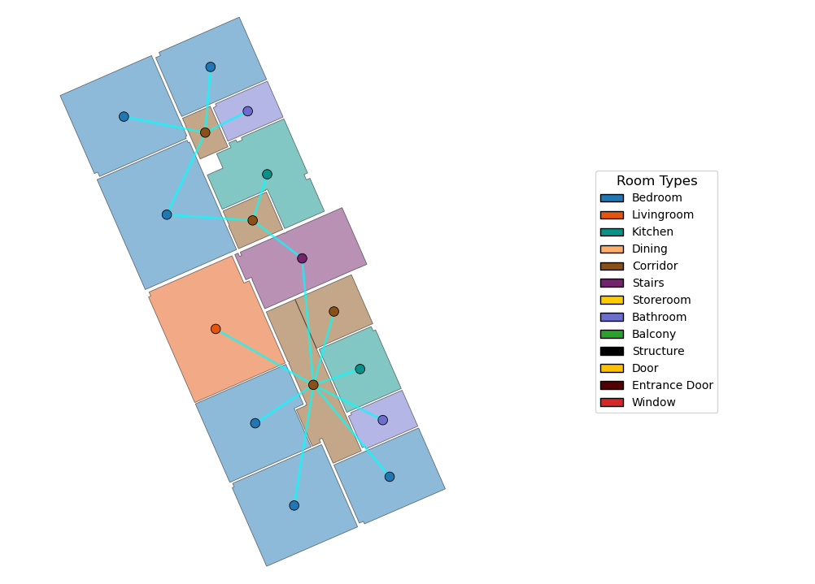
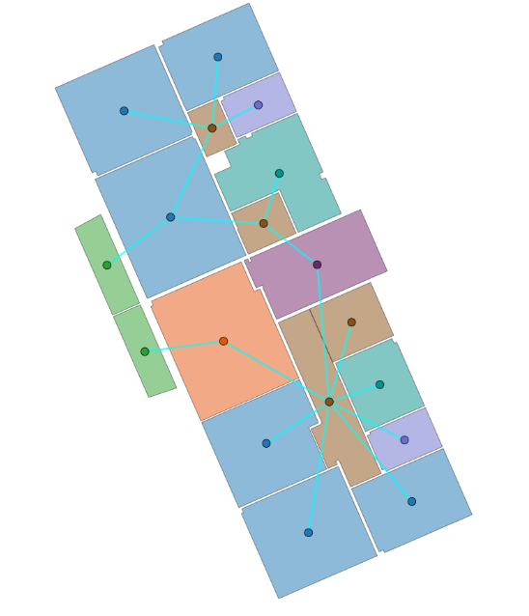
Dataset Preprocessing and Ground Truth Generation MSD
Raw Dataset
Apartment Classification
Apartment Footprint (GT)
Notes:
The dataset represnts the room type and the adjacency characteristics
Filter balconies
Identify apartment based on the adjacency graph
Extract the apartment footprint from the room polygons to create the GT

Slide 11
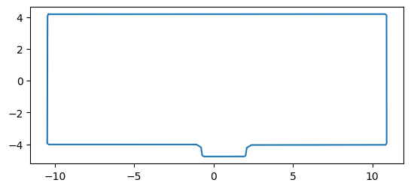
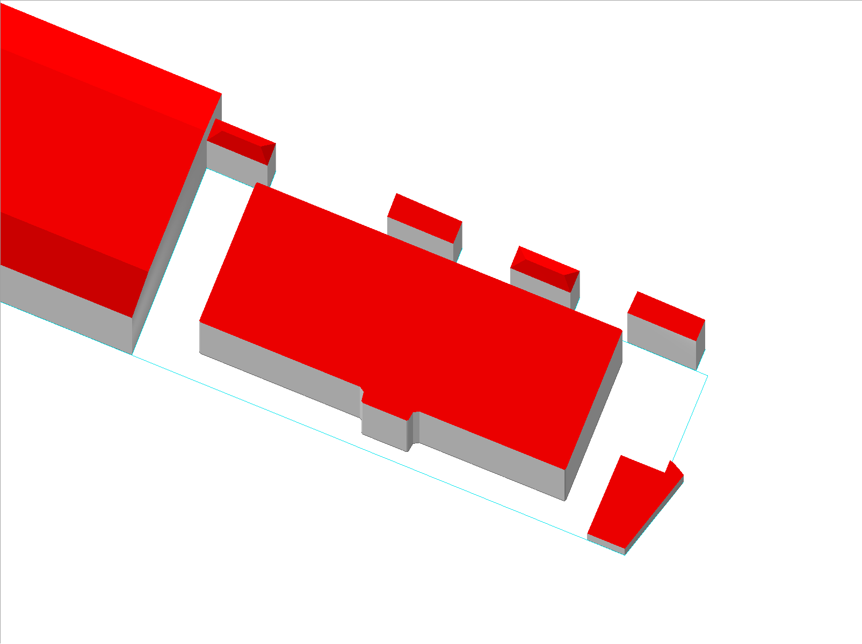
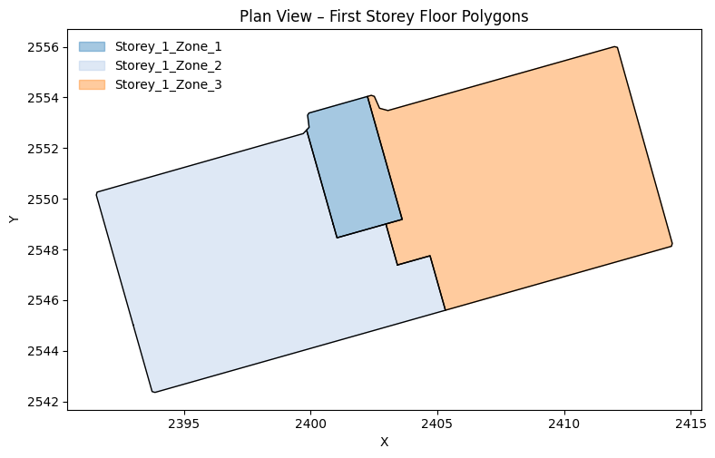
MZA Input Preparation MSD
Building Footprint GeoJSON
CityGML
Apartment Footprint (GT)
.geojson
.gml
.pickle
Input File for MZA
GeoJSON acts as an interoperable bridge between Pickle and CityGML, while also providing a normalised building geometry.
MZA zoning
.pickle
Notes:
And like like we discussed in the beginning MZA uses cityGML as an input, and the Citygml covers the outer building area or footprint,
Extract the building footprint which is the union of the apartments and the staircase
Normsalised to make the mza to place the staircase accurately
We use this to replace a building in an existing gml file and create a new file with the building footprint of our ground truth

Slide 12
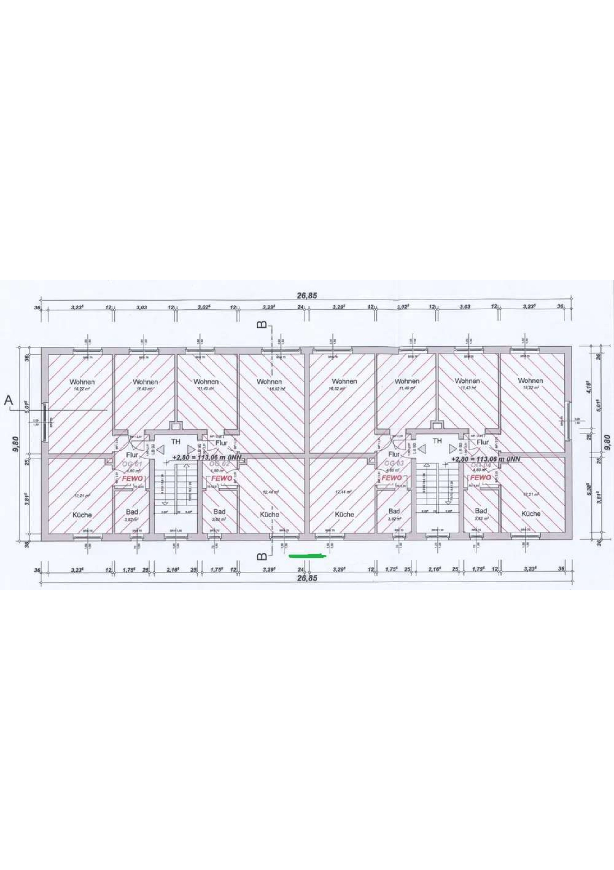
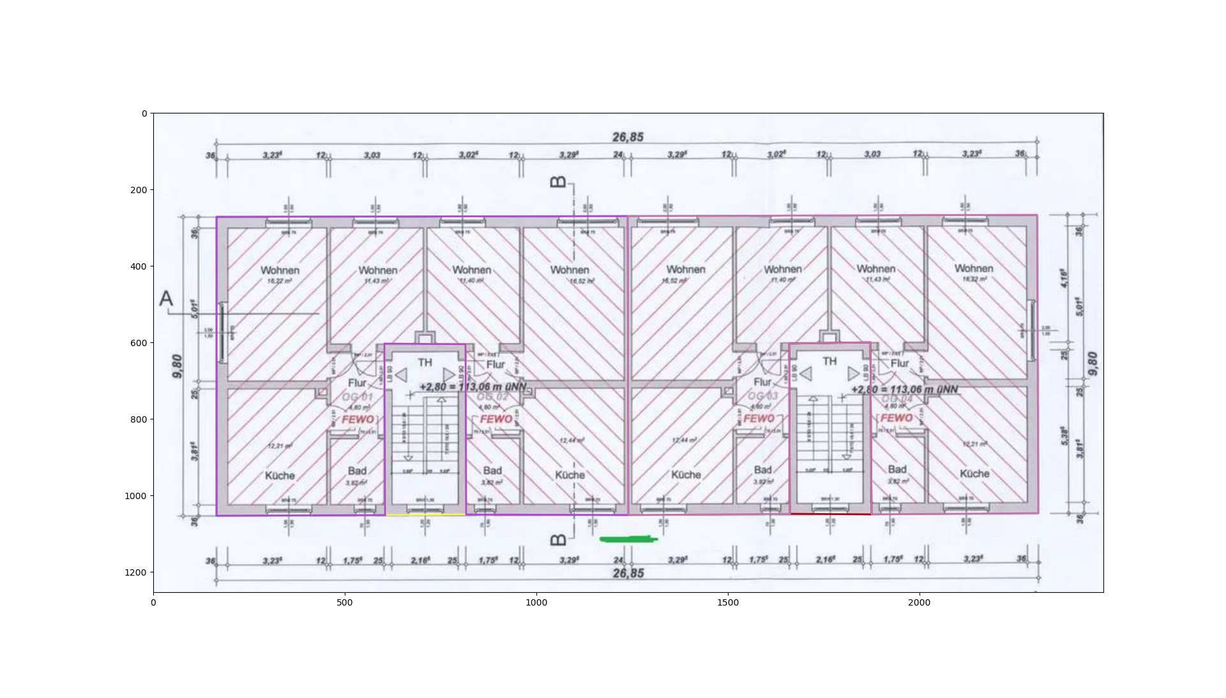
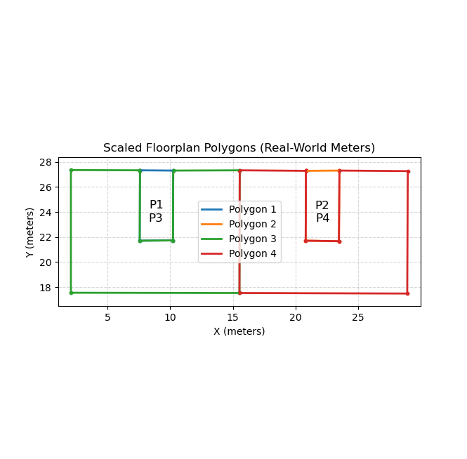
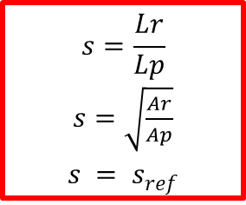
Dataset Preprocessing and Ground Truth Generation Real Estate Data
Raw Dataset
$$s=\frac{Lr}{Lp}$$
$s=$ $\sqrt{\frac{Ar}{Ap}}$
$$s = sref$$
Manual Sketching
Apartment Footprint (GT)
Notes:
- Transfered to real world measurements using a scale facttor which is calculated….

Slide 13
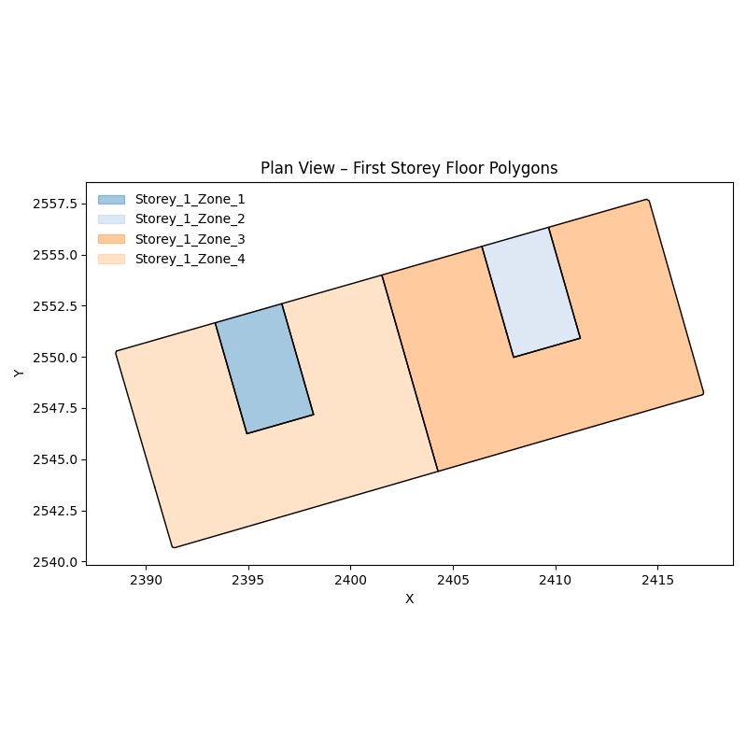
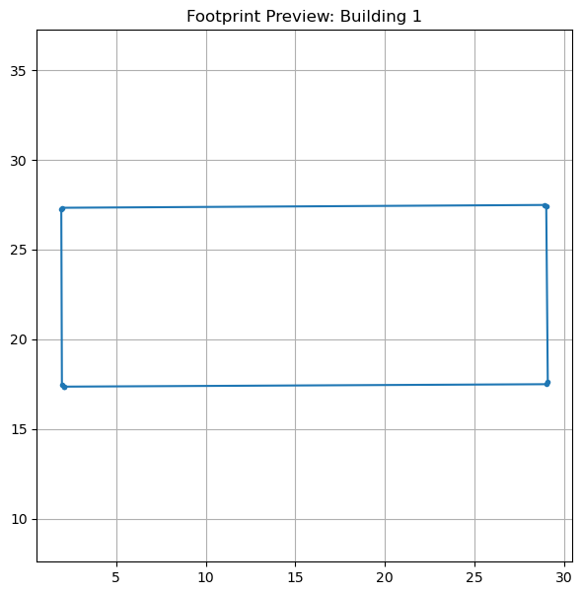
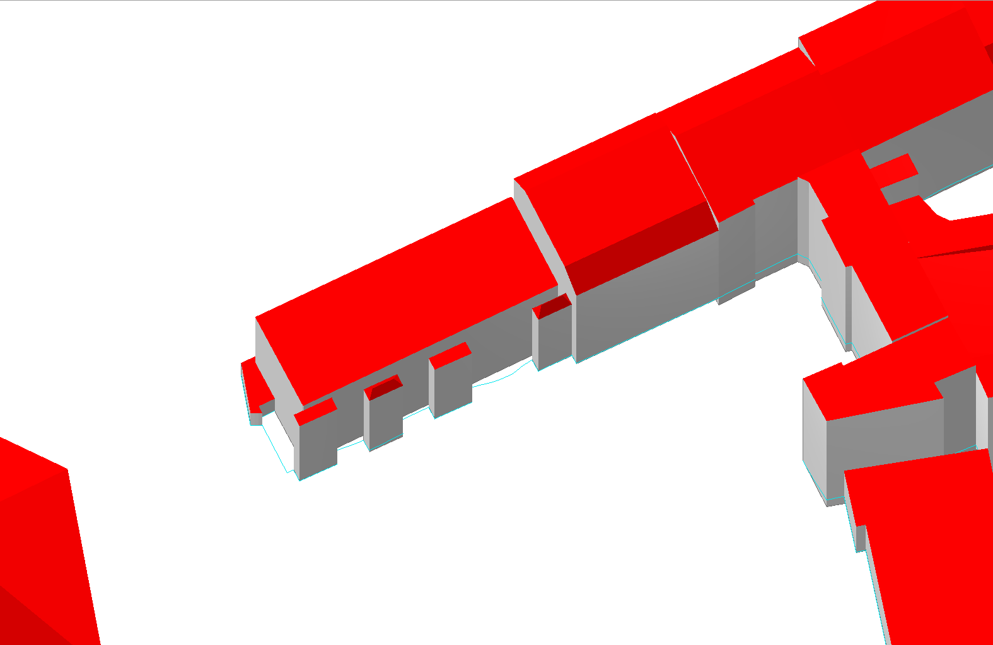
MZA Input Preparation Real Estate Data
Apartment Footprint (GT)
.pickle
MZA zoning
.pickle
Input File for MZA
Building Footprint GeoJSON
.geojson
CityGML
.gml

Slide 14
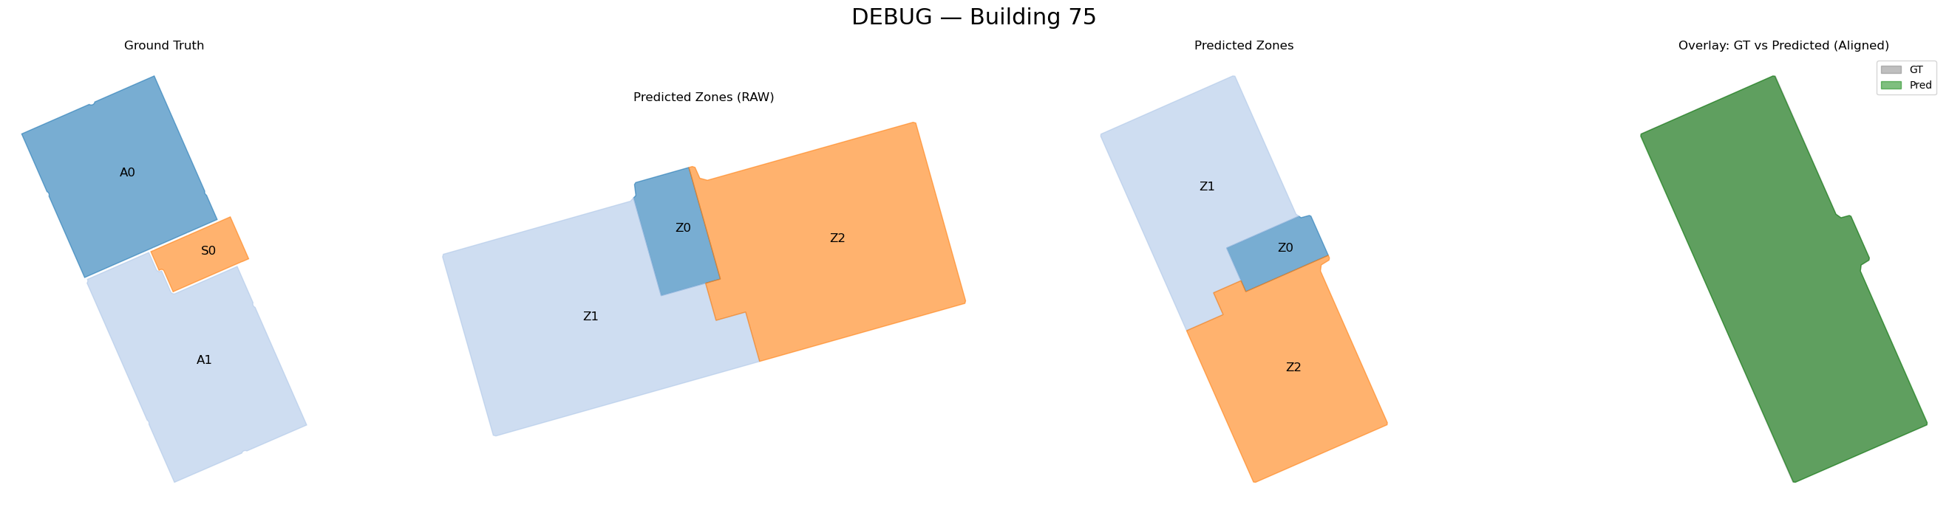
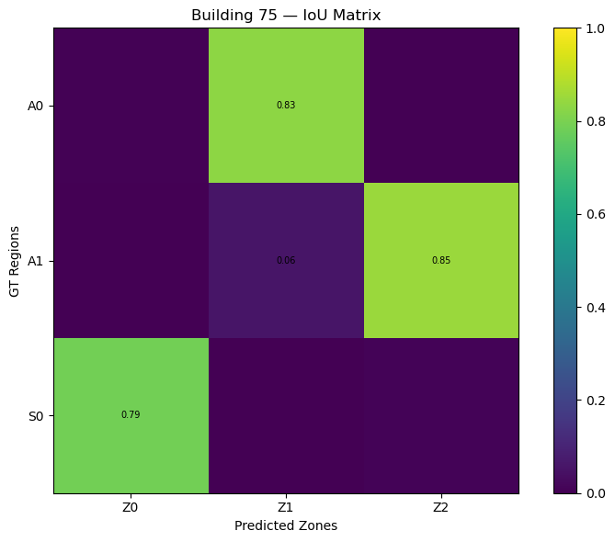
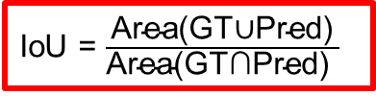
Initial Comparison: MZA vs. Ground Truth
Zoning Comparison: IoU Metrics
All GT regions are geometrically compared with all MZA predicted zones
Geometric similarity is quantified using Intersection over Union (IoU)
The IoU matrix represents all possible overlaps
IoU = $\frac{\text{Area(GT∪Pred)}}{\text{Area(GT∩Pred)​ }}$

Slide 15
Initial Comparison: MZA vs. Ground Truth
Mean IoU
Hungarian assignment selects a globally one-to-one correspondence
This helps to maximize the total IoU
Selected matches:
A0 → Z1 (IoU = 0.83)
A1 → Z2 (IoU = 0.85)
S0 → Z0 (IoU = 0.79)
Mean IoU = 0.82
The combined area of the ground truth region and the predicted zone, overlaps spatially by 82%

Slide 16
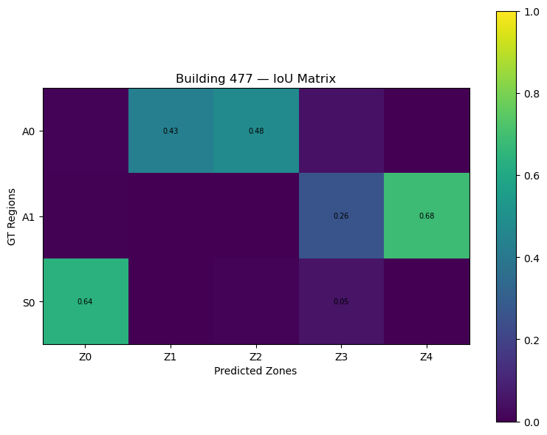
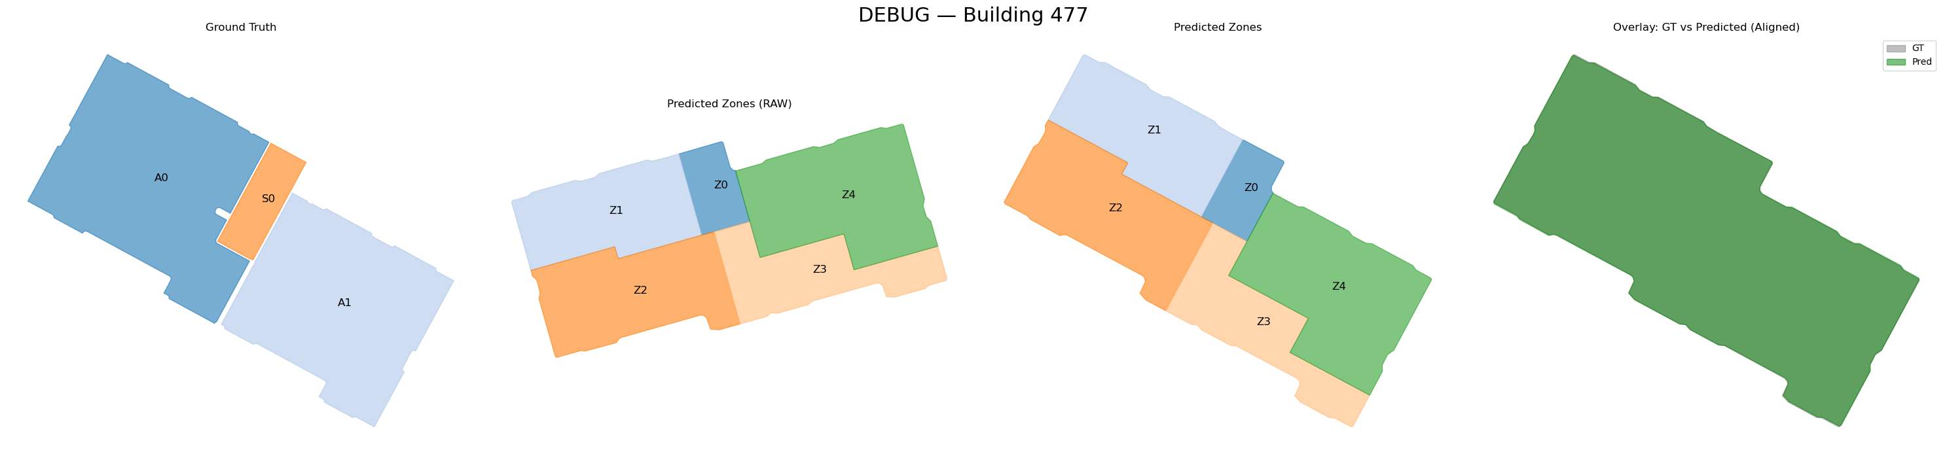
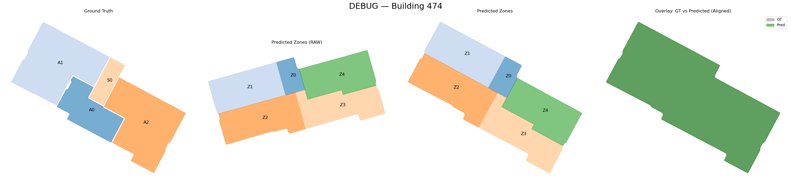
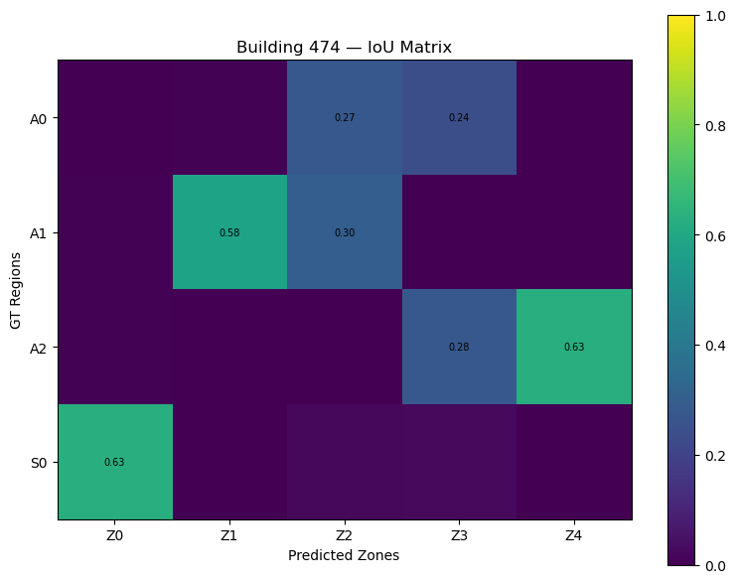
Challenges in Comparing GT and MZA Zoning
Over-segmentation in MZA zoning

Slide 17
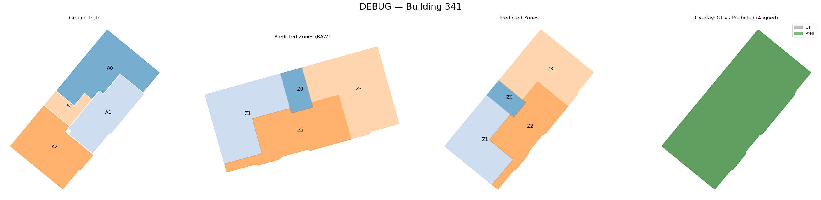
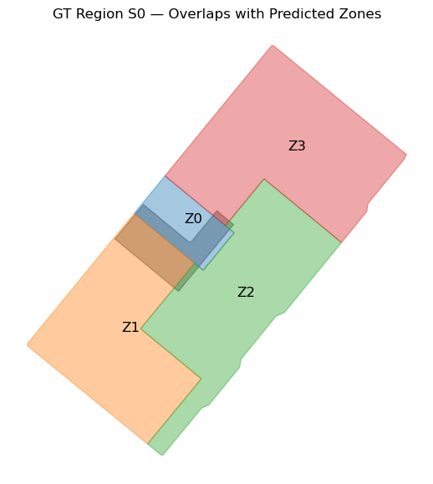
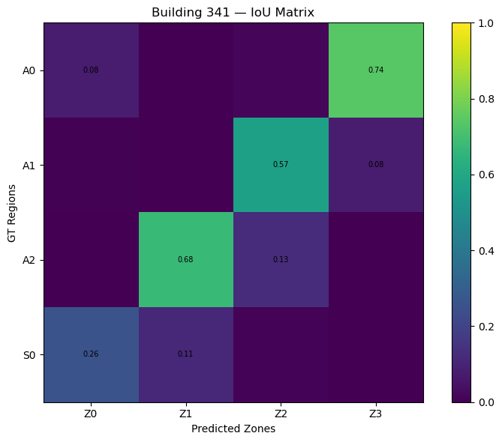
Challenges in Comparing GT and MZA Zoning
Staircase comparison
Staircases have a strong influence on the comparison due to their small area and sensitivity to geometric placement.

Slide 18
Future Works
Quantitative Analysis of Zoning Performance
Sensitivity Analysis
Aggregation of evaluation metrics across the full dataset
Statistical analysis of weakly performing zoning cases
Refinement of evaluation metrics and comparison logic
Identification of systematic patterns and recurring failures
Initial energy simulations of representative building archetypes
Identify key parameters influencing energy demand, like:
Year of Construction
BSP granularity
WWR Ratio
Setpoint temperature
Occupancy behaviour
Heated/Unheated staircase
Adjacent buildings, etc.
Assess how zoning deviations affect energy simulation results, by:
Comparing energy demand from GT zoning vs. MZA zoning
Staircase placement and configuration
Over and under segmentation of zones

Slide 19
Validation and Sensitivity Analysis of an Automatic Multizone Assignment Algorithm
Thank You For Your Attention !
Questions/Feedback/Suggestions ?
Prepared by Sharon Thomas
Supervised by Kevin Waiz

