Slide 1
Impact of Automated Thermal Zoning on Building Energy Simulations: Ground-Truth Validation and Sensitivity Analysis
Master Thesis Presentation
Sharon Thomas Charivupurayidom
M.Sc. Civil Systems Engineering · Technische Universität Berlin
Notes:
. Introduce by name and course
. Buildings and Districts group
. Read the topic
. Before starting acknowledge the people who has contributed to the successful completion of this thesis

Slide 2
Acknowledgement
With sincere thanks to everyone who supported this thesis
Prof. Dr. Timo Hartmann
Dr. Jacob Estevam Schmiedt
Kevin Waiz
Scientific supervision
Scientific guidance · Second examiner
DLR supervision
Technische Universität Berlin
DLR Institute of Solar Research
DLR Institute of Solar Research
for his valuable guidance, feedback and academic support throughout this work.
for his constructive feedback, guidance and support throughout the thesis.
for his dedicated technical supervision, helpful discussions and continuous support.
Thank you for your guidance, support, and valuable feedback throughout the development of this thesis.

Slide 3
Research motivation Why thermal zoning matters at urban scale
01
Urban-scale models rely on simplified building data
District and city simulations commonly use LoD2 / CityGML and building-stock assumptions to represent many buildings efficiently.
Envelope
02
Urban data capture the envelope — not the interior
?
Dwelling layouts, stairwells, circulation spaces and their adjacency are rarely available consistently at urban scale.
Interior
03
Thermal zoning affects simulation behaviour
Zoning defines heat-balance units, temperatures, internal gains, control assumptions and interzonal heat transfer — influencing annual, peak and comfort-related outputs.
Thermal zones
Need for a scalable thermal zoning method from limited urban data
Notes:
And therefore require a large building dataset to estimate the energy demand
As a result of insufficient data and computational constrains …
These models capture the outer building area but…
This gap between the simplified models and a need for internal zoning is where the mza becomes relevant

Slide 4
Research gap
What was still unknown about the Multizone Assignment Algorithm?
Available thermal zoning method
Limited urban input
MZA zoning
Multizone Assignment Algorithm (MZA)
CityGML / OSM + building-stock assumptions
Dwelling + stairwell zones from limited input
Automated thermal zoning from limited building information
Two questions remained unanswered
Geometric & topological reliability
Simulation relevance of zoning deviations
No systematic ground-truth validation has tested whether the MZA reproduces the real building.
Existing studies show that zoning matters, but not which MZA-related geometric deviations materially affect simulation outputs under uncertain input conditions.
Number of zones · geometry · position · adjacency
Representative deviation strategies are assessed with three KPIs:
Ground truth
MZA prediction
vs.
Annual heating demand
Peak heating load
Overheating hours
→ evaluates the geometric reliability of the MZA
→ evaluates the simulation relevance of zoning deviations

Slide 5





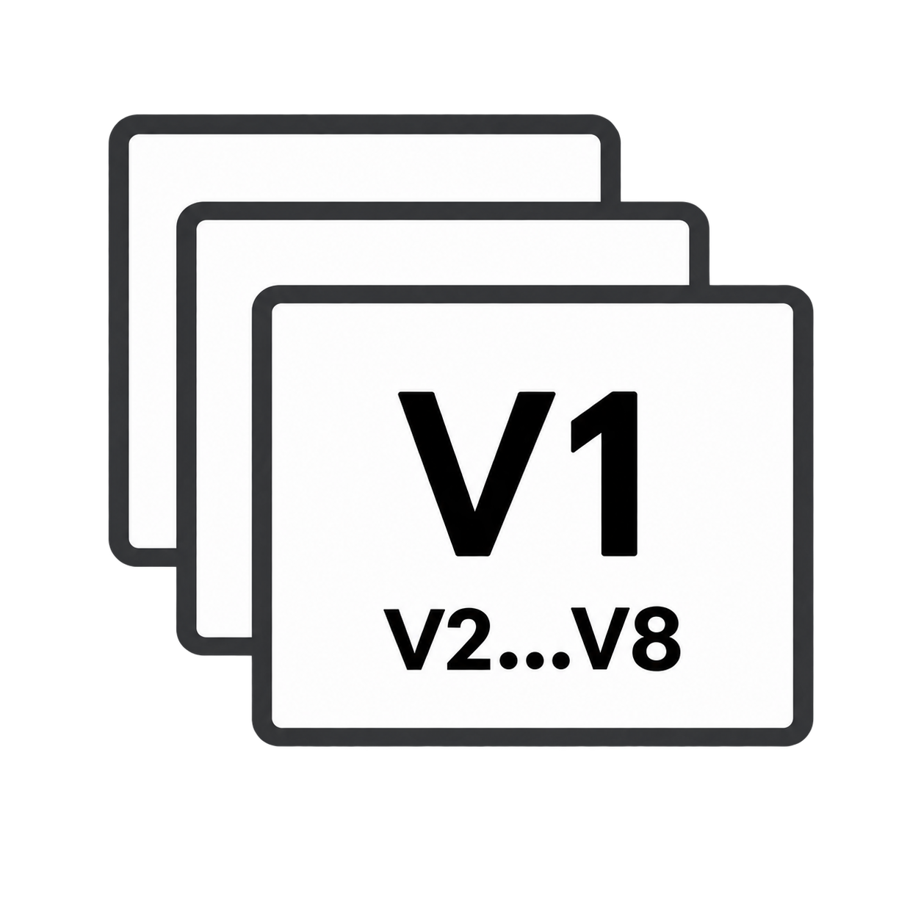









Research method
?
Overall research question
Can the MZA generate a reliable dwelling–stairwell zoning,
and how do zoning deviations influence simulation outputs?
Validation
Zoning-variant sensitivity analysis
1
Reference data
1
Deviation mechanisms
➜
from validation
2
Ground-truth extraction
2
Translate into controlled
zoning variants
3
Input preparation for MZA
Representative
3
Simulation setup
deviation
4
MZA-generated zoning
mechanisms
identified in
validation
4
Uncertain inputs
5
Comparison & metrics
6
Diagnostic classification
5
KPIs
Evaluation and interpretation
Validation
Sensitivity analysis
Ground truth ↔ MZA prediction
Geometric deviation strategies / V1–V8
IoU · centroid distance · area error · topology
3 KPIs: annual demand · peak load · overheating

Slide 6
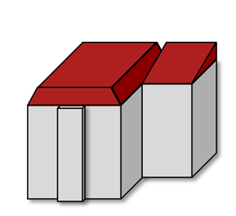


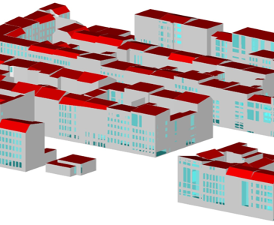

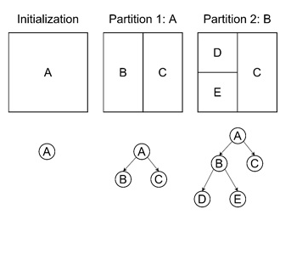
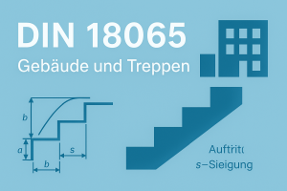

Multizone Assignment Algorithm
Geodata input
Preparation
Data clean up
Coordinate transformation
Front facade detection
Discretization
3D building envelope (LoD2)
Address point and street layout
Orientation
Roof type
Year of construction
…
Inner building data
Staircase measures
Corridor dimensions
Average apartment areas
WWR
+ DIN 18040-2
LBO
Binary Space Partitioning
Notes:
Geodata
Public data like Citygml and osm - City GML provides: 3D building envelope, roof type, orientation …. - OSM: Streets, address point, building type Inner building data - dimensions/regulations for staircase, corridors, average apartment area with respect to DIN, LBO and Destatis Discretization by Binary space partitioning – divides footprint into smaller leaves until a set granularity is fulfilled

Slide 7
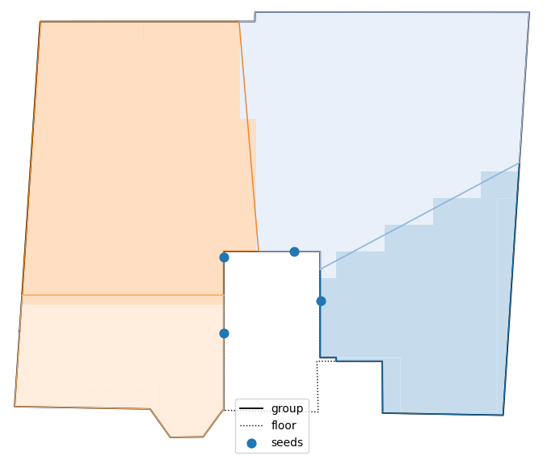
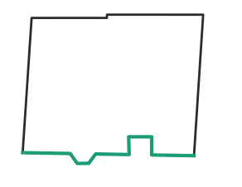
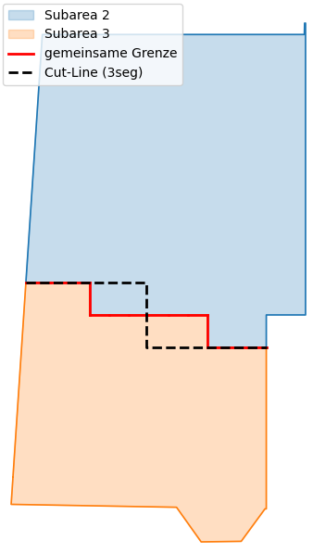
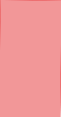
Multizone Assignment Algorithm
Voronoi-Seperation
Postprocessing
Seed placement along the staircase/corridor walls („doors“)
X-iterations (different seed placements)
Continuous evaluation:
Outer wall connection
Adjacend buildings / blocked walls
Windows accordingly? (if LoD3)
Artifacts, area connectivity
Eliminate „jagged patterns“ caused by voronoi (with respect to the restrictions)
Notes:
Staircase positioned along the detected façade
Seeds placed around the staircase/corridor boundaries (like doors)
Each seed acts as a Voronoi cell origin -> creates an initial zoning
We do this process for X-Itearions for different seed placement and continuously checked for necessary constains / errors like artifacts, cutted windows (if included), connection to outer walls …
Postprocessing needed to get rid of step patterns or other problems caused by the seed grow

Slide 8
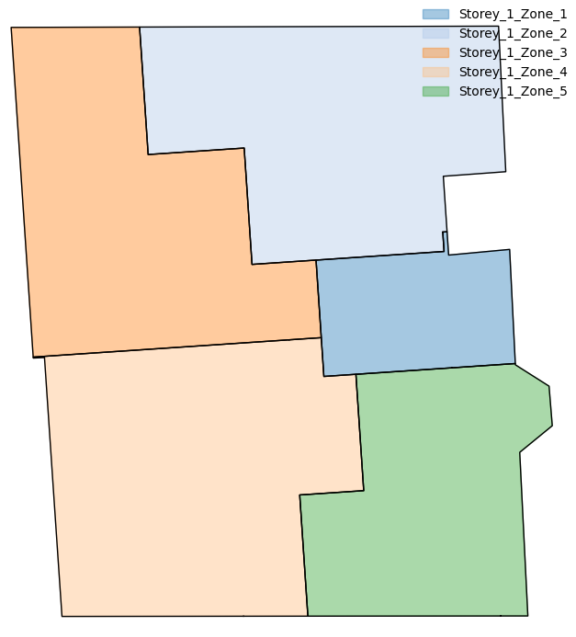
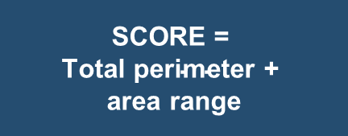
Multizone Assignment Algorithm
Voronoi-Seperation
Result
Seed placement along the staircase/corridor walls („doors“)
X-iterations (different seed placements)
Continuous evaluation:
Outer wall connection
Adjacend buildings / blocked walls
Windows accordingly? (if LoD3)
Artifacts, area connectivity
Best SCORE
$$\text{SCORE = }$$
$$\text{Total perimeter + }$$
$$\text{area range}$$
Notes:
Score defines the best result by taking the total perimeter and the area share between the zones into account
Alpha: Bigger alpha -> area range more important (usually 2.0)

Slide 9
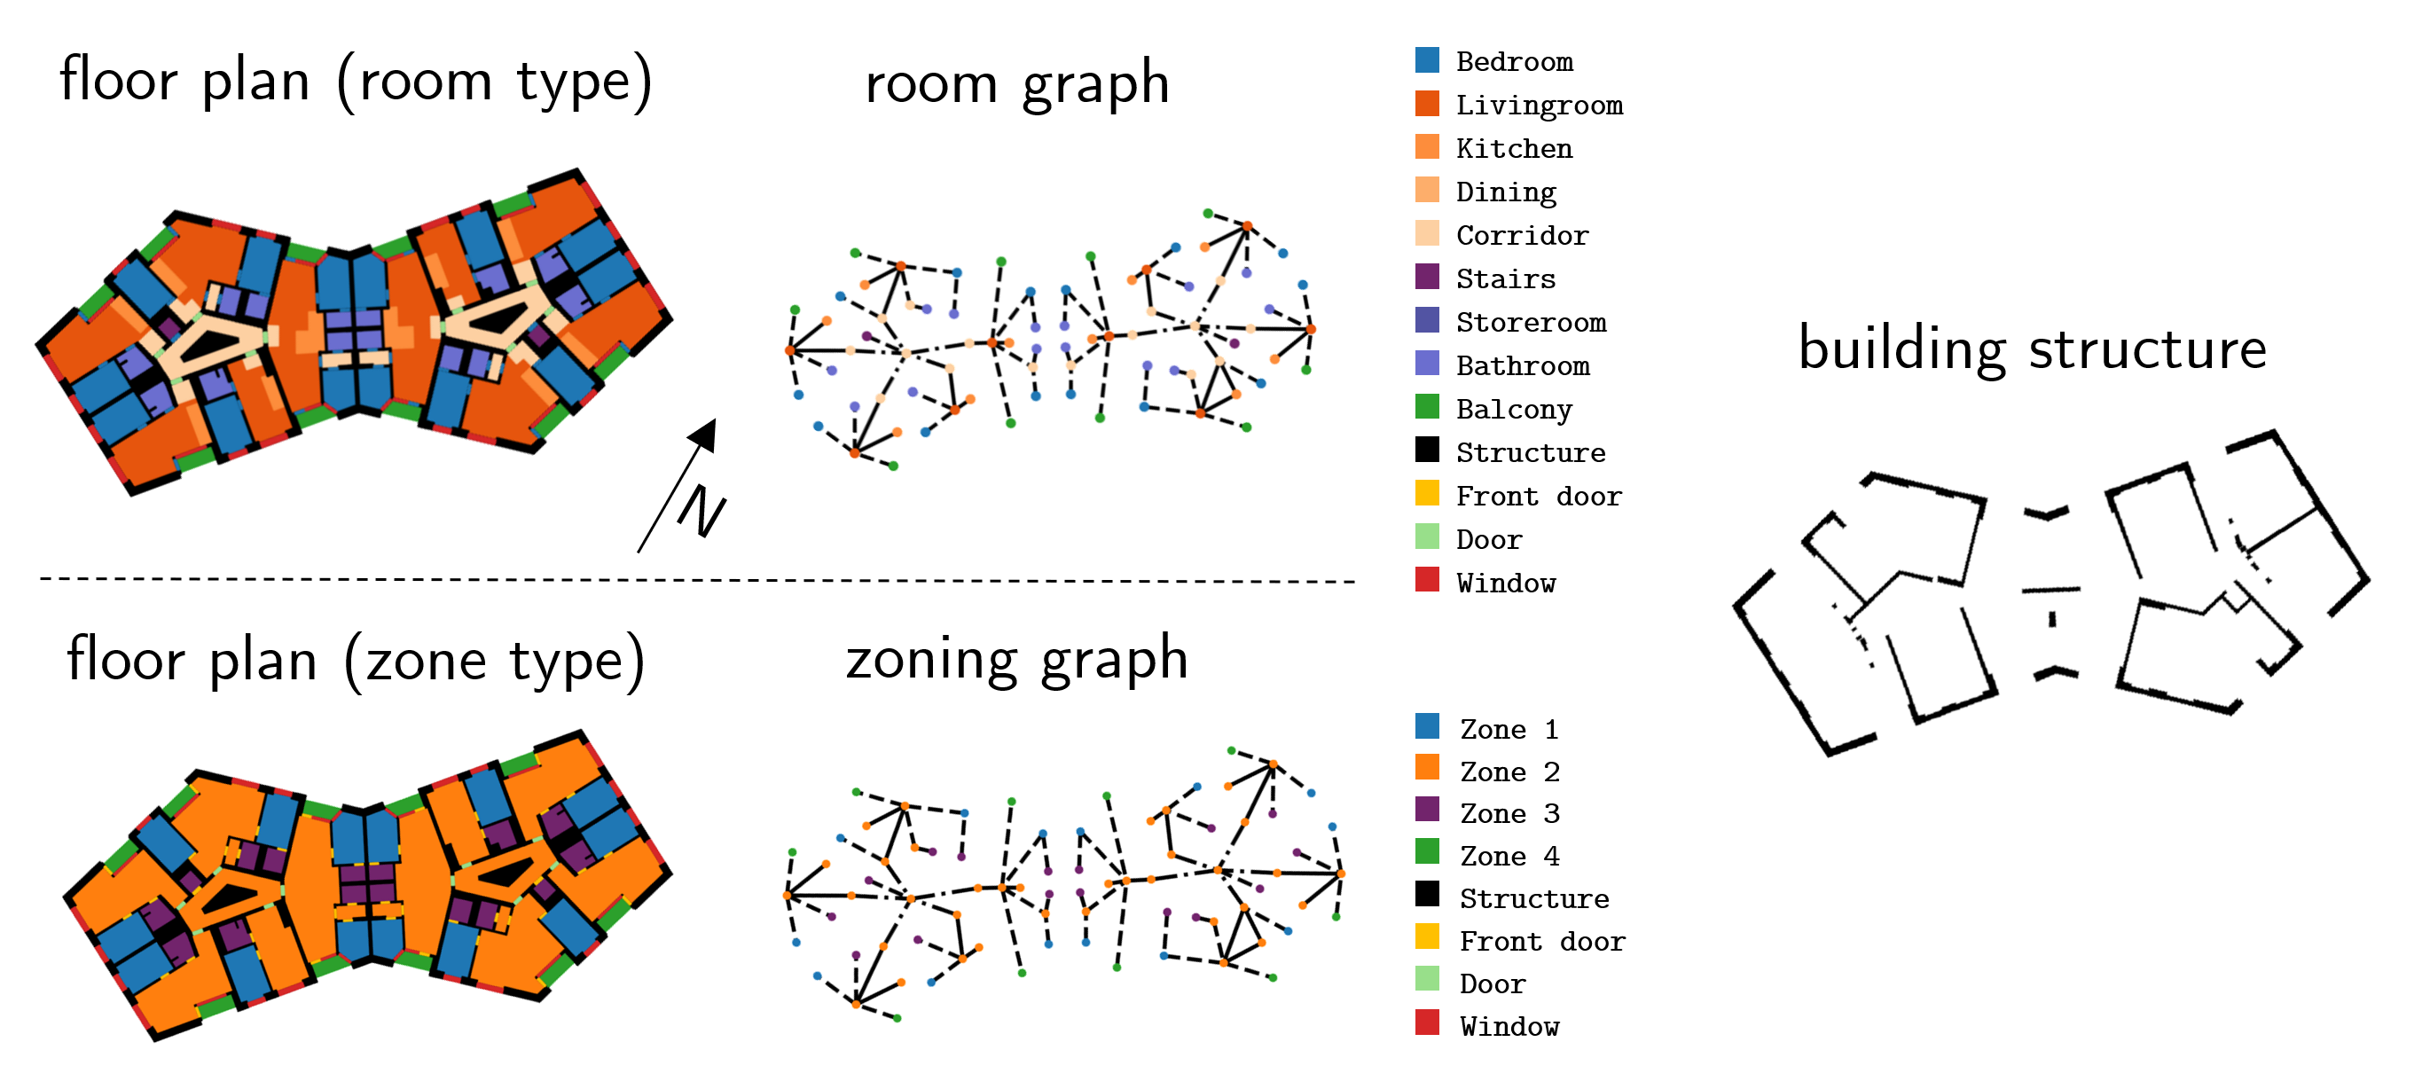
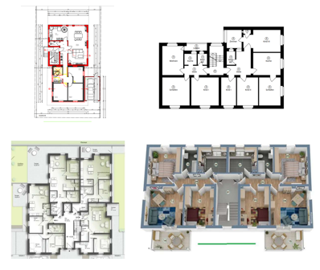
Datasets
Modified Swiss Dwellings (MSD)
German Real Estate Data
Floor plan dataset with multimodal representations (image, geometry, graph) derived from real floor plans
Graph based structure enables identification of apartments based on adjacency characteristics
Over 5,000 floor plans
Floor plans collected from real estate websites (Immoscout24).
Provided mainly as PDF documents
Include geometric information such as area and layout proportions
Collected over 40 real floor plans
Source : MSD: A Benchmark Dataset for Floor Plan Generation of Building Complexes, ImmoScout24 – Die Nr. 1 für Immobilien

Slide 10
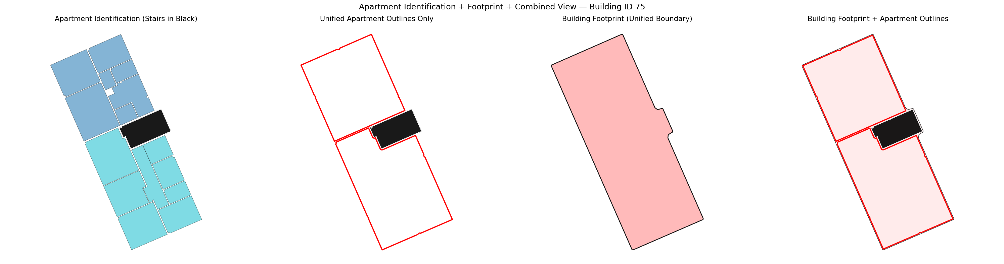
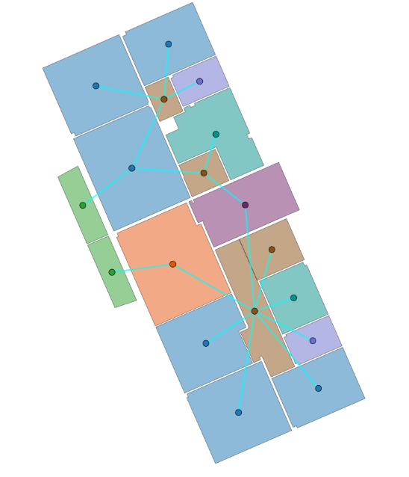
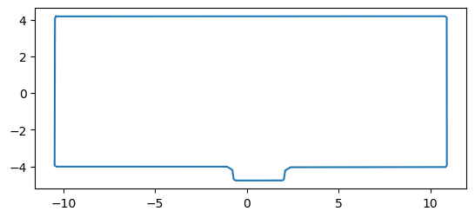
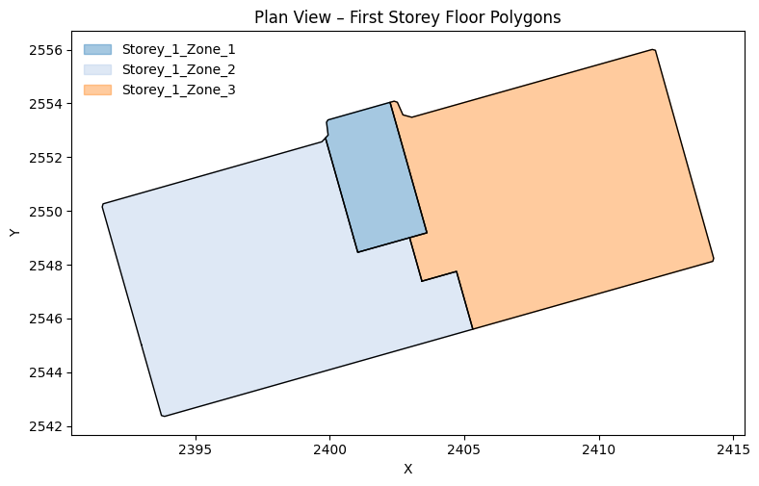
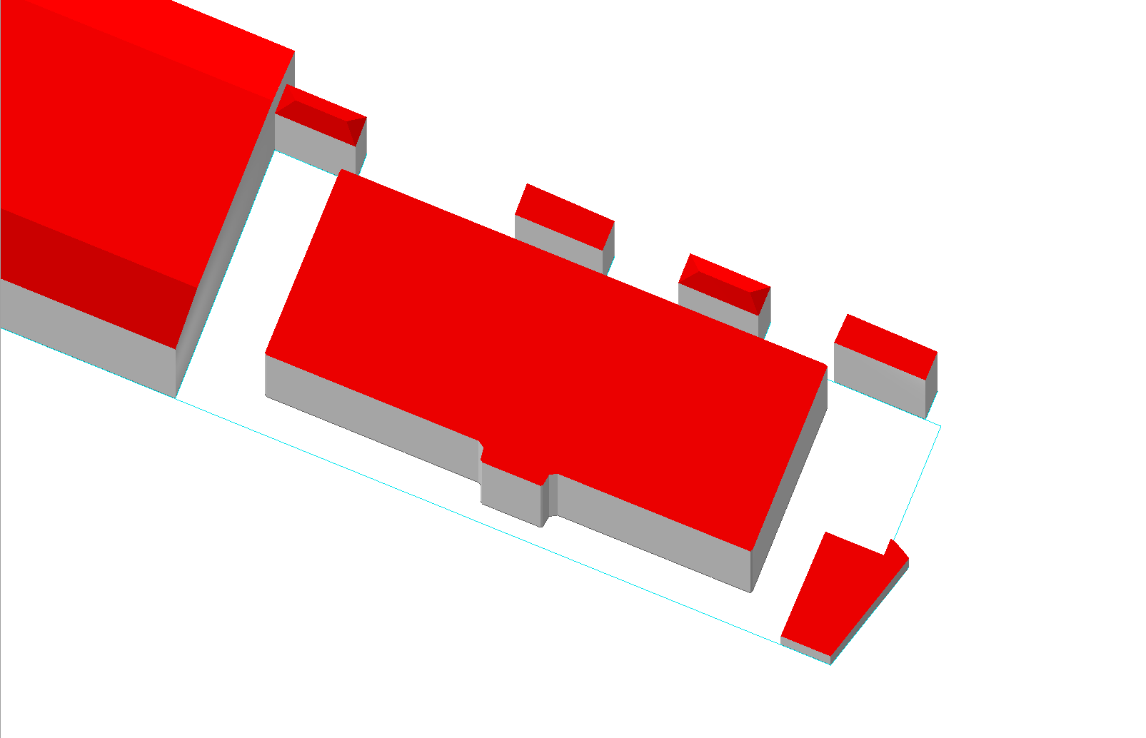
Dataset Preprocessing and Ground Truth Generation MSD
Building Footprint GeoJSON
Raw Dataset
Apartment Classification
Apartment Footprint (GT)
.geojson
CityGML
MZA zoning
.gml
.pickle
Notes:
The dataset represnts the room type and the adjacency characteristics
Filter balconies
Identify apartment based on the adjacency graph
Extract the apartment footprint from the room polygons to create the GT

Slide 11
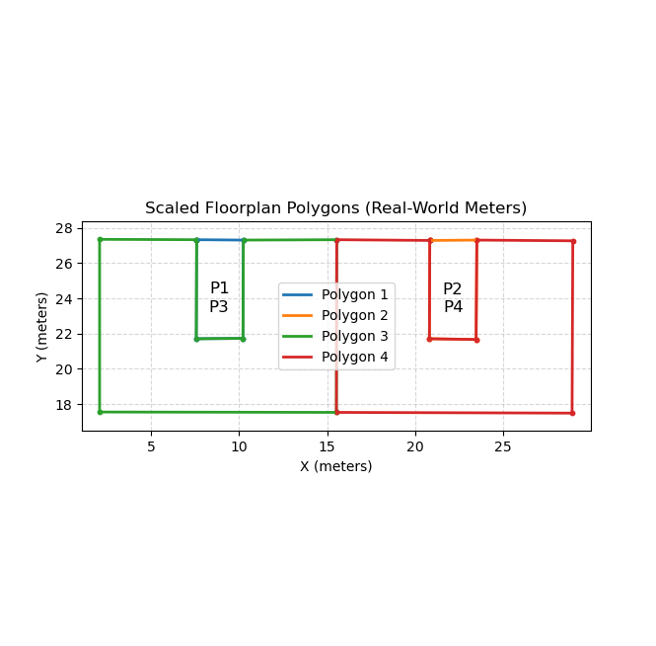
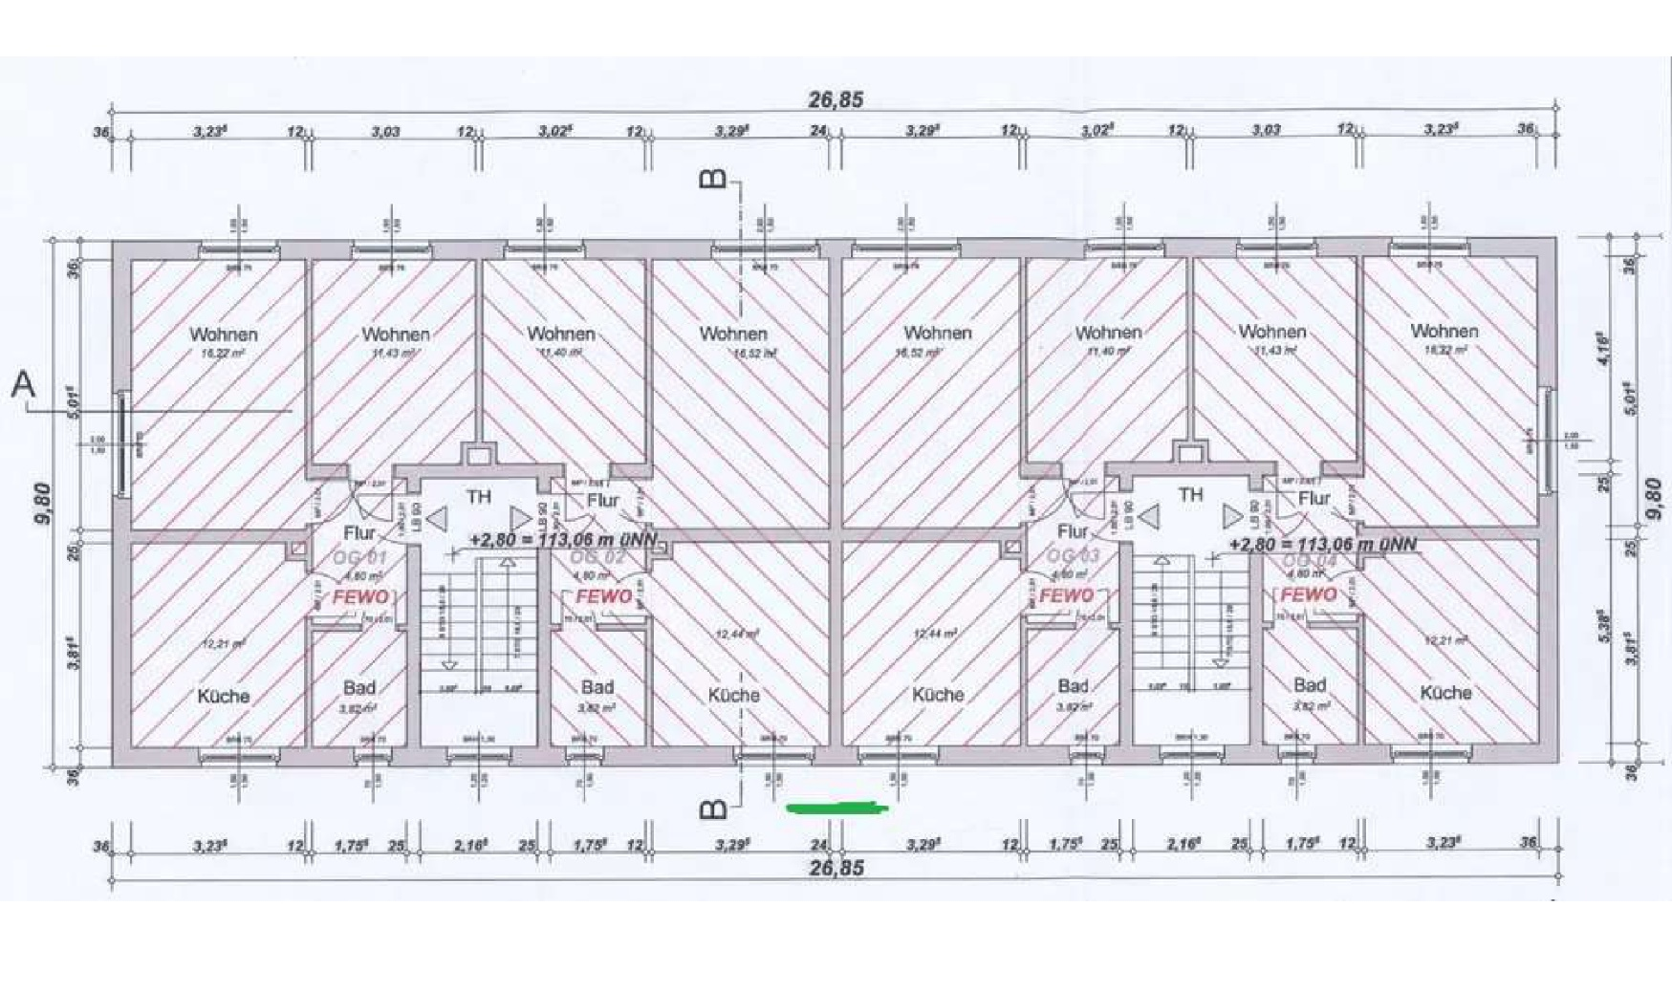
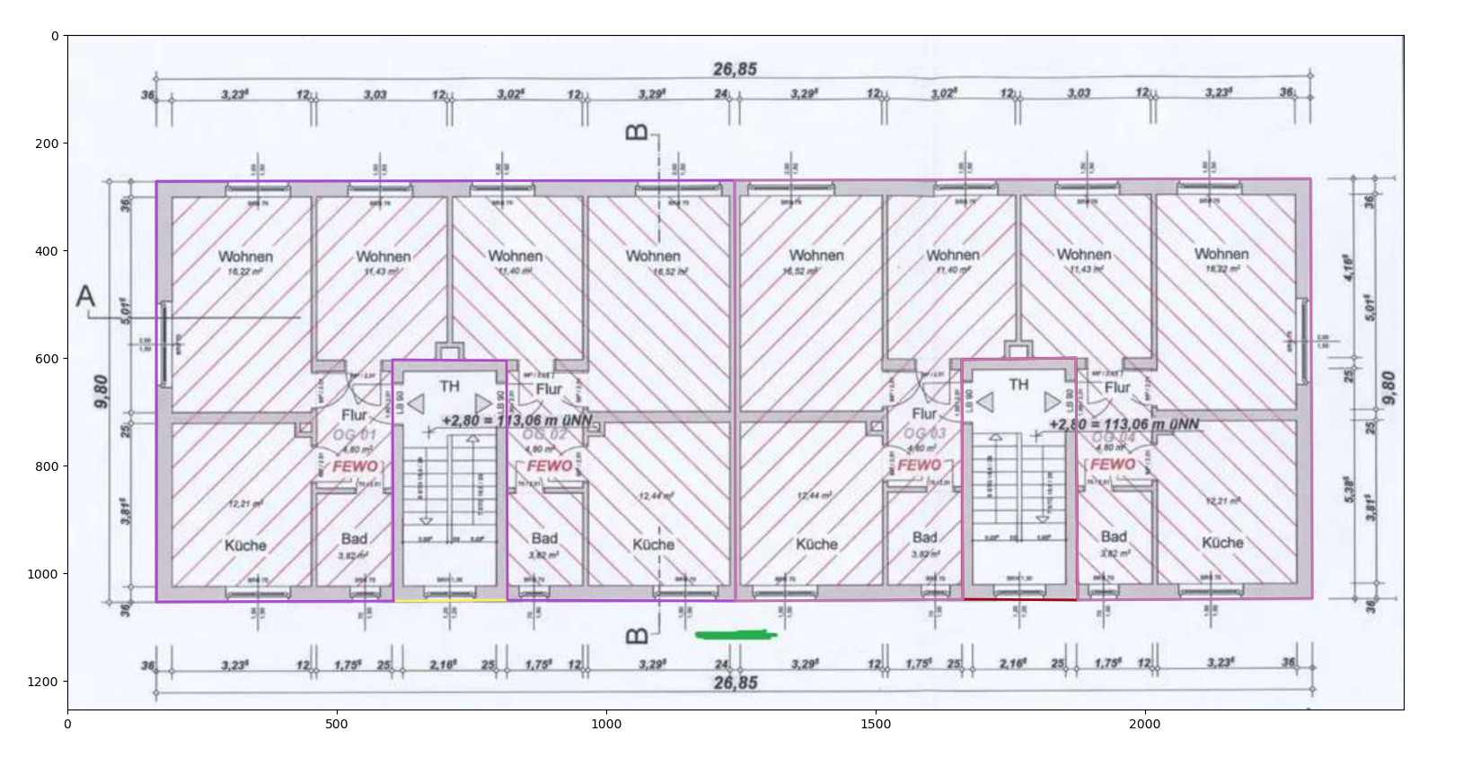
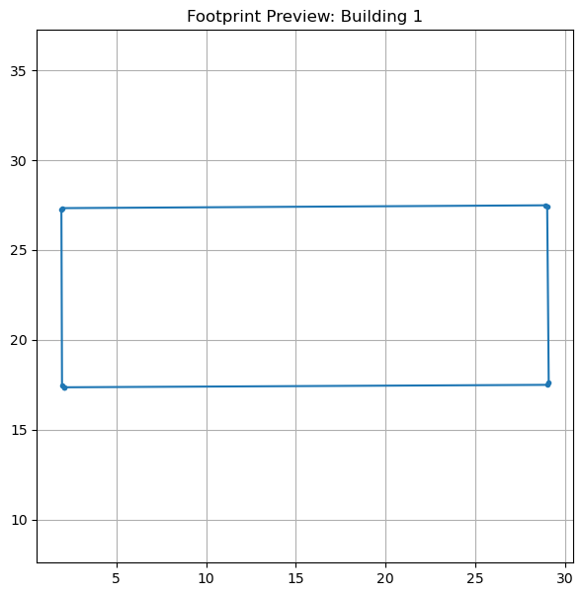
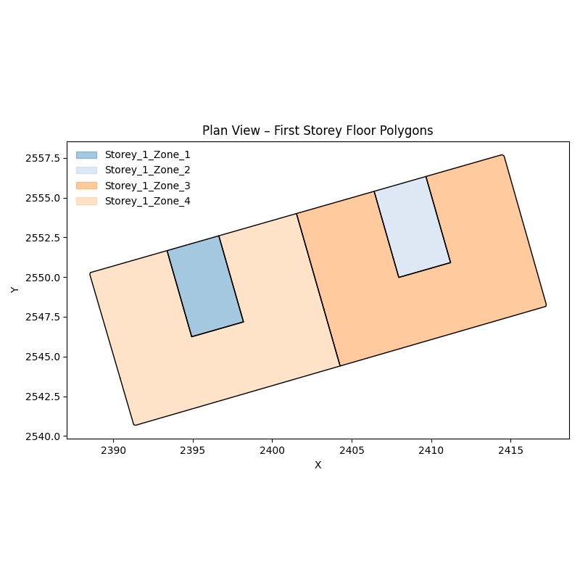
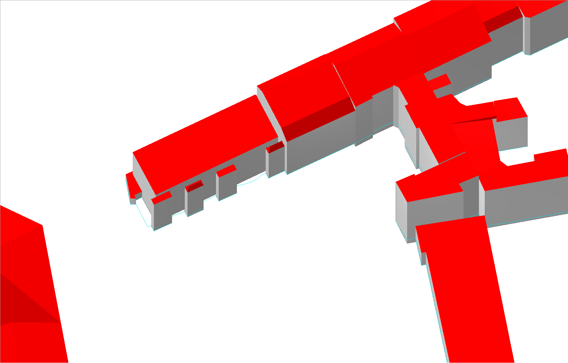
Dataset Preprocessing and Ground Truth Generation Real Estate Data
Raw Dataset
Manual Sketching
Apartment Footprint (GT)
Building Footprint GeoJSON
.geojson
MZA zoning
CityGML
.pickle
.gml
Notes:
- Transfered to real world measurements using a scale facttor which is calculated….

Slide 12
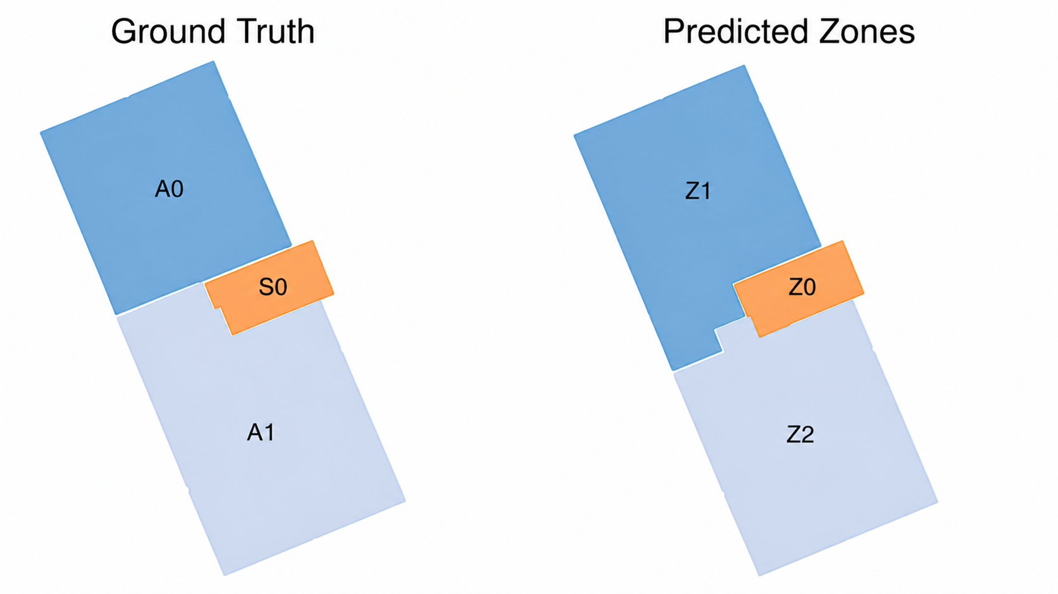
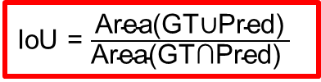
Validation Method
Ground Truth vs. MZA Zoning
Validation proceeds in three steps: zone matching, metric calculation, and diagnostic classification.
Hungarian assignment
IoU = $\frac{\text{Area(GT∪Pred)}}{\text{Area(GT∩Pred)​ }}$
maximises total IoU
Validation metrics
Diagnostic classification
Metric | What it checks
ΔN | Correct number of zones
IoU | Geometric overlap of matched zones
AreaError | Difference in zone size
d | Difference in centroid position
Topology | Missing / extra dwelling–stairwell adjacency
Outcome | Main criterion
Structural mismatch | Missing + additional zones
Under-zoned | Too few zones
Over-zoned | Too many zones
Shifted / area error | Correct count, but large area / position deviation
Moderate | 0.50 ≤ IoU < 0.70
Good | IoU ≥ 0.70 + correct topology / count
The metrics are evaluated hierarchically and condensed into one interpretable validation outcome per building

Slide 13
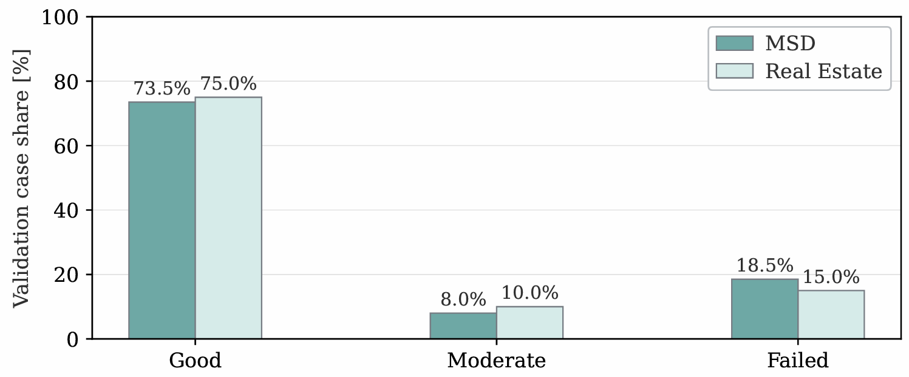
Validation Results
Diagnostic Classification Across Both Datasets
81.5% of MSD and 85.0% of German real-estate cases achieved at least moderate agreement

Slide 14
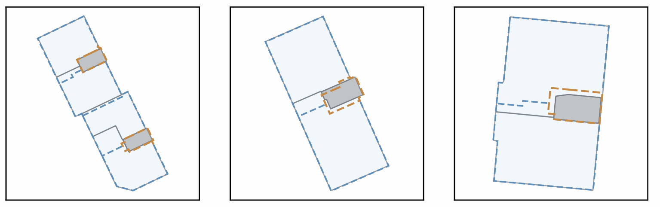
Validation Results
Representative Good Matches
In good cases, the MZA reproduces the dominant dwelling–stairwell structure, with only minor local boundary differences

Slide 15
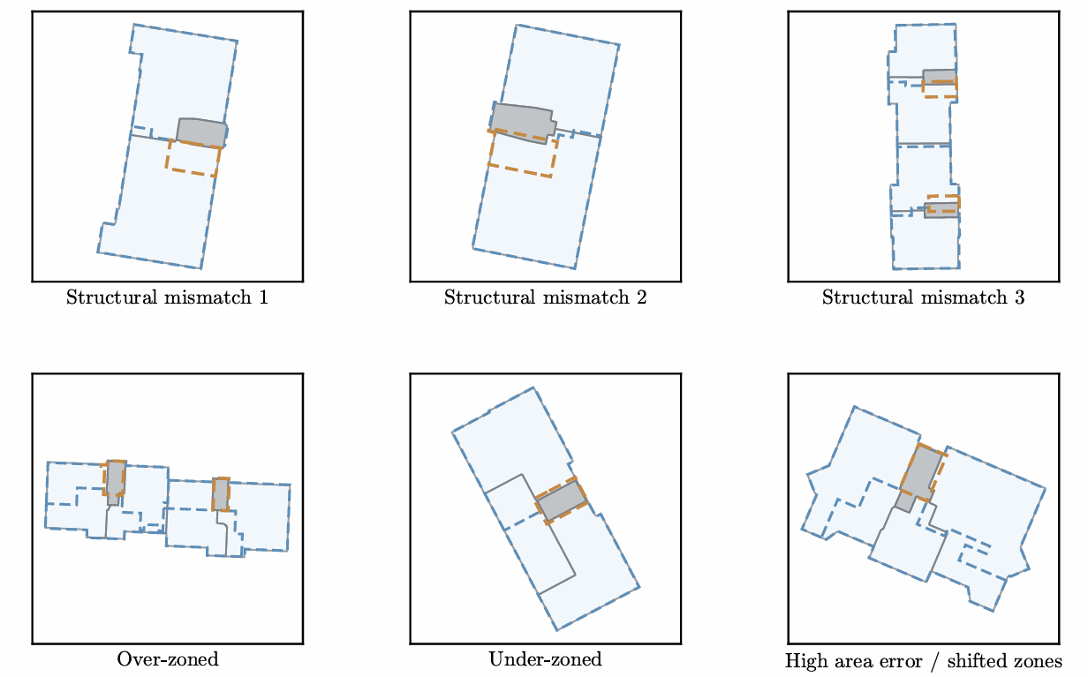
Where the MZA deviates
Structural mismatch
different dwelling–stairwell topology or stairwell organisation
Under / over-zoning
estimated dwelling subdivision produces too few or too many zones
Shifted / high-area error
correct count, but area balancing or placement changes zone size / position

Slide 16
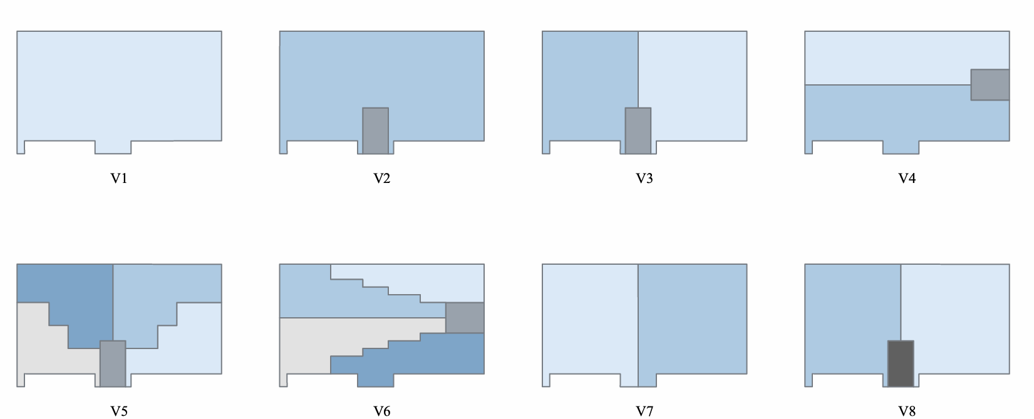
Sensitivity Analysis
Zoning Variants V1–V8
The validation identified recurring zoning deviations. To assess whether these deviations matter for building-energy simulation, representative mechanisms were translated into eight controlled zoning variants.
Schematic layouts of different zoning variants
Variant summary
Var. | Residential zoning | Stairwell | Zones
V1 | Aggregated building | No | 1
V2 | One zone per storey | Yes, unheated | 6
V3 | Two zones per storey, Layout A | Yes, unheated | 11
V4 | Two zones per storey, Layout B | Yes, unheated | 11
V5 | Four zones per storey, Layout A | Yes, unheated | 21
V6 | Four zones per storey, Layout B | Yes, unheated | 21
V7 | Two zones per storey, Layout A | No | 10
V8 | Two zones per storey, Layout A | Yes, heated | 11
V1–V8 span aggregation, dwelling-level layouts, finer subdivision, missing stairwell representation, and changed stairwell thermal treatment.

Slide 17
Sensitivity Analysis
From Validation Deviations to Controlled Variants
The zoning variants were designed as controlled analogues of the recurrent deviation mechanisms observed during validation.
Observed validation deviations
Sensitivity-analysis variants
Under-zoning / aggregation
V1 + V2
Aggregated representations (single-zone and storey-level zoning)
Too few zones or excessive aggregation of dwellings / storeys
Over-zoning / finer subdivision
V5 + V6
Finer subdivision variants (four zones per storey)
Too many zones caused by excessive dwelling subdivision
Shifted / high-area error
V4, V6
Alternative two-zone layout (boundary shift / area redistribution)
Correct count, but area balancing or boundary placement differs
Stairwell / topology deviation
V7 + V8
Stairwell variants (no stairwell / heated stairwell)
Missing, altered, or thermally different stairwell representation
Reference comparison case: V3 = dwelling-level baseline multi-zone model used to compare the effect of the other controlled variants.

Slide 18



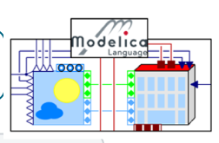

Sensitivity Analysis
Simulation Setup
Each zoning variant is simulated under the same exterior geometry while uncertain physical and operational inputs are sampled jointly.
Uncertain inputs and ranges
Simulation workflow
Input | Range / setting | Role in model
Construction state | Standard: p = 0.75 Retrofit: otherwise | TABULA envelope state
TABULA age class | −1 / 0 / +1 class shift | Construction properties
Mean heating setpoint | 20.5–21.5 °C | Building-level operation
Zonal setpoint spread | 0.5–2.0 K | Inter-zone heterogeneity
Residential setpoint | Limited to 18–24 °C | Zone-level bound
WWR factor | 0.8–1.2 | Window / façade scaling
Internal gains factor | 0.8–1.2 | Occupant + appliance gains
Weather | Napoli 2011 Munich 2015 | 2 annual climates
Zoning variant V1–V8
60 Sampled inputs / variant
4 occupancy seeds
Python workflow
orchestrates model generation, parameter assignment and simulation runs
TEASER
generates & parameterises the building model
Construction properties
AixLib / Modelica
reduced-order VDI 6007-1 model
SIMULATION RUNS
8 × 60 × 4
annual simulations
DYMOLA
compile & simulate one full year
Outputs: annual heating demand | peak heating load | overheating hours

Slide 19
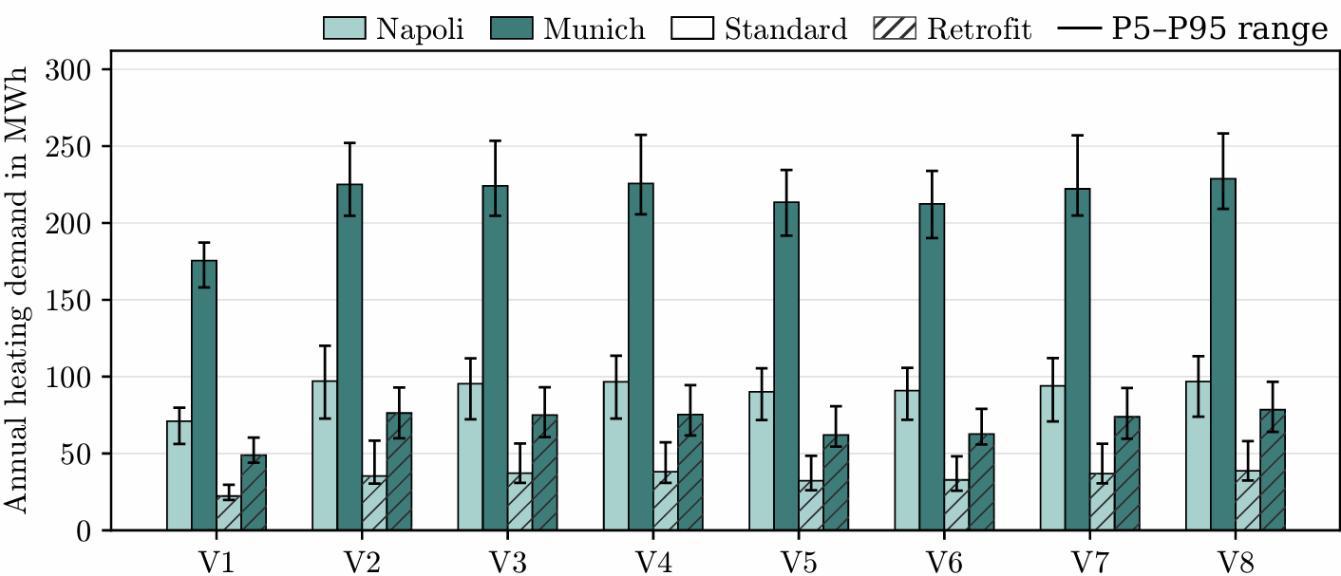
Sensitivity Analysis Results
Annual Heating Demand
Single-zone
Storey-level
Multi-zone

Slide 20
Sensitivity Analysis Results
Annual Heating Demand
Aggregation effect:
V3 – V1 = +27.7%
Boundary shift:
V3 – V4 = +0.8%
V5/V6 < V3
Aggregation effect
Boundary shifts have limited impact
More zones ≠ more demand
V1 is consistently the lowest. The strongest separation is between the fully aggregated single-zone model and explicit multi-zone representations.
V3 and V4 have the same number of zones but different internal layouts. Annual heating demand changes by <3% across the scenarios
V5/V6 are often below V3. Finer subdivisions therefore has a configuration-dependent rather than monotonic effect.

Slide 21
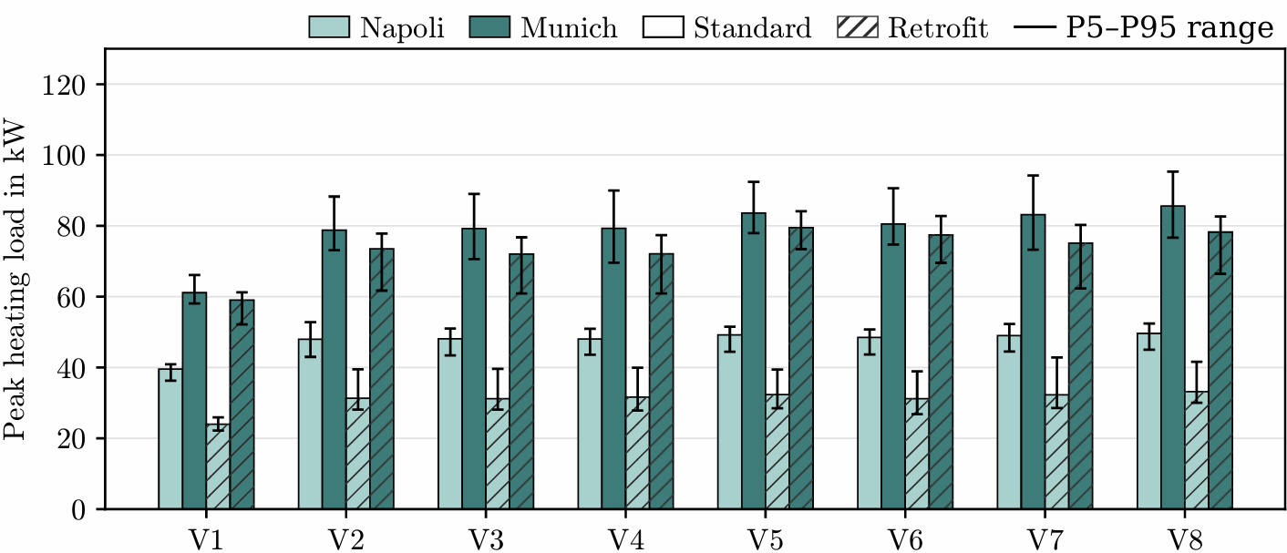
Sensitivity Analysis Results
Peak Heating Load
Aggregation effect:
V3 – V1 = +29.6%
Boundary shift:
V3 – V4 = +0.1%
V5/V7/V8 > V3 (8%)
Aggregation suppresses the peak
Boundary shifts have little effect
Finer zoning & stairwell treatment
Aggregation smooths dwelling-level setpoints, gains, and interzonal heat-transfer effects, thereby suppressing short-term load peaks. V1 consistently gives the lowest peak load.
V3–V4 and V5–V6 stay comparatively close. Exact internal boundary placement matters less than aggregation, granularity and stairwell representation.
Explicit multi-zone models reveal higher peak loads; finer variants and stairwell treatment affect the peak magnitude more clearly. V5, V7 and V8 exceed the reference V3.

Slide 22
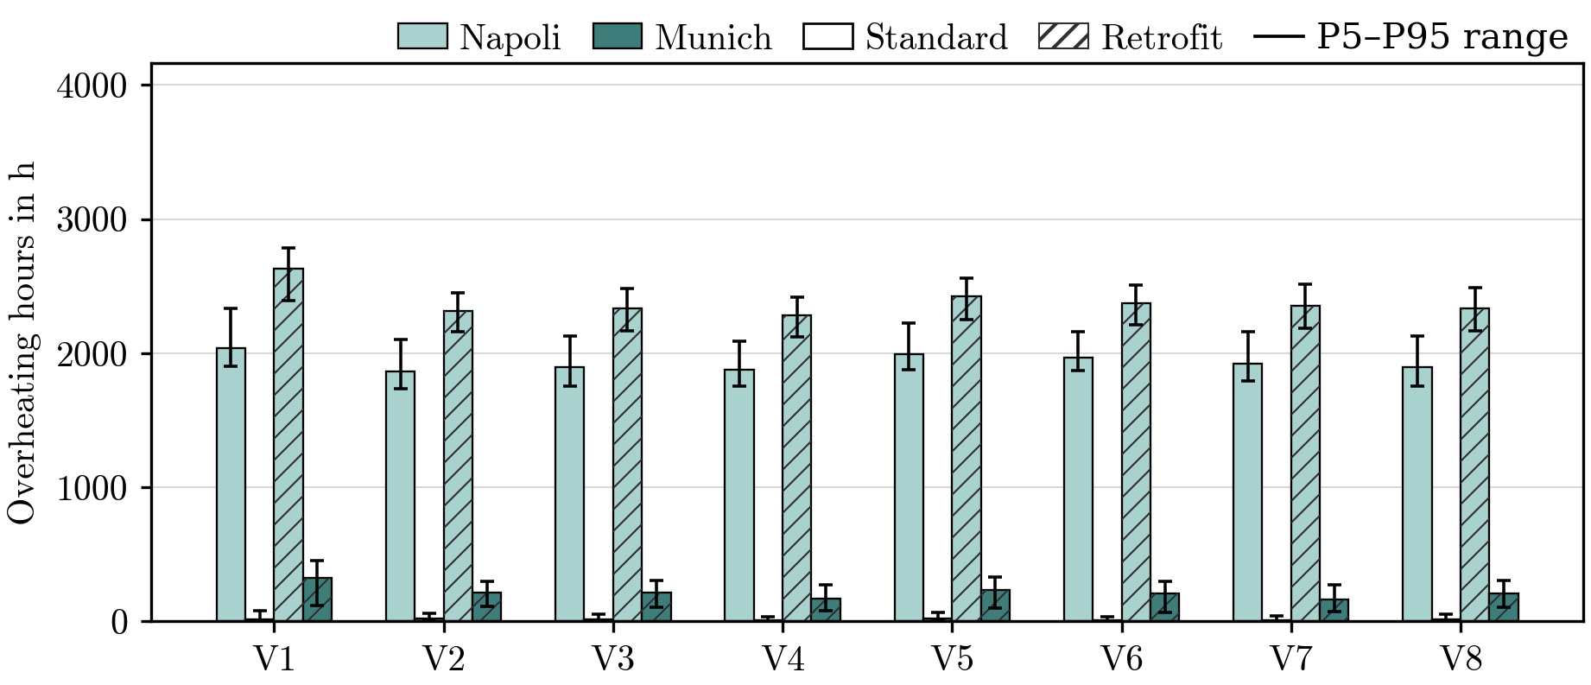
Sensitivity Analysis Results
Overheating Hours
Aggregation effect:
V3 – V1 = -7.5%
Boundary shift:
V3 – V4 = -0.4%
V5/V6 > V3
Different behaviour from heating KPIs
Boundary shifts have limited effect
Finer zoning slightly increases overheating
V1 is often among the highest overheating cases, showing that aggregation affects threshold-based comfort indicators differently.
V5 and V6 show somewhat higher overheating than V3, but the effect remains moderate and configuration-dependent.
V3 and V4 have the same number of zones but different internal layouts.

Slide 23

Conclusion & Outlook
Key findings and next steps
CONCLUSION
OUTLOOK
Geometric validation
Broader validation
81.5–85% of cases reached at least moderate agreement.
Test larger, more complex residential buildings and access layouts.
Simulation relevance
Refine automated zoning
Heating: aggregation dominates · Overheating: local zoning matters.
Improve stairwell placement, dwelling count and area assumptions.
Practical meaning
Extend the workflow
MZA is a scalable approximation — not an exact floor-plan reconstruction.
Automate ground truth and test more climates and modelling contexts.

Slide 24
Impact of Automated Thermal Zoning on Building Energy Simulations: Ground-Truth Validation and Sensitivity Analysis
Thank You For Your Attention !
Questions/Feedback
Sharon Thomas Charivupurayidom
M.Sc. Civil Systems Engineering · Technische Universität Berlin
Scientific supervision: Prof. Dr. Timo Hartmann | Scientific guidance: Dr. Jacob Estevam Schmiedt DLR supervision: Kevin Waiz

Slide 25
Thesis Timeline
Preparation
Data Collection and Preprocessing
Comparison
Simulation
Analysis and Results
Understanding the research topic and scope
Familiarization with the MZA
Identification of relevant datasets
Dataset preprocessing for MZA
Preparation of Ground Truth
Initial zoning comparison and MZA refinement
Systematic comparison of MZA zoning with Ground Truth
Initial simulation analysis to identify key parameters for base archetypes
Full-scale sensitivity analysis
Evaluate results
Final presentation​
4
5
1
3
2

