Slide 1
Surface-EMG Processing & Classification for Muscle Interfaces
Thomas Alexgaard Jensen

Slide 2
Contents
Introduction
Problems & Motivation
Anatomy
Dataset Creation & Processing
Intent Classification & Results
Angle Regression & Results
Simulated Prosthetic Hand & Results
Discussion
Conclusion

Slide 3
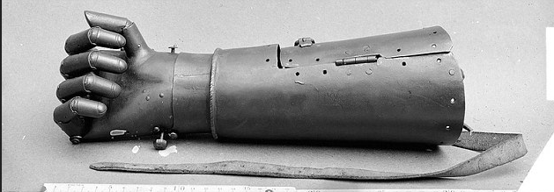
Introduction
~58 million amputees
Historical developments
Mechanical actuation
https://www.dailymail.co.uk/sciencetech/article-3303868/Now-iron-grip-Mechanical-hand-belonging-16th-century-German-knight-allowed-hold-sword-reins.html

Slide 4
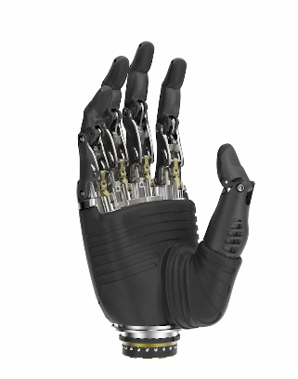
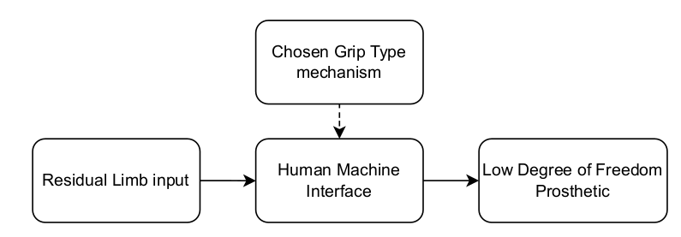
Problems
Crude dynamic control
Amputation severity & differences
The Ottobock hand
https://www.ottobock.com/en-gb/product/8E70

Slide 5
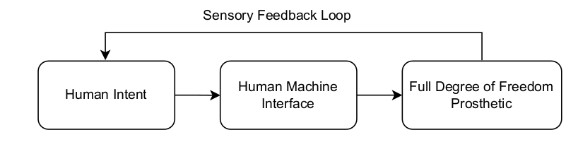
Motivation
Decreasing prosthesis rejection
“Real” & dynamic control

Slide 6

Motivation
Decreasing prosthesis rejection
“Real” & dynamic control

Slide 7
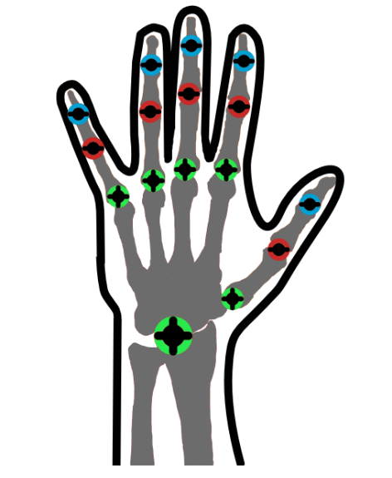
Anatomy
One of the most important tools
27 bones, 30+ muscles and 24 DoF
Joint types in the hand

Slide 8
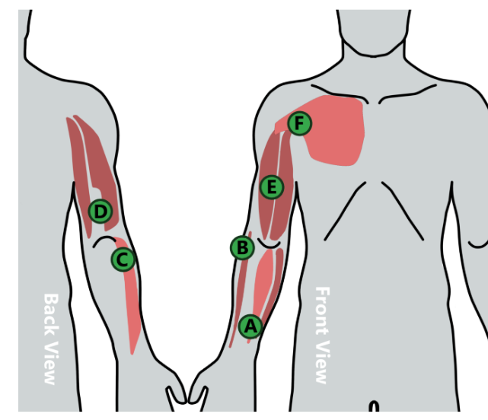
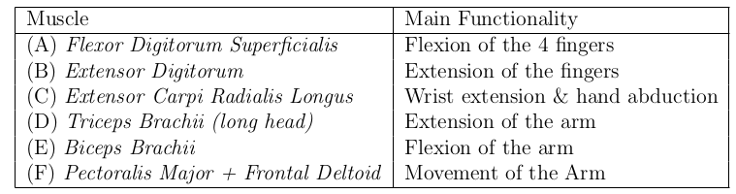
Preperation for Dataset Creation
What the dataset contains
Kinematic joint angles
Target muscles and distribution
Alternative muscles of interest

Slide 9
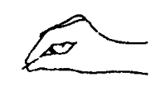
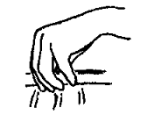
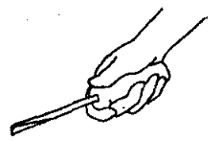
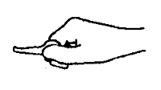
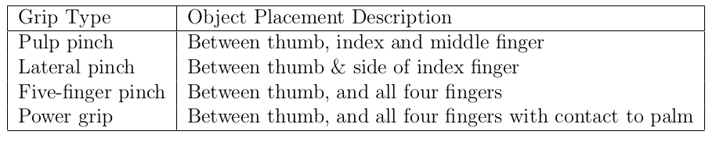
Preperation for Dataset Creation
Southhampton Hand Assessment Procedure (SHAP)
Sollerman Hand Function Test
https://www.sralab.org/sites/default/files/2017-06/sollermann1995handfunctiontest.pdf

Slide 10
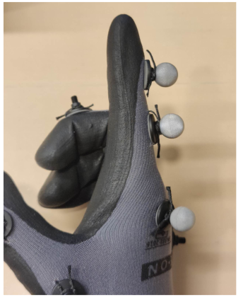
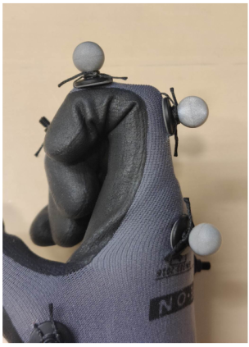
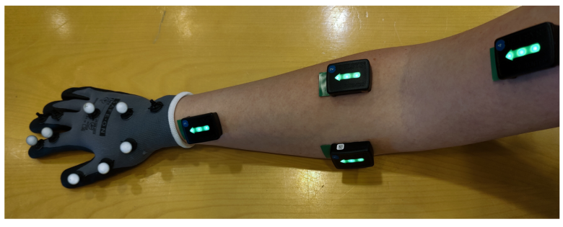
Dataset Recording Setup
Delsys Trigno
Optitrack Motive
Design of a recording glove
D

Slide 11
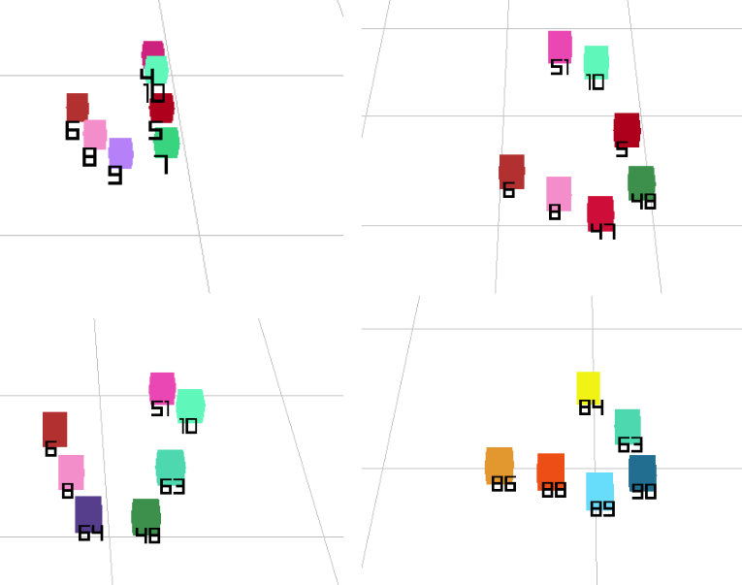
Dataset Processing
Spectral lighting & noise
Faulty labeling
No reliable tools in Motive
D

Slide 12
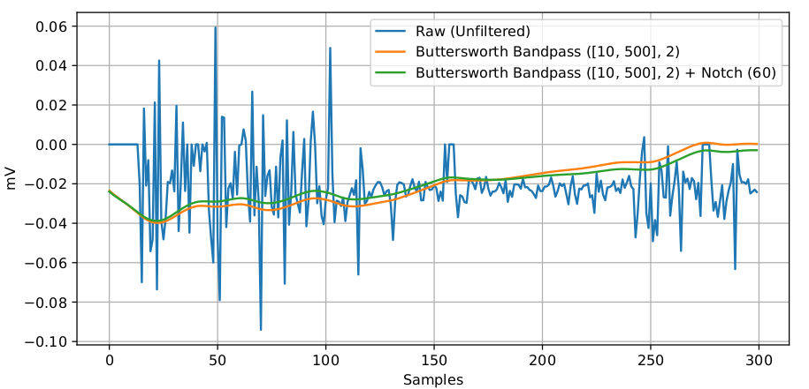
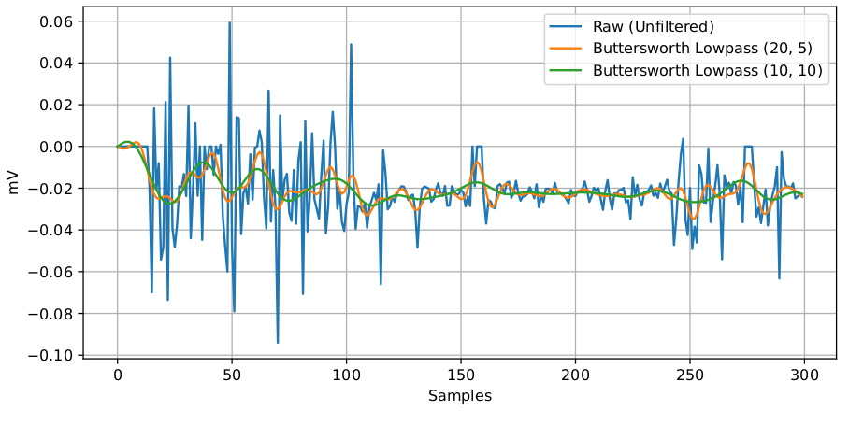
Dataset Processing
sEMG noise types
  Motion Artifacts
  Ambient Noise
  Electronics equipment
  Muscle cross-talking
Filter types and effects

Slide 13
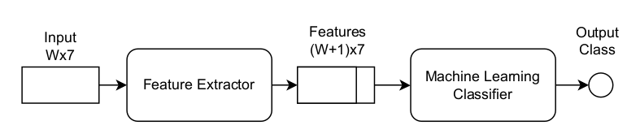
Intent Classification
Upper-body intent
Window based feature extraction
  MSE & ZC
ML classifiers

Slide 14
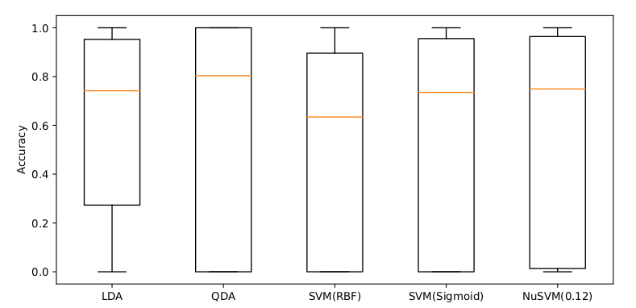
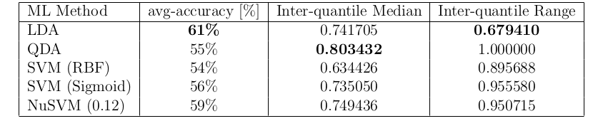
Intent Classification Results
Accuracy
Quantile Range & Median

Slide 15

Intent Classification Results
Accuracy
Quantile Range & Median

Slide 16
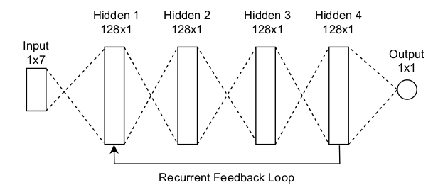
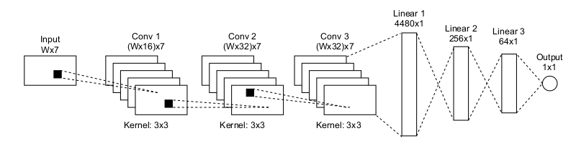
Movement Regression
Joint angles of the hand
NN regression techniques
  Moving windows
  Hidden states

Slide 17
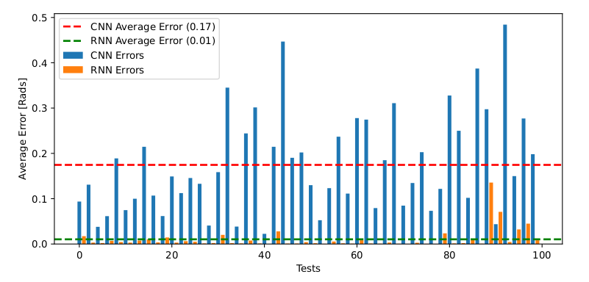

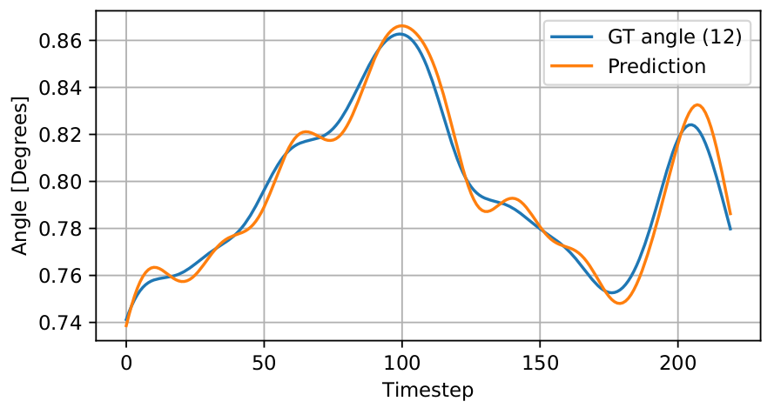
Movement Regression Results
Average Error
Outliers
Problems with CNN

Slide 18
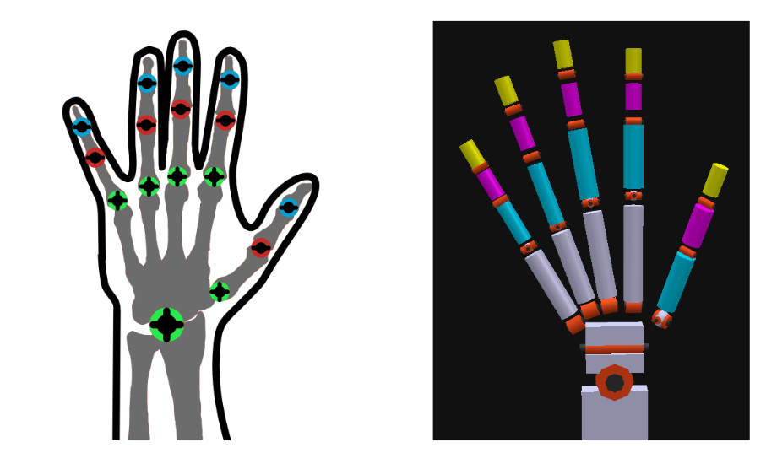
Prosthetic Hand Design
Designed in CoppeliaSim
Anatomically correct structure

Slide 19
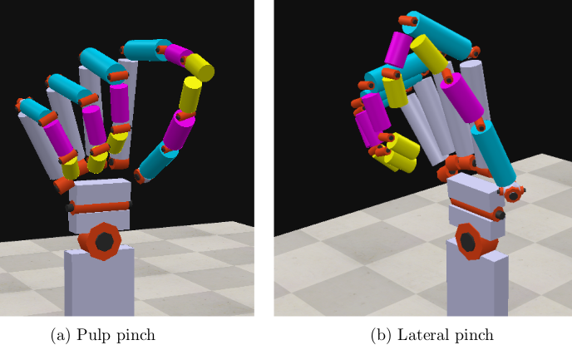
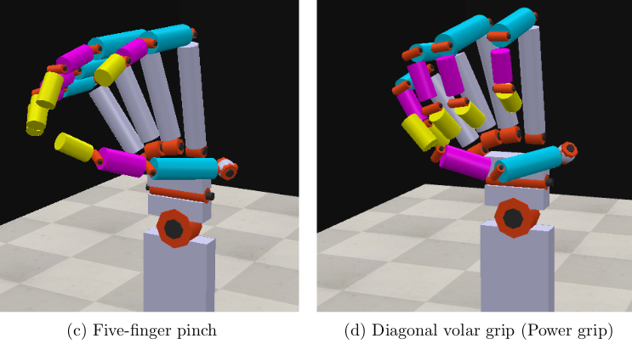
Prosthetic Hand Results
ROS2 controllable
Most used grips
Remaining fine tuning
D

Slide 20
Discussion
Motive label cleaning
3D marker capture
Dataset creation
Classification and regression
Alternative methods
Fine tuning of the simulated hand

Slide 21
Conclusion
Developed a solution for fixing Motive errors
Implemented a simulated hand
Designed AI-based HMI models
3-way classification accuracy of 61%
Regression error of 0.1 radians

