Slide 1
Graph Visualization of Tweets on Impeachment
Galadriel Thoman
Data Management

Slide 2
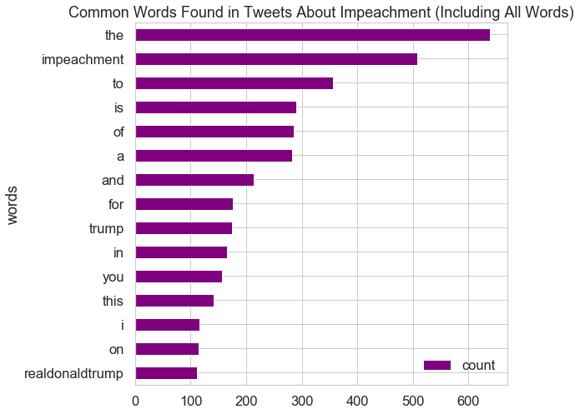

Slide 3
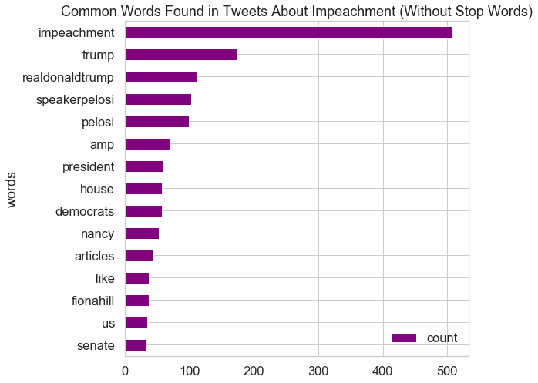

Slide 4
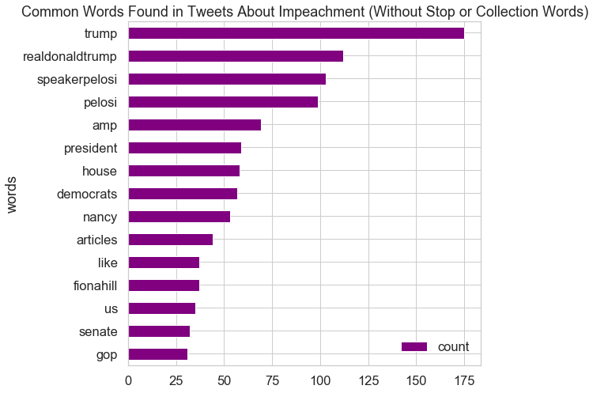

Slide 5
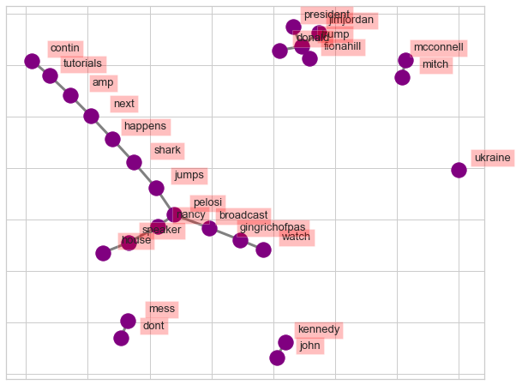

Slide 6
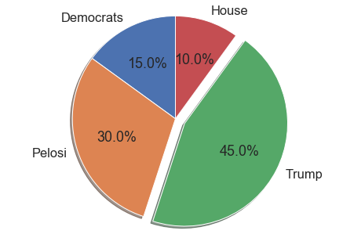

Slide 7
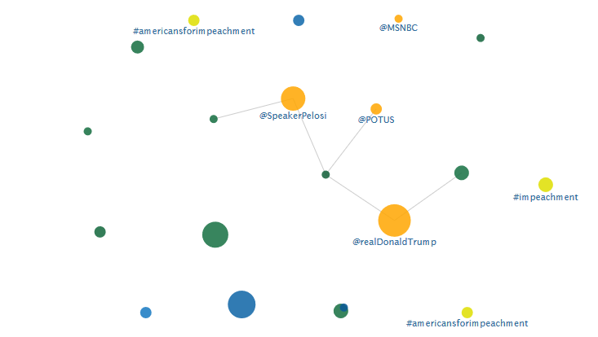
Twitter Visualization: Affinity
Notes:
Frequent tweets, people, hashtags, and URLs are drawn in a graph to show important actors in the tweet set, and any relationship or affinity they have to one another.

Slide 8
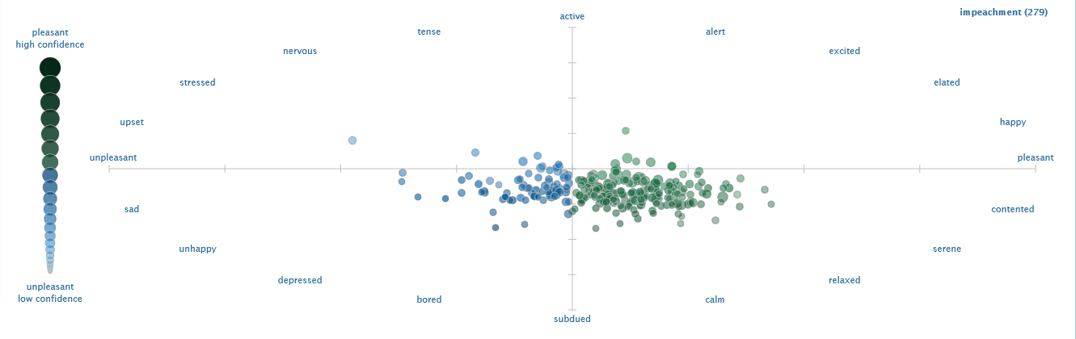
Twitter Visualization: Sentiment

Slide 9
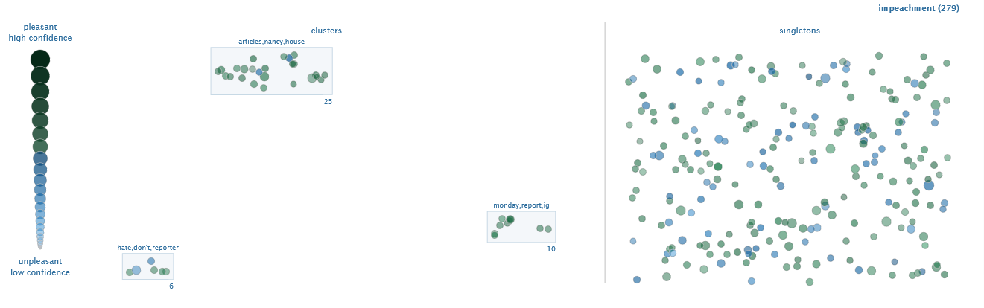
Twitter Visualization: Topics

Slide 10
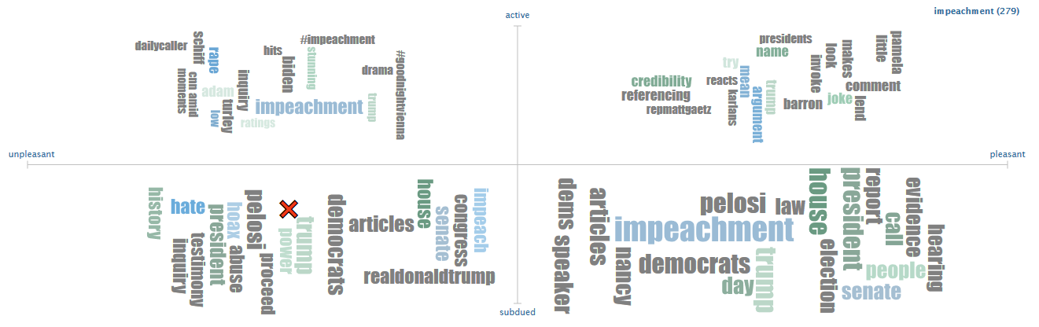
Twitter Visualization: WordClouds

Slide 11
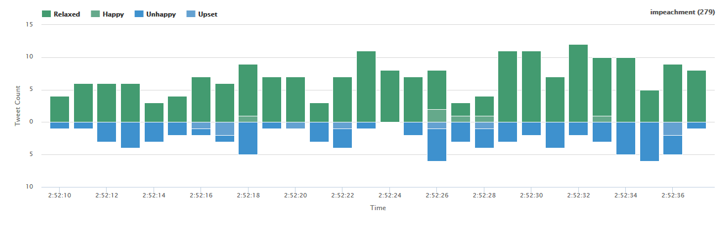
Twitter Visualization: Timeline of Today

Slide 12
Example Grabbed Tweets
12-05-19 14:52 LynCarps247qdds 5.08 4.68 RT @realDonaldTrump: The Do Nothing Democrats had a historically bad day yesterday in the House. They have no Impeachment case and are demeaning our Country. But nothing matters to them, they have gone crazy. Therefore I say, if you are going to impeach me, do it now, fast, so we can have a fair....
12-05-19 14:52 agabus98 5.73 4.07 'The president leaves us no choice but to act': Pelosi announces impeachment case against Trump will go forward #CCOT How many seats in house need to switch, 10, 15, 17!!! How many districts in Trump states voted demoncrats? 35!! Bye Nancy!! https://t.co/N0eZsGZUaR
12-05-19 14:52 Gwydion620 5.22 4.52 RT @JamilSmith: This argument from @ThePlumLineGS is very astute: essentially, two new reports show that Attorney General Barr and Trump’s personal lawyer continue to carry out elements of the exact same (corrupt) scheme that is now the subject of the impeachment inquiry. https://t.co/7ZsX3pbubC
12-05-19 14:52 sassy1ntn 5.45 4.10 RT @RepGosar: The far-left Senators running for president have already reached their verdict on impeachment. How can we trust them to be impartial jurors in a Senate trial? @RepJasonSmith is right: they should recuse themselves. https://t.co/Zl1rBlYOKW

