Slide 1

JavaScript
Needn’t Hurt!
Thomas Kjeldahl Nilsson thomas@kjeldahlnilsson.net linkedin.com/in/thomaskjeldahlnilsson twitter.com/thomanil
Notes:
First page

Slide 2
Intro

Slide 3
Who Are You?
Done any JavaScript?
Dozen lines of code?
Hundreds?
Thousands?

Slide 4
Who Am I?
JavaScript enthusiast
Hundreds of hours
Thousands lines of code
Not an expert!

Slide 5
What Are We Covering Today?
Language basics
Html scripting
Good practices
Tools

Slide 6
Practical Stuff

Slide 7
History Lesson

Slide 8


Slide 9
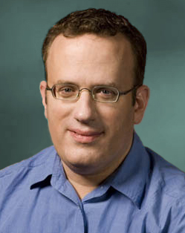
Brendan Eich

Slide 10
ECMAScript

Slide 11
A Note on ActionScript

Slide 12
What Rocks?
Powerful, elegant, dynamic
Present & enabled for most users
Not confined to the browser
Small learning surface

Slide 13
What Sucks?
Rushed out the door
Some bad language features
Crossbrowser problems

Slide 14
Development Environment
Walkthrough

Slide 15
Language Basics
Syntax
Types
Variables
Objects
Functions

Slide 16
Basic Syntax
Similar to Java, C#
Operators, statements if-else, while, for, try-catch-finally
Still in Kansas...

Slide 17
Types
Strings
Numbers
Booleans
Objects
Arrays

Slide 18
Variable Declarations
var x = “foo”; // string
var x = 2; // number
var x = true; // boolean
var x = { }; // object
var x = [ ]; // array

Slide 19
Objects

Slide 20
Object Creation
Literal Form
var BasicProject = {
name : "Steria Workshop",
version : 1.2,
getName : function() {
return this.name;
}
};

Slide 21
Object Creation
Dynamic Form
var BasicProject = {};
BasicProject.name = "Steria Workshop";
BasicProject.version = 1.2;
BasicProject.getName = function() {
return this.name;
};

Slide 22
Objects as Maps
(Associative Arrays)
var Person = { firstname:"John", lastname:"Smith" };
Person.firstname; // => "John" (Access using identifier)
Person["firstname"]; // => "John" (Access using variable name)

Slide 23
Arrays are Special Case of Object
var arr = []; // Always declared without size.
// Grows as needed.
arr[0] = true;
arr[3] = "john";
arr[300] = { description : "object!" };
arr[100]; // => Undefined
arr.length; // => 301

Slide 24
Arrays and Objects
Can Be Deeply Nested
var OuterObject = {
innerArray : [
innerObject : {
deepestArray : [1,2,3]
}
]
};

Slide 25
JSON
{"firstName":"Gustav","lastName":"Adolf",
"roles":["King of Sweden","Terrible shipbuilder"],
"other":{"birth":"9.12.1594","death":"16.11.1632"}}

Slide 26
Kind Familiar Looking
{
"firstName" : "Gustav",
"lastName" : "Adolf",
"roles" : [
"King of Sweden",
"Terrible shipbuilder"
],
"other" : {
"birth" : "9.12.1594",
"death" : "16.11.1632"
}
}

Slide 27
JavaScript
Object Literal!
var EvaluatedObject = {
firstName : "Gustav",
lastName : "Adolf",
roles : [
"King of Sweden",
"Terrible shipbuilder"
],
other : {
birth : "9.12.1594",
death : "16.11.1632"
}
};

Slide 28
Inheritance

Slide 29
Prototypal Inheritance (Simplified)
var Employee = {name : "CEO Jack", company : "ACME Inc."};
var Janitor = Object.create(Employee);
// Janitor now looks and behaves just like its prototype, Employee
Janitor.company // => "ACME Inc.", falls back to prototype.company
Janitor.name = "Janitor Tim"; // Override name
Janitor.tools = ["broom", "bucket"]; // Define member variable only on child
Employee.name = "CEO Jane"; // Change name of prototype
Janitor.name; // => Still "Janitor Tim". Overriden members unaffected by prototype changes

Slide 30
Functions

Slide 31
Simple Function Definition
function add(a, b) {
return a + b;
}

Slide 32
That's Just a
Way of Saying:
var add = function(a, b) {
return a + b;
};
// Use this consistently
// Helps you remember:
// Functions are just variables!

Slide 33
An Anonymous
Function...
function(element) {
// Do something with element
}

Slide 34
...Can Be Sent
To Another Function
each(collection, function(element) {
// Do something with current element
});

Slide 35
Example:
Event Handler
button.onClick(function(element) {
alert(«You clicked me!»);
});

Slide 36
Sharp Edges
Global variables
No block scope
Semicolon insertion
== operator

Slide 37
Properly Scoped
Variable
var getSmallNumber = function(){
var smallNumber = 42; // Note use of var keyword
return smallNumber;
};

Slide 38
Sloppy,
Global Variable
var getSmallNumber = function(){
smallNumber = 42;
return smallNumber;
};
// Missing var prefix = smallNumber gets global scope
// Becomes available for all code
// Sticks around and pollutes namespace

Slide 39
No Block Scope
var x = 1;
if (true) {
var x = 123;
}
// x => 123

Slide 40
Semicolon insertion
Don't force the browser to guess!

Slide 41
Example
a = b + c
(d + e).print()
becomes...
a = b + c(d + e).print();

Slide 42
== vs ===

Slide 43
Quiz
'' == '0' // true or false?
0 == '' // true or false?
0 == '0' // true or false?
false == 'false' // true or false?
false == '0' // true or false?
false == undefined // true or false?
false == null // true or false?
null == undefined // true or false?
' \t\r\n ' == 0 // true or false?

Slide 44
How Many
Did You Get?
'' == '0' // false
0 == '' // true
0 == '0' // true
false == 'false' // false
false == '0' // true
false == undefined // false
false == null // false
null == undefined // true
' \t\r\n ' == 0 // true
// Why? Type coercion on right operand, that's why.

Slide 45
Instead, Use ===
(And !==)
'' === '0' // false
0 === '' // false
0 === '0' // false
false === 'false' // false
false === '0' // false
false === undefined // false
false === null // false
null === undefined // false
' \t\r\n ' === 0 // false

Slide 46
Advanced Stuff
Closures
Modules
Memoization

Slide 47
Clientside
Firebug jQuery

Slide 48
Firebug
Demo

Slide 49
The DOM

Slide 50
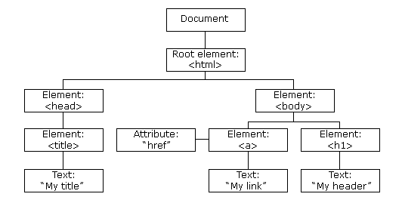

Slide 51
<TABLE>
<TBODY>
<TR>
<TD>Shady Grove</TD>
<TD>Aeolian</TD>
</TR>
<TR>
<TD>Over the River, Charlie</TD>
<TD>Dorian</TD>
</TR>
</TBODY>
</TABLE>

Slide 52
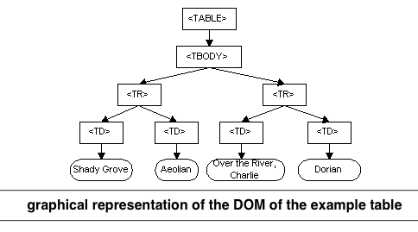

Slide 53
DOM Scripting
Basics
x.getElementById(id) ; // get the element with a specified id
x.getElementsByTagName(name); // get all elements with a // specified tag name
x.appendChild(node); // insert a child node to x
x.removeChild(node), // remove a child node from x
x.innerHTML = «<p>New text</p>»; // fill element with html or text

Slide 54
Live Example

Slide 55
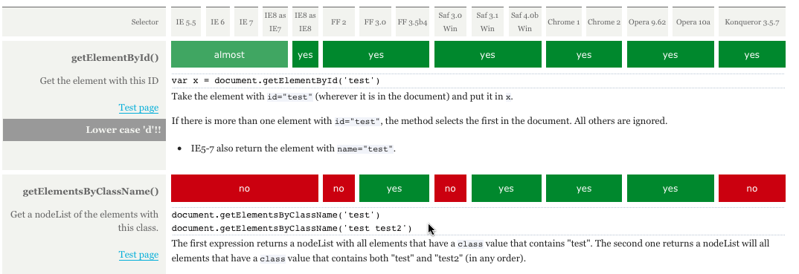
DOM Api:
Crossbrowser Headache
http://www.quirksmode.org

Slide 56
So Use a Framework!

Slide 57
jQuery

Slide 58
Instant Win:
Crossbrowser
Non-verbose
Traverse DOM
Manipulate DOM

Slide 59
Lots of Other Stuff, Too
Server communication
UI widgets and effects each(), map(), etc
JSON parsing
+++

Slide 60
jQuery Function
$() // Short form
jQuery() // Long form

Slide 61
Find Stuff
$(“p”); // Find all paragraphs
$(“#shoppingList”); // Find element with id 'shoppingList'
$(“.shoppingListItem”); // Find elements with class 'shoppingListItem'
$(“:text”); // Find all text elements
$(“:visible”); // Find only visible elements

Slide 62
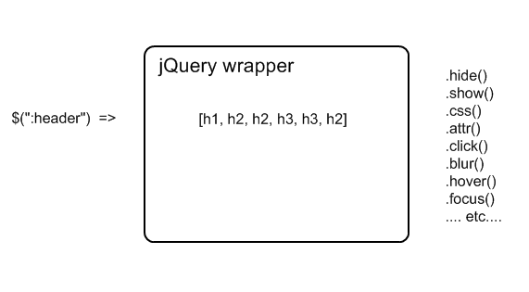
$() Wraps and Returns Matching Element(s)

Slide 63
Manipulate Matched
DOM Elements
$(“p”).css(”color”, ”green”); // Set color on all paragraph elements
$(“p”).hide(); // Hide all paragraphs
// Make all input buttons react to mouse clicks
$(“input”).click(function(){ alert(”You clicked this button!”); });

Slide 64
Chaining
Every API call returns jQuery object
So we can chain function calls together
“Fluent API”

Slide 65
Chaining Example
// Set color on all paragraph elements, then hide them all
$(“p”).css(”color”, ”green”).hide();

Slide 66
Live Example

Slide 67
Prepared Example

Slide 68
Caution!
Use frameworks as needed
But don't depend on them!
JavaScript != jQuery

Slide 69
Good Practices jsLint
Automated testing
Unobtrusive JavaScript

Slide 70
JsLint
Demo

Slide 71
Automated Testing
YUI Test demo

Slide 72
Unobtrusive JavaScript
Structure vs behavior
Separate js files
Event handler setup
Namespaces
Universal Access

Slide 73
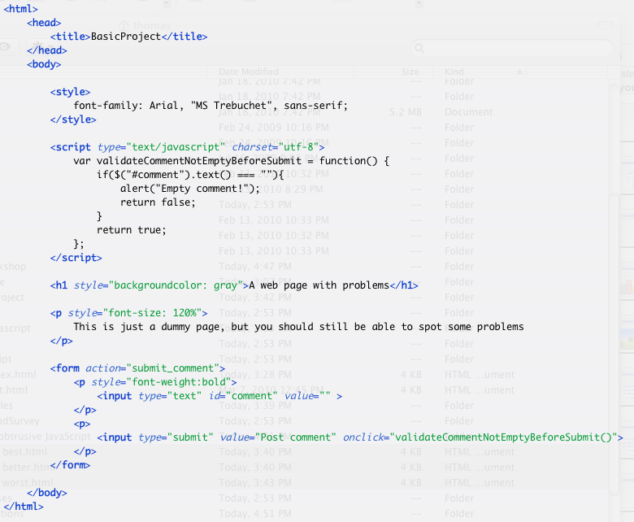

Slide 74
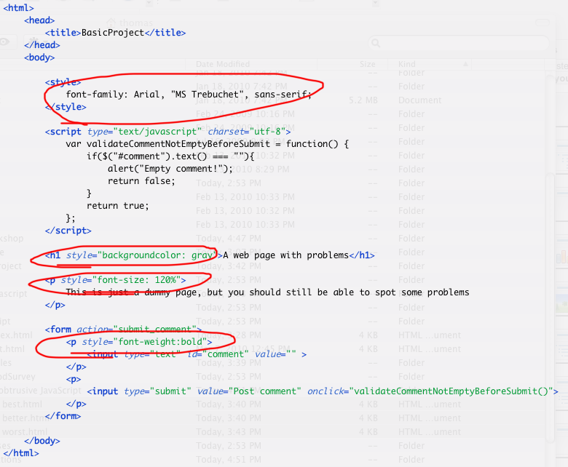

Slide 75
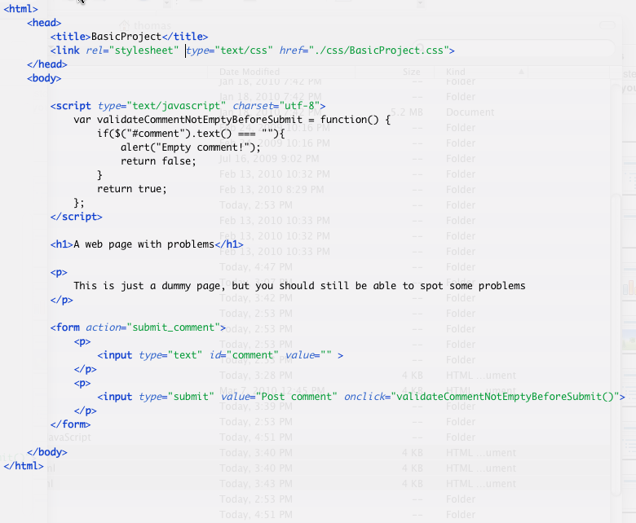

Slide 76
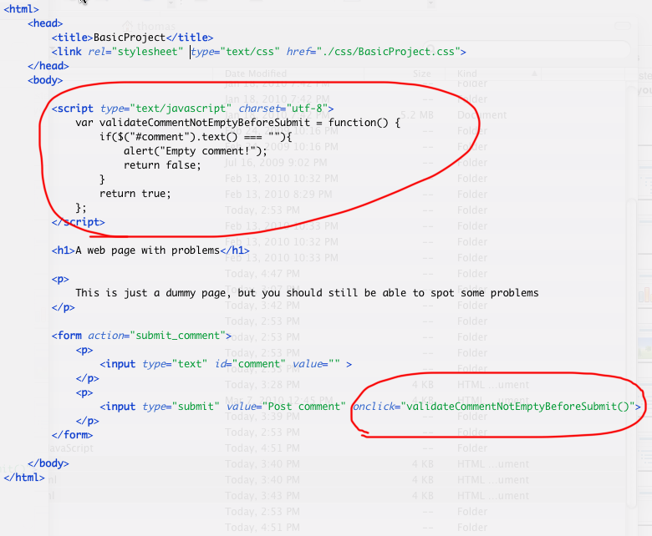

Slide 77
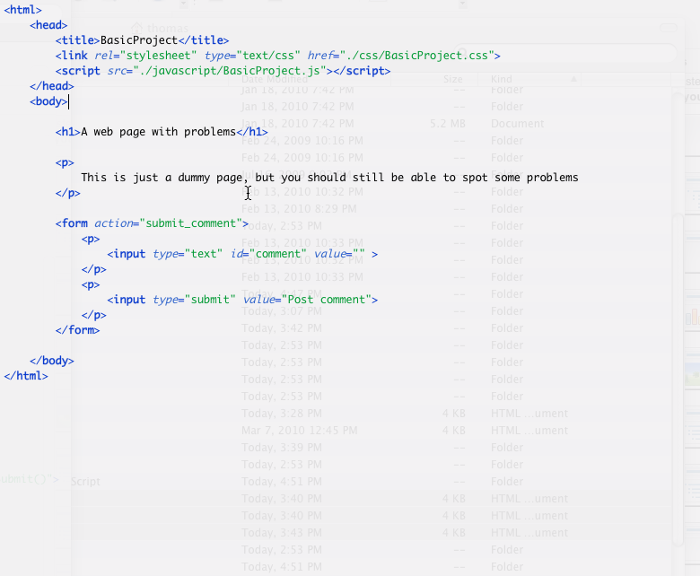

Slide 78
Namespace Hygiene
All your code within single object

Slide 79
Universal Access
Can all your users use your site?
Users without JS?
Blind users with screen readers?
Use progressive enhancement

Slide 80
Crossbrowser Dev Process
Frameworks > raw DOM
Test early, test often
Clean, disciplined code

Slide 81
Let’s Code!
Exercises

Slide 82
Wrap-up

Slide 83
What Did We Cover Today?
Language basics
Html scripting
Good practices
Tools

Slide 84
What´s Missing?
Server Communication
Performance
Security
Practice practice practice!

Slide 85
References & Further Studies

Slide 86


Slide 87


Slide 88
Web Resources http://javascript.crockford.com http://cjohansen.no/javascript http://developer.yahoo.com/yui/theater http://ajaxian.com

Slide 89

Best Way to Learn:
Start Building!
http://ajaxian.com/archives/writing-a-javascript-tetris-lessons-learned-from-a-ruby-chap

Slide 90
Download
This Workshop http://kjeldahlnilsson.net/jsnh.zip
Slides, lecture notes, exercises
Creative Commons license
Use and distribute freely...
...or have me present it for you on-site :)

Slide 91
Q&A
Discussion

Slide 92
Contact Info thomas@kjeldahlnilsson.net linkedin.com/in/thomaskjeldahlnilsson twitter.com/thomanil
Notes:
First page

